Slide 1

Lean Six Sigma Green Belt
Project Report Presentation: Food Industry
Project Number: XXX
Project Name: Addressing Inaccurate Portioning
Project Team Leader: XXXX / XXXX
Project Champion: XXXX

Slide 2
Six Sigma Roadmap
Define
Measure
Analyze
Improve
Control

Slide 3
Operational Definitions of Key Terms
Key Terms | Operational Definitions
Portion | An individually purchased component of a meal, i.e., ½ cup of mashed potatoes A component used to prepare a recipe, i.e., 8oz wt. of cheese on a pizza
Recipe | Instructions for preparing a menu item
Volume | Measurement used to define the amount of an ingredient that fills a designated portioning device
Weight | Measurement used to define how heavy an item is
Portioning device | Designated tool used to allocate a prescribed measure of food
FLA | Front Line Associate (Food Service Worker)
FLM | Front Line manager
LOB | Line of business – Division within the ABC Company, i.e., Education, Healthcare, Business & Industry
POS | Point of Service

Slide 4
Operational Definitions of Key Terms
Key Terms | Operational Definitions
Waste | The amount of food that is purchased but not served
AP | “As Purchased” weight or volume of food that is received from a supplier
EP | “Edible Portion” the yield of a food item or recipe after it has been processed
Self Serve | The process of a consumer to portion food for themselves rather than having a food service employee control the portion size.
PRIMA Web | The automated food production software used by ABC Company associates to produce production sheets, recipes and manage inventory.
Portion Survey | A study conducted within ABC Company to evaluate the accuracy of how food is served to consumers as compared to a defined recipe portion size.
Addressable Opportunity | Foods (menued and tracked in Prima Web) that are portioned and have reasonable risk of error. Does not include pre-portioned, self-portioned or easily portioned (e.g.”1 hot dog on a bun”) items. **see handout

Slide 5
Problem and Goal
Problem Statement:
There are many opportunities to reduce waste throughout our food operational processes, over-portioning is our focus.
The National Restaurant Association estimates 2% - 5% of waste associated with over-portioning.
While we are addressing many sources of food waste within ABC Company, the proportion of waste associated with over portioning is not clear and not systematically addressed.
Based on our summer study, approx. 50% of items portioned are either over or under portioned. The net impact is 6% of food cost of portioned items is over-portioned.
Goals Statement:
Reduce the incidence of incorrect portioning by at least 50% (from 50% to 25% or less) for a proven cause (how deli meats are portioned).

Slide 6
Summer survey Scope
In Scope:
The scope of the survey project includes data obtained from OSD in-unit field surveys and data gathering.
The study includes data from the following ABC Company Lines of Business:
Education (Higher Ed & K-12)* Healthcare
Business Dining Sports Leisure and Corrections
Items Out of Scope:
Pre-portioned AP items, e.g. 3oz chicken patty,
Customer-portioned foods (self-serve),
National branded or 3rd Party Commissary prepackaged foods
Catering.
          * Limited Education data due to summer break

Slide 7
Portion Accuracy Project Scope
In Scope:
Retail locations that offer Made-to-order deli sandwiches.
Limited study to ham and turkey SKUs
Items Out of Scope:
Other service types (pre-made sandwiches, catering, etc.)
Other deli ingredients (roast beef, salami, cheese toppings etc.).

Slide 8
Project Justification and Expected Results
Relevant Metrics
ABC Company purchases $2.5 billion of food each year.
Reducing waste from any cause, including inaccurate portioning, by 1 percentage point is worth approximately $15 million to ABC Company.
Industry standard for waste is 3-4% of COGS. Many ABC Company locations have over 10-12% waste.
Improvement Targets:
  Reduce incidence of mis-portioning by 50% for targeted items (ham and turkey deli meats)
Operational/Strategic Impact:
All mis-portioning disrupts the customer’s perception of value for price paid.
Reducing inaccurate portioning enables
    Savings to reinvest in other initiatives
    Market share growth
    Reduced ecological footprint
    Repeat sales driven by consistency

Slide 9
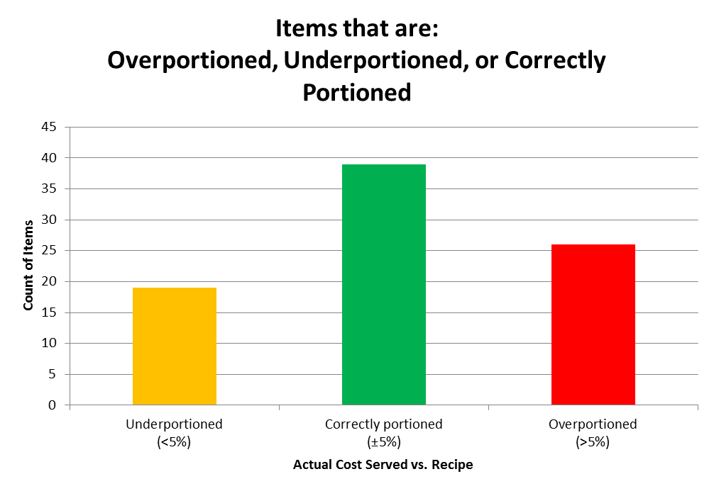
Financial Impact: Business Case
2 caveats to conclusion:
The majority of Residential Dining food is self-serve or pre-portioned.
The savings is off-set to a degree by the cost of fixing under portioning
Data Analysis from 2013 Higher Ed Portion Study
Annual F&B Spend = $775M
Annual Residential Dining Spend = $325M
Annual Residential Dining Spend that is food = $279M
Higher Education Residential savings potential =
$279M * 1.7% = $4.7M potential savings from correct portioning
Overall Average of Overportion Cost = 1.7%

Slide 10
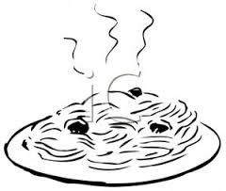
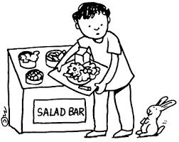






Addressable opportunity:
Items we serve that have reasonable opportunity for error
Customer Demand
Determined proportion of contracts that are P & L
Determined amount of LOB Food spend that is tracked via PRIMA Production Module
Evaluated PRIMA production data from sample of locations to calculate food cost % from addressable items.
$.49 / oz.
Notes:
Business Dining Retail
Total Food Cost spend is $340 mil
Approximately 35% of contracts are straight P & L
Approx. 50% of food spend is tracked vie PRIMA Production module
Approximately 52% of retail menu costs tracked in PRIMA are addressable – about $90 mil
35% (if P&L and subsidy contracts average same value) of $90 million = $32 million
For business dining retail, approximately 10% of food spend is addressable via portion control.
2015 study will indicate correct portioning about 50% of sampled items across all LOBs
Higher Ed Residential
Total Residential Food Spend is $247 mil
Approx. 70% of contracts are P & L
Approx. 22% of Residential spend is “AWC” (not tracked in PRIMA) –about $54 mil.
Approximately 40% of residential menu costs tracked in PRIMA are addressable – about $77 mil
70% of $77 million = $54 million
Approximately 22% of total Residential spend is addressable
Higher Ed Retail
Remainder of HE food spend = $481 mil
Did not calculate addressable spend. Too many unknown variables
Health Care
Total Food Spend is $428 mil
Approx. 20% of contracts are P & L
Do not know what portion of total food cost is tracked via PRIMA Production Module
Retail - Approximately 55% of retail menu costs tracked in PRIMA are addressable
Patients - Approximately 75% of patient menu costs tracked in PRIMA are addressable
Too many unknown variables to calculate addressable opportunity

Slide 11
Business Dining Food Spend
P & L Spend
Opportunity for improved portioning with savings flow through
Food spend tracked via PRIMA Menu module
Addressable Food spend

Slide 12
Addressable Opportunity
Total HC 428 MM
Total BD $340 MM
Residential HE $247 MM
$105 to $115 MM are portioned items
LOB Spend

Slide 13
Project Team Membership
Role | Name & Title
Project Champion | XXXX
Project Team Leader(s) | XXXX * / XXXX *
* LSS Green Belt Candidate
Core Team Members | XXXX
Ad hoc or SMEs

Slide 14
Project Plan- Milestones and Timing
Phase | JUN | JUL | AUG | SEP | OCT. | NOV | DEC | JAN
Define
Measure
Analyze
Improve
Control

Slide 15
Voice of Customer to CTQ Analysis
Voice of the Customer (VOC) Matrix
Rank | Customer | Voice of Customer | Key Issue | CTQ (the Y)
Internal Customers
1 | Frontline Associate | I need the instructions and right tools to portion correctly | Recipes are either not available or don't provide accurate portioning information | Information such as a Pre-service / production meeting to ensure correct recipes and measuring devices are used daily
4 | Frontline Manager | I need correct and timely information as well as the decision making authority to provide my staff, client and customers quality service and achieve expected results | PRIMA Web recipes / ingredients are not available and/or do not include key information and/or not consistent with client contracts. Need direction for different service types. | Clear direction for my team that meets corp. and client expectations. Approval channel for changes to meet client specifications
External Customers
5 | The Consumer: Patient, Inmate, Student, Retail Guest | I want to receive quality food served in the specified quantity at a fair price | Price value proposition | On a daily basis, food is portioned correctly and priced accordingly.
2 | Finance Department | Ensure you accurately project cost of goods sold | Processes are not In place to guarantee consistent financial reporting | Costs are monitored at critical points through out the food processing and portioning process
3 | Client | Ensure I have satisfied customers who frequent our food venues, I expect quality food that is prepared safely and is consistent. I expect excellent value for the price paid. | Specification compliance | 100% of Client contract requirements are achieved
http://www.juran.com

Slide 16


Stakeholder Analysis Worksheet
Name or Group | Strongly Against | Moderately Against | Neutral | Moderately Supportive | Strongly Supportive
Frontline Associate
Frontline Manager
Global Op-x
Line of Business Leadership
Client
Notes:
FLA supportive IF job is easier or at least no more complicated and they can be proud of outcome
FLM supportive IF benefit is clear, process implementation is simple
GOE supportive IF measurable. IF cost-benefit of change is demonstrated and can be achieved
LOB Leaders supportive IF cost-benefit of change is demonstrated and achievement is met.
Client is supportive IF no pushback from customers RE: ‘stinginess’ or value. Greater support if health perspective understood. Greater support in regulated environments.

Slide 17

High Level Process Map (SIPOC)
SIPOC - Portioning "As Is"
SUPPLIER | INPUT (use nouns) | PROCESS (use verbs) | OUTPUT (use nouns) | CUSTOMER
LOB Culinary Department | Menu | Create Recipe Database | Key Ingredient List | Supply Chain and OPCO
OPCO | SKU Optimization | "VI's" coded | Locked Down Order Guide | Regional Foodservice Location mgmt.
Frontline Manager | Cycle Menu | Create Service Menu | Needs List | Chef / FLM
Chef / FLM | Inventory | Order / Receive Food | Confirmation Order / Rejection Log | FLA
Frontline Associate | Recipe | Prepare Food | Portioned or bulk menu item | Service Staff
Point of Service staff | Portioning information and devices | Serve food according to recipe instructions | Completed meal | Patient, Student, Inmate or Retail Guest
http://www.juran.com

Slide 18
Six Sigma Roadmap
Define
Measure
Analyze
Improve
Control

Slide 19
Project Y (or Ys) in Y=f(x)
Ineffective Portioning Effects Food Cost
Y= Portion Accuracy

Slide 20
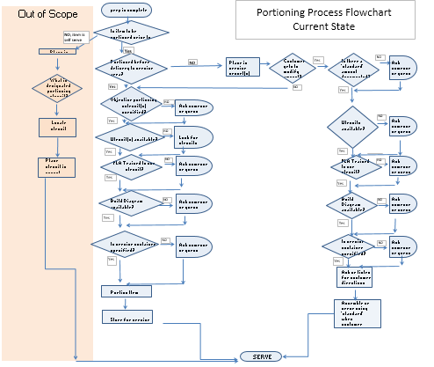
Current State Detailed Process Map
Many decisions to be made by FLAs

Slide 21
Plan for Baseline Data Collection
Data Collection Plan (Measure Phase)
 | What to Measure |  |  | Operational Definition |  | Data Collection
Ref # | Question to Answer | Measure Name |  | Words | Formulas | Data Type | Sample Size | Collection Method | Who collects | Tools to use | Stratification Variables
1 | Is food portioned correctly? | Portioning accuracy |  | Percent of times food is portioned correctly vs. over portioned or under portioned | correct / total over / total Under / total | Categorical | 82 locations (21 no data) | In location study | OSD's | Pareto Chi Square | LOB Food Type
2 | What's the cost of improper portioning? | Cost of portioning |  | Is there a cumulative increase in food cost due to incorrect portioning | actual cost / recipe cost | Categorical | 82 locations (21 no data) | Location study data Other LOB portion studies | OSD's LOB OPX | Correlation Box Plots | LOB Food Type
3 | Does the Line of business effect portioning? | LOB |  | Is there a relationship between the LOB and portioning accuracy | % correct per LOB | Categorical | 82 locations (21 no data) | In location study | OSD's | Chi Square | Food Type
4 | What factors effect portioning? | Contributing factors |  | What is the ratio between various factors that effect correct portioning | factor/ correct factor/over-portion factor/under portion | Categorical | 82 locations (21 no data) | In location study | OSD's | Contingency Table (Test of Independence) | Tools Information Language

Slide 22
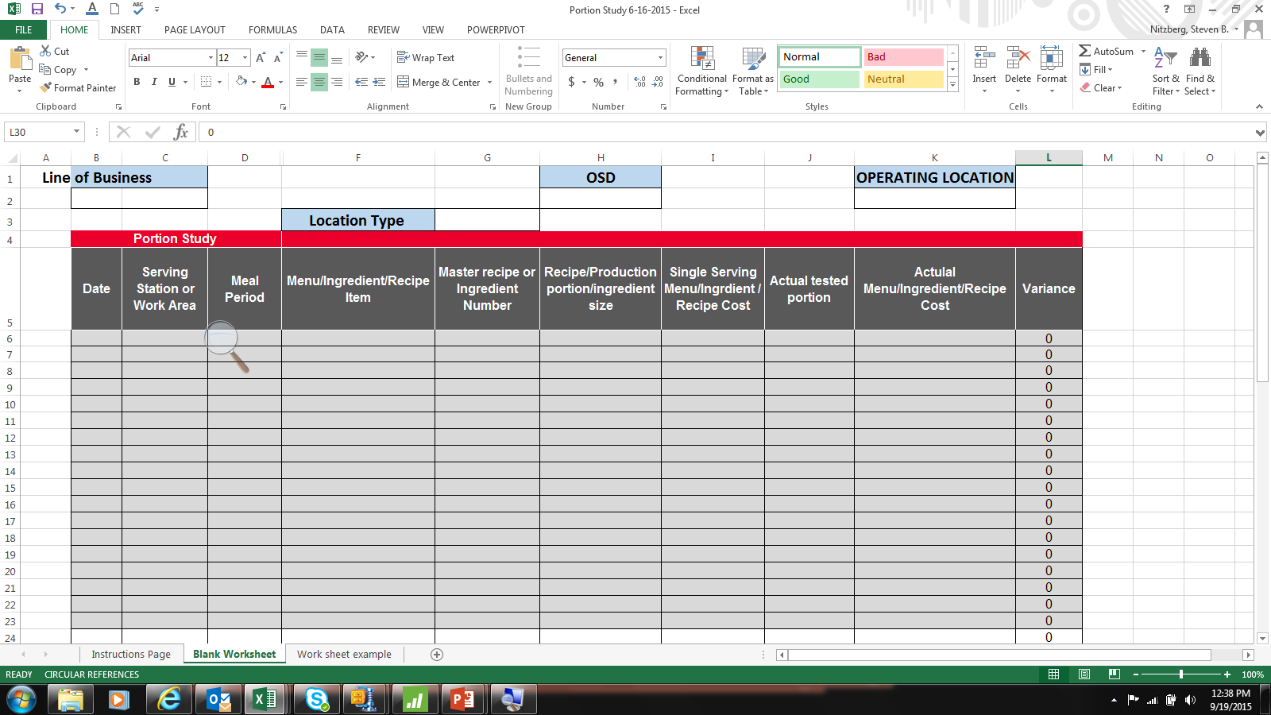
Measurement System - Study
OSDs used on-site measuring devices (scales, measuring cups, scoops, etc.).
Did not capture quantity produced of each item sampled or relationship to total food spend at that location.
15 Surveyors (OSD’s)
82 Locations
  Business Dining – 32
  Healthcare – 20
  Corrections – 17
  Higher Ed – 9
  Sports & Entertainment - 2
21 locations no data (not using PWS or Recipes)
756 random food samples
Study Period June 16, 2015 – July 30, 2015

Slide 23
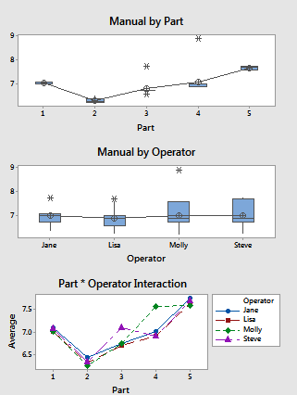
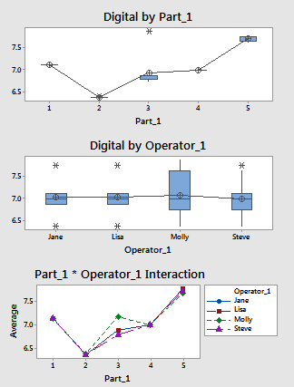
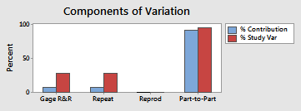
Validate Measurement System Gage R&R
Manual
Digital
Practical conclusion:
Digital scales yield more repeatable data.
Source Var Comp %Contribution (of Var Comp)
Total Gage R&R 0.019508 7.85
Repeatability 0.019508 7.85
Reproducibility 0.000000 0.00
Operator_1 0.000000 0.00
Part-To-Part 0.229081 92.15
Total Variation 0.248589 100.00
Source Var Comp %Contribution (of Var Comp)
Total Gage R&R 0.087322 27.56
Repeatability 0.087322 27.56
Reproducibility 0.000000 0.00
Operator 0.000000 0.00
Part-To-Part 0.229569 72.44
Total Variation 0.316891 100.00

Slide 24
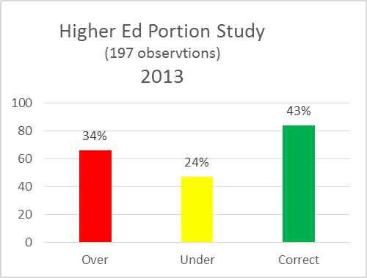
Baseline Performance – results of 2015 study
Chi-Square
H_{o}: There is no difference between studies
H_{a}: There is a difference between studies
Pearson Chi-Square = 3.470, DF = 2, P-Value = 0.176
Likelihood Ratio Chi-Square = 3.405, DF = 2, P-Value = 0.182
Conclusion – There is no statistical difference between the results of the 2 studies

Slide 25
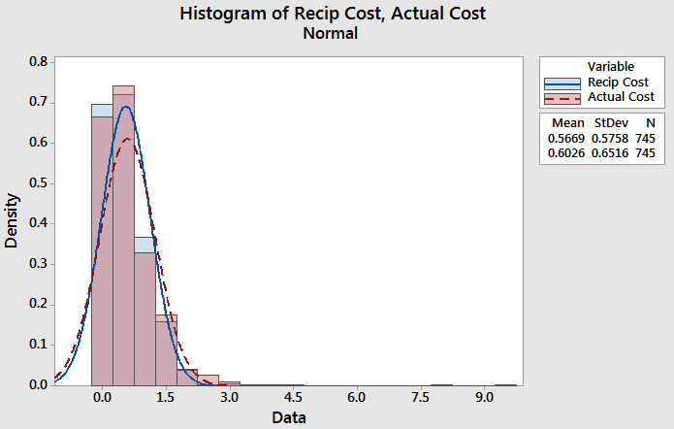
Baseline Performance: Calculated Recipe cost & Actual cost
Highest over Most Under
BD $1.94 $(0.89)
HC $1.06 $(1.78)
HE $0.47 $(0.52)
Corr $0.14 $(0.08)
S & E $0.09 $(0.49)

Slide 26
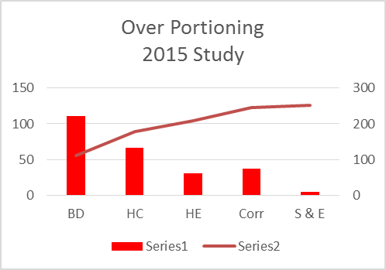
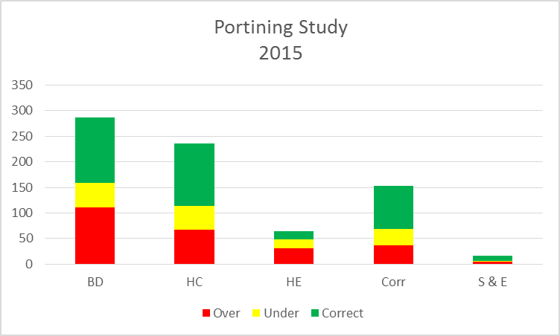
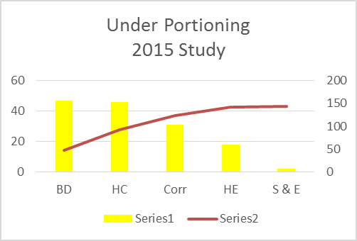
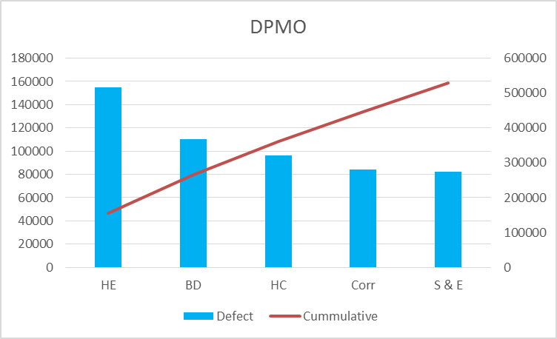
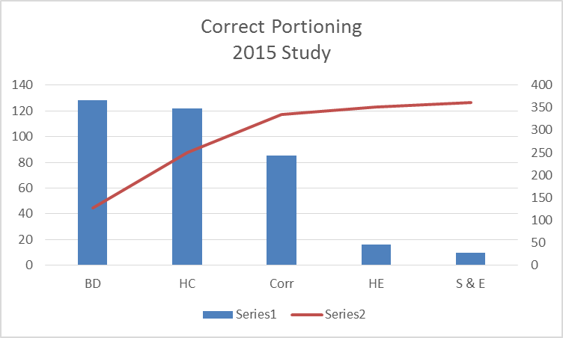
Baseline Performance : LOB Analysis

Slide 27
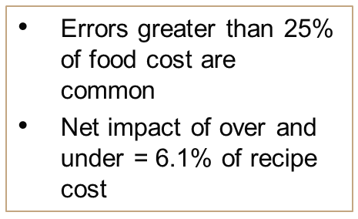
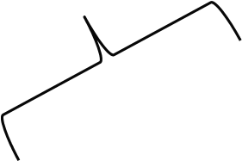
Baseline Performance: How out of compliance

Slide 28
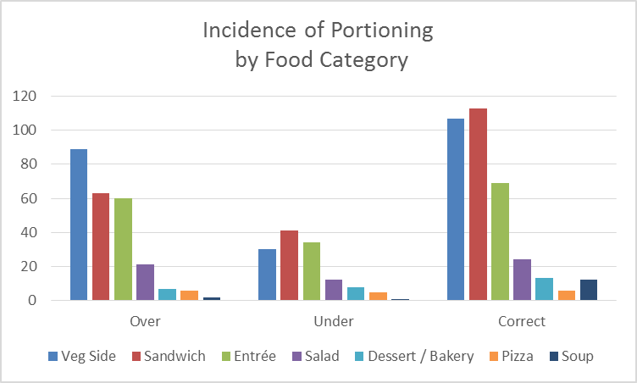
Baseline Performance : Food Category
34%
18%
48%
Notes:
Note that not all food types were tested. Foods that have a low probability of error (e.g. a hamburger on a bun or 1 chicken breast) were not assessed.
Assessed likelihood of a particular category having higher contribution to error – none found

Slide 29
Food Category Chi Square
 | Over | Under | Correct
Veg Side | 89 | 30 | 107 | 226
 | 77.52 | 40.95 | 107.53
 | 1.6996 | 2.9275 | 0.0026
Sandwich | 63 | 41 | 113 | 217
 | 74.43 | 39.92 | 103.25
 | 1.7565 | 0.0719 | 0.9212
Entrée | 60 | 34 | 69 | 163
 | 55.91 | 29.53 | 77.55
 | 0.299 | 0.6754 | 0.9436
Salad | 21 | 12 | 24 | 57
 | 19.55 | 10.33 | 27.12
 | 0.1073 | 0.2707 | 0.359
Dessert / Bakery | 7 | 8 | 13 | 28
 | 9.6 | 5.07 | 13.32
 | 0.7062 | 1.6884 | 0.0078
Pizza | 6 | 5 | 6 | 17
 | 5.83 | 3.08 | 8.09
 | 0.0049 | 1.1965 | 0.5393
Soup | 2 | 1 | 12 | 15
 | 5.15 | 2.72 | 7.14
 | 1.9226 | 1.0858 | 3.3137
 | 248 | 131 | 344 | 723
Theory: Portioning is determined by food type
H_{o}: There is no accuracy differences between food categories tested
H_{a}: There is an accuracy difference between food categories tested
Pearson Chi-Square = 20.499, DF = 12, P-Value = 0.058
Likelihood Ratio Chi-Square = 20.840, DF = 12, P-Value = 0.053
Statistical Conclusion:: At a 0.95 confidence level P-Value = .058. Fail to reject the null.
Practical Conclusion: We cannot show with a high degree of confidence that there are significant differences among the food groups.

Slide 30
Measure Baseline Performance
 | Current | Goal
COPQ (Ham / Turkey) | $5.5 to 6 mil $297,162 | $148,581
Relevant Metric | 10.2% Defect Rate | 5% Defect Rate
PPM (of DPMO) | 102,865 | 50,000
Sigma Level | 2.77 | 3.14
Cost from one proven cause:
Purchase about $3Mil in just 2 SKUs of deli meat
All food categories had similar rates of error.
Big Picture from Summer data:
COPQ BD ~ $2 million net of over & under-portioning
COPQ HE residential ~$ 3.6 million
Cost of under-portioning (fines, customer dis-satisfaction) not calculated

Slide 31
Project evolution
Summer data collecting and analysis
Understand likelihood of error
Identify some of the many sources of error that can be managed
Determine the efficacy of managing those sources
Deli meat portioning process
Examine a commonly served item and process for applicability across most LOBs
Determine the impact of an improved process.

Slide 32
Six Sigma Roadmap
Define
Measure
Analyze
Improve
Control

Slide 33
Portion Variability by Line of Business
Statistical Conclusion: At a confidence level of 95%, based on P-Value of 0.000, reject the Null and accept the Alternative hypothesis.
Practical Conclusion:
Healthcare and Corrections are more likely to portion accurately.
Business Dining and Higher Ed mis-portion more frequently.
Portioning Variation between LOB’s
Chi-Square Test for Association: LOB, Over, Under, Correct
Rows: LOB
Columns: Over Under Correct
Over Under Correct All
BD 111 47 128 286
95.98 54.18 135.84
HC 67 46 122 235
78.86 44.52 111.62
HE 31 18 16 65
21.81 12.31 30.87
Corr 39 29 85 153
51.35 28.99 72.67
All 248 140 351 739
H_{o}: There is no difference between Business Units
H_{a}: There is a difference between Business Units
Cell Contents: Count / Expected count
Pearson Chi-Square = 25.275, DF = 6, P-Value = 0.000
Likelihood Ratio Chi-Square = 26.210, DF = 6, P-Value = 0.000

Slide 34
Analysis of Cause

Slide 35
Causes of Inaccurate and/or Over Portioning
Equipment
Employee
Wrong tool / device used
Form vs. function. Serving spoon / tong vs. measuring portion device
Supervision
Not reviewing portioning pre-service
Unavailable to answer questions
Scales: Inconsistent results
Gaps in training
Not calibrated - Digital vs. Manual
FMP not included in New Employee orientation
Not enough measuring tools for service
Tribal knowledge
FLA’s reluctant to ask Manager
Long term FLA’s on “autopilot”
Inconsistent Portion vessel
Inaccurate and/or
Over Portioning
Language / literacy
French Fry portion cup vs “boat”
English as a Second Language
Use of GOE language aids on Portal
Directions not clear
Self Serve
Volume vs weight
Planogram / PWS not matching recipe
Single serving not defined
Font size too small to read
Not sold by the ounce
“Proteins” not controlled
Customer pressure
Recipes not followed as written
Price value expectations not achieved
Recipe unavailable
Unique Service expectations
Static quantities
Home-style” serving tools
Self Serve vs FLA Served
Yield inconsistencies
Speed of service
Using non scalable recipes
Portions per pan not defined
Inconsistent when rushed
Client / Customer
Recipe

Slide 36
Current State FMEA
Flowchart decision point | What is the process step? | In what ways can the Process Step, Variable, or Key Input go wrong? (chance of not meeting requirements) | What is the impact on the Key Output Variables (customer requirements) or internal requirements? | How Severe is effect to the customer? | What causes the Key Input to go wrong? (How could the failure mode occur?) | How frequent is cause likely to Occur? | What are the existing controls that either prevent the failure mode from occurring or detect it should it occur? | How probable is Detection of cause? | Risk Priority # to rank order concerns
1 | Item portioned as part of service process | move to self-serve from serve or shut down station due to staffing issues | Run out of food before end of service / higher FC% / Customer expectations | 4 | punt due to insufficient staff (call-offs, open positions) | 9 | LST | 7 | 252
2 | Objective portioning Utensil is specified | Device not accurate | Run out of food before end of service / higher FC% / Customer expectations | 4 | Scales are not calibrated or not read correctly | 9 | none | 10 | 360
3 | Utensil is made available | Wrong device selected to portion | Run out of food before end of service / higher FC% / Customer expectations | 4 | not communicated to server | 9 | portion size but not utensil on production sheet or recipe &/or build diagram | 9 | 324
4 | FLA Trained and uses utensil correctly | Speed pressure leads to inattention to accuracy. Cust. pressure for better "value" | Run out of food before end of service / higher FC% / Customer expectations | 4 | Perceived speed pressure and customer pressure | 8 | manager coaching | 10 | 320
5 | Build Diagram is used | Build diagram not available or incorrect | Run out of food before end of service / higher FC% / Customer expectations | 4 | Build diagram not downloaded or reviewed by manager. | 7 | Notification to manager that build diagrams are available when new menu implemented. Inconsistent communication | 9 | 252
6 | Service container is specified | Portion presentation is poor | Run out of food before end of service / higher FC% / Customer expectations | 4 | failure to select service vessel that enhances presentation (fry cup, parfait cup, salad containers) | 7 | Recipe or build diagram should state container to use Usually does not. | 10 | 280

Slide 37
Potential Xs—Theories To Be Tested
X₁: Measurement system reliability: digital scales reduce errors
X₂: Specific service vessel effect on portioning accuracy
X₃: Self Serve vs portioning by trained staff member
X₄: Build Diagram use improves accuracy
X₅: Lack of management involvement in providing portioning guidance affects accuracy
X₆: Pre-portioned deli meat improves accuracy of portions

Slide 38
Data Collection Plan for Analyze Phase
Ref. | Theories To Be Tested (Selected From The C-E Diagram, FMECA, and/or FDM) | List Of Questions That Must Be Answered To Test Each Selected Theory | Where Applicable, State The Null and Alternative Hypotheses |  | Tools To Be Used | Data To Be Collected
 |  |  | H₀ | H_{A} |  | Description/ Data Type | Sample Size, Number of Samples | Where To Collect Data | Who Will Collect Data | How Will Data Be Recorded | Remarks
1 | Measurement systems can effect portioning accuracy | Does the type of scale affect its repeatability? | 1 Way ANOVA P-Value ≤ .05 | 1 Way ANOVA P-Value ≥ 0.05 | Digital Scales, Manual Scales | Weight variances among scales | 212 samples | Test kitchen | Jane & Steve | Gage R &R data form | Tested both Gage R&R variances and differences in mean by scale types Gage R&R - 120 ANOVA diff. of means - 92
2 | Where practical the use of a defined service vessel (e.g., French fry cup) reduces inconsistent / over portioning. | Can a server portion a more consistent serving with a fry cup & scoop vs. a paper boat and gloved hand? Does the type of vessel determine accuracy? | 2 Sample t-test P-Value ≤ .05 | 2 Sample t-test P-Value ≥ 0.05 | Fry scoop, Portion cups, Paper boats, Digital scale | French Fry portion weight | 164 samples | Business dining locations. | Steve | Excel data form | Tested the2 different vessel types and effect of portioning accuracy when the portion size is known?
3 | Inadequate staffing results in higher food cost, (e.g., HE Comfort station converts to self serve when short staffed where normally served when properly staffed) | What is the impact, if any, to food cost when a residential dining hall opts to make a station self-serve rather than portioning amounts for the student? |  |  | Prima Web | Prima post service records |  |  |  |  | Could not determine effective method to identify locations that make this decision and that also have sufficiently high quality PRIMA Post service records

Slide 39
Data Collection Plan for Analyze Phase
Ref. | Theories To Be Tested (Selected From The C-E Diagram, FMECA, and/or FDM) | List Of Questions That Must Be Answered To Test Each Selected Theory | Where Applicable, State The Null and Alternative Hypotheses |  | Tools To Be Used | Data To Be Collected
 |  |  | H₀ | H_{A} |  | Description/ Data Type | Sample Size, Number of Samples | Where To Collect Data | Who Will Collect Data | How Will Data Be Recorded | Remarks
4 | Recipes / portioning not followed as intended because directions are not clear. The use of Build Diagram provides enhanced clarity and improves accuracy. | Does the implementation of Build diagrams, in place of or in addition to the recipe result in product usage that could be closer to the predicted amount? | No improvement 2 Sample t-test P-Value ≤ .05 | Improvement 2 Sample t-test P-Value ≥ .05 | Build diagrams for omelets and deli meat. Use data as recorded on production record for identified ingredient before and after implementation | Prima post cost service results | 2 locations with 2 items assessed in each. Compared product use before and after intervention | HE Residential dining locations | Steve | PRIMA data | SAMPLE SIZE: Omelet - 42 before days, 41 after days. Turkey - 42 before days, 43 after days
5 | Mgr. / superv. led one-time training using a Portion Utensil Guide improves accuracy | 1)What is the accuracy of commonly portioned items without recent training? 2) What impact if any does the review of a Portion Guide by mgmt. with the servers have on accuracy? 3) Can the accuracy be sustained over time? | Chi² Percent Defective P-Value ≤ .05 | Chi² Percent Defective P-Value ≥ 0.05 | Portion Utensil guide for menus, scoops, spoodles, scales | Measurement of portion for accuracy before, after and one week after training | 5 locations, 5 items in each location, before, after and 1-week after | 5 hospitals using national Room service menu | Jane | Excel data form
6 | Pre-portioning deli meat improves accuracy at service | 1) How likely are servers to accurately portion deli meat at the point of service? 2) If pre-portioned in advance, what is the likelihood of accuracy? | One Way ANOVA P-Value ≤ .05 | One Way ANOVA P-Value ≥ 0.05 | Scales, Meat purchased pre-sliced and Bulk deli sliced on-site | Mean weights and variance from target of deli meat portions served to customers | 5 locations that do not pre-portion, at least 10 samples pre-portioned and not pre-portioned | Retail locations that do not currently preportion meat | Jane & Steve | Excel data form | Sample Size Pre-portioned vendor -36 Portioned at Service - 34 Pre-portioned bulk - 60

Slide 40
Test of Theories X₁
Theory: Measurement Systems Can Effect Portioning Accuracy
H_{o}: There is no accuracy differences between manual or digital scales
H_{a}: There is an accuracy difference between manual and digital scales
Analysis Method:
One-way ANOVA: Manual vs Digital (1lb weight measure)
Significance level α = 0.05
Equal variances were assumed for the analysis.
Factor Information
Factor Levels Values
Factor 2 Manual, Digital
Analysis of Variance
Source DF Adj SS Adj MS F-Value P-Value
Factor 1 2.112 2.11217 21.19 0.000
Error 82 8.173 0.09967
Total 83 10.285
Statistical Conclusion: At a confidence level of 95%, based on P-Value of 0.000, reject the Null and accept the Alternative hypothesis.
Practical Conclusion: This is an accuracy difference between manual and digital scales. On average, manual scales tested 19% higher weights than digital scales, therefore digital scales are consistently more accurate.

Slide 41
Test of Theories X₂
Theory: The use of specifically designed service vessel results in a higher likelihood of portioning accuracy (“Boat’ vs Fry Scoop + Fry Cup).
H_{o}: The type of service vessel does not effect portioning accuracy
H_{a}: The type of service vessel does effect portioning accuracy
Statistical Conclusion: P-value = 0.971 – Fail to reject the Null Hypothesis “There is not enough evidence to conclude there is any difference in mean or standard deviation at 0.05 significance level between the 2 sample sets”.
Practical Conclusion: French Fry portioning accuracy is inconsistent whether using a scoop and defined portioning vessel vs. free handing into a paper boat. However we did not compare the use of a defined service vessel to no service vessel.

Slide 42
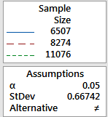
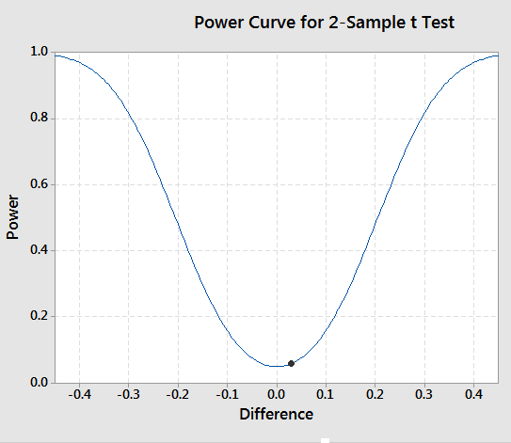
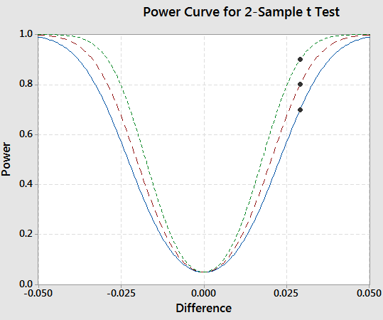
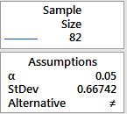
Power Calculation of X₂
Required sample size for sufficient power
Our data

Slide 43
Test of Theories X₃
Theory Over portioning is impacted when stations are switched to “self-serve” service in residential halls.
H_{o}: There is no difference in food cost when food is served vs. self served
H_{a}: There is a difference in food cost when food is served vs. self served
Analysis:
Compare PRIMA web post service results
Statistical Conclusion:
Practical Conclusion:
Not able to design and complete this study within timeframe.
Recommend future study to understand cost/benefit of portioning vs. self-serve to labor and food costs as well as customer perception.

Slide 44
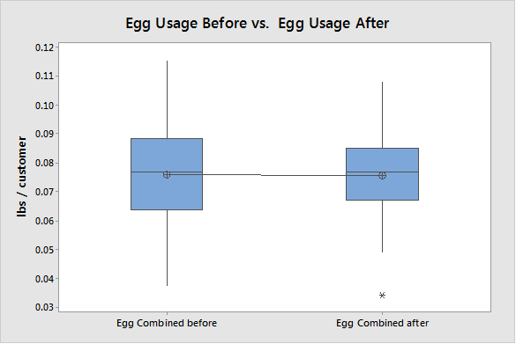
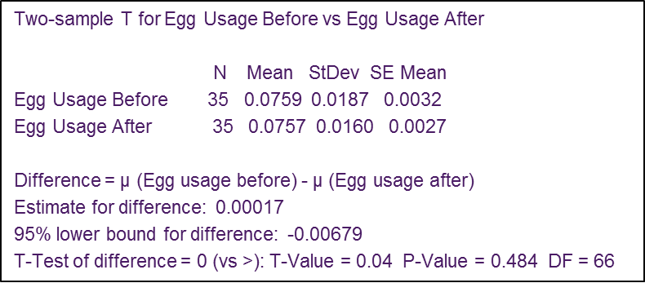
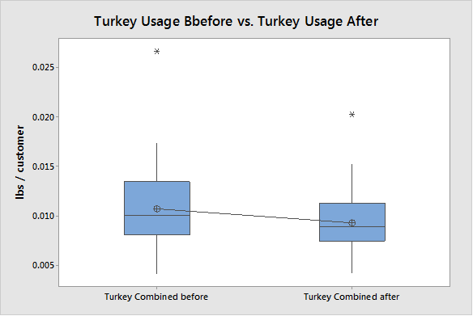
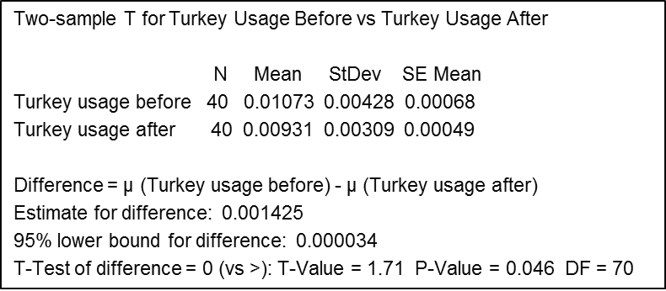
Test of Theories X₄
Theory: Build Diagram use improves accuracy and cost.
H_{o}: There is no difference in portioning accuracy and cost when Build Diagrams are used
H_{a}: There is a difference in portioning accuracy and cost when Build Diagrams are used
Analysis Method:
Prima web post service usage and cost results were analyzed before and after OSD assessment. Study targeted MTO Omelet and Deli Sandwiches where build diagrams were not in place prior to OSD visit. Two Sample T Test used to determine variance of means
Omelet
Deli
Sandwich

Slide 45
Test of Theories X₄
Conclusion:
Statistical Conclusion: Fail to reject Null Hypothesis for omelet but reject Null for turkey (Egg P-value 0.484 / Turkey P-value 0.046). There is not enough evidence to conclude there is a difference in mean or standard deviation at 0.05 significance level of the sample set for eggs.
However you can conclude that the mean of Turkey usage before is greater than Turkey usage after at the 0.05 level of significance .
Practical Conclusion: While there is not a statistical validation supporting the hypothesis that the use of build diagrams at MTO stations improves portioning accuracy and hence the quantity and cost of product used for MTO egg blend at omelet stations, At the theoretical level the calculated loss of product due to over portioning (~25%). Additional study data may help support the original hypothesis.
We can however conclude that using build diagrams as a guide to correct portion size does improve accuracy and subsequent usage of turkey at MTO Deli stations.

Slide 46
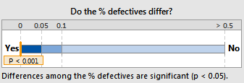
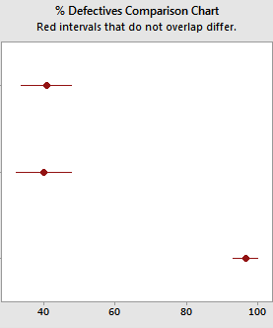
Test of Theories X₅
Theory: One-time training of staff on correct portion utensils and technique using a printed portion guide results in a higher likelihood of portioning accuracy.
H_{o}: Guide &Training does not effect portioning accuracy
H_{a}: Guide & Training does effect portioning accuracy
Analysis Method:
Samples of portioned food items were tested before and after training plus 1 week later and assess as either correct or incorrect. Used Chi-Square % Defective Test
Statistical Conclusion: P = 0.001 Reject the Null Hypothesis “There is enough evidence to conclude there is a difference in defective portions at 0.05 significance level between the sample sets”.
Practical Conclusion: Portioning accuracy is improved and sustained, in the short term at least, by a one-time review of utensils and techniques.
Day after Training
1-week later
Before training

Slide 47
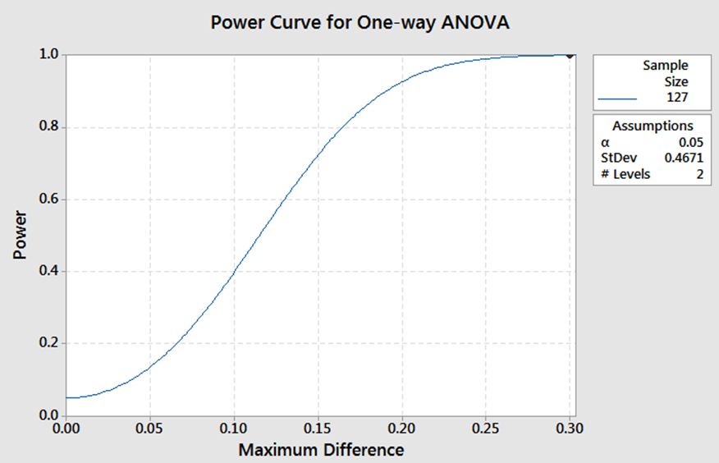
Test of Theories X₆
Theory: Pre-portioned deli meat improves accuracy of portions
H_{o}: There is no difference in portioning accuracy by pre-portioning deli meats prior to service
H_{a}: There is a difference in portioning accuracy by pre-portioning deli meats prior to service
Analysis Method: One Way ANOVA
Cold Cut meat used for the deli station was evaluated for portioning accuracy of 3 oz. units.
Meat was sliced from bulk in-house and randomly placed in a service vessel to be portioned by hand on the service line at the point of service
Meat was sliced from bulk in-house or purchased pre-sliced and portioned in the production kitchen prior to bringing out to the service line prior to service.
Means
Factor N Mean St Dev 95% CI
Pre-Portioned Vendor Sliced 35 3.0029 0.1254 (2.9102, 3.0955)
Portioned at Service 33 3.3955 0.4671 (3.3000, 3.4909)
Pre Portioned Bulk 59 3.0909 0.1857 (3.0196, 3.1623)
Analysis of Variance
Source DF Adj SS Adj MS F-Value P-Value
Factor 2 2.950 1.47478 19.22 0.000
Error 124 9.516 0.07674
Total 126 12.465
Notes:
Power Test needed.

Slide 48
Test of Theories X₆
Statistical Conclusion: P-value 0.000 – Reject the Null Hypothesis. There is enough evidence to conclude there is a difference in mean at 0.05 significance level between the sample sets.
Practical Conclusion: Whether meat is sliced from bulk in-house or purchased pre-sliced, portioning accuracy is improved when meat is pre-portioned prior to service vs. attempting to portion at the time of service. Where acceptable, vendor sliced pre-portioning vendor sliced meats rends to yield higher levels of portion accuracy

Slide 49
Summary of Testing Results
X₁
X₂
X₃
X₄
X₅
X₆
There is a repeatability difference between manual and digital scales. Therefore digital scales are consistently more accurate.
French Fry portioning accuracy is inconsistent whether using a scoop and defined portioning vessel vs. free handing into a paper boat.
While there is not a statistical validation supporting the hypothesis that the use of build diagrams at MTO stations improves portioning accuracy of product used for MTO egg blend at omelet stations, At the theoretical level the calculated loss of product due to over portioning (~25%). Additional study data may help support the original hypothesis.
We can however conclude that using build diagrams as a guide to correct portion size does improve accuracy and subsequent usage of turkey at MTO Deli stations.
Portioning accuracy is improved and sustained, in the short term at least, by a one-time review of utensils and techniques.
Whether meat is sliced from bulk in-house or purchased pre-sliced, portioning accuracy is improved when meat is pre-portioned prior to service vs. attempting to portion at the time of service.

Slide 50
List of Vital Few Root Causes (Proven Xs)
Y=f(X₁,……X_{n})
Vital Few Xs are:
Digital portion scales will improve repeatability of accurately weighed portions
Portion Guide, with build diagrams, and review of guide with staff by manager or supervisor on correct portion utensil use improves accuracy
Pre-portioning of items such as deli meats improves accuracy

Slide 51
Six Sigma Roadmap
Define
Measure
Analyze
Improve
Control

Slide 52
Improvement Strategies for Proven Xs
Proven Xs (Causes) | Strategies
Manual scales do not yield accurate results that are repeatable | Invest in digital scales
Failing to train and communicate expected portioning tool to use leads to inaccuracy. | Develop portion guide to specify portion utensil, build diagram and service container. Mandate a specified portion utensil by menu and service type.
Portioning deli meat ahead of service improves accuracy | Create a standard for how to pre-portion Where acceptable, specify the use of vendor pre-sliced deli meat and standardize slice weight across deli meat types

Slide 53
Descriptions of Possible Solutions (Pros and Cons)
Possible Solution | Strengths (Pros) | Weaknesses (Cons)
Invest in digital scales | More accurate Easier to read More consistent customer experience | Investment. Cost of batteries or limited electricity access May need more than one model for different applications
Portion Guide with Build diagrams | All-inclusive information Centrally compiled – same standard everywhere Correspond to PRIMA recipe numbers | Time and effort to build Needs update with every menu update Some clients have non-standard contracts with different expectations
Pre-portion deli meat | Consistency Single approach at all locations Vendor pre-sliced has longer shelf life (vacuumed sealed pouches). Speed of service | Possible poor perception of “vendor” pre-sliced Some clients have non-standard contracts with different expectations Cost difference of pre-sliced Time to handle deli meat twice (slice & portion)

Slide 54
Evaluation Using Pugh Concept Selection Matrix
Pugh Selection Matrix
 |  | Alternative Concepts
Criteria | Rating (1-10) | Digital portion scales | Supervised Training | Pre-portioning
Improves portioning accuracy | 9 | + | + | +
Ease of implementation and adaption | 9 | + | s | +
Process change sustainability | 7 | + | - | +
Time needed to implement | 8 | s | s | +
Additional resources required, training, LOB approval, etc. | 7 | + | + | +
Simplicity | 8 | + | + | +
Cost of implementation | 7 | - | s | s
Sum of Positives |  | 5 | 3 | 6
Sum of Negatives |  | 1 | 1 | 0
Sum of Sames |  | 1 | 3 | 1
Weighted Sum of Positives |  | 40 | 24 | 48
Weighted Sum of Negatives |  | 7 | 7 | 0
Notes:
Need to complete if there are multiple competing solutions. Add note to slide Add pay off Matrix

Slide 55
Pilot (as applicable)
Digital Scales
  Identify at least 5 locations that currently used manual scales and choose at least one weighed portion
  Calculate total food cost of weighed portions before implementation and cost after
Portion Guide – pilot complete
  Extend the implementation of Room Service portion guide to more Healthcare locations.
  Create a portion guide for the summer retail menu. Conduct before and after study in 5 locations.
Pre-portion deli meat
  Where appropriate, move locations from in-house sliced to vendor to pre-sliced.
  Require pre-portioned bundles prior to service (e.g., rolls for pre-sliced or balls for shaved). Conduct COGS comparison as well as look for any change in customer behavior.

Slide 56
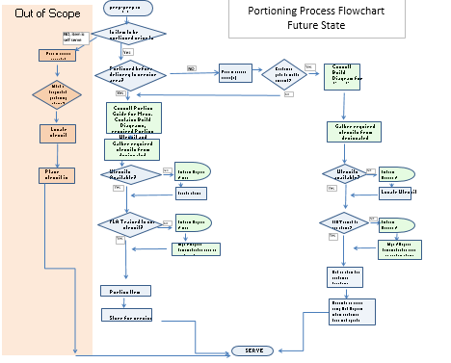
Future State Process Map(s)
Fewer FLA-level decisions

Slide 57
Standard Work
Order | Description of work/activity | Action time | est. frequency or number to be acted on | Quality Control Description
1 | Update Hubert catalog to offer only digital scales | 6 hours | once and reviewed annually | Completed by Supply chain
2 | Update FM QA to specifically require digital scales (must be available in unit) to assess recipe and portion accuracy | 30 min | once | Completed by GOE
3 | Update recipes for sliced meats to include the 3 acceptable methods for portioning deli meats | 15 min per recipe | 12 recipes | Completed by culinary
4 | Create a Portion Guide for all portioned items on centrally designed menus and updates (Retail, Residential, Patient) | 2 to 8 hours | 4 times a year | Completed by Culinary. Time varies by complexity of menu

Slide 58

Standard Work
PRIMA Shaved Turkey recipe M14556
Current Instructions:
Recommended instruction revision
***Only work with an amount that can be cut, pre-portioned and returned to refrigeration within 30 minutes ***
Shave deli meat item on slicer.
Pre-Portion to Portion Guide Amount by using the following method:
  Tare a digital food scale
  Weigh out the Portion Guide Amount (+/- 0.1 ozw) of each portion.
  Using clean gloved hands, ball up shaved meat into a lightly compressed ball that will hold together but not crush the meat.
  Place in designated service container. If more than one layer of portions will be placed in the container separate layers with parchment paper
  Weigh all portions
Cover, label and date container. Return to refrigeration. Keep chilled for service
Notes:
Portion Guide
Meat portioning
Mandate use of digital scales

Slide 59
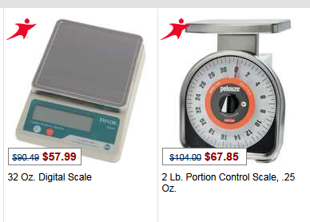
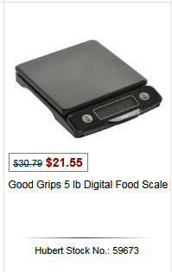
Standard Work
Hubert Catalog (3 of 62 currently authorized scale options)

Slide 60
Updated Process FMEA
 | What is the process step? | In what ways can the Process Step, Variable, or Key Input go wrong? (chance of not meeting requirements) | Risk Priority # to rank order concerns | What are the actions for reducing the Occurrence of the cause, or improving Detection? Should have actions on high RPN's or Severity of 9 or 10. | Who's Responsible for the recommended action? What date? | What were the actions implemented? Include completion month/year. (Then recalculate resulting RPN.) | Future Severity | Future Occurrence | Future Detection
1 | Item portioned as part of service process | move to self-serve from serve or shut down station due to staffing issues | 252 | Did not complete study Recommend as future DMAIC Project to assess impact on food and labor cost
2 | Objective portioning Utensil is specified | Device not accurate | 360 | Move locations from manual to digital food portioning scales | OP-x / Supply chain / throughout FY 16 | Pilot locations Jan 2016 | 4 | 4 | 3 | 48
3 | Utensil is made available | Wrong device selected to portion | 324 | Menu releases to include portion guide for all items portioned Tool is validated by mgr.. / suprv before each meal period | OP-X / Culinary / Channel Growth Spring Menu implementation | Pilot locations Dec 2015 | 4 | 4 | 3 | 48
4 | FLA Trained and uses utensil correctly | Speed pressure leads to inattention to accuracy. Cust. pressure for better "value" | 320 | Where possible, pre-portion items BOH. Update recipes to include pre-portioning directions | OP-X / Culinary / Channel Growth | Pilot locations Jan 2016 | 4 | 4 | 2 | 32
5 | Build Diagram is used | Build diagram not available or incorrect | 252 | Menu releases to include Build Diagrams that are easily located. Tool is validated by mgr. / suprv before each meal period | OP-X / Culinary / Channel Growth Spring Menu implementation | No further implementation - Recommend Fall menu release | 4 | 4 | 4 | 64
6 | Service container is specified | Portion presentation is poor | 280 | Specify containers for appropriate items | Channel Growth / Supply chain | Needs further analysis | 4 | 7 | 10 | 280

Slide 61
Change Management Plan
Change Management Plan
Planned Change | Who is Affected? | Potential Objections | Facts (What will really happen-use data) | Benefits to those affected (Business and Personal Benefits) | Noted in Communication Plan?
Transition from deli meat that is randomly portioned to a rigorous pre-service portioning protocol. | Frontline Associates Frontline Managers Customer | It will take more time to pre-portion My Client doesn't like the look of pre-portioned meat Pre-portioning looks different | Reduction of variances - Control Chart data Client acceptance will come with proper communication (outlining plan and benefits) and enhanced presentation tactics for displaying meat | Easier to count portions prepared and accuracy of post service results on worksheets. Consistent portions helps control costs. Improved purchase forecasting Consistency drives sales | Yes
Formalize the approval to use pre-sliced meat within MTM KIL options. | Culinary Supply Chain Field Operators Vendors | Quality concerns of pre-sliced meats Sourcing a quality pre-sliced product may be cost prohibitive | A number of locations are already using pre-sliced meats - minimal effect on customer perception and /or profitability. * | Supply chain can source an acceptable high quality product at a lower price. Vendors stocking agreement reducing stock outs. | Undocumented proof - will need to assess through VOC and cost of purchasing

Slide 62
Change Management Plan
Change Management Plan
Planned Change | Who is Affected? | Potential Objections | Facts (What will really happen-use data) | Benefits to those affected (Business and Personal Benefits) | Noted in Communication Plan?
Eliminate the use of non digital scales across ABC Company | Supply Chain Equipment Vendors Field Operators Asset Management | The cost of purchasing digital scales is cost prohibitive Eliminating non-digital scales from asset inventory will negatively affect the general ledger | Many locations use digital scales and are hence able to consistently portion - MSA Gage R&R Many manual scales are obsolete, hard to keep clean and/or in-op and should be disposed of anyway. | Accurate measurement to 0.1oz which translates to improved cost control Easy to read More discrete in service areas Cost of digital scales are budget friendly. | Yes
Creation of Portion Guides | Culinary Channel Growth FLM FLAs | 1. Administrative time and resources to develop guides for enterprise menu / recipes 2. Hard to keep track of what is expected | MTM standards currently in place will require modest alteration to include portion guidelines, i.e., tools to use, process changes, i.e., pre-portion meats, etc.. Build Diagram. See 2sample t-test results | One Stop instruction guide Developed from the "Center" will improve consistency of portioning expectations | Yes

Slide 63
Implementation Plan
What | When | Who
Digital Scales
Provide results to GOE leadership | February 2016 | GB Candidates
Update ABC Company’s Hubert catalog to emphasize recommendation to purchase digital scales for portioning | Q3 FY 16 | Supply Chain
Communicate recommendation to field. Provide guidance for locations that do not control smallwares expenditures. | Q3 FY 16 | GOE and LOB Op-X teams
Portion Guide
Work with Culinary and Channel Growth to develop plan to create and implement Portion Guides for each centrally-managed menu. | Q3 FY16 | LOB Op-X Teams and menu design Teams for each centrally planned menu
Pre-portion deli meat
Culinary to update MTO recipes for deli meats to include acceptable methods for proportioning. | Q3 FY16 | Culinary PRIMA support team

Slide 64
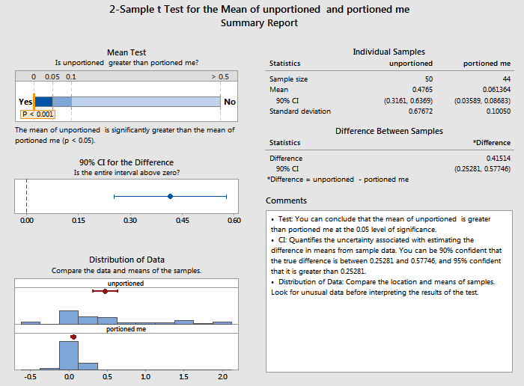
Proof of Improvements: Pre-Portioning
Practical Conclusion:
In field use, portioning deli meat prior to placing into service is more accurate

Slide 65
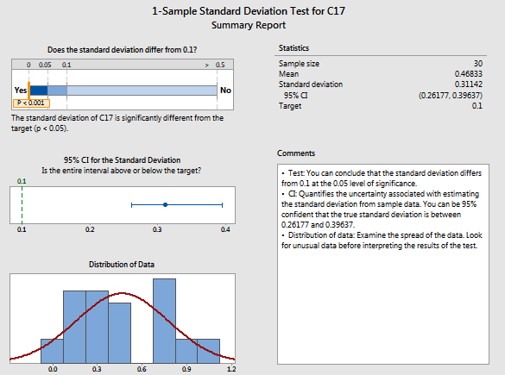
Proof of Improvements: Manual vs Digital Scales
Practical Conclusion:
In field use, weights read on manual scale significantly different than digital

Slide 66
Six Sigma Roadmap
Define
Measure
Analyze
Improve
Control

Slide 67
Control Plan – Portion Accuracy
Juran's Process Control Plan Matrix
Process Control Plan for: Portion Accuracy improvement |  |  |  |  |  |  | Date:1/26/16 |  | Revision Level: |  | Approved By:
Control Subject |  | Subject Goal (Standard) | Unit of Measure | Sensor | Frequency of Measurement | Sample Size | Where Measurement Recorded | Measured by Whom | Criteria for Taking Action | What Actions to Take | Who Decides | Who Acts | Where Action Recorded
Portioned deli meat (ham and turkey tested) |  | 3.0 * | oz. | digital scale | monthly | 20 | collection form attached to production record | FLM | >10% of std | Retrain, check accuracy of scale, | FLM | FLM | Productivity Portal
Digital scales used for portioning |  | 1 for every 500K in sales | each | inventory | annual | all locations | smallwares inventory | FLM | less than standard | Purchase scales, contact client if they are responsible for small wares | FLM | FLM | Updated inventory
Portion Utensil assessment |  | 100% match to Portion Guide | each | Food Management QA | monthly | all locations | FM QA criteria achievement | QA assessor (multiple levels) | less than standard | Purchase utensils, Retrain, conduct more assessments to assure compliance, coaching or discipline if needed | FLM | FLM | QA report
* or contract requirement
Notes:
Minimum – Maintain project goal achievement.

Slide 68
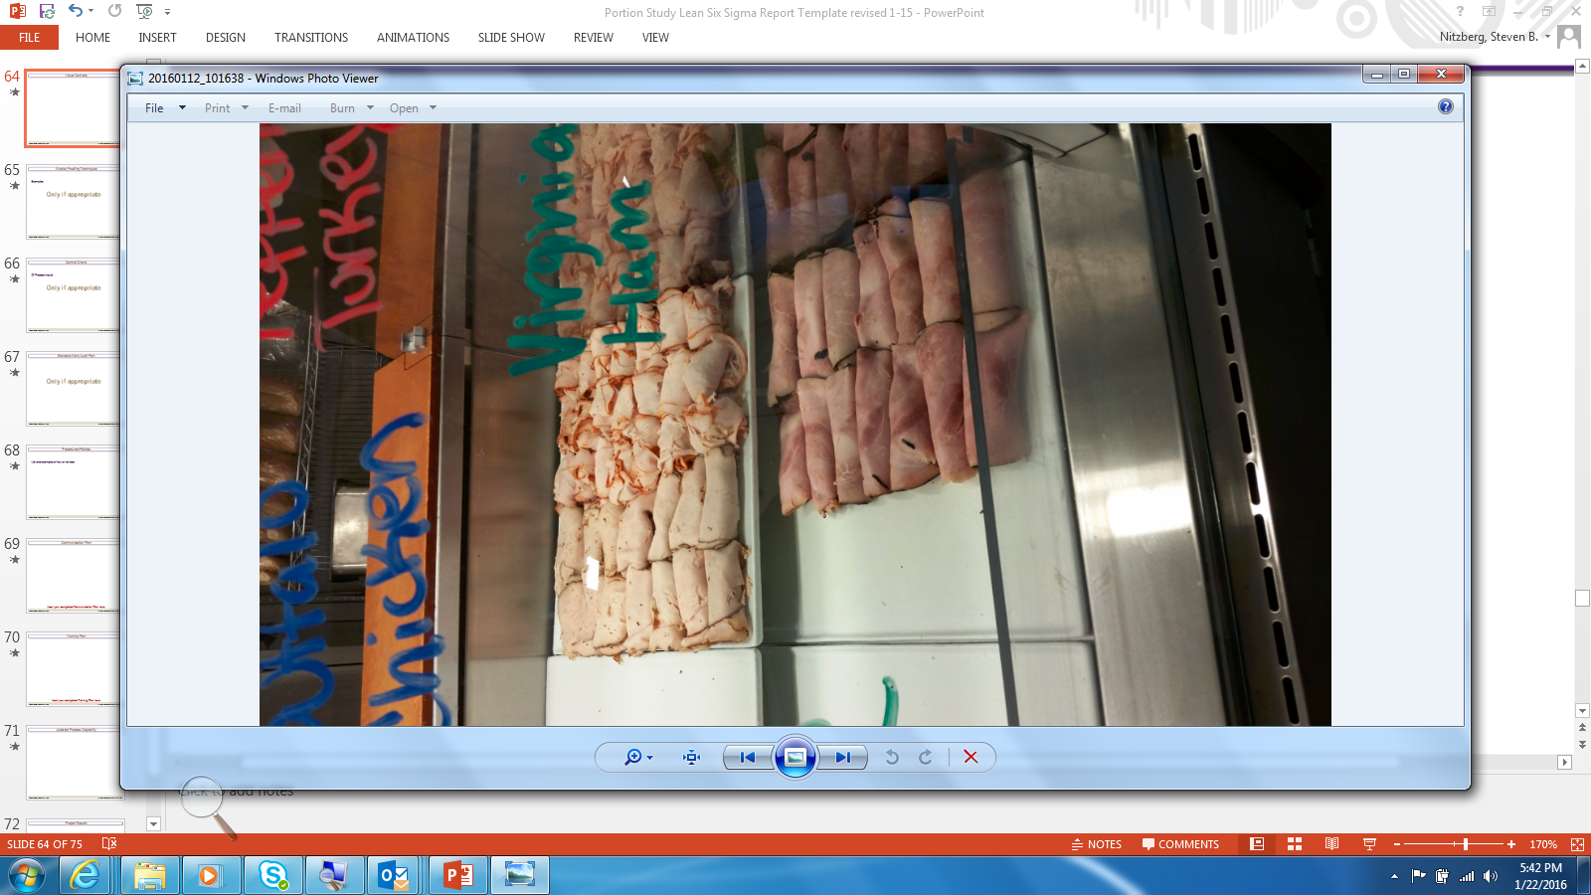
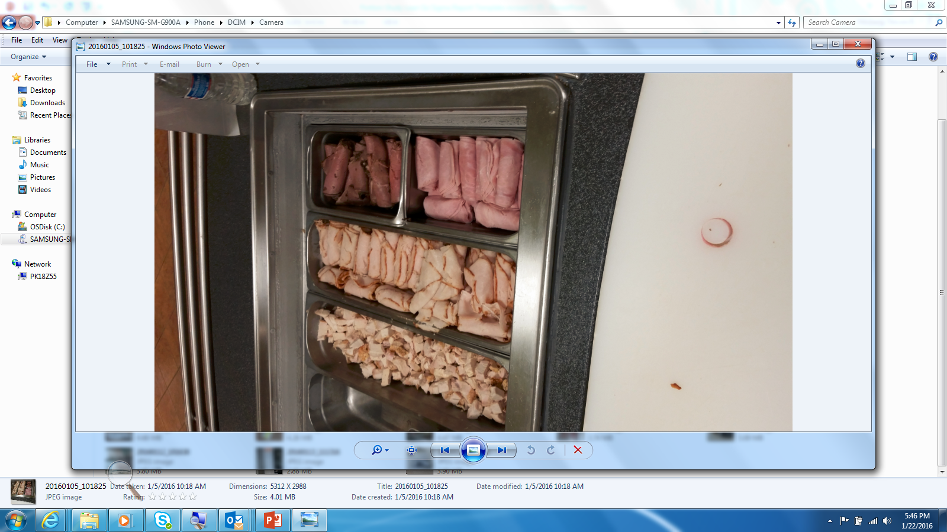
Visual Controls - Pre-portioned Meat
Counter Display
Service line

Slide 69
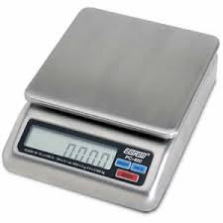
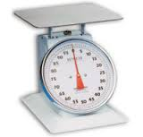
Mistake Proofing Techniques
Examples:
Hard to read
Easy to read

Slide 70
Control Charts
Comparison of In-house vs Vendor Sliced Meat
Notes:
Column is meat type
Row is Vendor sliced vs House sliced
Demonstrates that vendor sliced is more consistent although ham is less consistent than turkey
The house –sliced turkey is more variable due to the ‘natural shape’ of the turkey breast.
The house-sliced meats were Boar’s Head Ham and turkey

Slide 71
Communication Plan
Communication Plan
Stakeholder | Current Knowledge | What Need to Know | What to Communicate | Medium | Who Communicates | By When | Completed
FLA | Portions should be sufficient to customer - don't want to be chintzy or give too much. Reactive to perceived customer expectations | Portions should = consistency. There are nutrition standards we commit to and portion consistency matters. Also customers want to know what to expect so each server needs to provide the same amount. Finally, we can't know what is really popular if some people give bigger or smaller portions | Portion accuracy matters because nutrition matters and consistency matters | Pre-service huddles with provided talking points | FLM | 30-Dec | Completed for pilot locations
FLM | Portioning is obvious and simple. A little more or less cottage cheese is not my biggest problem | Over portioning is food waste and under portioning is a client commitment issue. While perfection is unrealistic, consistency is an important value for teams to adopt | Portion accuracy matters because nutrition matters and consistency matters. Portion accuracy impacts food cost target achievement and customer satisfaction | DM Team call with FSDs and FLMs | DM | 30-Dec | Completed for pilot locations

Slide 72
Communication Plan
Communication Plan
Stakeholder | Current Knowledge | What Need to Know | What to Communicate | Medium | Who Communicates | By When | Completed
Client | Portions need to meet my personal expectations | Food portions impact nutritional commitment we've made, may contribute to food waste (an environmental issue), and impact customer expectations | Portion accuracy matters because nutrition matters and consistency matters | DM conversation with clients | DM
Customers | I want value for what I pay | Portion accuracy matters because nutrition matters and consistency matters | Value is important. Commitments made for consistency are important | Talking points for FLAs to use, conversation with customers, sample plates to demonstrate what to expect | FLM / DM

Slide 73
Project results
Portion Guide
  Ave savings per week ~$27 for the eight patient menu items assessed (approx. 0.3 % of menued food cost).
    At 21% drop through for all loc. (P&L ratio) = $112K annually (conservative) + other menu items
    Non-P&L locations would have improved consistency.
Digital Scales
  Manual scale results read 11% higher than digital.
  Digital scales will improve accuracy but not result in food cost savings.
Pre-Portioned Deli Meats
  We purchase approx. $3 MM in just 2 SKUs of deli turkey and ham
  Impact of not pre-portioning = 13% over-portioning
  Sandwich error ~ 52%
  Savings of correction approx. $205 K for 2 SKU’s*

Slide 74
Project Results
 |  |  |  |  | enter | enter
1 | Number Of Units Processed |  |  | n= | 217 | 94
2 | Number Of Defect Opportunities | Per Unit |  | o= | 5 | 5
3 | Total Count Of Defects Made | (Include Defects Made And Later Fixed) |  | c= | 104 | 12
4 | Solve for Defects Per Opportunity DPO = c / (n*o) |  |  |  | 0.095853 | 0.025532
5 | Solve For Defects Per Million Opportunities (DPO * 1,000,000) |  |  |  | 95,853 | 25,532
6 | Look Up Process Sigma In Abridged Sigma Conversion Table |  |  | Sigma = | 2.81 | 3.45
 | Current | Goal | Actual
COPQ (Ham / Turkey) | $6 to $9 mil $297, 162 | $3 to 4.5 mil $148,581 | $47,182*
Relevant Metric | 10.2% Defect Rate 9.5% Sandw. | 5% Defect Rate | 4.7%* Defect rate
PPM (of DPMO) (Turkey / Ham) | 102,865 95,853 | 50,000 | 25,532
Sigma Level | 2.77 2.81 | 3.14 | 3.45
*HAM BUFFET BNLS W/A 1877
TURKEY BRST CLS SKLS

Slide 75
Lessons Learned
Field-test all studies prior to ‘roll-out’
    The deli meat study identified more variables than we initially anticipated.
    The Portion accuracy survey in the summer could have required additional data points to provide better insight. Number of portions prepared of each item tested would have simplified impact calculations
Break down big concept into smaller projects
    Look at only a section of the portioning picture such as a single LOB or a single food group. Use a couple of dedicated pilot locations
Locate key corporate data early
    Calculations of impact were more complex because data unavailable.

Slide 76
Possible future projects
What is customer impact, if any, of portion consistency? Does it matter to customers and/or to financial results that we objectively portion toppings on MTO items like shredded lettuce on sandwiches? Many national brands only tightly control a few items and allow significant variability in other items. Is that perceived as more customer-friendly?
What is a realistic tolerance for accuracy for different food types and portions?
Are there portioning techniques that effectively yield accuracy while also providing a better customer experience (e.g. piped mashed potatoes)?
What is customer reaction to exclusively using pre-sliced deli meats? Does it matter at premium locations?
How accurate is post-cost analysis for self-serve stations like salad bars? Do we correctly document food use? Is there a better method than daily production records?
How frequently do locations shift to self-serve for all items in a residential hall station? What impact does that have on food cost? Does it offset labor cost and customer satisfaction?
Study to understand and improve quality of PRIMA data, not simply ‘compliance’
Can coffee waste be reduced? Coffee category, excluding refreshment services, represents over 5% of food purchases. Few locations track their coffee waste

