Slide 1

Six Sigma Green Belt
Project Report Presentation: Healthcare Industry
Project Number: XX
Project Name: Reduce Patients Placed in Incorrect Status
Project Team Leader: XXXX
Project Champion: XXXX
Green Belt Candidates: XXXX

Slide 2
Six Sigma Roadmap
Define
Measure
Analyze
Improve
Control

Slide 3
Operational Definitions of Key Terms
Key Terms | Operational Definitions
Observation Status | The time in which a patient requires care in a bed at the hospital, receiving hospital level services and is placed in Observation status instead of admitted as an inpatient.
Inpatient Status | Full admission, Inpatient Order
Floor Providers | Attending, Resident and Consulting Physicians
Ancillary Services | Therapists ( OT/PT/SP) Lab, Imaging and Pharmacy
HRM | Contracted Company that handles Insurance verification and precertification for observation and inpatients, and Medicaid Applications.
HIM | Health Information Management Department (Medical Records).
Diagnostic Results | Test and Lab results, Imaging etc.
1st Level Review | Utilization Review applying medical necessity criteria for every observation patient using InterQual.

Slide 4
Operational Definitions of Key Terms
Key Terms | Operational Definitions
2nd Level Review | Physician review applying medical necessity criteria for every observation patient using evidence-based algorithm (EHR Logic)
EDM | The ABC Emergency Department Management module in Meditech.
ADM | The ABC Admissions module in Meditech.

Slide 5
Problem and Goal
Problem Statement:
Background: Patients given a room in the hospital receive a status of either “observation status” or “inpatient status.” Patients given an inappropriate status create an opportunity for the hospital to lose revenue and/or reimbursement.
From October 1 – October 17, 2014 the average number of patients on the daily observation list with a current full admit inpatient order was 15% (23/152). The impact of not assigning the correct status includes financial losses, patient flow issues and decreased patient and provider satisfaction.
Goal Statement: Achieve the following by July 31, 2015.
Reduce the average number of patients on the observation list with a full admit inpatient order from 15% to <10%.

Slide 6
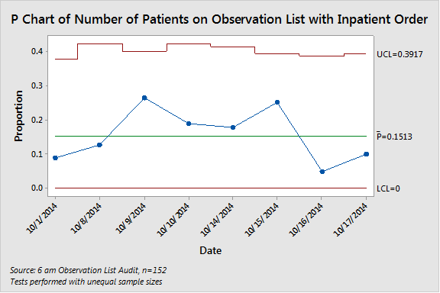
Graphical Verification of Problem
Conclusion:
The number of patients on the Observation List with an Inpatient order from
October 1, 2014 to October 17, 2014 was 23 out of 152 resulting in a 15% error rate.
Source:6 am Observation List audit n=152 months

Slide 7
Project Scope
In Scope:
ABC Hospital 6 AM observation list patients.
The process begins with the decision to keep the patient and place them in a bed and ends with the discharge or change to “admitted patient”.
Items Out of Scope:
XYZ, All other services and entities, Day Surgery/Outpt in a Bed

Slide 8
Project Justification and Expected Results
Relevant Metrics and Improvement Targets:
Registration errors for patients on Observation List based on to less than 2 per day.
Patients changed to Observation without a 2nd level physician review at 0.
Operational:
Improve patient throughput
Decrease rework
Improve billing accuracy
Obtaining appropriate authorizations
Strategic Impact:
Improve patient, staff, and physician satisfaction.

Slide 9
Alignment to Strategic Pillars
Reducing the number of patients registered with the incorrect status directly aligns with ABC Hospital’s strategic pillars to improve quality, service, premium and people. All of these activities will help to improve patient and caregiver loyalty.
Quality
Improved clinical outcomes by allowing the correct data to be available as needed for patients
Service
Move patients through the system more efficiently and reduce the possibility of missed authorizations/in-correct reviews
Premium
Improve denials or loss of revenue by submitting correct data
People
Improve caregiver satisfaction by providing clinicians with the correct information to perform their jobs
LOYALTY

Slide 10
Financial Impact: Business Case or COPQ Calculation
Hard: Patients changed from Inpatient to Observation at Discharge. COPQ based on the difference in reimbursement (by payer) from Inpatient to Observation.
March to December 2014: $62,877 total or $6,287 per month or $75,444 Annually.
Soft: Rework time spent by caregivers to review and correct registration errors(estimated).
UR = ($34/60 x 15 Min x 46 x 12) = $4,692 Annually
Access = ($13.50/60 x 10 Min x 46 x 12) = $1,242 Annually
Time spent by Biller, Access, HIM reworking accounts that were discharged as Inpatient that only have an order for Observation.

Slide 11
Project Team Membership
Role | Name & Title
Project Champion | XXXX
Project Team Leader(s) | XXXX
LSS Green Belt Candidate | XXXX
Core Team Members | XXXX XXXX XXXX
Ad hoc or SMEs | XXXX

Slide 12
Project Plan - Milestones and Timing
Project Milestones
Phase | Milestones | Target Start | Target Completion
Define | Establish project charter and team | September , 2014 | September , 2014
Measure | Create process map and collect required baseline data | October , 2014 | November , 2014
Analyze | Perform root cause analysis and test theories | December , 2014 | January , 2015
Improve | Identify, select, and implement solutions | January, 2015 | March, 2015
Control | Establish control plan to sustain results | March, 2015 | July , 2015

Slide 13
High Level Process Map (SIPOC)
SIPOC Template
SUPPLIER | INPUT (use nouns) | PROCESS (use verbs) | OUTPUT (use nouns) | CUSTOMER
Patient Family EMS Other Facility Ancillary Services Past Medical Record | Patient Current Condition Diagnostic Results Consults Past Medical History | Decide on Patient's Status | Correct Patient Status Observation vs. Inpatient | ED Provider Patient
ED Provider | Attending Physician Name Patient Clinical Information Patient Status Bed Type | Enter Order For Bed Request | Paper Bed Request Paper Patient Registration Order | Patient Access/Admitting Bed Resource Coordinator
Patient Access/Admitting Bed Resource Coordinator | Data Re-Entry into Meditech MedTracking | Process Order and Bed Assigned | Bed Assignment ED Patient Status to ADM Status | Utilization Review Coordinator Bed Resource Coordinator Nursing Units Floor Providers HRM Transportation Housekeeping
Patient Ancillary Services Utilization Review Coordinator Floor Providers | Patient Current Condition Diagnostic Results Consults Past Medical History | Evaluate Patient Condition/Status | Correct Patient Status Observation vs. Inpatient | Utilization Review Coordinator Nursing Units Floor Providers HRM
Patient Ancillary Services Utilization Review Coordinator Floor Providers | Patient Current Condition Diagnostic Results Consults Past Medical History Social Needs | Discharge or Admit patient | Change Observation to Inpatient Order Discharge Order | Nursing Units Patient Patient Access/Admitting Transportation Housekeeping Patient Accounts HRM HIM Ancillary Services

Slide 14
Voice of Customer to CTQ Analysis
A Sample of 65
Verbatim Comments
Collected

Slide 15
Final List of CTQ’s
CTQ’s
Number of inpatients that are changed to observation without a 2nd level review at 0 per month.
Number of registration errors to less than 2 per day.
Notes:
All CTQ’s must be measurable and have a target established.
For example: Turnaround time of <30 minutes from receipt in lab to results

Slide 16
Stakeholder Analysis Worksheet
Name or Group | Strongly Against | Moderately Against | Neutral | Moderately Supportive | Strongly Supportive
Administration |  |  |  |  | X
Finance |  |  |  |  | X
ED Provider |  |  | X
UR Coordinator |  |  |  | X
HRM |  |  |  |  | X
Patient |  |  |  | X
Patent Access/Admitting |  |  |  |  | X
Floor Providers |  |  |  | X
HIM |  |  |  |  | X
Ancillary Services |  |  |  | X
Patient Accounts |  |  |  |  | X

Slide 17
Define Phase Deliverables
Define | Complete
Operational definitions of key terms | Yes
Problem statement | Yes
Graphical Verification of Problem | Yes
Goal statement | Yes
Business case and expected benefits | Yes
Project scope | Yes
Project team members | Yes
Project plan | Yes
High level process map (SIPOC) | Yes
Voice of Customer (VOC) and Critical-to-Quality (CTQs) | Yes
Stakeholder analysis | Yes
Gate Review and Sign-off by Champion | Yes

Slide 18
Six Sigma Roadmap
Define
Measure
Analyze
Improve
Control

Slide 19
Project Y (or Ys) in Y=f(x)
Project Y = The average number of patients on the daily observation list with a current full admit inpatient order.

Slide 20
Current State Value Stream Map
Not applicable for our project.
We were not evaluating
measures or potential
improvement
to process/cycle times

Slide 21
Current State Detailed Process Map

Slide 22
Current State Detailed Process Map

Slide 23
Plan for Baseline Data Collection
Data Collection Plan (Measure Phase)
 | What to Measure |  | Operational Definition |  | Data Collection
Ref # | Question to Answer | Measure Name | Words | Formulas | Data Type | Sample Size | Collection Method | Who collects | Tools to use | Stratification Variables
1 | How many patients in house do not have orders? | Percent in House Patients without orders | % of patients placed in a bed in either Observation or Full admit with no corresponding order entered or written | # of patients in abed with no order / # of total patients in a bed in house for 1 week | Categorical |  | Manual | UR staff | Bar chart | Day of the week
2 | What Percentage of Observation patients met INPT criteria at the first level review? | Percentage changed OBS to INPT by meeting criteria at 1st level review | % of orders entered as Observation when they were meeting INPT criteria at the time they were placed in a bed in an observation status | # of patients in house in Observation status that after UR 1st level review meet inpatient criteria from initial clinical information/ total patients in Obsevation status for 1 week | Categorical |  | Manual | UR staff | Bar chart | By Reviewer By Physician By service
3 | What percentage of Patients listed on the Observation list had an order for INPT? | Percentage registration error | % of times patients are placed in a bed as Observation or Full admit and the order entered in Meditech or written does not match | # of patients where the status in meditech is not the same as the last order in the sytem (greater than 10 min)/all patients in house daily for 1 week | Categorical | 152 | Manual based on Meditech report | Katherine Underwood | Bar chart | Patients admitted per day at a given time of the day, patients with no corresponding status order

Slide 24
Plan for Baseline Data Collection
Data Collection Plan (Measure Phase)
 | What to Measure |  | Operational Definition |  | Data Collection
Ref # | Question to Answer | Measure Name | Words | Formulas | Data Type | Sample Size | Collection Method | Who collects | Tools to use | Stratification Variables
4 | How many times are patients changed INPT to OBS without proper authorization? | Percentage status changed with no second level review | % of times patients are changed from INPT to Obsevation without a documented second level physician review | # per day of patients who have change INPT to OBS order without proper 2nd level review/ all change INPT to Obs orders for 4 months | Categorical | 112 | Manual based on Order Entry reports | XXXX | Bar chart | By Month, By Service By Physician
5 | What are the observation rates by service line? | Percentage of Observation to total patients | % of patients placed in Observation compared to all admissions by service line | # of patients Discharged in Obs/ total # of patients discharged for YTD JAN -Sept 2014 | Categorical |  | Meditech report | XXXX | Pareto Chart | percentage and service line cummulative percent of total
6 | How many patients are changed from OBS to INPT at second level physician review? | Percentage changed OBS to INPT after Second level | % of patients changed from Observation to INPT based on second level review determination based on information available at admission | # of patients admitted as Observation that after 2nd level physician review are approved for INPT/ All patients in OBS submitted fro 2nd level Physician Review.For past 12 months 9/13-9/14 | Categorical | 994 | EHR portal report | EHR | Bar chart | By Physician By UR reviewer By Month
7 | What Percentage of the ED History and Physicals Documented communication with the Admitting Physician? | Percentage of patients who have phone or in person consult with Attending prior to Bed Request/ Patient Reg order entered | % of patients who have patient status discussion with the Attending doc/On call hospitalist prior to entering the order to determine the status to Admitting | # of patients with conversations documented to discuss status priro to entering orders in the ED/ All patients who are In house for 1 week | Categorical | 103 | Manual | ED Physicians Attending Physicians | Pareto Chart | Day of the week By ED Physician

Slide 25
Customer Demand
Summary: The number of observation status orders on admission has increased from 150 in January 2013 to over 250 per month by November 2014 (Source: Meditech, n= ).

Slide 26
Question to be Answered
Question 1:
How many patients in house do not have orders?
Summary:
Out of 542 admissions from 11/19/14 to 11/29/14, 8 or 1.5% did not have an admission order in the record. (Source: Meditech, n= 550)
Percent of Admissions with No Order
600
542
Should be count
500
400
300
200
100
8
0
Total Admissions
No Order

Slide 27
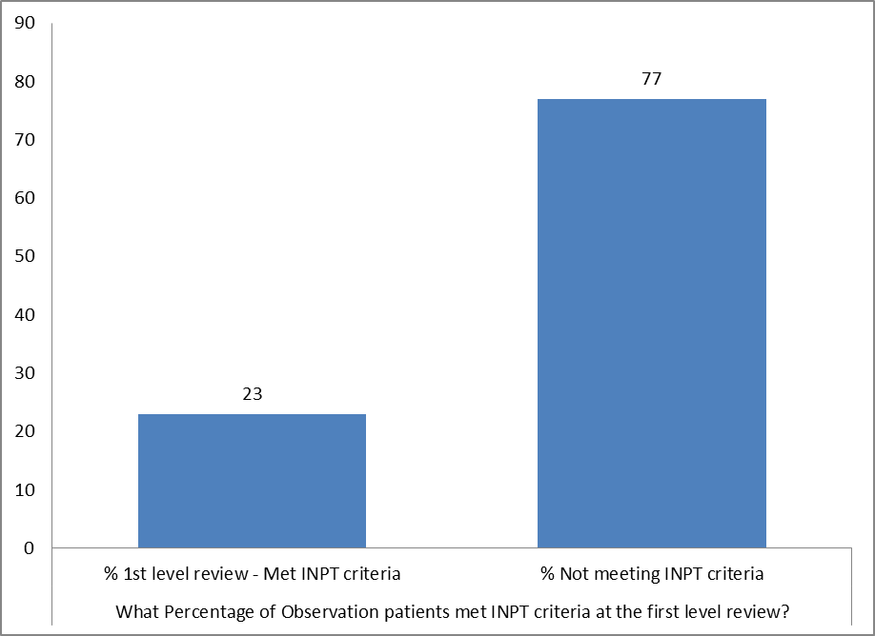
Question to be Answered
Question 2:
What Percentage of Observation patients met INPT criteria at the first level review?
Summary:
A Total of 108 records reviewed and 25 (23%) met INPT criteria at the first level review (Source: Meditech, n= 108).

Slide 28
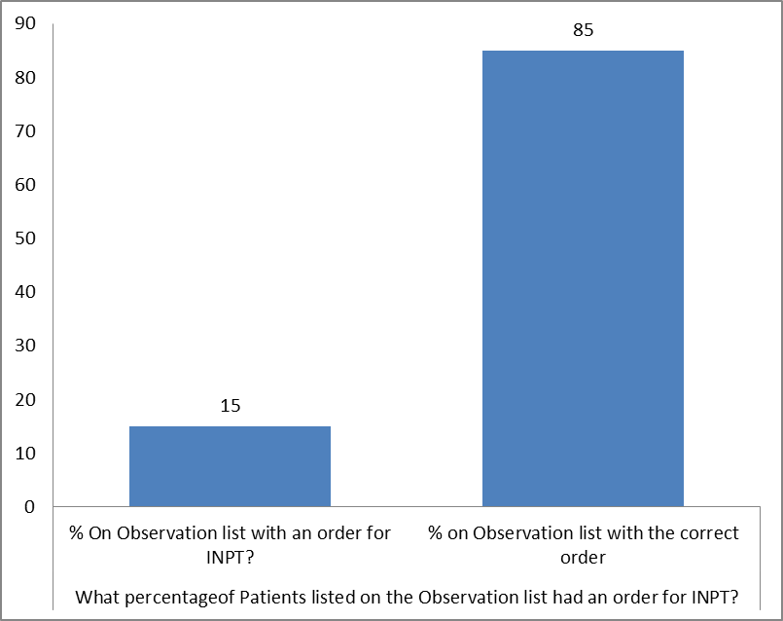
Question to be Answered
Question 3:
What percentage of Patients listed on the Observation list had an order for INPT?
Summary:
152 patients reviewed on the Observation list between 10/1-10/17. 23 (15%) had an order for INPT in the medical record (Source: Observation List and Meditech, n=152).

Slide 29
Question to be Answered
Question 4:
How many times are patients changed INPT to OBS without proper authorization?
Summary:
From March 2014 to Dec 2014, there were 112 orders to change an Inpatient to Observation status. 20 (18%) of those orders were entered without a 2nd Level Review. (Source: Meditech, n=112)

Slide 30
Question to be Answered
Question 5:
What are the Observation Rates by Service Line?
Summary:
Medicine, Surgery and Family Practice are the vital few service lines that admit patients in Observation status (Source: Meditech, n= 1157).

Slide 31
Question to be Answered
Question 6: How many patients are changed from OBS to INPT at second level physician review?
Summary: For October 1, 2013 through Sept 30. 2014, there were 157 out of 528 (29.7%) patients met inpatient status at the 2nd Level review (Source: EHR exchange report, n=528).

Slide 32
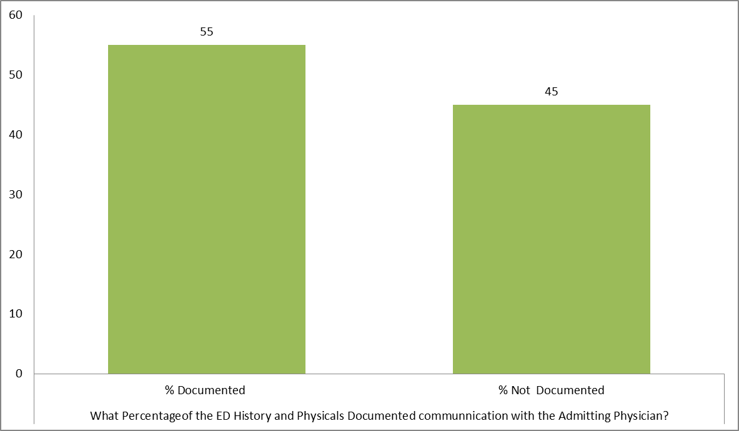
Question to be Answered
Question 7:
What Percentage of the ED History and Physicals Documented communication with the Admitting Physician?
Summary:
The percentage of ED History and Physicals documenting a conversation with the admitting Physician was 55% ( 57/103) Total of 103 patients in Observation were reviewed in October and November 2014. 57 ( 55%) had documentation of a conversation with the Admitting Physician. (Source: Meditech, n=103)

Slide 33
Measure Baseline Performance
 | Current | Goal
COPQ (Annualized) | Hard: $75,444 Soft: $5,934+ | $0 $3,956
Registration Errors | 15% | <10%
PPM (of DPMO) | 110,609 | 98,684
Sigma Level | 2.5 | 2.79
General Worksheet For Calculating Process Sigma
 |  |  |  |  | enter | enter
1 | Number Of Units Processed |  |  | n= | 152 | 152
2 | Number Of Defect Opportunities | Per Unit |  | o= | 1 | 1
3 | Total Count Of Defects Made | (Include Defects Made And Later Fixed) |  | c= | 23 | 15
4 | Solve for Defects Per Opportunity DPO = c / (n*o) |  |  |  | 0.151316 | 0.098684
5 | Solve For Defects Per Million Opportunities (DPO * 1,000,000) |  |  |  | 151,316 | 98,684
6 | Look Up Process Sigma In Abridged Sigma Conversion Table |  |  | Sigma = | 2.53 | 2.79
 | Calculated by NORMSINV(1-DPMO/Million)+1.5
Estimated COPQ savings based on project goal is $78,411.

Slide 34
Other Relevant Metrics
Metrics | Baseline Performance
Observation Rate | 15.2%
Percent of patients on observation list with an order for inpatient status | 15%
Number of time patient status changed from inpatient to observation without 2nd level review | 20 out of 112 (18%)

Slide 35
Spaghetti Diagram
Not applicable to this project

Slide 36
Load Charts
Not applicable for our project.
We were not evaluating
measures or potential
improvement
to process/cycle times. Takt
Time not applicable.

Slide 37
S1 – S3
Not applicable for our project.
We were not evaluating
physical space and
the needs to remove
clutter from work areas

Slide 38
Measure Phase Deliverables
Measure | Complete
Measureable definition of Y (or Ys) in Y = f(x) | Yes
At least one of the following for current state (as is) process: detailed process map(s) or value stream map with process attributes | Yes
Data collection plan for measure phase | Yes
Customer demand analysis | Yes
Baseline performance (Y or Y’s) | Yes
Process capability – Sigma level | Yes
Pareto charts | Yes
Value stream map attribute data (as appropriate) | N/A
Spaghetti diagrams (as appropriate) | N/A
Current load charts (as appropriate) | N/A
Assess for 6S and implement S1 – S3 | N/A
Gate review and Sign-off by Champion | Yes

Slide 39
Six Sigma Roadmap
Define
Measure
Analyze
Improve
Control

Slide 40
Cause-Effect Diagram(s)
= Potential Root Cause

Slide 41
5 Why Analysis
Just a Sample

Slide 42
Potential Root Causes/Root Causes

Slide 43
Current State FMEA

Slide 44
VA/NVA Analysis Process Map(s)
Add Kaizen bursts

Slide 45
VA/NVA Analysis Process Map(s)

Slide 46
Impact Control Matrix
 |  | IMPACT
 |  | High | Medium | Low
CONTROL | High | Registration Errors | Providers Changing Status Orders Incorrectly
 |  | Residents changing Orders at Discharge | Providers not Aware of INPT criteria
 |  | ED to Inpt Providers Not Consulting One Another
 | Medium | Ease of changing Status with orders | Status Change to avoid D/C summary
 |  | ED Providers do not feel OBS/INPT their role | UR Availability
 |  | Doctors Not Calling Executive Health Resources | HRM not notified timely Manner
 |  | Diagnositc departments closed | Social Issues/Social patients put in a bed
 |  | MD/Residents think OBS is always 23 hours | Labs/Ancillary services- No priority for OBS patients
 |  | Providers refuse to change to INPT | Multiple Status Change Orders
 |  | ED doc rush for bed request | Too many steps in the ED to enter orders
 |  | OBS status does not appear on Provider census
 |  | Poor provder documentation
 | Low | CMS guidelines unclear | Timid decision making | Meditech Downtime
 |  | 2 Midnight rule | OBS patients located on every unit
 |  | Bed Request tied to the order in the ED | Insurance only approving Observation
 |  |  | HRM hours of Operation
 |  |  | No access to clinicla info ( Multiple Indepdent systems)

Slide 47
VA/NVA Analysis of VSM
Not applicable for our project.
We were not evaluating
measures or potential
improvement
to process/cycle times

Slide 48
Potential Xs—Theories To Be Tested
X₁: Variability in UR coverage impacts reviews completed.
X_{2:} Variability in processing the orders in Patient Access impacts correct patient status.(CE diagram, process map)
X₂: Residents Changing Orders at Discharge impacts correct status assignment (CE diagram, FMEA)
X₃: ED MD to Attending communication deficits impacts correct status assignment. (CE diagram, FMEA, process map)

Slide 49
Data Collection Plan for Analyze Phase
Theory Test Plan
Ref. | Theories To Be Tested (Selected From The C-E Diagram, and/or Impact Control Matrix | Data Required | Tools To Be Used | Results that will support theory | Results that will rule out theory
1 | Variability in UR coverage impacts reviews completed. | The number of patients admitted after 10 am | Line Chart | greater than 50% of pateints are admitted after 10 AM | less than 50 % of pateitns are admitted after 10 AM
2 | Variability in processing the orders in Patient Access impacts correct patient status. | The number of patients registered incorrectly as Observation | Bar Chart | Greater than 3 patients per day on observation list that had inpatient orders | Less than 3 patients per day on observation list that had inpatient orders
3 | Changing Orders without 2nd level review and at discharge impacts accurate patient status. | Number of patients with a status order change from inpatient to observation without a 2nd level review. | Bar Chart | Greater than 10% of patients with a status order change without a 2nd level review and at discharge. | Less than 10% of patients with a status order change without a 2nd level review and at discharge.
4 | ED MD to Attending communication impacts correct patient status | The percent of patients admitted to observation status that met inpatient criteria where an ED to Attending communication was documented. | Bar Chart | Greater than 10% of patients that changed from observation to inpatient status with a ED MD to Attending communication. | Less than 10% of patients that changed from observation to inpatient status with a ED MD to Attending communication.

Slide 50
Test of Theories X₁
Theory 1: Variability in UR coverage impacts reviews completed.
Does UR Availability impact the ability to move Observation patients to Inpatients?
Analysis: Compare the percentage of patients admitted after 10 AM that would be reviewed by UR for correct status versus desirable proportion of 50%.
Statistical Conclusion: The percentage of patients who are admitted after 10 AM is statistically greater than the goal of 50% at the 95% confidence level
Practical Conclusion: The number of patients that could receive a 1st level UR on day one exceeds the desired threshold of 50%. Theory TRUE

Slide 51
Test of Theories X₂
Theory 2: Variability in processing the orders in Patient Access impacts correct patient status.(CE diagram, process map)
Question: Do the processes in Patient Access impact correct patient statuses?
Analysis:
Statistical Conclusion: 152 patients reviewed on the Observation list between 10/1-10/17. 23 (15%) had an order for INPT in the medical record (Source: Observation List and Meditech, n=152).
Practical Conclusion: Processes are different for Registration and in the ED. Multiple people were printing to the printer with all the orders, increasing the likelihood for registration errors and missed orders. Theory TRUE

Slide 52
Test of Theories X₃
Theory 3: Changing Orders without 2nd level review and at discharge impacts Correct Patient status.
Question: Does Changing orders without a 2nd level affect Observation rate and accuracy of Patient Status?
Analysis: Determine the number of patients in inpatient status that are changed to observation status at discharge without 2nd level review.
Test and CI for One Proportion
Test of p = 0.1 vs p > 0.1
Exact
Sample X N Sample p 95% Lower Bound P-Value
1 20 112 0.178571 0.121596 0.008
Statistical Conclusion: The proportion of patients changed from inpatient to observation without approval is greater than 10% at a 95% confidence level (p value = 0.008).
Practical Conclusion: Providers are changing the status from inpatient to observation status more than expected or desired. Theory TRUE

Slide 53
Test of Theories X₄
Theory 4: ED MD to Attending communication impacts the correct status order.
Analysis: What percent of observation patients with ED MD to Attending communication documentation met inpatient criteria at 1st level review.
Test and CI for One Proportion
Test of p = 0.1 vs p > 0.1
Exact
Sample X N Sample p 95% Lower Bound P-Value
1 17 25 0.680000 0.496358 0.000
Statistical Conclusion: Greater than 10% of patients that changed from observation to inpatient status with a ED MD to Attending MD communication at a 95% confidence level (p value = 0.00).
Practical Conclusion: Out of 25 patients that met 1st level review, 17 (68%) had a documented conversation between the ED Physician and the attending Physician. A documented conversation does not necessarily lead to a correct status on admission.

Slide 54
Summary of Testing Results
X₁: Variability in UR coverage impacts reviews completed. – TRUE
X_{2:} Variability in processing the orders in Patient Access impacts correct patient status.(CE diagram, process map) TRUE
X₃: Changing Orders without 2nd level review and at discharge. - TRUE
X₄: ED MD to Attending communication deficits lead to incorrect status order.
- FALSE

Slide 55
List of Vital Few Root Causes (Proven Xs)
Y=f(X₁,……X_{n})
Vital Few Xs are:
Variability in UR coverage impacts reviews completed.
Variability in processing the orders in Patient Access impacts correct patient status.
Changing Orders without 2nd level review and at discharge

Slide 56
List of Vital Few Wastes
Vital Few Wastes are:
Access Fax is in Closest Proximity to Reception Desk (Process Map)
Order processed in admitting without the admission order being entered into Meditech (Process Map)

Slide 57
Quick Hits
Remove the duplicate patient registration order from the floor order sets
Change the wording in the ED documentation about who is responsible for the status order.
Expedite Printer order for A1200 receptionist desk
Dedicate the printer at the bed coordinator desk just for admissions
Admissions to print report to verify that order matches status in Meditech
Feedback loop to the ED physicians created to notify them when patients placed in Observation are changed to Inpatient.

Slide 58
Analyze Phase Deliverables
Analyze | Complete
Cause-effect diagram(s) | Yes
5 Why analysis (as appropriate) | Yes
FMEA on current state process | Yes
Analysis of value stream map and process map(s) | Yes
VA/NVA decomposition analysis | Yes
Inventory analysis (as appropriate) | N/A
Impact control matrix to prioritize potential root causes and wastes | Yes
List of theories to be tested (list of selected potential Xs) | Yes
Data collection plan for analyze phase | Yes
Each theory tested (proven or disproven) using graphical or statistical analysis | Yes
Summary listing of proven or disproven theories | Yes
List of vital few root causes (proven Xs), i.e., Y=f(X₁, X₂, ….X_{n}) | Yes
List of vital few wastes (as appropriate) | Yes
Gate review and Sign-off by Champion | Yes

Slide 59
Six Sigma Roadmap
Define
Measure
Analyze
Improve
Control

Slide 60
Future State Value Stream Map
Not applicable for our project.
We were not evaluating
measures or potential
improvement
to process/cycle times

Slide 61
Improvement Strategies for Proven Xs or Wastes
Proven Xs (Causes) | Strategies
Registration Errors | ABC Hospital needs to streamline process and create a feedback loop for Patient Access.
UR availability | Provide UR capacity to ensure Day 1 status review
Residents Changing Orders without 2nd level physician review at Discharge. | ABC Hospital needs to prevent Residents from changing status at discharge.

Slide 62
Improvement Strategies for Proven Xs or Wastes
Proven Xs (Causes) | Strategies
Order entered without the order being entered into Meditech | Empower Access to no longer provide a bed without a non-verbal order
No Trigger for Status Order for Attending MD | Implement a visual management tool to highlight patient status
Status Designation Process Knowledge Deficit | Provide provider education on latest observation status guidelines
Financial Incentive on Private Practice Side to Have Patients in Observation Status | Reduce physician practice variation through the medical staff of ABC Hospital
Census report used currently used by Providers is shorter than the report that shows patient status | Provide a better visual management tool for attending physicians and residents to highlight patient status

Slide 63
Descriptions of Possible Solutions (Pros and Cons)
Possible Solution | Strengths (Pros) | Weaknesses (Cons)
Case Management/UR in the ED | Help to get the status correct sooner in the process | Cost, Buy-in in the ED and UR
Provider Standard Work for Status Designation | Getting the order correct the first time/Correct Reimbursement | Varying schedules, wide range of people, rotations
ED Provider criteria Education/Guidelines | Top Dx- giving ED Providers tool to make correct status decision | Very few
Avoidable Days tracking | Assist with Providers trends, decrease wasted days | Finding out where the fields are in Meditech, Training
Registration Standard Work | Improve order entry accuracy | Timing, scheduling
Color code Medical Record in Meditech INPT/Obs (Clinical Review) | Easily see patient status | IS capabilities, cost
Doctor Bill to Match Patient Status | Proper reimbursement, Incentive for Docs to get it right | Tracking, capability, resistance
UR Presents in Resident Orientation | Educational opportunity, improve accuracy of orders | Varying schedules, wide range of people, rotations

Slide 64
Descriptions of Possible Solutions (Pros and Cons)
Possible Solution | Strengths (Pros) | Weaknesses (Cons)
Second Shift UR Nurse | Help to get the status correct sooner in the process/same day | Cost, hiring for that shift
Stress Test Available 7 Days Per Week | Decrease LOS, make decisions earlier, better patient satisfaction | Cost, staffing availability
INo- change to <OBSV> | Clearer designation for all to see | IS Capability, Meditech capability
Physician/Resident education on the importance of correct patient status designation | Limit residents errors | Attending Resistance, IS capabilities
Patient Status on all Attending Patient Lists to Include Time Obs Status | Help Attending to know status of their patients, better decision making/Prioritization | Meditech Capabilities,
Change ED Doc incentive | Getting the correct status the first time, decrease ED 190 time | Attending resistance, Increase in ED time,
Clear Documentation for Provider Level of Concern | Easier to meet INPT and support decision, Better documentation to prevent INPT denials | Provider Buy-In, training and education, enforcement

Slide 65
Descriptions of Possible Solutions (Pros and Cons)
Possible Solution | Strengths (Pros) | Weaknesses (Cons)
OBS patients ID’d and priority for Labs | Decrease time in OBS, allow for quicker decision making. | Incentive to put in Obs, availability of ancillary services, cost
Observation Unit | Clear delineation of patients in OBS | Cost, space, cross education complications,
Separate Bed Request from Pat Reg. Order | Separate getting a bed from determining status | Potential for missed orders, may complicate the process, los of 2 MN cases
Develop standard work for verbal admission orders | Compliance with regulations, avoids admissions without orders | Resistance to change, delays in admission
Meditech not require status for Bed Request | Bed request process begins when bed need known | Meditech Capabilities, potential for missed orders, patients in limbo
Cancel First Bed Request Remove ability to Query | Eliminate duplicate orders, accurately reflects bed needs | Meditech Capability, resistance to change
Make Order Process all Electronic | Eliminate paper, streamline process, | Meditech/IS Capability
Move the Bed Request from ADM to EDM and put registration order back to Attending team. | Easier for ED Providers, save time, Provider Sat, Eliminate work-arounds and potential to reduce ED190 time | Meditech Capabilities, Potential Missed Orders

Slide 66
Evaluation using Criteria-Based Selection Matrix

Slide 67
Just Do Its
Avoidable Days tracking
Develop standard work for verbal admission orders
Update before OPR

Slide 68
List of Selected Remedies (Solutions)
Case Management/UR in the ED (in progress)
UR increase Day 1 reviews
ED Provider criteria Education/Guidelines and provide a reference link in Meditech
Physician/Resident education on the importance of correct patient status designation
Registration Standard Work
Feedback loop to ED physicians for Status changes

Slide 69
Pilot/DOE (as applicable)
Pilot Not Applicable
See Implementation Plan

Slide 70
Pilot Planning Worksheet
Not Applicable

Slide 71
Future State Process Map(s)

Slide 72
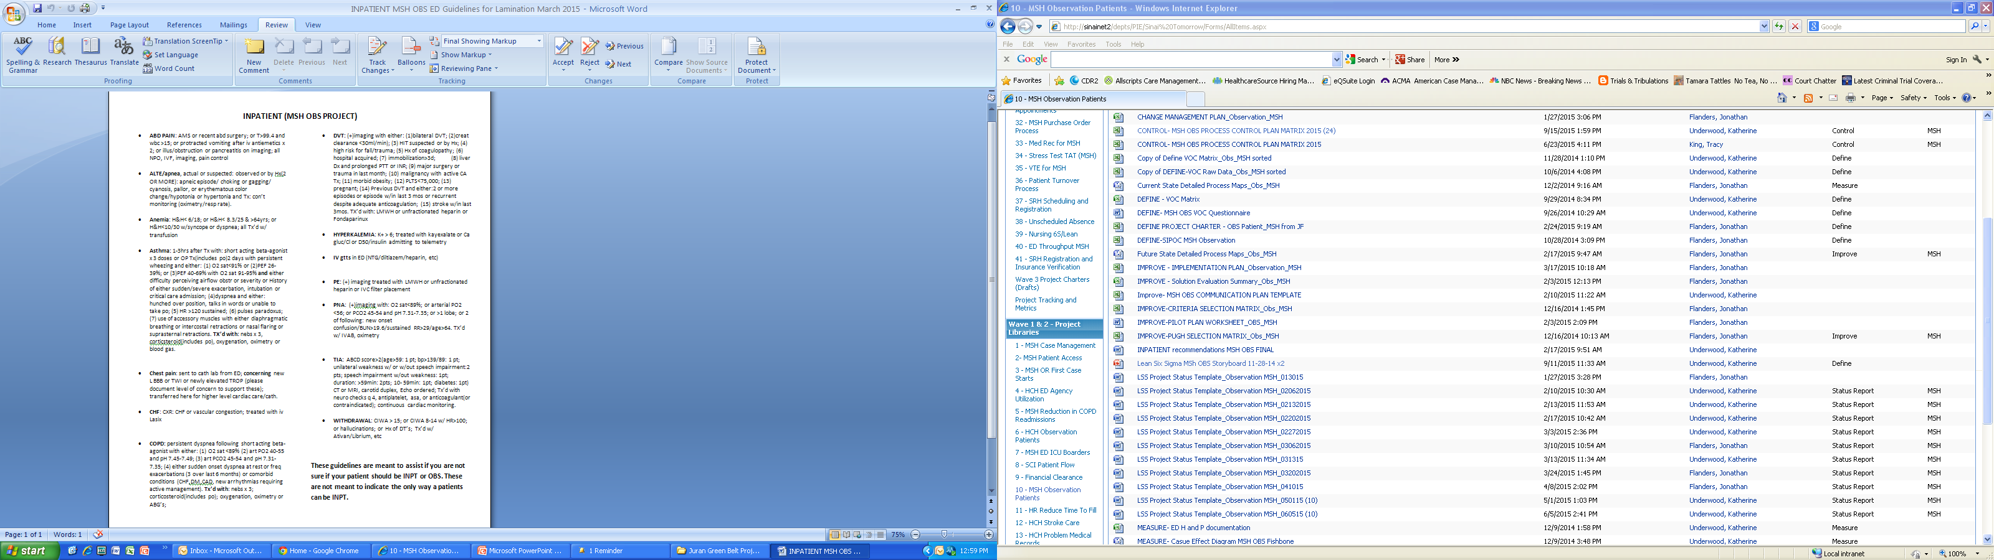
Standard Work
Review Patient Status Guidelines
Designate Patient as Observation or Inpatient
Review Patient status with Attending MD
Enter Bed Request Order with Correct Patient Status
Insert a picture of the card
And guidelines.

Slide 73
Future State Process FMEA

Slide 74
Barrier and Aids Chart
Barriers
Provider compliance and buy in
IT Resourcing
Admission Status Future State
Restrict CHANGE.A.O
Simplified ED Status Order
Aids
Provide Feedback on Status Changes
CMO Approval
Countermeasures

Slide 75
Change Management Plan

Slide 76
Implementation Plan
Improvement Solutions | Status | Due Date | Owner
Case Management/UR in the ED | 1/27 - Case management positions posted and interviews in process. 2/3 - Interview in process. 2/10- CMA's both accepted start dates March 2015. RN CM- scheduling interviews 2/17 - RN CM- scheduling interviews. 2/24 - RN CM scheduling interviews | 3/31/15 | Kathy
UR increase Day 1 reviews | 1/27 - Starting to move case load this week. 2/3 - Started pilot on 2/3 2/10- in progress 2/24 - Complete | ü | Kathy
ED Provider criteria Education/Guidelines and provide a reference link in Meditech | 1/27 - Guidelines are completed and will be emailed out to ED Physicians this week. Additional eduction at next ED MD staff meeting on 2/19/15. Guidelines to be added to Meditech as a link by the end of the week. 2/17 - On agenda for the meeting 2/24 - Presented on 2/19 to ED MD Staff. Final guideline approval in progress. 3/10 - Waiting on approval from ED MD to roll out 3/17 - Will laminate and place in the ED today. | 2/19/15 | Dr. Efferen Karen
Physician/Resident education on the importance of correct patient status designation, restrict CHANGE.A.O and only allow one registration order per account | 1/27 - Discussed with Dr. Bell about time in Resident orientation. Plan is to get time at the Resident monthly meeting to discuss the guidelines and the importance of status. 2/10- need to f/up with IS as to status 2/17 - Hard stop on 2nd order not possible. F/U with Dr. Bell on Resident education. 2/24 - Dr. Herrera to provide education to Residen. Dr. Bell invited to meeting next week. 3/10 - Met with Dr. Bell to discuss Resident education regarding observation status. He will meet with each group quarterly. | On-Going | Kathy
Designate printers, implementing feedback loop through Admitted with Order report and mistake proof techniques. | 1/27 - Implemented. Last step is to dedicate admiting printer in ED. 2/3 - Dedicted printer in place in the ED | ü | Vicki
Stress Test "Read" Available 6 Days Per Week | 1/27 - Escscalated to Suzette, will follow up on status. 2/3 - Suzette to schedule mtg with Justin to discuss. 2/10- Jonathan to f/up with Maria re; Mtg | ü | Team

Slide 77
S4 – S6
Not applicable
for our project

Slide 78
Proof of Improvements
Conclusion:
Status errors dropped from 15% to 7%.
Source: Meditech Obs Report,

Slide 79
Improve Phase Deliverables
Improve | Complete
Rapid Improvement Event (as appropriate) | N/A
Ideal and Future state value stream map(s) (as appropriate) | N/A
Pugh matrix or criteria selection matrix to evaluate solution alternatives | Yes
Planning and results of pilot (if applicable) | N/A
List of solutions selected | Yes
Process changes and revised process map(s) and photos if applicable | Yes
Revised processes to improve flow, balance work, and pull production (as appropriate) | Yes
Standard work (as appropriate) | Yes
FMEA on future state process | Yes
Barriers and Aids Chart (as needed) | Yes
Change Management Plan (as appropriate) | Yes
Implementation Plan for solutions (with dates and assigned responsibilities) | Yes
S4 – S6 implementation and 6S Audit after improvements (as appropriate) | N/A
Graphical analysis of results -- before vs. after, to prove effectiveness of solutions | Yes
Gate review and Sign-off by Champion | Yes

Slide 80
Six Sigma Roadmap
Define
Measure
Analyze
Improve
Control

Slide 81
Control Plan
 | Juran's Process Control Plan Matrix
 | Process Control Plan for: |  |  |  |  |  | Date: Feb 3, 2015 |  | Revision Level: First |  | Approved By: Champion- Dr. Mark Multach
Ref. | Control Subject | Subject Goal (Standard) | Unit of Measure | Sensor | Frequency of Measurement | Sample Size | Where Measurement Recorded | Measured by Whom | Criteria for Taking Action | What Actions to Take | Who Decides | Who Acts | Where Action Recorded
3 | Registration Errors- Patients on Obs list with order for IP | < 1 | # of errors | Meditech Admitted with Orders report | Daily | All Patients placed in Inpatient or Observation | Control Plan Dashboard | Vicki/Carmen | > 1 | Drill down and follow up with any identified caregivers | Vicki | Vicki/Carmen | Control Plan Log
4 | Changing Inpt to Observation without second level | 0 | # of Inappropriate orders | Meditech- Orders by Order Date report | Weekly | # of CHANGE.A.O orders entered | Control Plan Dashboard | Kathy | > 0 | Identify Person from Report | Kathy | Process Owners | Control Plan Log

Slide 82
Visual Controls
Examples/Photos of visual controls
Only if appropriate

Slide 83
Mistake Proofing Techniques
Examples:
Only if appropriate

Slide 84
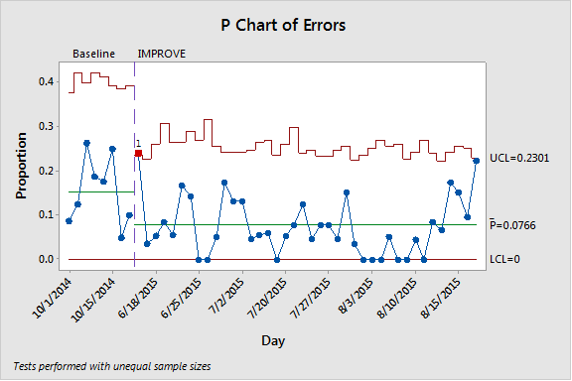
Control Charts
Of Process Inputs: Registration Errors-Orders do not match the status.

Slide 85
Control Charts
Of Process Inputs: Changing Inpatient status to Observation status without second level.

Slide 86
Standard Work Audit Plan
Only if appropriate

Slide 87
Procedures/Policies
List and examples of new or revised: N/A

Slide 88
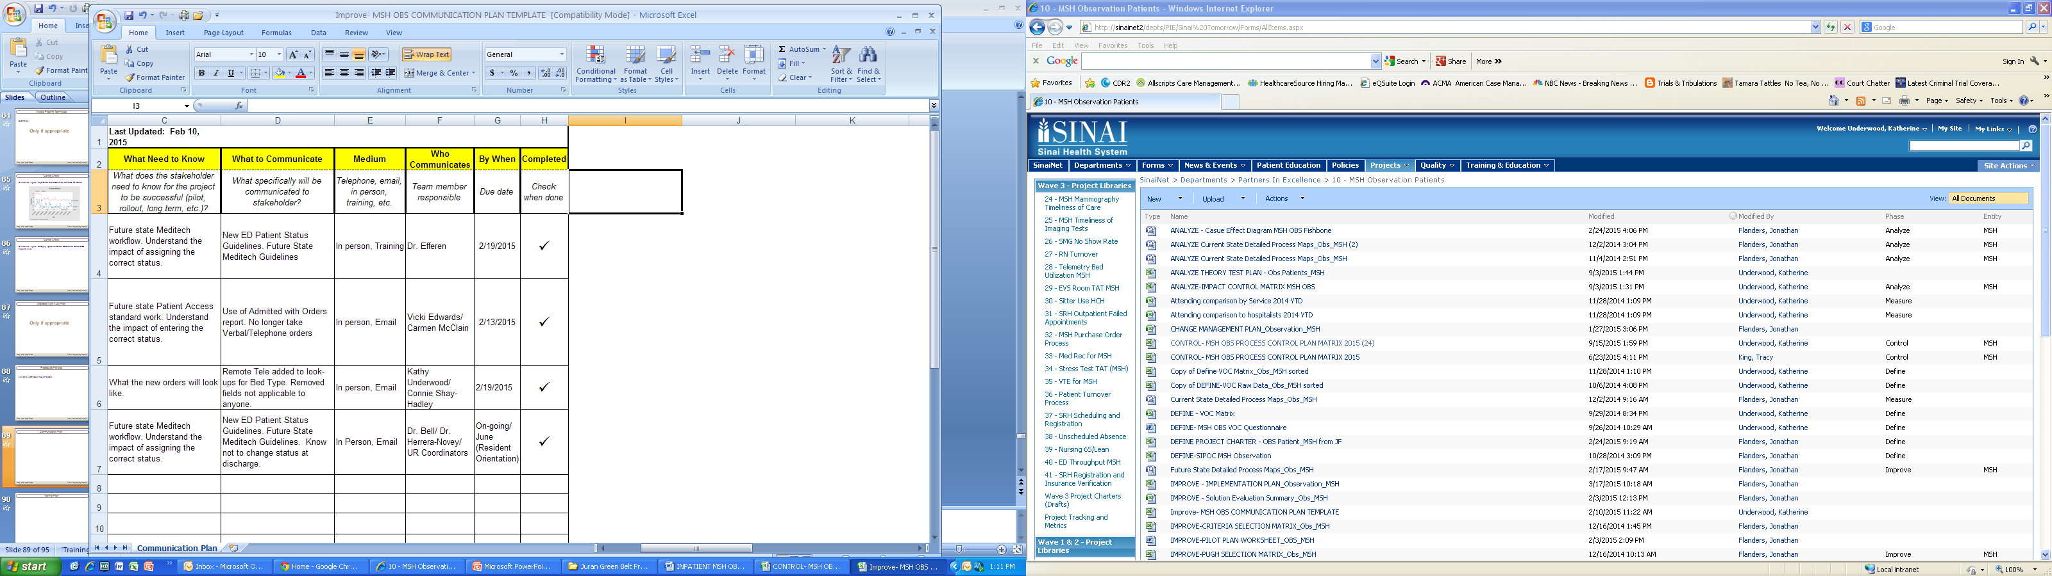
Communication Plan

Slide 89
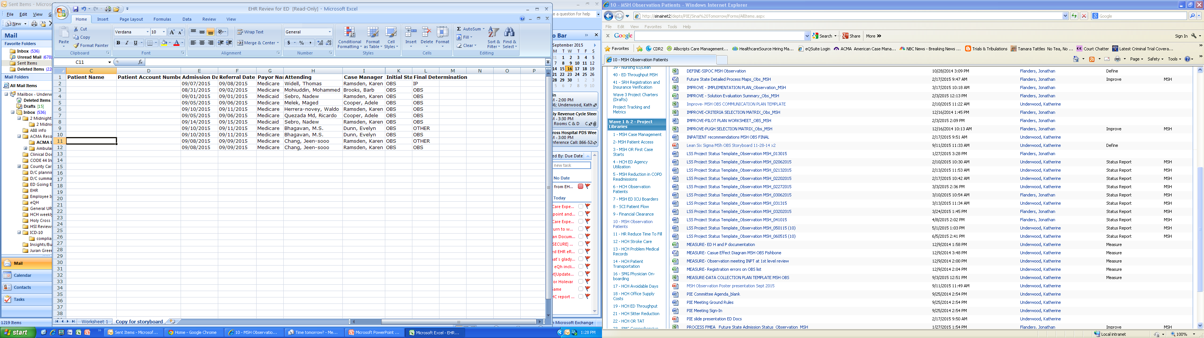
Training Plan
Example of Feedback report for ED Physicians for Changes in Status. (Patient Information removed)

Slide 90
Project Plan - Milestones and Timing
Project Milestones
Phase | Milestones | Target Start | Target Completion
Define | Establish project charter and team | September , 2014 | September , 2014
Measure | Create process map and collect required baseline data | October , 2014 | November , 2014
Analyze | Perform root cause analysis and test theories | December , 2014 | January , 2015
Improve | Identify, select, and implement solutions | January, 2015 | March, 2015
Control | Establish control plan to sustain results | March, 2015 | September , 2015

Slide 91
Project Results
 | Current | Goal | Actual
COPQ | Hard: $75,444 Soft: $5,934+ | $0 $3,956 | $16,765 $2,769
Relevant Metric | 15% | <10% | 7%
PPM (of DPMO) | 110,609 | 98,684 | 76,667
Sigma Level | 2.5 | 2.79 | 2.93

Slide 92
Measure Process Capability
 |  |  |  | enter | enter
Number Of Units Processed |  |  | n= | 152 | 600
Number Of Defect Opportunities | Per Unit |  | o= | 1 | 1
Total Count Of Defects Made | (Include Defects Made And Later Fixed) |  | c= | 23 | 46
Solve for Defects Per Opportunity DPO = c / (n*o) |  |  |  | 0.151316 | 0.076667
Solve For Defects Per Million Opportunities (DPO * 1,000,000) |  |  |  | 151,316 | 76,667
Look Up Process Sigma In Abridged Sigma Conversion Table |  |  | Sigma = | 2.53 | 2.93
Calculated by NORMSINV(1-DPMO/Million)+1.5

Slide 93
Lessons Learned
Need to have an accurate metric to validate that the problem is real
Realization of how problems exist through many functions/departments and processes in the system
Insurance companies are requiring more information to pay for services
Team participation – must have team member’s manager to support the time necessary to be productive
Admitting learned a lot about their opportunities to improve and employee satisfaction is up through error reduction
Having a well balanced committed team with strong executive oversight is critical to success.
Having accurate data from the beginning is key to the projects success.
Multidisciplinary teams are critical for everyone’s perspectives into the problem and ultimately finding a solution.
There were so many factors that contribute to an problem that initially appeared to be a clear cut issue.
In order to work on and complete a project successfully take a great deal of time and good documentation is key.

Slide 94
Control Phase Deliverables
Control | Complete
Control Plan (including employee self-control where appropriate) | Yes
Visual controls (as appropriate) | Yes
Mistake-proofing techniques (as appropriate) | N/A
Control Charts (as appropriate) | Yes
Standard Work Audit Plans (as appropriate) | Yes
List and examples of Procedures (created and/or updated documents, etc.) | Yes
Communication and Training Plans (and status) | Yes
Control chart(s) showing results and comparison of process performance (before vs. after implementation -- similar to Juran Trilogy chart) to indicate that the gains are held | Yes
Graphical (e.g. box plots) analysis to prove significance of improvement | Yes
Sustained results (metrics and COPQ) of Actual vs. Target vs. Baseline | Yes
Gate Review and Signoff on results by Champion and Finance | Yes
Updated Project Plan (timeline/Gantt chart) | Yes
Replication opportunities (if applicable) | N/A
Lessons learned | Yes
Project documentation | Yes

