Slide 1
Lean Six Sigma Green Belt
Project Report Presentation: Manufacuring Industry
Project Number: XXX
Project Name: Line 12 Shrink Capability Improvement
Project Team Leader: XXXX
Project Champion : XXXX

Slide 2
Define Phase
Right Project?
Right Team?

Slide 3
Problem Overview
Line 12 has both high shrink and low output since the installation of the new draw oven. The new oven replaced hot cans.
Currently approximately 48% of all lab checks are inside the specification range of 1.3% to 3.3%. Line 12 had 97.7% of all checks in spec in January.
Currently the line speed is 850 feet per minute. Engineering estimates that 970 feet per minute are required to meet plan.

Slide 4
Objective
End goals are fewer hold doffs, fewer rejected ends and increased pounds per day.
We hope to return to the previous level of performance on Line 12.
  97.7% First Quality
  970 Feet per Minute

Slide 5
Baseline, Goal and Savings
Off Quality and Waste cost $0.515 per pound
Since the draw oven was installed, we have had 2774 pounds of burn-off and waste per day - $1429 per day.
Returning to the original quality level will avoid costs of over $1000 per day.

Slide 6
Other impacts on customers and profits
High warp shrink variation causes significant problems in XYZ Plant in Chickamauga.
Standing Looms due to lack of usable product.

Slide 7
Project Scope
The project is limited to Line 12, product 1111 – Secondary Warp Yarn.

Slide 8
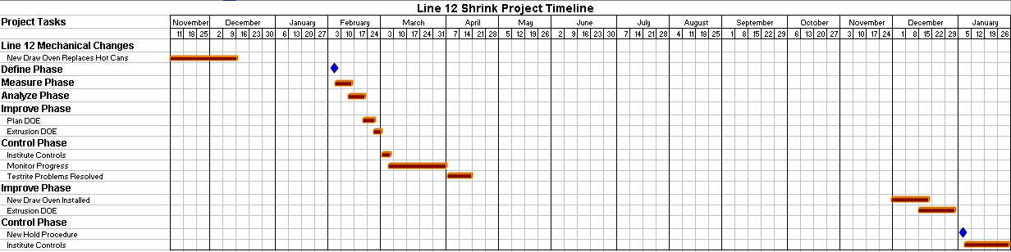
Project Timeline

Slide 9
Team Members
XXXX – Process Engineer
XXXX – Process Engineer
XXXX – Maintenance
XXXX – Technical Manager
XXXX – PCO

Slide 10
Primary Customer and Key Measure
Primary Customer – XYZ Plant in Chickamauga
Key Measures – Shrink, Elongation, Net Pounds per Day

Slide 11
Shrink Definition
Lengthwise contraction of warp yarn on exposure to elevated temperature.

Slide 12
Measure Phase

Slide 13
Top Downgrade Reasons
Shrink has suddenly spiked in February.

Slide 14
Lab Procedures
Four packages are sampled per doff.
The average shrink must be between 1.3 and 3.3.
The doff is accepted or burned off by the average specification.
Any individual packages that test out of spec are burned off.

Slide 15
Yarn Shrink by Week

Slide 16
Yarn Shrink by Week

Slide 17
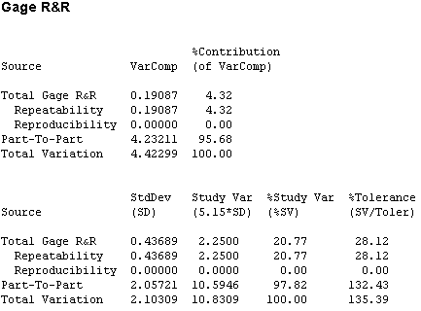
Shrink Tester R&R Test

Slide 18
Shrink Control Chart
Process lost control after installation of Draw Oven

Slide 19
Shrink Capability - January

Slide 20
Shrink Capability – February

Slide 21
Line 12 Process Flow
Control Points are Checked Once a Shift

Slide 22
Developing Potential Xs
The team brainstormed potential Xs that could effect shrink on Product 1111.

Slide 23
Analyze Phase
Y = f (x₁+x₂+x₃+...x_{n})
Let`s find the vital few X`s

Slide 24
Correlation of Shrink and Elongation
Conventional wisdom says that you cannot improve shrink without hurting elongation.
Lab data shows a weak relationship between the two.
Therefore, we may improve shrink without hurting elongation.

Slide 25
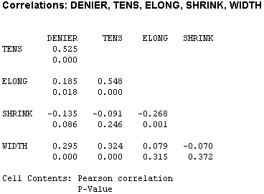
Other Correlations
No other criteria correlates to shrink.

Slide 26
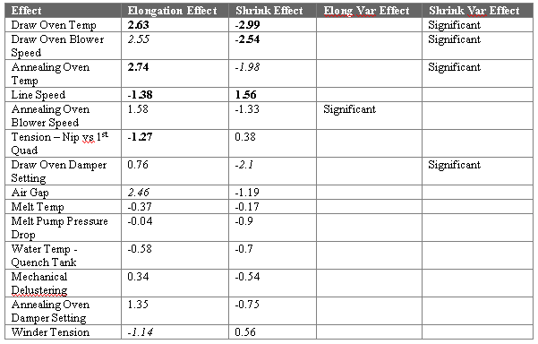
Plackett-Burman Screening DOE
A twenty-run Plackett-Burman screening DOE had been run previously to determine key process parameters.
Fourteen factors were investigated.
Effects in bold are significant at 95% confidence.
Effects in italics are significant at 90% confidence.
Effects were figured for both location and variation.

Slide 27
OFAT Testing – February 1997
There was also a considerable amount of One Factor at a Time testing in February.
This led to increased variation, but it also verified some expected important Xs:
Draw Oven Temp ↑ → Shrink ↓
Annealing Oven Temp ↑ → Shrink ↓ , Elongation ↑
Line Speed ↑ → Elongation ↓
Draw Oven Blower Speed greatly effects shrink variation
No significant effect demonstrated for air gap

Slide 28
Improve Phase

Slide 29
DOE
The team decided to try to improve performance with a Designed Experiment.
We employed a 2⁵⁻¹ fractional factorial design with one center run.
Six subsamples were evaluated per run.
The lab evaluated Shrink, Elongation, Denier, Tensile, Width and Modulus.

Slide 30
The Experiment
2⁵⁻¹ Factorial Experiment - 17 Test Runs
  Draw Oven Temperature (187 - 217)
  Annealing Oven Temperature (192 - 222)
  Air Gap (0.75 - 1.25)
  Tension - Nip vs First Quad (3 - 7)
  Melt Temperature (215 - 245) - Tied to Melt Pressure
Test Ran for 13 Hours

Slide 31
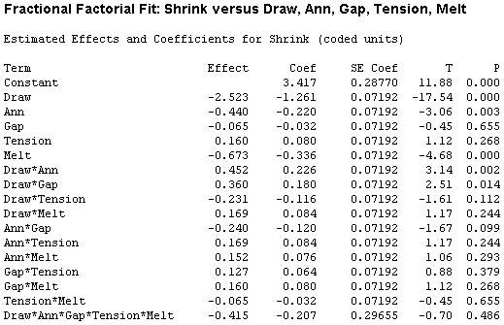
Significant Effects - Shrink
Draw Oven Temperature - Negative Relationship
Melt Temperature - Negative Relationship
Annealing Oven Temperature - Negative Relationship
Draw Oven x Annealing Oven Interaction
Draw Oven x Air Gap Interaction

Slide 32
Shrink – Main Effects
Increasing Draw Oven temperature decreases shrink.
Annealing Oven temperature and Melt Temperature are also significant.

Slide 33
Draw Oven – Annealing Oven Interaction
If the Draw Oven Temperature is high, the Annealing Oven temperature does not effect shrink.

Slide 34
Draw Oven – Air Gap Interaction
The Draw Oven Effect is different with different Air Gaps.

Slide 35
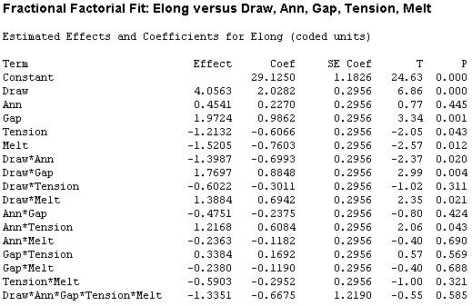
Significant Effects - Elongation
Draw Oven Temperature - Pos. Relationship
Air Gap - Positive Relationship
Melt Temperature - Negative Relationship
Tension - Negative Relationship
Draw Oven x Air Gap Interaction
Draw Oven x Annealing Oven
Draw Oven x Melt Temperature
Annealing Oven x Tension

Slide 36
Elongation – Main Effects
Draw Oven Temperature is the most significant main effect for Elongation. This effect is opposite of the Shrink Effect.
An increase in Melt Temperature reduces both shrink AND elongation.
Air Gap and Q1 Tension effect only Elongation.

Slide 37
Prediction Equations
Prediction equations were created for all six physicals using multiple regression.
An optimal region was determined that simultaneously optimized all six physicals.
Line performance was also considered in optimal region selection.
Tests for curvature were not significant.

Slide 38
Curvature is not Significant

Slide 39
Residual Analysis – Shrink
There are no major violations of assumptions for the fitted Shrink model.
Residual Analysis was performed for all six physicals.

Slide 40
Next Steps
Set Optimal Settings and Evaluate Long Term
Fix Operating Parameters throughout Evaluation
Seek Corrective Actions without Changing Operating Parameters
Experiment with Faster Line Speeds

Slide 41
Control Phase

Slide 42
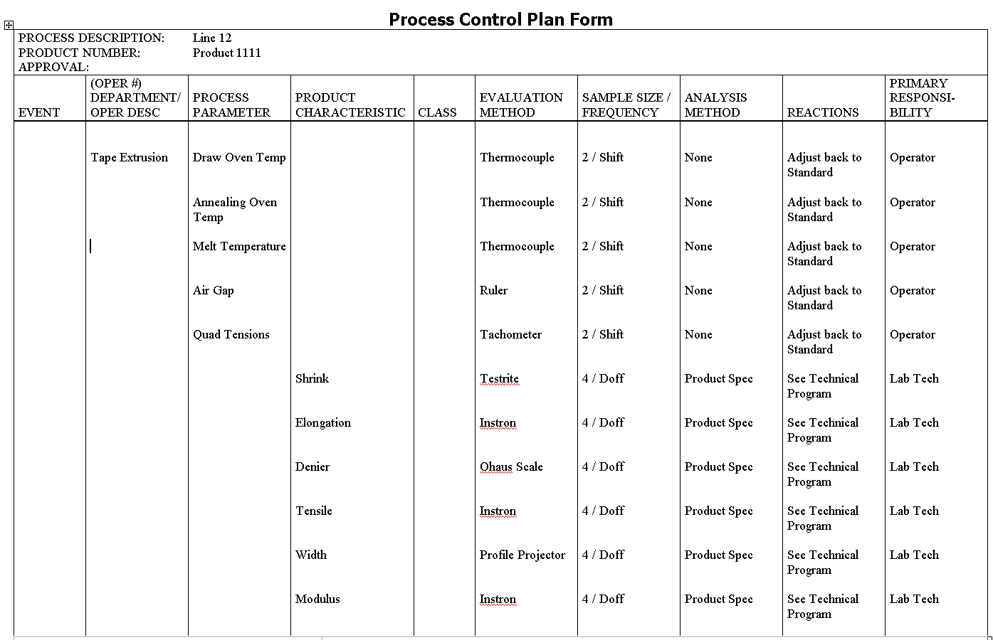
Control Plan

Slide 43
Top Downgrade Reasons by Specification

Slide 44
Process Control Chart – April
Line 12 is back in control – well within the upper spec limit of 3.3.

Slide 45
Process Capability (Averages)– April

Slide 46
Shrink Yield

Slide 47
Line Speed
The results show that we can run at lower temperatures and produce yarn in spec while decreasing the melt density of the extrudate – thereby increasing the outputs.
Potential added output – 400,000 lbs / year.

Slide 48
Savings
Savings was estimated at $32,831 per month.
April was even better, so the goal of $1000 cost avoidance per day was easily met.

Slide 49
Postscript
This was the end of that project.
However there were still two more issues.
  XYZ Plant (the customer) still thought that the Chattanooga yarn had high shrink.
  Now that the line was running better, we wanted even more speed.

Slide 50
Interlab Studies
Every quarter, the same packages of yarn were tested at each facility. Not having calibrated standards, the best way to ensure accuracy, was to show that the labs agreed.
An audit of interlab studies showed a critical analysis flaw.
  A homemade Excel program had an incorrect “IF” statement. The program returned “No Statistical Difference” for ALL p-values. The Lab Manager never plotted the data.
Upon reworking the data, a significant difference occurred way back in February of the previous year.
XYZ Plant actually had the problem!

Slide 51
Problem Solved
A recalibration of the heat source brought the gages back in agreement.
Many XYZ Plant processes had to be adjusted.

Slide 52
Tampering
In the desire for more pounds for Line 11, we continued to increase speeds.
This led to more variation and off-quality.

Slide 53
New Equipment DOE
In December, we purchased a new screw and draw oven that would allow for increased line speeds.
We also ran another DOE. This time to improve runnability conditions as well as to improve physicals. The factors were the same, except tension was replaced by Draw Oven Blower Speed.
Once again we developed prediction equations and optimal settings.

Slide 54
DOE Conclusions
Can’t run high Draw Oven Temperature with High Blower Speed – the line falls.
Can’t run low Draw Oven Temperature with Low Blower Speed – Shrink is too high.
Low Blower Speed increases variability.
Wide Air Gap and Low Draw Oven Temperature helps runnability.

Slide 55
New Performance Standard
With the new equipment and the new DOE, we virtually eliminated shrink as a downgrade reason.

Slide 56
New Control Plan
The control plan remained largely unchanged, except for process settings.
One additional improvement was making process change decisions based on SPC rather than out-of-specification conditions.
I-MR-R charts had always been in use for Denier, Shrink and Elongation. Now the SOP was changed to mandate changes ONLY when the chart predicted them, not based on out-of-spec conditions.

Slide 57

New Control Plan

Slide 58
Line Output
While the target line speed was not quite met, the increased ends and improved first quality brought the available pounds close to the target.
Line 12 was never able to process at the standard speed specified before installation. However, decreased waste allowed us to achieve target standard costs.
Savings estimates were presented earlier.

