Slide 1

Six Sigma Green Belt
Project Report Presentation: Food Industry
Project Number: 7
Project Name: Fixed Assets CER Defect Reduction
Project Team Leader: XXXX, XXXX
Project Champion(s): XXXX, XXXX

Slide 2
Six Sigma Roadmap
Define
Measure
Analyze
Improve
Control

Slide 3
Operational Definitions of Key Terms
Term 1: CER – Capital Expenditure Request
Term 2: CST – Contract Spend Type (refers to a type of CER)
Term 3: BSU – Business Service Unit
Term 4: GBS – Global Business Services (shared service center for ABC Company)
Term 5: PC – Profit Center (an ABC Company location)
Term 6: RFD – Regional Finance Director
Term 7: CAP-FADL – Capitalized to the Fixed Asset Detail List (possible contract spend type selection for CER)
Term 8: SOX – Sarbanes-Oxley (legislation related to internal control over financial reporting)
Term 9: OPEx – Operational Excellence Team

Slide 4
Problem & Goal
Problem Statement: On a monthly basis, GBS FA teams process 800-900 CERs. The defect rate of these requests is 77%. Defective CERs must be returned or followed up on in order to request additional information or corrections. This leads to delays in the capitalization of assets.
Goals/Objective(s): Reduce the defect rate of CERs to 35% by the end of Q2 FY 2017

Slide 5
Project Scope
In Scope: All capital expenditures requests (CERs) received and reviewed by GBS within the Service Management system.
Items Out of Scope: Capital expenditure requests (CERs) not received by GBS for review within the Service Management system.

Slide 6
Project Justification and Expected Results
Relevant Metrics: current % of CERs closed by GBS with no defects – 77.65%
Improvement targets: lower % of CERs closed with no defects – 35%
Operational/Strategic Impact: Reducing the CER defect rate will accelerate the asset capitalization process, reduce re-work time, increase the capacity of an FTE on the FA team, and allow the team to redeploy that time to be used in more productive ways. Additionally, reducing the defect rate will mitigate the risk associated with circumventing key SOX controls and approval levels in the CER submission process.

Slide 7
Financial Impact: Business Case or COPQ Calculation
 | Current | Goal
Annual CERs submitted | 10,767 | 10,767
Observed Defective Rate | 77.65 % | 35.00 %
Avg rework time on defective CER | 0.75 hours | 0.75 hours
Avg Hourly Wage | $28.00 per hour | $28.00 per hour
Known GBS COPQ | $ 175,571.56 | $ 79,137.45
Estimated Field COPQ* | $ 175,571.56 | $ 79,137.45
Total COPQ | $ 351,143.12 | $ 158,274.90
Current COPQ - $ 351,143.12)
less Goal COPQ - ($ 158,274.90)
Savings COPQ - $ 192,168.22)
*COPQ in ABC Company Field locations is estimated to be equivalent to the COPQ at GBS

Slide 8
Project Team Membership
Project Champion: XXXX – Associate Vice President
Project Team Leader: XXXX – Business Analyst
XXXX – Accounting Director
Project Core Team Members: XXXX – Fixed Assets Manager
XXXX – Fixed Assets Lead
XXXX – Fixed Assets Lead
XXXX – Fixed Assets Lead
Ad Hoc Members or SMEs: XXXX – Refreshments OPEx

Slide 9
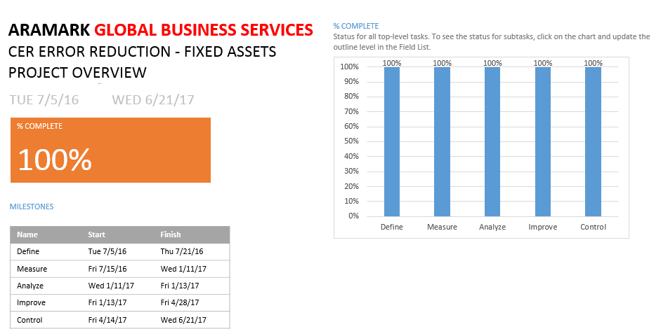
Project Plan- Milestones and Timing

Slide 10
Voice of Customer to CTQ Analysis

Slide 11
High Level
Process Map
(SIPOC)

Slide 12
Six Sigma Roadmap
Define
Measure
Analyze
Improve
Control

Slide 13
Project Y (or Ys) in Y=f(x)
Y = % of CERs that can be completed successfully as they are originally received by the GBS Fixed Assets team.

Slide 14
Detailed Process Map

Slide 16
Plan for Data Collection

Slide 17
Measure Process Capability
Issue | Solution
Mechanism for flagging defective CERs did not exist | Standardized notation system developed to be utilized in CER work notes field
Documented process and standard for reviewing CERs did not exist | Created training documents: Revamped process map Standardized Desktop Procedure Standardized Decision Tree/Checklist
Appraisers prone to skipping process steps during CER review | Standardized checklist tool developed to force all steps to be completed prior to output of defect code (mistake proof)
Appraisers prone to interpreting CERs against standard differently than one another | Continual adjustments made to Standardized Decision Tree/Checklist to further clarify process Allowed appraisers to work in pairs to simulate ability to ask someone a question in the GBS open office environment
Measurement System Analysis:
  Multiple issues encountered during MSA phase.
  8 MSA trials were required to successfully complete this phase with learnings taken from each trial to drive improvements in the next.

Slide 18
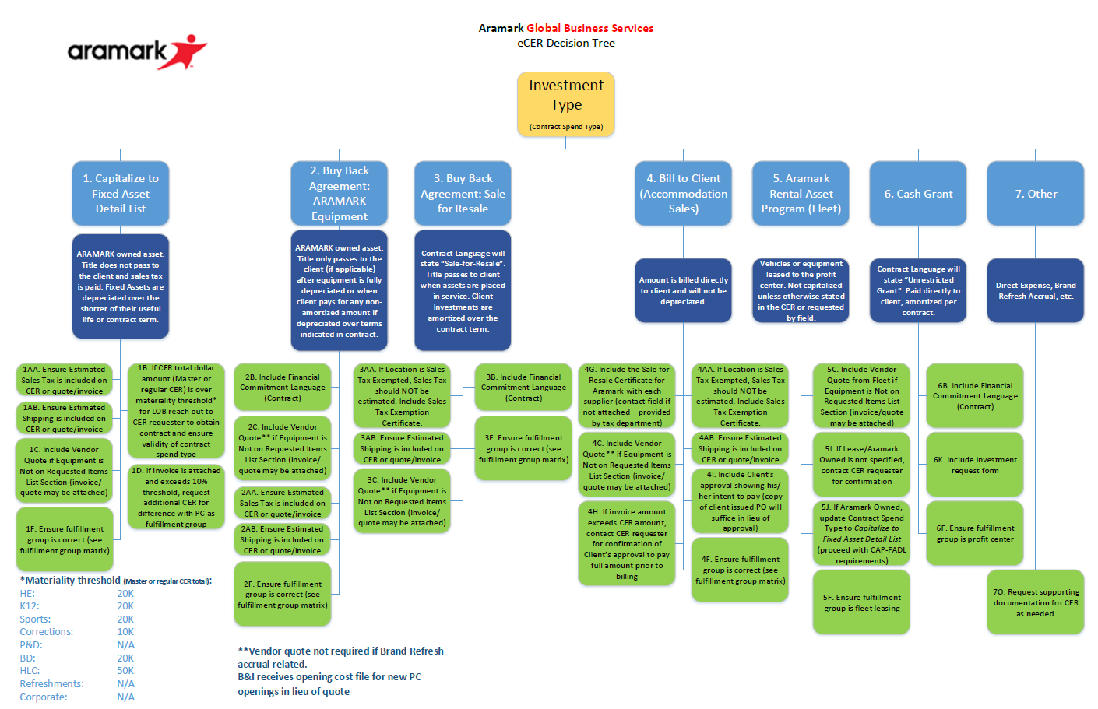
Validate Measurement System
Decision Tree now used to help visualize requirements while reviewing CERs.

Slide 19
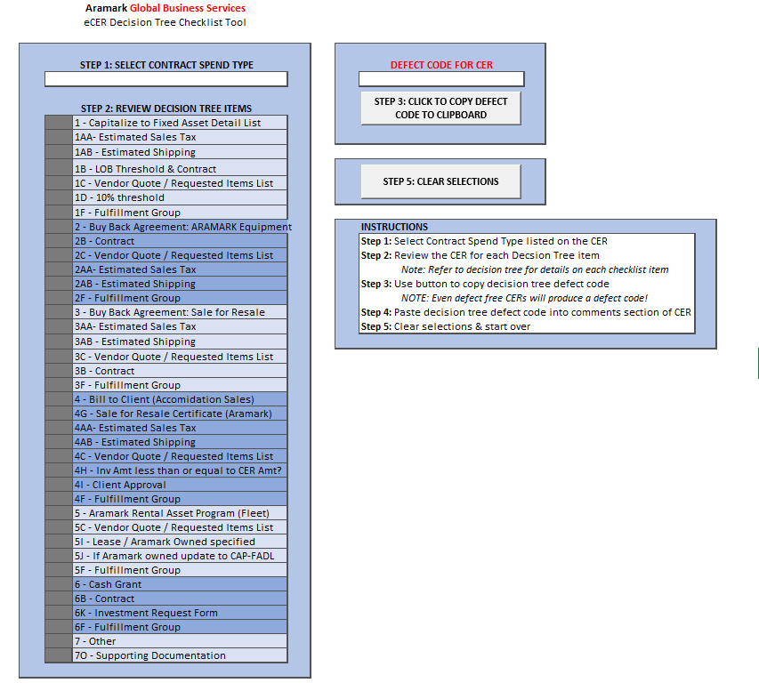
Validate
Measurement
System
Mistake proof checklist tool now used within Service Management System while reviewing CERs.
This tool produces a defect code that is used to track CER defects.

Slide 20
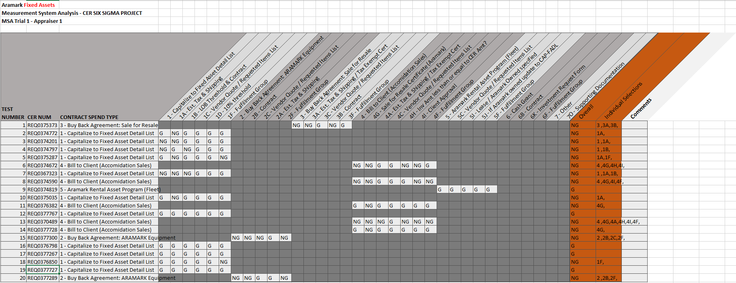
Validate Measurement System
MSA Instructions to Appraisers:
Sample of 20 CERs
Select an action taken on the CER
Provide the appropriate notation from the standardized list
Standardized form for data collection during MSA – Same concept as checklist tool.

Slide 21
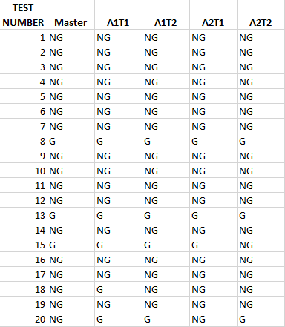
Validate
Measurement System
Measurement System Analysis – Results
KEY
G = CER STATUS: G
NG = CER STATUS: NG

Slide 22
Validate Measurement System
Measurement System Analysis - Minitab Graph

Slide 23
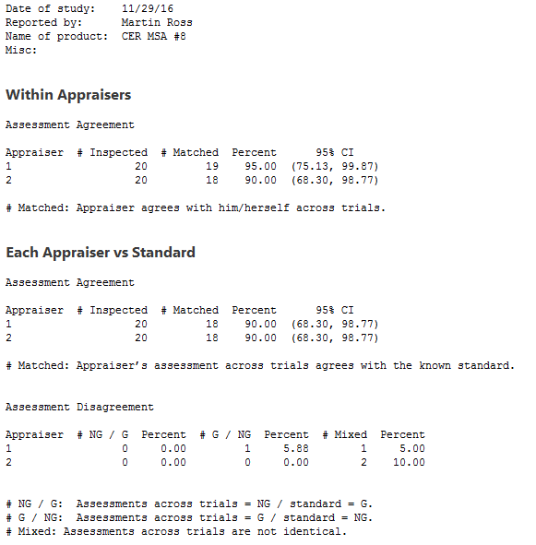
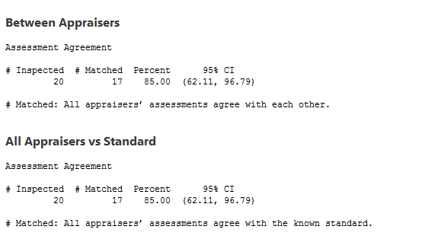
Validate Measurement System
Measurement System Analysis - Minitab Session Results

Slide 24
Validate Measurement System
Measurement System Analysis - Conclusions
Appraisers were consistent with themselves 95% and 90% of the time.
The appraisers agreed with each other 85% of the time.
Appraisers agreed with the standard 90% and 90% of the time.
In total both appraisers agreed with the standard 85% of the time.
The conclusion is the measurement system analysis passed and the system is valid.

Slide 25
Measure Process Capability

Slide 26
Measure Baseline Performance
Current:
COPQ: $ 175,571.56 (Known GBS)
$ 175,571.56 (Estimated Field)
$ 351,143.13 Total
Relevant Metric: 77.65% defective submission rate
PPM (or DPMO): 210,471
Sigma Level: 2.30
Goal:
COPQ: $ 79,137.45 (Known GBS)
$ 79,137.45 (Estimated Field)
$ 158,274.90 Total
Relevant Metric: 35.00% defective submission rate
PPM (or DPMO): 94,868
Sigma Level: 2.81

Slide 27
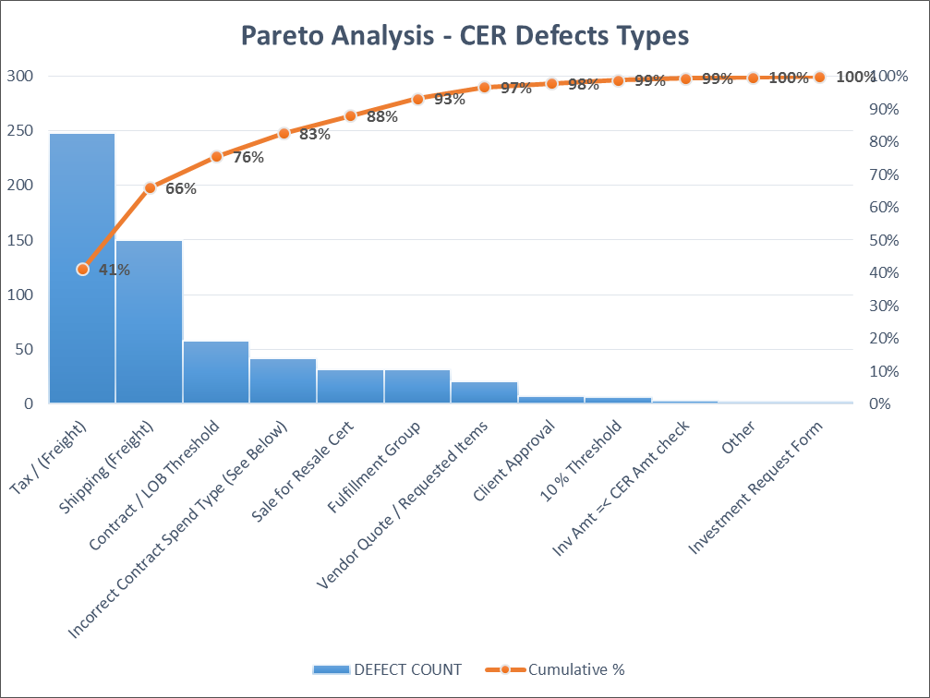
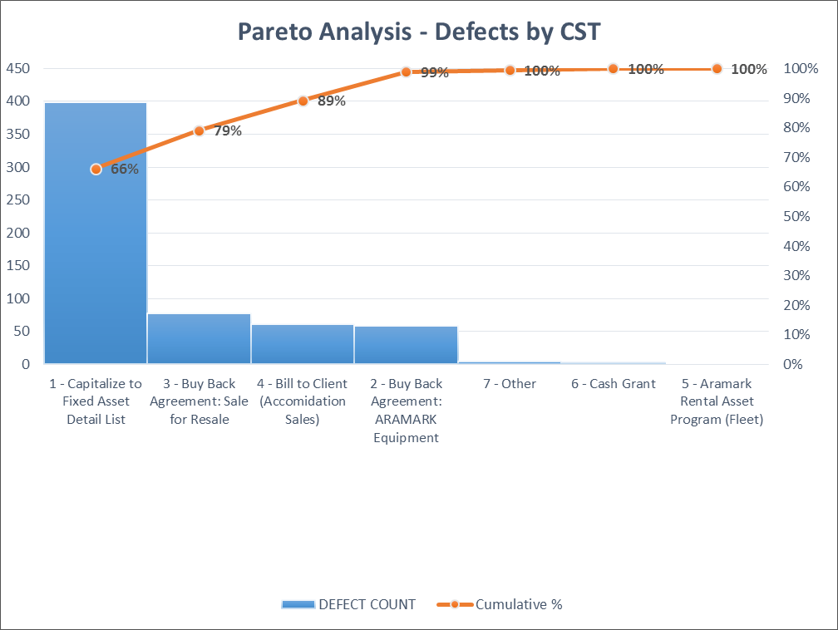
Graphical Analyses

Slide 28
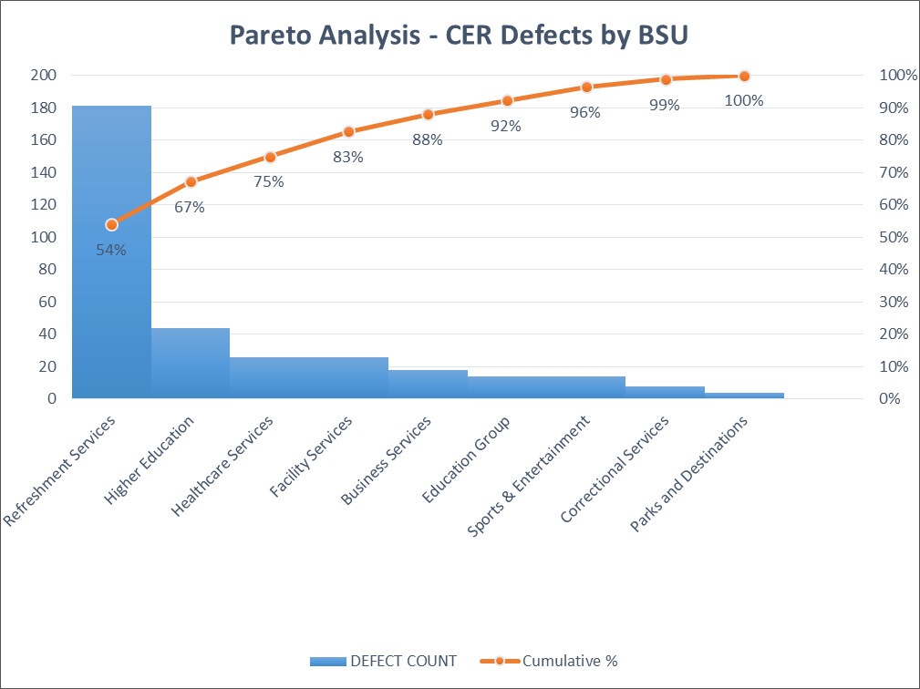
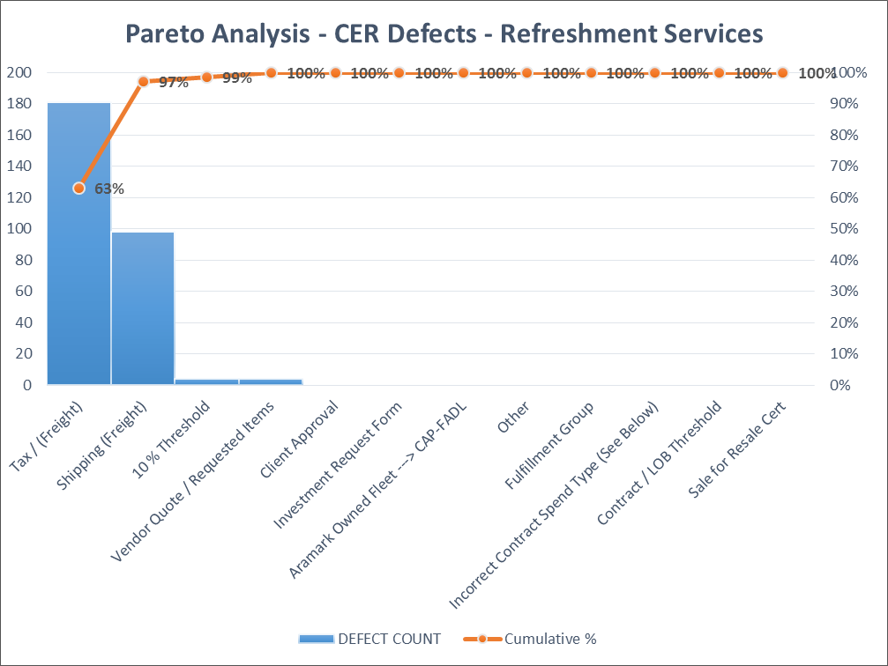
Graphical Analyses

Slide 29
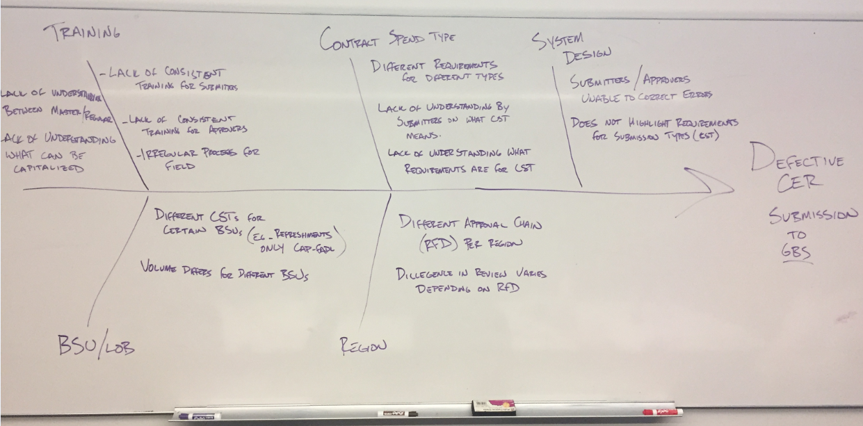
Cause-Effect Diagram(s)

Slide 30
Process FMEA

Slide 31
Potential Xs—Theories To Be Tested
X₁: CER quality differs for each BSU
X₂: Diligence in review varies depending on RFD (region)
X₃: CER quality differs for each PC
X₄: CER quality differs for each CST
X₅: Different CSTs for different BSUs (e.g. Refreshments only CAP-FADL)
X₆: High dollar CERs are more accurate than low dollar CERs

Slide 32
Six Sigma Roadmap
Define
Measure
Analyze
Improve
Control

Slide 33
Potential Xs—Theories To Be Tested
X₁: CER quality differs for each BSU
X₂: Diligence in review varies depending on RFD (region)
X₃: CER quality differs for each PC
X₄: CER quality differs for each CST
X₅: Different CSTs for different BSUs (e.g. Refreshments only CAP-FADL)
X₆: High dollar CERs are more accurate than low dollar CERs

Slide 34
Data Collection Plan for Analyze Phase

Slide 35
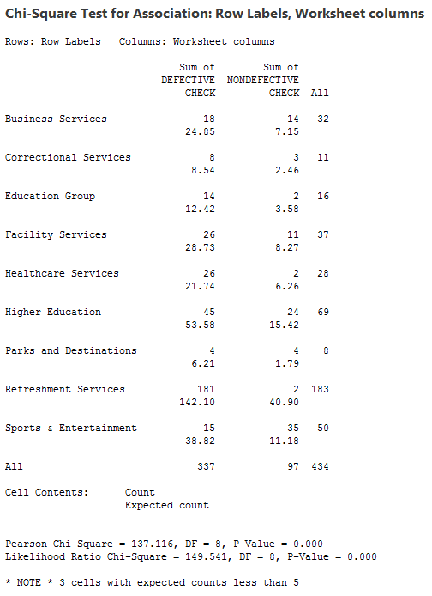
Test of Theories X₁
Theory: CER quality differs for each BSU
H_{o}: Quality is independent of BSU
H_{a}: Quality is dependent of BSU
Analysis:
Statistical Conclusion: P = 0.000, therefore reject the null-hypothesis
Practical Conclusion: Some BSUs are more defect prone than others. Specifically the Refreshments Services BSU has a defect rate much higher than that other BSUs.

Slide 36
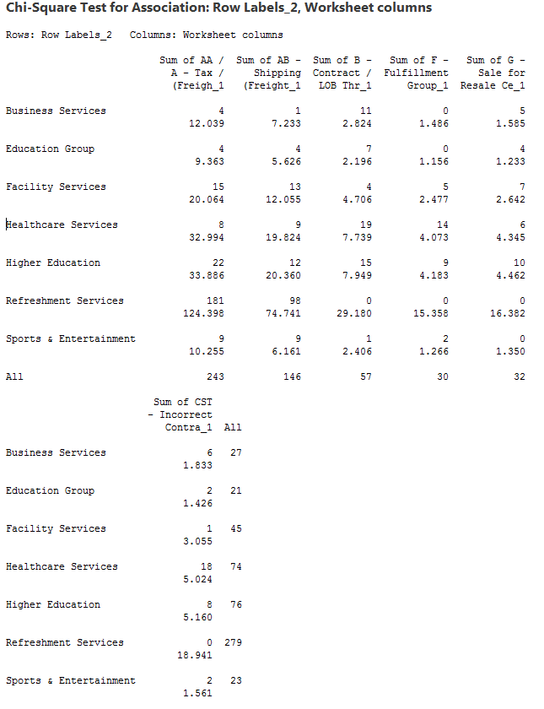
Test of Theories X₁
Theory: CER quality differs for each BSU
H_{o}: CER defect type rate is the same for each BSU
H_{a}: CER defect type rate is different for each BSU
Analysis:
Statistical Conclusion: P = 0.000, therefore reject the null-hypothesis
Practical Conclusion: Some BSUs are more prone to certain types of defects than other BSUs. Specifically the Refreshments Services BSU has a higher rate than other BSUs for tax and freight defect types.

Slide 37
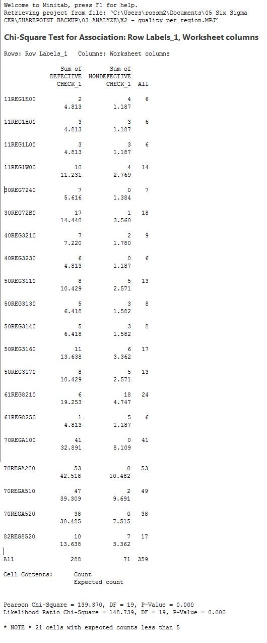

Test of Theories X₂
Theory: Diligence in review varies depending on RFD (region)
H_{o}: Quality is independent of Region
H_{a}: Quality is dependent of Region
Analysis:
Statistical Conclusion: P = 0.000, therefore reject the null-hypothesis
Practical Conclusion: Certain regions are more defect prone than others. Specifically the Refreshment regions have a defect rate much higher than the others.

Slide 38

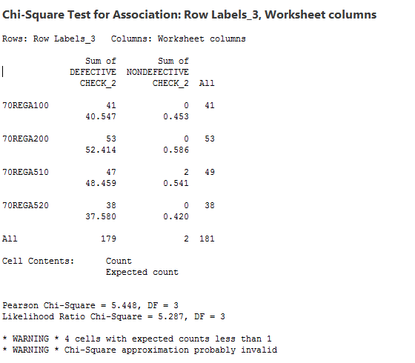
Test of Theories X₂
Theory: Diligence in review varies depending on RFD (region)
H_{o}: Quality is independent of Refreshment Services Region
H_{a}: Quality is dependent of Refreshment Services Region
Analysis:
Statistical Conclusion: Not enough non-defective CERs observed to carry out test, fail to reject the null hypothesis
Practical Conclusion: All Refreshments regions submit defective CERs at statistically similar rate (>98% defective rate observed), therefore no one region is better or worse than the others.

Slide 39

Test of Theories X₃
Theory: Some PCs submit more defects than others
H_{o}: Quality is independent of PC
H_{a}: Quality is dependent of PC
Analysis:
Statistical Conclusion: Insufficient sample size for each PC, unable to come to sound statistical conclusion.
Practical Conclusion: Some PCs may be more defect prone than others, but it is difficult to statistically conclude because CER submission is an irregular process and we are unable to collect a sufficient sample size for each PC.

Slide 40
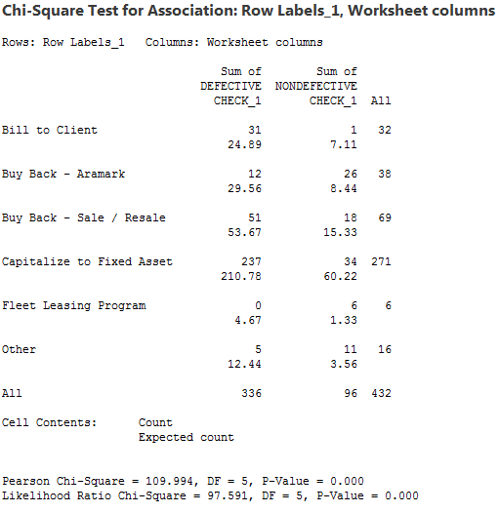
Test of Theories X₄
Theory: Some CSTs are more defect prone than others
H_{o}: Quality is independent of CST
H_{a}: Quality is dependent of CST
Analysis:
Statistical Conclusion: P = 0.000, therefore reject the null-hypothesis
Practical Conclusion: Some CSTs are more defect prone than others. Specifically CAP-FADL has a higher defect rate than the other CSTs.

Slide 41
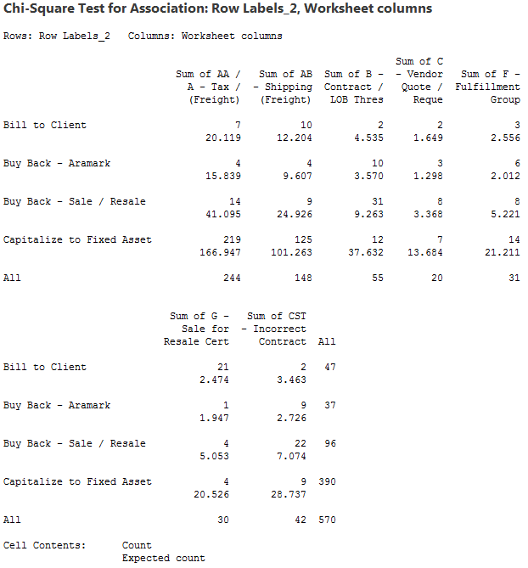
Test of Theories X₄
Theory: Some CSTs are more defect prone than others
H_{o}: CER defect type rate is the same for each CST
H_{a}: CER defect type rate is different for each CST
Analysis:
Statistical Conclusion: P = 0.000, therefore reject the null-hypothesis
Practical Conclusion: Some CSTs are prone to certain defect types more than others. Specifically CAP-FADL has a higher rate of tax and freight defect types than the other CSTs.

Slide 42
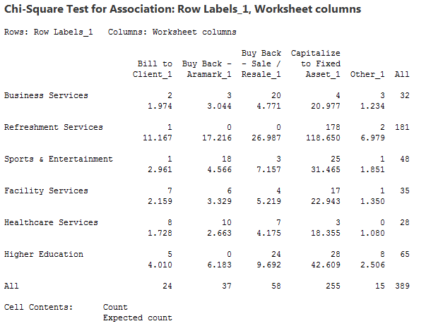
Test of Theories X₅
Theory: Different BSUs submit certain CSTs more often than other BSUs
H_{o}: CST type selection is independent of BSU
H_{a}: CST type selection is dependent of BSU
Analysis:
Statistical Conclusion: P = 0.000, therefore reject the null-hypothesis
Practical Conclusion: Some BSUs submit more of one type of CST than other BSUs. Specifically, Refreshments submits more CAP-FADL CERs than other BSUs

Slide 43
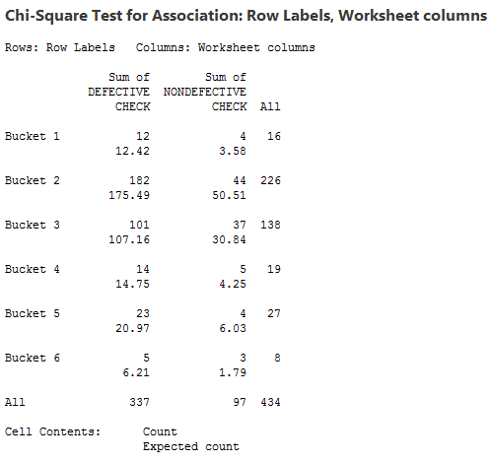
Test of Theories X₆
Theory: High dollar CERs are less defective than other CERs
H_{o}: Quality is independent of CER dollar amount
H_{a}: Quality is dependent of CER dollar amount
Analysis:
Statistical Conclusion: P = 0.445, therefore fail to reject the null-hypothesis
Practical Conclusion: High dollar CERs are no less error prone than low dollar CERs

Slide 44
Summary of Testing Results
X₁: Some BSUs are more defect prone than others (e.g. – Refreshment Services). Some BSUs are more prone to certain types of defects than other BSUs.
X₂: Certain regions are more defect prone than others (e.g. - Refreshment Services Regions). Any one Refreshment Services region is no more defect prone than another Refreshment Services region.
X₃: Unable to statistically conclude if certain PCs are more defect prone than others.
X₄: Some CSTs are more defect prone than others (e.g. – CAP-FADL). Some CSTs are prone to certain defect types more than other CSTs (e.g. – CAP-FADL is more prone to tax and freight defect types).
X₅: Some BSUs submit more of one type of CST than other BSUs (e.g. Refreshment Services submits more CAP-FADL).
X₆: CER dollar amount has no statistical impact on the defective rate of CERs.

Slide 45
Vital Few Xs
Y=f(X₁,……X_{n})
Vital Few Xs are:
X_{1a} Some BSUs are more defect prone than others.
X_{1b}: Some BSUs are more prone to certain types of defects than other BSUs.
X_{4a}: Some CSTs are more defect prone than others
X_{4b}: Some CSTs are more prone to certain defect types than other CSTs.
X₅: Some BSUs submit more of one type of CST than other BSUs.

Slide 46
Six Sigma Roadmap
Define
Measure
Analyze
Improve
Control

Slide 47
Improvement Strategies for Proven Xs
Proven Xs (Causes): | Strategies:
X_{1a}: Some BSUs are more defect prone than others. X_{1b}: Some BSUs are more prone to certain types of defects than other BSUs. X_{4a}: Some CSTs are more defect prone than others X_{4b}: Some CSTs are more prone to certain defect types than other CSTs. X₅: Some BSUs submit more of one type of CST than other BSUs. | X_{1a}: Target Refreshments BSU for overall improvement via training X_{1b}: Target Refreshments BSU for tax / freight improvement via training X_{4a}: Create training specifically for CAP-FADL CST requirements X_{4b}: Emphasize training for tax / freight requirements on CAP-FADL CST. Force select fields to be required in CER submission system. X₅: Focus Refreshments BSU training on CAP-FADL CER requirements.

Slide 48
Descriptions of Possible Solutions (Pros and Cons)
Include descriptions of possible solutions, and the pros and cons of each here:
Possible Solution: | Strengths (Pros): | Weaknesses (Cons):
Training for Refreshment Services | Addresses the BSU with the highest overall submission volume and highest overall defect rate; does not involve IT changes | Does not address entire CER population; does not systemically prevent defects
Training for all BSUs | Addresses entire CER population; does not involve IT changes | More time consuming; does not focus on most defect prone areas; does not systemically prevent defects
IT System changes to Service Management for required fields | Systemically prevents defects from occurring | IT changes are more time consuming; involves approval from multiple parties in organization (IT, Canada, etc.); necessitates training on requirements- not a stand alone solution
IT System changes to make Tax/Freight required field for CAP-FADL | Addresses highest volume defect type | Does not address all defect types. Requires broad communication of changes.

Slide 49
Evaluation Using Pugh Concept Selection Matrix

Slide 50
Pay-off Matrix of Selected Solutions
Selected Solutions
Training for Refreshment Services
Training for all BSUs
IT System changes to Service Management for required fields
IT System changes to make Tax/Freight required field for CAP-FADL (Mistake Proofing)
 |  | Effort
 |  | Low | High
Benefit | High | Pursue | Re-scope / Reconsider
 | Low | Eliminate | Eliminate
A
C
B
D

Slide 51
Selected Solutions
Decision: All solutions worth exploring in a phased approached.
Solution | Comments
Phase 1: Training for Refreshment Services | Lowest effort solution with the highest benefit
Phase 2: IT System changes to make Tax/Freight required field for CAP-FADL (Mistake Proofing) | Mistake Proofing #1 defect type will require minimal IT effort and yield significant results
Phase 3a: IT System Changes to Service Management for required fields | Requires significant IT resource involvement
Phase 3b: Training for all BSUs | Will be necessary to support Phase 3a, significant outreach required

Slide 52
Selected Solutions
Phase 1 Solution: Training for Refreshment Services
Observations:
    54% of observed defects from total population
    98% defective rate for Refreshment Services CER submissions
    99% of observed defects related to Tax/Freight for CAP-FADL
    Tax/Freight requirements not originally included in training for Refreshment Services
Solution Details:
    Update Refreshment Services training documents to include Tax/Freight requirements
    Produce Tax-Warehouse matrix for estimating tax
    Provide guidance on estimating freight

Slide 53
Pilot/DOE - Phase 1
Pilot Participants: Refreshment Services Central Region
Training Offered: 3/20 & 3/22
Expectation of compliance to new changes once training is completed
Data Collection: 3/22 – 4/28
Pilot Description: The Refreshment Services CER training was revamped to include a new slide that outlines the step of estimating tax and freight.

Slide 54
Updated Process Map(s) – Phase 1
Only update to process map

Slide 55
Implementation Plan – Phase 1
Phase 1 Participants: Remaining Refreshment Services Regions
Targeted Training:
    Refreshments Users: May Refreshments Operator’s call – 5/15
    GBS Users: GBS FA Refreshments – 5/15
Expectation of compliance to new changes once training is completed
Description: The Refreshment Services CER training will be delivered to the remaining regions. The intention is to repurpose a standing monthly call with the operators, who are the primary users raising CERs. The training material will also be posted to the Refreshment Services Procurement Website as reference material.

Slide 56
Implementation Plan – Phase 1
Task Name | Duration | Start | Finish | % Complete
Phase 1 - Refreshment Services | 118 days | Wed 1/18/17 | Fri 6/30/17 | 58%
Phase 1 - Pilot | 73 days | Wed 1/18/17 | Fri 4/28/17 | 100%
Training Development | 13 days | Wed 1/18/17 | Fri 2/3/17 | 100%
Communicate with Central Region Stakeholders | 5 days | Mon 2/6/17 | Fri 2/10/17 | 100%
Kickoff with Central Region Stakeholders | 3 days | Mon 3/20/17 | Wed 3/22/17 | 100%
Data collection | 30 days | Mon 3/20/17 | Fri 4/28/17 | 100%
Phase 1 - Remaining Regions | 40 days | Mon 5/8/17 | Fri 6/30/17 | 0%
Communicate with Region Stakeholders | 1 day | Mon 5/8/17 | Mon 5/8/17 | 0%
Kickoff with Region Stakeholders | 1 day | Mon 5/15/17 | Mon 5/15/17 | 0%
Data collection | 35 days | Mon 5/15/17 | Fri 6/30/17 | 0%

Slide 57
Updated Process FMEA

Slide 58
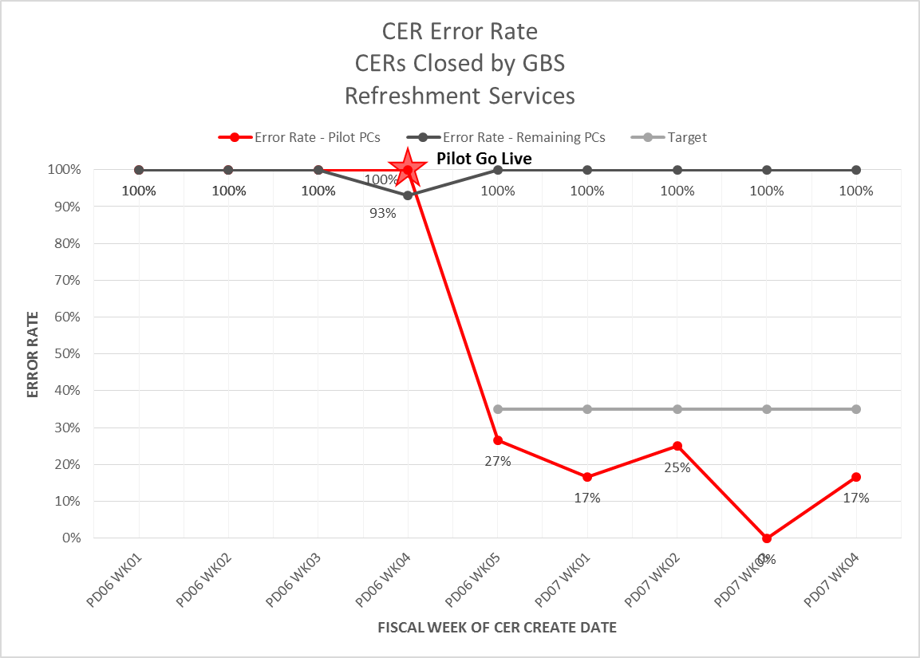
Statistical Proof of Improvements – Phase 1 Pilot

Slide 59
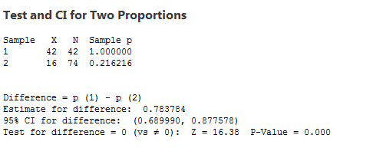
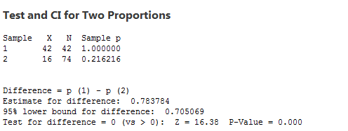
Statistical Proof of Improvements – Phase 1 Pilot
2 Proportion Test
Sample 1: Pilot sites’ defective CERs – 4 weeks prior to pilot kick-off
Sample 2: Pilot sites’ defective CERs – 4 weeks post pilot kick-off
Theory: Sample 2 defective rate is less than Sample 1 defective rate
H_{o}: Difference = p(1) – p(2) = 0
H_{a}: Difference = p(1) – p(2) ≠ 0 or Difference = p(1) – p(2) > 0
Analysis:
Statistical Conclusion: P = 0.00, therefore reject the null-hypothesis, the defective rate in sample 2 is lower than the defective rate in sample 1
Practical Conclusion: The defective rate of the pilot sites was lowered as a result of the changes made by the pilot solution
Sample | X | N | p
1 | 42 | 42 | 1.000
2 | 16 | 74 | 0.216

Slide 60
Six Sigma Roadmap
Define
Measure
Analyze
Improve
Control

Slide 61
Control Plan

Slide 62
Procedures/Policies
Procedure / Policy | Status
GBS FA CER Review Process Maps | Revised
GBS FA CER Review Desktop Procedure | Revised
GBS FA CER Review Requirements (Decision Tree) | New
GBS FA CER Review Checklist Tool | New
Refreshments CER Submission Instructions | Revised

Slide 63
Communication Plan

Slide 64
Training Plans
Audience | GBS Fixed Assets | Refreshments Operators | GBS Fixed Assets - Refreshments
Training Purpose | Training CER requirements by Contract Spend Type | Estimate Tax & Freight Training | Rejection of Refreshments CER for lack of Tax & Freight
Training Date | 12/9/16 Ongoing for new employees as part of GBS Fixed Assets onboarding | 5/15/17 Ongoing for new employees as part of Operator onboarding | 5/15/17
Training Method | In person training class | Virtual training session | In person training session
Training Materials | Standardized Procedures Decision Tree Checklist tool | Revised Refreshments CER submission instructions | N/A

Slide 65
Control Charts – Phase 1 Pilot Results

Slide 66
Control Charts – Extrapolated Phase 1
Extrapolated Results: Pilot results extrapolated across all Refreshments Services CERs. Impact to total population CER defect rate (all BSUs) depicted above.

Slide 67
Updated Process Capability

Slide 68
Project Results
 | Project Baseline: | Project Target: | Project Actual - Pilot: | Project Actual – Extrapolated Phase 1:
COPQ Savings | $ 351,143.13 -- | $ 158,274.90 $ 192,168.22 | $ 256,224.45 $ 94,918.68 | $ 173,424.07 $ 177,719.06
Metric | 77.65% | 35.00% | 56.66% | 38.35%
DPMO | 227,923 | 94,868 | 166,130 | 112,444
Sigma Level | 2.25 | 2.81 | 2.47 | 2.71

Slide 69
Next Steps – Expected Impact
Next Steps: Continued pursuit of remaining phases to drive continued improvements.
*Estimate based on removal of CAP-FADL Tax/Freight defects from Phase 1 pilot sample (expected results of mistake proofing).
⁺Estimate based on extrapolating Phase 1 results of targeted training across remaining defect population
Phase | Defect Rate | Delta
Phase 0 – Baseline | 77% | --
Phase 1 – Pilot | 57% | (20%)
Phase 1 – Training for Refreshment Services | 38% | (19%)
Phase 2 – IT System Changes to make Tax/Freight required field for CAP-FADL (mistake proofing) | 24% * | (14%)
Phase 3 – IT System changes to Service Management for all required fields / Training for all BSUs | 12% ⁺ | (12%)

Slide 70
Control Charts – Expected Phase 2 Results
Expected Results: Depiction of the expected results of Phase 2 implementation.

Slide 71
Next Steps – All Phases
Task Name | Duration | Start | Finish | % Complete
Phase 1 - Refreshment Services | 118 days | Wed 1/18/17 | Fri 6/30/17 | 58%
Phase 1 - Pilot | 73 days | Wed 1/18/17 | Fri 4/28/17 | 100%
Training Development | 13 days | Wed 1/18/17 | Fri 2/3/17 | 100%
Communicate with Central Region Stakeholders | 5 days | Mon 2/6/17 | Fri 2/10/17 | 100%
Kickoff with Central Region Stakeholders | 3 days | Mon 3/20/17 | Wed 3/22/17 | 100%
Data collection | 30 days | Mon 3/20/17 | Fri 4/28/17 | 100%
Phase 1 - Remaining Regions | 40 days | Mon 5/8/17 | Fri 6/30/17 | 0%
Communicate with Region Stakeholders | 1 day | Mon 5/8/17 | Mon 5/8/17 | 0%
Kickoff with Region Stakeholders | 1 day | Mon 5/15/17 | Mon 5/15/17 | 0%
Data collection | 35 days | Mon 5/15/17 | Fri 6/30/17 | 0%
Phase 2 - IT System Changes - Tax/Freight Bullet Proofing | 65 days | Mon 5/29/17 | Fri 8/25/17 | 0%
Design requirements with IT Stakeholders | 10 days | Mon 5/29/17 | Fri 6/9/17 | 0%
IT system development | 20 days | Mon 6/12/17 | Fri 7/7/17 | 0%
Test system changes | 1 day | Mon 7/10/17 | Mon 7/10/17 | 0%
Draft communications | 1 day | Mon 6/12/17 | Mon 6/12/17 | 0%
Send communications to appropriate stakeholders | 1 day | Tue 7/11/17 | Tue 7/11/17 | 0%
Deploy system changes to production | 1 day | Mon 7/17/17 | Mon 7/17/17 | 0%
Data collection | 30 days | Mon 7/17/17 | Fri 8/25/17 | 0%
Phase 3 - IT System Changes - Remaining CER requirements | 87 days | Tue 7/18/17 | Wed 11/15/17 | 0%
Phase 3a - IT System Changes | 57 days | Tue 7/18/17 | Wed 10/4/17 | 0%
Design requirements with IT Stakeholders | 14 days | Tue 7/18/17 | Fri 8/4/17 | 0%
IT system development | 20 days | Mon 8/7/17 | Fri 9/1/17 | 0%
Test system changes | 10 days | Mon 9/4/17 | Fri 9/15/17 | 0%
Deploy system changes to production | 1 day | Wed 10/4/17 | Wed 10/4/17 | 0%
Phase 3b - Training for all BSUs | 57 days | Tue 7/18/17 | Wed 10/4/17 | 0%
Create training documentation | 15 days | Mon 9/4/17 | Fri 9/22/17 | 0%
Design communications | 3 days | Mon 9/25/17 | Wed 9/27/17 | 0%
Send communications to appropriate stakeholders | 1 day | Mon 10/2/17 | Mon 10/2/17 | 0%
Issue training to key stakeholders | 1 day | Tue 10/3/17 | Tue 10/3/17 | 0%
Data Collection | 30 days | Thu 10/5/17 | Wed 11/15/17 | 0%

Slide 72
Lessons Learned
Never assume your experts are experts.
Ensure you have a standardized process in place before trying to promote continuous improvement.
Use statistical analysis to find the actual problems that are occurring. The squeakiest wheel isn’t always the biggest problem.
You may have to think outside the box in order to obtain the data you need. Don’t be afraid to mistake proof your data collection technique.
Sometimes you can quickly make a big impact prior to implementation of a long term solution.
Change is hard and often requires reinforcement efforts.
Not every project is a good fit for Six Sigma DMAIC methodologies.

