Slide 1

Six Sigma Green Belt
Project Report Presentation: Food Industry
Project Number: MOS14-16
Project Name: Line 4 Retail Throughput Improvement
Project Team Leaders: XXXX, XXXX
Project Champions: XXXX, XXXX

Slide 2
Six Sigma Roadmap
Define
Measure
Analyze
Improve
Control

Slide 3
Operational Definitions of Key Terms
Operational Terms:
Term 1: Absorption – overhead cost the plant incurs every hour.
Term 2: CPS – Case Packing System, machine that packs bags into cases.
Term 3: DCS – Data Collection System. Inventory management site.
Term 4: Distribution deck – area of packaging where frozen product is conveyed, sorted, graded for length, and distributed to each of the Ishida scales on the line.
Term 5: Hayssen bagger – machine that forms bags and seals product inside these bags.
Term 6: Ishida scale – machine which weighs product and drops appropriate portions into a bag.
Term 7: MMS – Manufacturing Management Suite. Online data storage system.
Term 8: Pack pattern – pattern in which bags are backed into a case. Vertically – bags stand in a vertical orientation in finished case, or Horizontally – bags lay flat in finished case.
Term 9: Raw – unprocessed potatoes.
Term 10: Retail – product packed in 2.5lb bags or under. Intended to be sold on store shelves.
Term 11: SKU – Identification of a product.
Term 12: Synch – coordinated timing between 2 Hayssen baggers connected to 1 CPS. Utilized while packing in a horizontal pack pattern.
Term 13: Throughput – measure of rate at which raw food item is processed into frozen fried product and packed into bags and cases. Measured in Lbs./Hour.
Term 14: Vantage Point – data collection system which pulls data from many of Plant’s various pieces of equipment.
Notes:
Consider removing some terms that are self explanatory- sort terms in alphabetical order -KB

Slide 4
Problem and Goal
Problem Statement:
In FY2015 the actual throughput for Plant retail products averaged only 60% of their budgeted rates, running at an average of 26,619 lbs./hr. against an average budgeted rate of 43,337, this resulted in decreased line capacity of 271 hours which costs the company $1.3 million a year in absorption.
Goals/Objective(s):
Increase average throughput of Plant retail products from 26,619 lbs/hr to FY2015 budget average of 43,337 lbs/hr. This difference is a 61.4% improvement and a 271 run hour difference. Improvements will be made by June 1st, 2016.
Notes:
Update target completion - KB

Slide 5
Project Scope
In Scope:
Plant Line 4 retail SKUs. Retail SKU is defined as product that is ran in poly bags that are 2.5 lbs or less.
Items Out of Scope:
Other plants, Plant Lines 1,2,3, and 5, and Line 4 non-retail SKUs.
Notes:
Update target completion - KB

Slide 6
Project Justification and Expected Results
Relevant Metrics:
Throughput lbs per hour. Current average of 26,619 lbs. / hr.
Improvement targets:
Increase average throughput of Plant retail products from 26,619 lbs. / hr. to FY2015 budget average of 43,337 lbs. / hr. This difference is a 61.4% improvement and a 271 run hour difference.
Operational/Strategic Impact:
Aligns with the ABC Company NAFG strategy of Operational Excellence to achieve an ROIC of 12% in 2016.
Notes:
Update improvement to mirror metrics in goal statement. - KB

Slide 7
Financial Impact: Business Case or COPQ Calculation
Current
Current Required Line Time | 683
Line Absorption cost / hour* | $ 5,000.00
x
Current cost to run retail at Plant | $ 3,415,000.00
Goal
Goal Run Time | 412
Line Absorption cost / hour* | $ 5,000.00
x
Cost at Improved Goal State | $ 2,060,000.00
COPQ Summary
Current Required Line Time | 683
Goal Required Line Time | 412
-
Excess Line Time Created | 271
Line Absorption cost / hour* | $ 5,000.00
x
Dollar Value Saved (Goal) | $ 1,355,000.00
* Note: Line Absorption cost / hour acquired from Plant Accountant
Notes:
Update to display info in accouting or spreadsheet form – need to demonstrate calculations and how you arrived at the numbers - KB

Slide 8
Project Plan- Milestones and Timing
Measure:
Finish MSA – 2/22/16
Measure Process Capability – 2/24/16
Measure Baseline Performance – 2/24/16
Fishbone / Cause and Effect Diagrams – sometime the week of Feb 29 – Mar 4
Process FMEA - sometime the week of Feb 29 – Mar 4
List potential X’s, come up with theories for Analyze - sometime the week of Feb 29 – Mar 4
Analyze:
Complete Data Collection Plan for Analyze – 3/7/16
Test theories for X’s – Sometime between 3/8 and 3/15
Determine vital few X’s - Sometime between 3/8 and 3/15
Relate X’s to Y (formula Y=f(X)) - Sometime between 3/8 and 3/15
Improve:
Determine strategies and possible solutions – week of 3/28 – 4/1
Evaluate and choose solutions – week of 3/28 – 4/1
Run Pilot or DOE with solutions – First retail run after the DT
Update the Process Map and FMEA – week following pilot test
Prove Statistical impact of improvements – week following pilot test
Create Implementation Plan – week following pilot test
Control:
Create Control Plan – 4/25/16
Create or update any relevant procedures / 1Point Lessons / Standard work – week of 4/25 – 4/29
Create communication and training plans – 5/2/16
Communicate to stake holders and complete training – week of 5/2 – 5/6
Update Process Capability and Summarize Project Results – 5/2/16
Notes:
Paste info on timeline from Charter - KB

Slide 9
Voice of Customer to CTQ Analysis
Voice of the Customer (VOC) Matrix - Line 4 Throughput
Rank | Customer | Voice of Customer | Key Issue | CTQ (the Y) Critical to Quality
1 | Production Manager | "I need increased retail rates to allow for longer run cycles on products, which will in turn help our quality and workmanship" | Increased rates will help meet customer orders ahead of time and reduce need for frequent changeovers. | Increase average throughput to 43,337 pounds / hour.
2 | Production Planner/Scheduler | "I need increased consistency in line rates in order to plan line time more effectively. Improved quality as a result of this consistency also helps to plan since we will not hold as much." | Increased consistency and reduced holds make planning more accurate and simpler. | FTQ should be 95% or higher
3 | Supervisors | "I need improved quality in package workmanship along with increased throughputs in order to meet budget and reduce holds/rework." | Improved quality along with increased rates help our performance against budget and improve FTQ. | Increase average throughput to 43,337 pounds / hour. And FTQ should be 95% or higher
4 | PPIC | “I need the plant to hit the planning rates in order to meet deployment orders and the logistics that are set up for customer orders.” | Impacts costs since we then have to pay for logistics that we don't need, extra work for several people. | Increase average throughput to 43,337 pounds / hour. .
5 | PPIC | “I need the plant to hit the planning rates in order to be able to accurately plan for the future to determine if we have open capacity for the plant that sales can fill up.” | Sales strategy cannot be planned since we are not able to accurately hit rates. | Increase average throughput to 43,337 pounds / hour. .
6 | Employees | “Running retail has several challenges: equipment syncing, bag seals, temperature, CPS. I need the equipment and the processing to be correct so that we can pack the product.” | Throughput, employee moral, rework, and overall costs. | Increase average throughput to 43,337 pounds / hour.
7 | Sales | “I need to have good quality packaged goods that the sales team and the customer can trust. When we don't make quality product the first time, our customers get frustrated with us and we lower our customer experience and overall customer relationships go down.” | Quality and trust | 0.2 Complaints or less per 1Million lbs sold. FTQ should be 95% or higher.
8 | Sales | “We need to have the ability to do smaller run sizes so that we can get all of the customer's business no just 80 % of the business, but all of it. If the plant can handle smaller retail.” | 100% of customer's business | Increase average throughput to 43,337 pounds / hour. Change over times should be 45 minutes or less.
Notes:
Try to bring back to a metric – i.e. >=85% Line efficiency – Update in powersteering

Slide 10
High Level Process Map (SIPOC)
SIPOC - Line 4 Retail Improvement
SUPPLIER | INPUT (use nouns) | PROCESS (use verbs) | OUTPUT (use nouns) | CUSTOMER | CTQ
Raw Receiving | Potatoes | Process Potatoes | Processed Potatoes | Freezer | 40% <2's and 0% >4's
Freezer | Fried Product | Freeze Product | Frozen product | Distribution Deck | In grade temperature 12 – 18 degrees
Distribution Deck | Frozen product | Grade/Distribute Product | Graded and Distributed Product | Ishida Scales | 40% <2's and 0% >4's
Ishida Scales | Graded and Distributed Product | Weigh product | Portioned product | Hayssen Bagger | 0 underweights and max 10 g. overweight
Hayssen Bagger | Portioned product | Bag Product | Bagged Product | Infeed to CPS | 0 bad bag seals and 45bpm average (53bpm setting with 85% efficiency)
Infeed to CPS | Bagged Product | Synchronize bags | Synchronized bags | CPS | 0 weight / leak kickoffs, 0 unnecessary X-ray / MD kickoffs. Perfectly synched bags.
CPS | Synchronized bags | Case bags | Cases | Palletizer | 0 CPS faults causing stoppage. 450 cases / hr from each CPS.
Notes:
Add metric for temperature, range is okay – 18-25

Slide 11
Six Sigma Roadmap
Define
Measure
Analyze
Improve
Control

Slide 12
Project Y (or Ys) in Y=f(x)
Line 4 Retail Throughput
Y = Finished pounds / hour

Slide 13
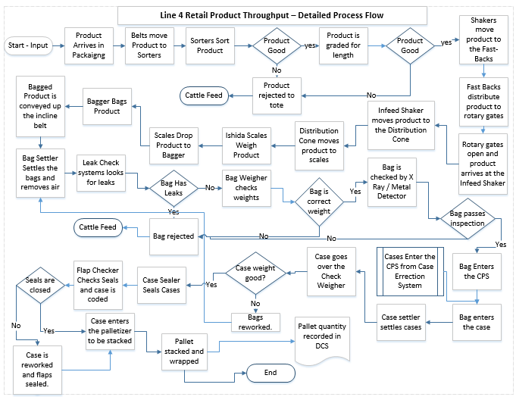
Detailed Process Map

Slide 14
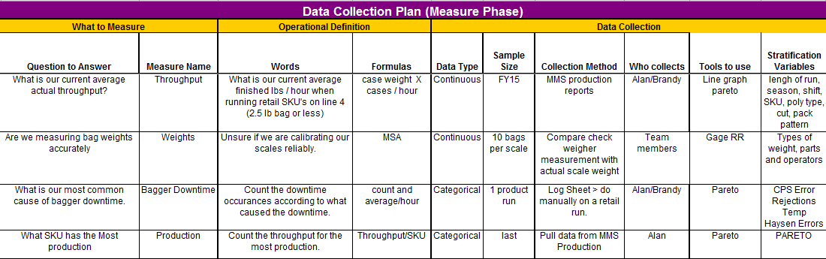
Plan for Data Collection

Slide 15
Most common retail run – ABC Retailer
To simplify our data collection efforts, we decided to focus on ABC Retailer for the remainder of the project since this is the retail product with the most budgeted production volume.

Slide 16
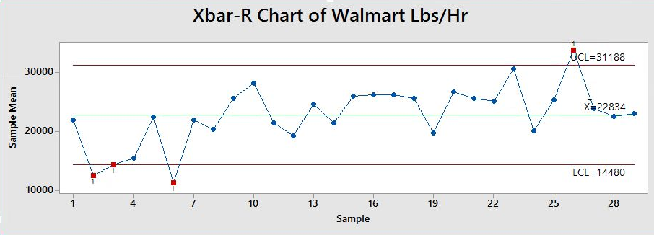
Current Average Throughput / Hour
Current average Throughput / Hour = 22,834 Lbs/Hr

Slide 17
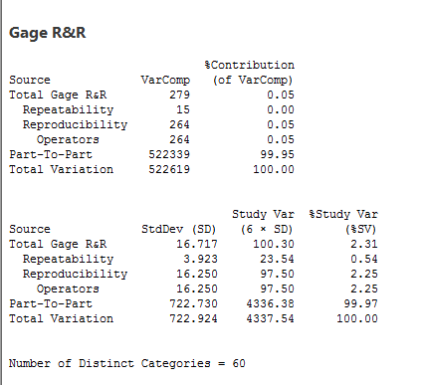
Validate Measurement System - MSA
An MSA was performed to answer the question, “Are we measuring bag weights accurately?”
MSA was performed using 10 samples of random weight, 3 operators, 2 different times. Bags were ran across the bag check weigh scale on the line and compared to hand weights on a separate scale.
PASS
% Contribution less than 1
% Study Variation less than 10
Distinct Categories greater than 10
Completed Feb 2016
Notes:
MSA was completed on line 44B as well as a mini validation on all the other lines to verify the scales on all legs.
MSA passed. We did 10 parts, 3 operators, and 2 repetitions.
Gage RR was used.
Continuous Data – should be less than 1. we have a zero.
% Study Variation – should be less than 10. We passed at .54.
# of Distinct Categories – should be greater than 10. We passed at 60.
Add call outs to %contribution = <1%, % study variation = <10% and Distinct cat = >10
A short slide prior to this slide briefly explain process. How ops you used, how many parts, etc. --- KB

Slide 18
Validate Measurement System - MSA
An MSA was performed to answer the question, “Are we measuring bag weights accurately?”
MSA was performed using 10 samples of random weight, 3 operators, 2 different times. Bags were ran across the bag check weigh scale on the line and compared to hand weights on a separate scale.
PASS
% Contribution less than 1
% Study Variation less than 10
Distinct Categories greater than 10
Completed Feb 2016
Notes:
MSA was completed on line 44B as well as a mini validation on all the other lines to verify the scales on all legs.
MSA passed. We did 10 parts, 3 operators, and 2 repetitions.
Gage RR was used.
Continuous Data – should be less than 1. we have a zero.
% Study Variation – should be less than 10. We passed at .54.
# of Distinct Categories – should be greater than 10. We passed at 60.
Add call outs to %contribution = <1%, % study variation = <10% and Distinct cat = >10
A short slide prior to this slide briefly explain process. How ops you used, how many parts, etc. --- KB

Slide 19
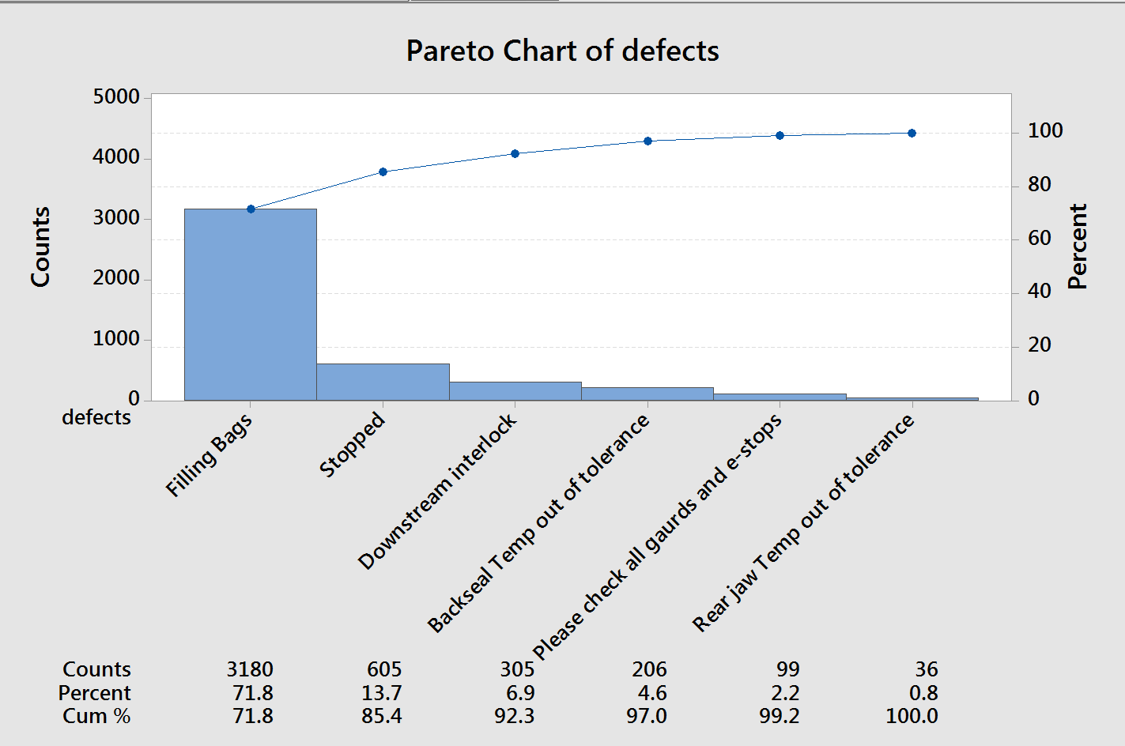
Most Common Cause of Bagger Downtime
Note: Data is bagger status, which is why the top defect is “Filling Bags.” Next, “Stopped,” is due to resetting various faults. So, the top causes of bagger downtime are actually:
“Downstream Interlock”
“Backseal Temp out of tolerance”

Slide 20
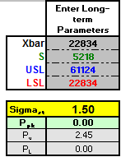
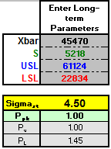
Measure Baseline Performance
Current:
COPQ: $3,415,000
Relevant Metric: Pounds per Hour
PPM (or DPMO): 500,000
Sigma Level: 1.5
Goal:
COPQ: $2,060,000
Relevant Metric: Pounds per Hour
PPM (or DPMO): 1,350
Sigma Level: 4.5

Slide 21
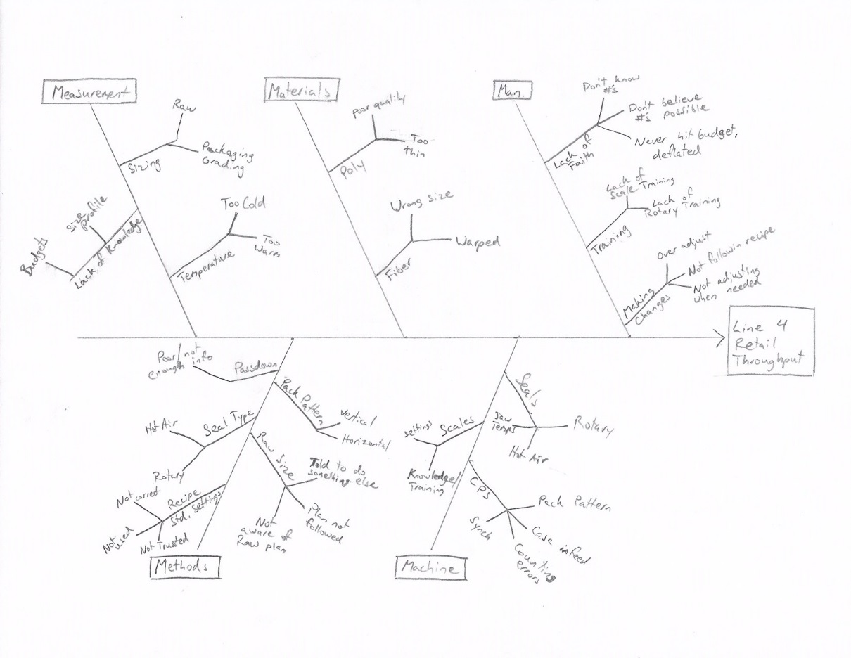
Fishbone
Notes:
X1 – Raw Sizing
X2 – Bagger Seals
X3 – Scales – wrong settings and/or don’t know
X4 – CPS – Horizonal vs Vertical

Slide 22
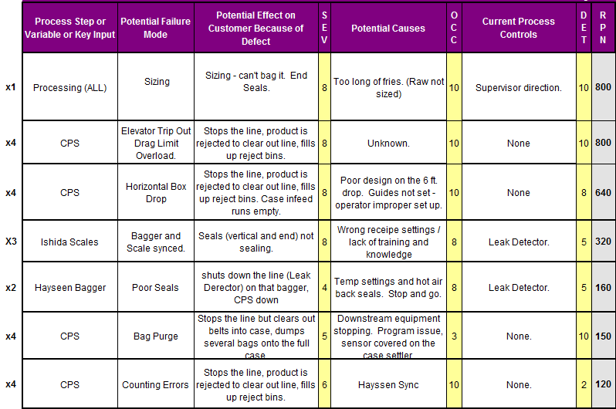
Process FMEA

Slide 23
Potential Xs—Theories To Be Tested
X₁: Raw Sizing - Too large (long) of raw size impacts ability to pack the product and thus impacts throughput.
X₂: Rotary vs Hot Air Bag Seals - The hot air back seal negatively impacts our ability to make good seals and pack budgeted rates.
X₃: Scale settings - Ishida scale operation impacts the ability for the bagger to bag effectively and creates bagger downtime.
X₄: Vertical Pack vs Horizontal Pack – a vertical pack pattern will pack at higher rates than the horizontal pack pattern.

Slide 24
Six Sigma Roadmap
Define
Measure
Analyze
Improve
Control

Slide 25
Potential Xs—Theories To Be Tested
X₁: Raw Sizing - Too large (long) of raw size impacts ability to pack the product and thus impacts throughput.
X₂: Rotary vs Hot Air Bag Seals - The hot air back seal negatively impacts our ability to make good seals and pack budgeted rates.
X₃: Scale settings - Ishida scale operation impacts the ability for the bagger to bag effectively and creates bagger downtime.
X₄: Vertical Pack vs Horizontal Pack – a vertical pack pattern will pack at higher rates than the horizontal pack pattern.

Slide 26
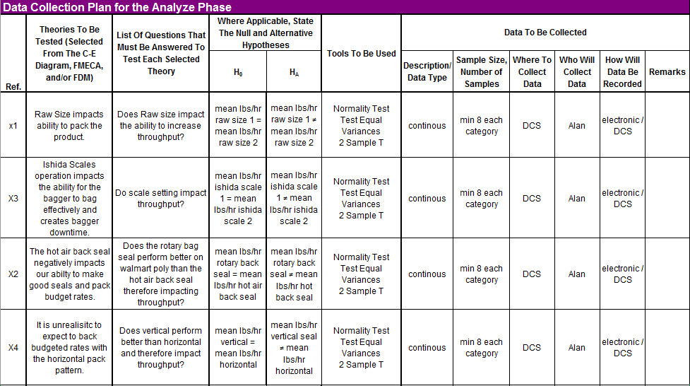
Data Collection Plan for Analyze Phase
Notes:
Change to match previous slide exactly.

Slide 27
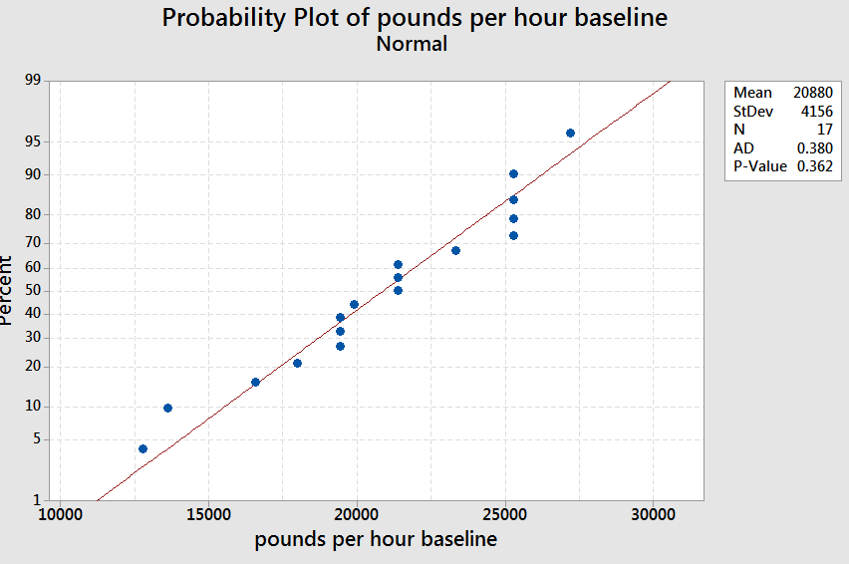
Data Set Up – Test for Normality – Baseline Data
Baseline data tested for Normality.
Ho: data is normal
Ha: data is not normal
P value >0.05 therefore fail to reject null. Data is normal.
Notes:
P-value < 0.05 = not normal. normal = P-value >= 0.05
Because or P-Values are greater than .05, our data is normal.

Slide 28
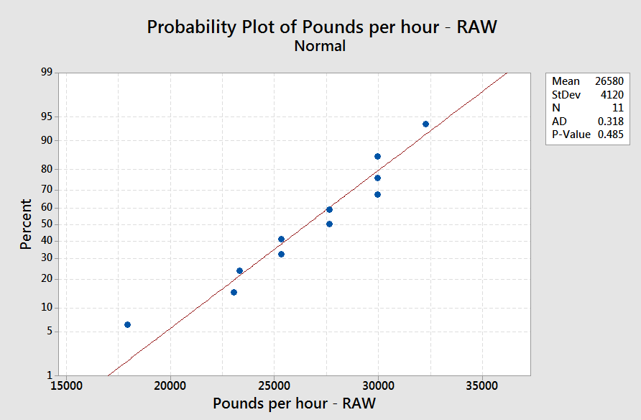
X1 – Raw Sizing
X1 (Raw Sizing) data tested for normality.
Ho: data is normal
Ha: data is not normal
P value >0.05 therefore fail to reject null. Data is normal
Notes:
P-value < 0.05 = not normal. normal = P-value >= 0.05
Because or P-Values are greater than .05, our data is normal.

Slide 29
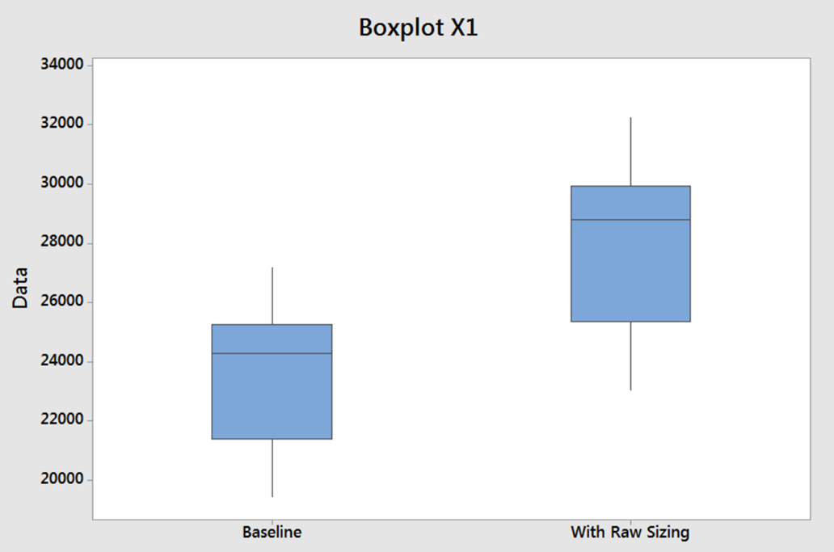
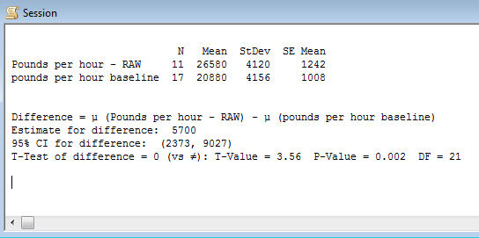
X1 – Raw Sizing
Theory:
Too large (too long: average length >2.5” and >5% over 4”) of raw size impacts ability to pack the product and thus impacts throughput.
Ho: mean lbs/hr of raw size 1 = mean lbs/hr of raw size 2
Ha: mean lbs/hr of raw size 1 ≠ mean lbs/hr of raw size 2
Analysis: 2 sample T test.
Statistical Conclusion: P Value is < 0.05, so reject the null hypothesis.
Practical Conclusion: Mean lbs/hr in the test was higher than baseline data therefore raw sizing does impact the throughput. Sizing of 95% 2-4” with average length of 2.5” positively impacts throughput.
Notes:
Clean this up. Insert box plot.

Slide 30
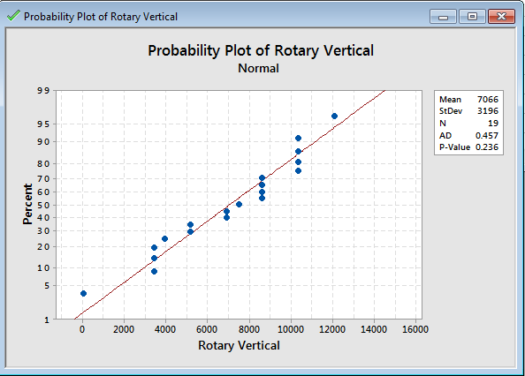

X2 – Bagger Seals
X2 (Bagger Seals) data tested for normality
Ho: data is normal
Ha: data is not normal
P value > 0.05 therefore fail to reject null. Data is normal.
Notes:
P-value < 0.05 = not normal. normal = P-value >= 0.05
Because or P-Values are greater than .05, our data is normal.

Slide 31
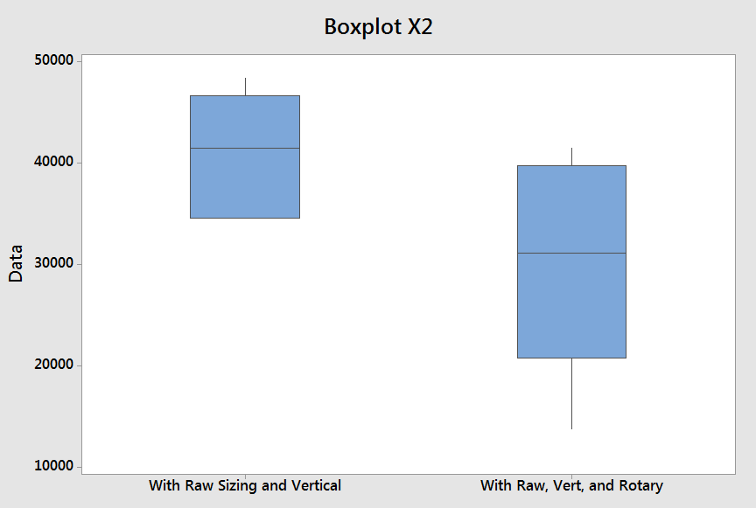
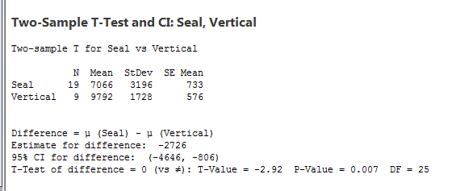

X2 – Bagger Seals
Theory:
The hot air back seal negatively impacts our ability to make good seals and pack budget rates.
Ho: mean lbs/hr with rotary seal = mean lbs/hr with hot air seal
Ha: mean lbs/hr with rotary seal ≠ mean lbs/hr with hot air seal
Analysis: 2 sample T test.
Statistical Conclusion: P Value is < 0.05, so reject the null.
Practical Conclusion: Rotary Bag Seals do impact the throughput, but in a negative fashion. (this may be due to lack of experience and knowledge with the rotary seals. Additionally, no negative impact on throughput due to the hot air seal was noted once the vertical pack pattern was in place, likely because of less stop and go from the CPS)
Notes:
Based on on our data – the Hot Air Back Seal had better throughput than the rotary bag seal.

Slide 32
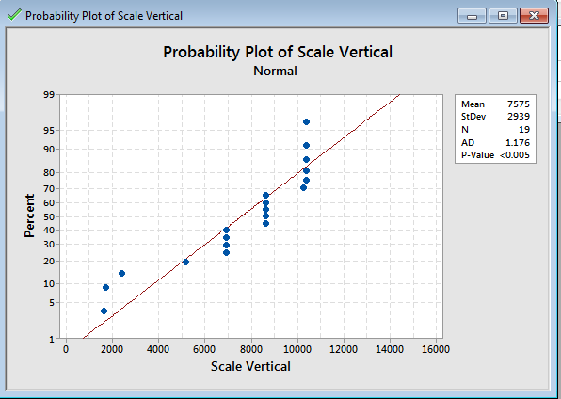

X3 – Scale Settings
X3 (Scale settings) data tested for normality
Ho: data is normal
Ha: data is not normal
P value is < 0.05 therefore reject the null. Data is not normal.

Slide 33
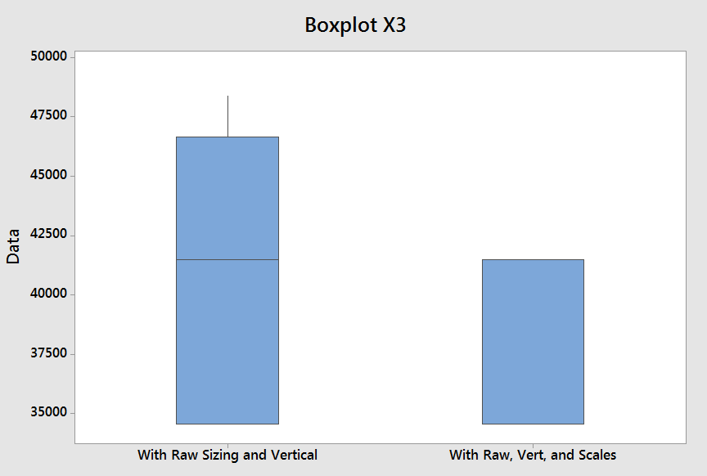
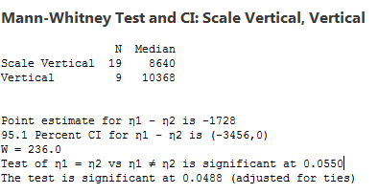
X3– Scale Settings
Theory:
Ishida Scales operation impacts the ability for the bagger to bag effectively and creates bagger downtime.
Ho: median lbs/hr scale settings 1 = median lbs/hr scale settings 2
Ha: median lbs/hr scale settings 1 ≠ median lbs/hr scale settings 2
Analysis: Mann-Whitney
Statistical Conclusion: P Value is less than .05, so reject the null.
Practical Conclusion: Scale settings do impact the throughput, but in a negative fashion.

Slide 34
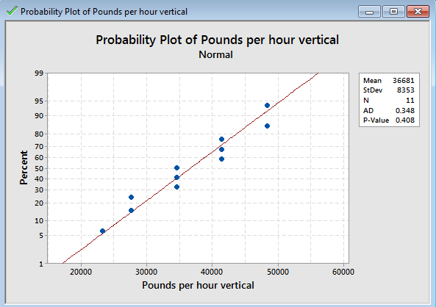

X4 – CPS
X4 (CPS) data tested for normality.
Ho: data is normal
Ha: data is not normal
P value >0.05 therefore fail to reject null. Data is normal.
Notes:
P-value < 0.05 = not normal. normal = P-value >= 0.05
Because or P-Values are greater than .05, our data is normal.
Don’t need to show this graph.

Slide 35
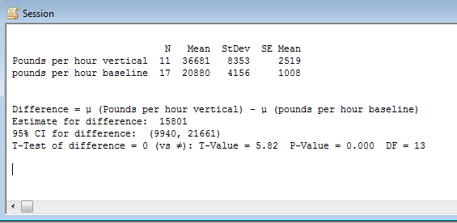
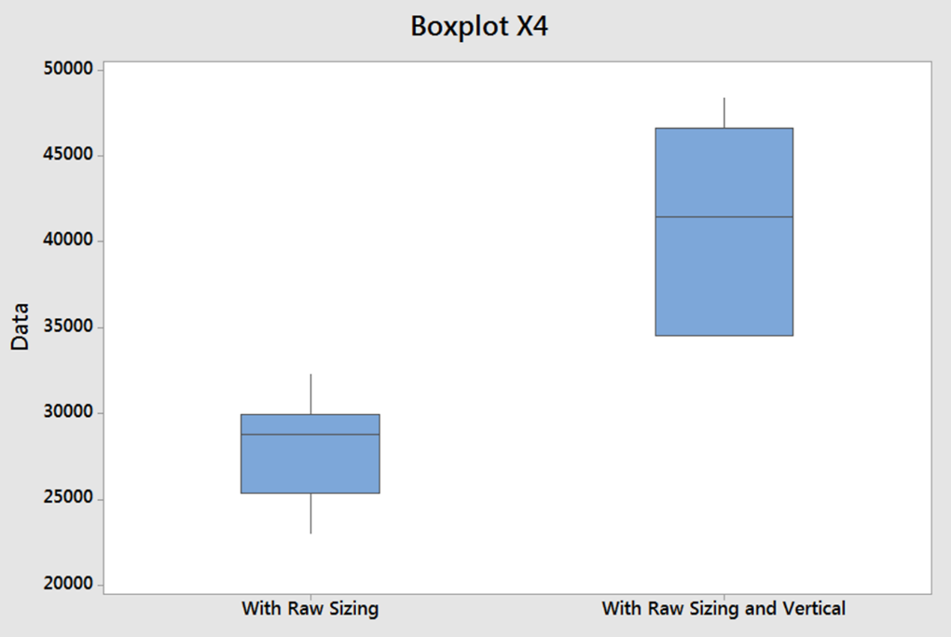
X4– CPS Pack Pattern
Theory:
A vertical pack pattern will pack at higher rates than horizontal pack pattern.
Ho: mean lbs/hr vertical pattern = mean lbs/hr horizontal pattern
Ha: mean lbs/hr vertical pattern ≠ mean lbs/hr horizontal pattern
Analysis: 2 sample T test.
Statistical Conclusion: P Value is less than .05, so reject the null.
Practical Conclusion: Vertical Pack Pattern does impact throughput

Slide 36
Summary of Testing Results
X₁: Raw Sizing
Theory: Too large (long) of raw size impacts ability to pack the product and thus impacts throughput.
Conclusion: It was determined during the April run that the raw sizing did have a positive impact the throughput. We will pursue this X.
X2: Rotary vs Hot Air Back Seal
Theory: The hot air back seal negatively impacts our ability to make good seals and pack budgeted rates.
Conclusion: Testing was done on the run in May. It was concluded that the rotary ran worse than the hot air back seal. Because no improvement was observed we have decided not to pursue this X further.
X₃: Scale settings
Theory: Ishida scale operation impacts the ability for the bagger to bag effectively and creates bagger downtime.
Conclusion: Testing was done on the run in May. It was concluded that the test settings ran worse than the baseline settings. Because no significant improvement was observed we have decided not to pursue this X further.
X4: Vertical Pack vs Horizontal Pack
Theory: A vertical pack pattern will pack at higher rates than the horizontal pack pattern.
Conclusion: Testing was done on the run in April. It was determined during that run that the vertical pack pattern did impact the throughput. We will pursue this X.
Notes:
Need to update X2 and X3. Re-run #’s in Minitab.

Slide 37
Vital Few Xs
Y=f(X₁,……X_{n})
Vital Few Xs are:
X₁ – Raw Sizing
X₄ – CPS Pack Pattern
Notes:
These are the ones that proved out to be impactful to throughput.

Slide 38
Six Sigma Roadmap
Define
Measure
Analyze
Improve
Control

Slide 39
Improvement Strategies for Proven Xs
Proven Xs (Causes): | Strategies:
X1 – Raw Sizing X4 – CPS Pack Pattern | Follow the raw plan and sizing guidelines: Target an average length of 2.5”, 95% 2” – 4”, Use optical sorter to size the potatoes. Don’t blend other bins into the sized raw. Keep / change to vertical pattern for as many retail products as possible. Ensure that all parts are available at change over (spreaders, settings, etc..) to ensure minimum DT and maximize ability to dial the machine settings in.
Notes:
Need to be more detailed than “follow the raw plan”. Need an action plan.

Slide 40
Descriptions of Possible Solutions (Pros and Cons) – X1
Possible Solution: | Strengths (Pros): | Weaknesses (Cons):
RAW 1) Follow the raw plan and sizing guidelines. | Information already provided. The product will pack and will not get caught in the end seals of the bags. | Not able to blend the other sized bins, leaving the bin room too full (only if not planned correctly).
RAW 2) Don’t blend other bins into the sized raw. | So long as the sized raw is sized correctly, the product will pack and will not get caught in the end seals of the bags | Not able to blend the other sized bins, leaving the bin room too full (only if not planned correctly).
RAW 3) Raw Sup / Op awareness of how changes affect packaging. | Improved reaction time and clear understanding of impacts of changes to line. Proactive instead of reactive. | None.
RAW 4) Review pre and post blancher length data. | Provides overview of length profile before product reaches packaging. Proactive instead of reactive. | None.

Slide 41
Descriptions of Possible Solutions (Pros and Cons) – X4
Possible Solution: | Strengths (Pros): | Weaknesses (Cons):
CPS 1) Keep / change to vertical pattern for as many retail products as possible. | Each side of the CPS is independent when set up this way, keeping the line running when one side has problems. Allows for higher bag speeds. Eliminates several problems associated with case infeed / outfeed in the horizontal pattern. Settings are more commonly known and therefore operators are more efficient and competent at making adjustments. | Might not be customer preference. Possibly requires changes to case sizes. Changeover / setup requires installation of more parts than the horizontal pattern.
CPS 2) Ensure that all parts are available at change over (spreaders, settings, etc..) | Quicker change over, less time setting up, more time dialing the line in. More organized work space. | None.

Slide 42
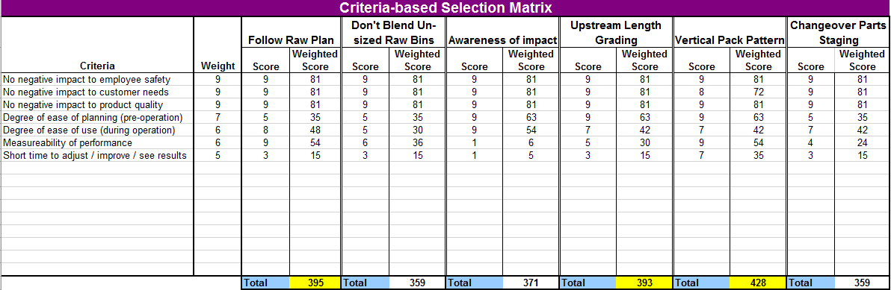
Criteria Selection Matrix

Slide 43
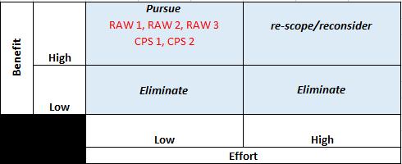
Pay-off Matrix
Determined all proposed solutions for X1 and X4 to be low effort and high benefit. Also, all scored highly in the Criteria Selection Matrix. Therefore we will pursue them all.
Notes:
X1 – pursue – Keep working on this.
X2 – not impactful
X3 – Unable to evaluate

Slide 44
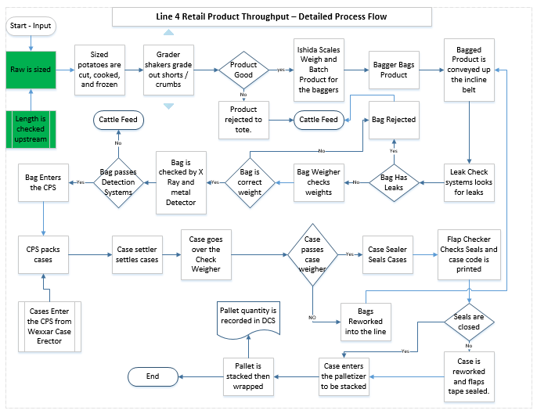
Updated Process Map(s)
Added steps “Raw is sized” and “Length is checked upstream.” Process Map also was simplified compared to original process map.
Notes:
Add size is checked.

Slide 45
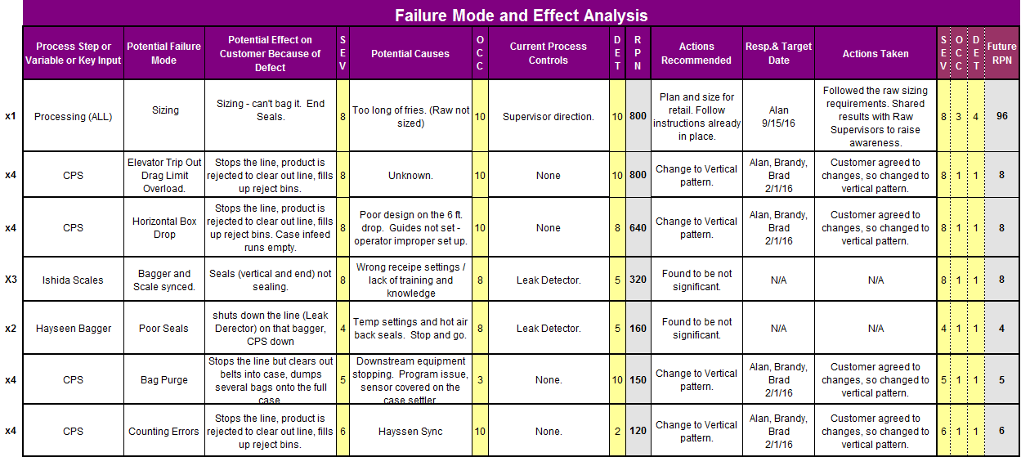
Updated Process FMEA

Slide 46
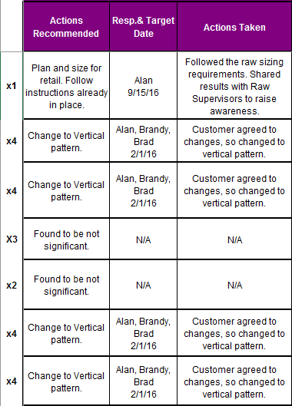
Implementation Plan
Notes:
Copy columns K through N on previous slide and insert.

Slide 47
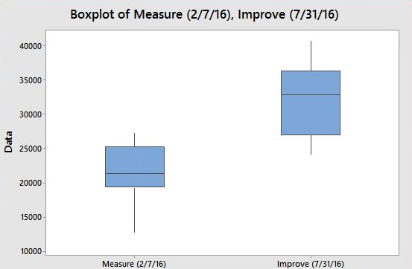
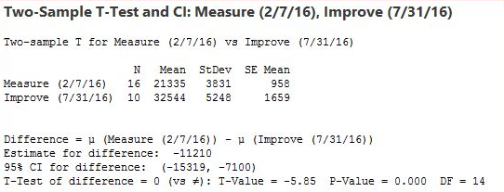

Statistical Proof of Improvements
Theory: Following the Raw Sizing plan and implementing a vertical pack pattern have increased throughput rates for the ABC Retailer retail product.
Ho: mean lbs/hr Measure = mean lbs/hr Improve
Ha: mean lbs/hr Measure ≠ mean lbs/hr Improve
Analysis: 2 sample T Test
Statisical Conclusion: P value <0.05 therefore reject the null.
Practical Conclusion: changes made in the Improve stage have positively impacted finished lbs/hr.
Notes:
Redo this. Numbers appear wrong.

Slide 48
Six Sigma Roadmap
Define
Measure
Analyze
Improve
Control

Slide 49
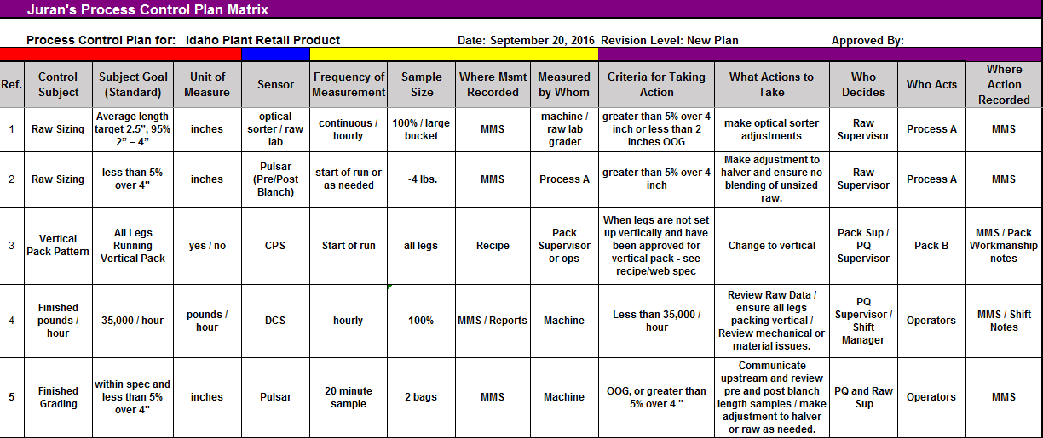
Control Plan

Slide 50
Procedures/Policies
X1 Raw –
Raw plan already in place, simply raised awareness.
Control plan includes requirement to check length upstream at the start of the run or as requested in order to be pro-active in delivering the appropriate product length to packaging.
X4 CPS –
1) Changed the pack pattern from horizontal to vertical when allowed by customer. Only one customer (Schwan’s) declined. Those accepting of vertical pack pattern are: ABC Retailer, XXX Retailer, XXX Retailer, XXX Retailer, XXX Retailer, and XXX Retailer.
2) Webspec and packaging recipes updated to reflect change to vertical pack pattern.

Slide 51
Communication Plan
Raw: Reminder email and individual meeting with each Raw Supervisor to share control chart and emphasize the importance of running to the recipe. Also insert notes on Production Short Term Schedule as reminder to size the raw appropriately. – Completion date: 9/22/16
Packaging: Work with the Packaging Room Manager to request ability to use vertical pack pattern. Ensure Web Spec and packaging recipes reflect this change. Communicate changes to Packaging Supervisors through email and individual meetings. – Completion date 9/22/16

Slide 52
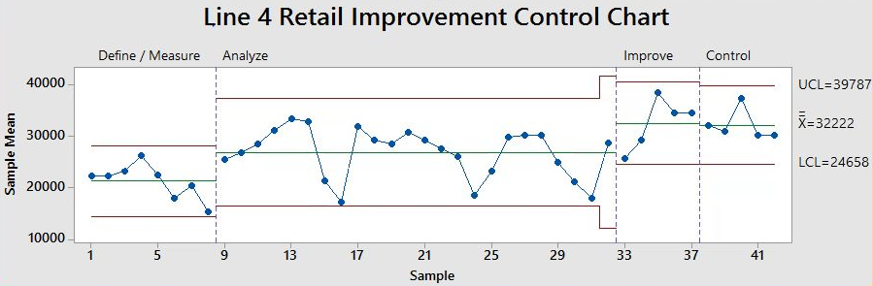
Control Chart
Notes:
Insert comments: used subgroups of 2, not going to be run for a while. Oct 23rd.

Slide 53
Project Results
Savings equate to $393,357. Projected savings for FY17 are $533,000 (see following slide for calculation).
Note: DPMO and Sigma Level based on ABC Retailer production alone, which improved by 41%. COPQ based on overall retail improvement of 13% (Calculated with weighted average of all retail products ran during “Improve” stage or after). See next slide for COPQ calculation for FY17 (projected).
Project Baseline: |  | Project Target: |  | Project Actual:
COPQ= | $3,415,000 | COPQ= | $2,060,000 | COPQ= | $3,021,463
Metric= | Pounds / hour | Metric= | Pounds / hour | Metric= | Pounds / hour
DPMO= | 500,000 | DPMO= | 1,350 | DPMO= | 35,900
Sigma Level= | 1.5 | Sigma Level= | 4.5 | Sigma Level= | 3.3

Slide 54
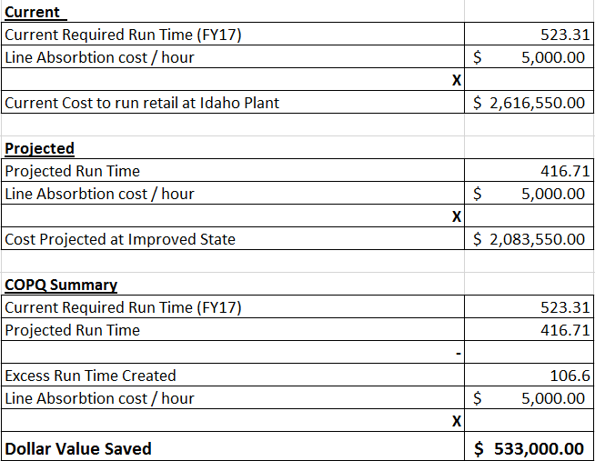
Project Results (FY17 Projected COPQ Calculation)
Note: Required Run Time (FY17) and Line Absorption cost/ hour acquired from Plant Accountant.

Slide 55
Updated Project Plan- Milestones and Timing
Measure:
Finish MSA – 2/22/16
Measure Process Capability – 2/24/16
Measure Baseline Performance – 2/24/16
Fishbone / Cause and Effect Diagrams – sometime the week of Feb 29 – Mar 4
Process FMEA (with team) - sometime the week of Feb 29 – Mar 4
List potential X’s, come up with theories for Analyze - week of Feb 29 – Mar 4
Analyze:
Complete Data Collection Plan for Analyze – 3/7/16
Test theories for X’s – From beginning of March through end of June 2016 (extended timeline due to availability of ABC Retailer production runs)
Determine vital few X’s – 7/1/16
Relate X’s to Y (formula Y=f(X)) – 7/6/16
Improve:
Determine strategies and possible solutions – 7/13/16
Evaluate and choose solutions – week of 7/18/16
Run Pilot or DOE with solutions – 7/31/16
Update the Process Map and FMEA – 8/8/16
Prove Statistical impact of improvements – 8/15/16
Create Implementation Plan – 8/17/16
Control:
Create Control Plan – 8/24/16
Create or update any relevant procedures / 1Point Lessons / Standard work – week of 8/24/16
Create communication and training plans – 9/1/16
Communicate to stake holders and complete training – 9/22/16
Update Process Capability and Summarize Project Results – 9/22/16
Notes:
Update the dates.

Slide 56
Lessons Learned
Original Scope was too large. Our project moved forward in a much clearer and easier manner when we decided to narrow our scope. Improvements and lessons can be applied to many retail SKU’s at the Plant.
Following the raw sizing guidelines is extremely important when running retail products. These guidelines have been in place for some time, our project simply points out and proves the need to plan ahead and follow the guidelines.
Further improvements could possibly be made through scale settings. We did not have sufficient time to analyze this fully, and what analysis and changes we tried actually had negative effects. However, based on observations we believe additional analysis (perhaps a project dedicated to scales) could further improve throughput and quality.

