Slide 1

Six Sigma Black Belt
Project Report Presentation: Manufacturing Industry
Project Number: MOS 14-11
Project Name: Starch System Optimization
Project Team Leader: XXXX
Project Champion: XXXX

Slide 2
Six Sigma Roadmap
Define
Measure
Analyze
Improve
Control

Slide 3
Operational Definitions of Key Terms
Baume: Specific gravity / percent solids of the starch slurry
Hammer Mill: Equipment used to reduce the raw feed to release starch granules.
Hydro-cyclean: Vortex effect causes heavy solids separation and discharge downward while the effluent and light solids eject from the top.
Hydrosieve: Screen for separating particles from water that may plug hydro-cycleans.
iFix: Commercial name for our Supervisory Control And Data Acquisition (SCADA) system which controls portions of the factory equipment.
MMS: Manufacturing Management Suite; a ABC Company developed, web based SQL system for housing data.
Sweco: Fine mesh vibratory screen (74 – 84 mesh).
Water Knife: Grid pattern of blades for cutting whole potatoes into strips which releases a by-product of starch.

Slide 4
Problem and Goal
Problem Statement:
The three year average for the ABC Company plant starch production was 4,070,828 pounds. The three year average of raw deliveries of whole potatoes was 667,059,398 pounds which is a recovery rate of 0.6103%. We are only capturing a portion of the raw material for starch generation that we have the potential to capture.
Goals/Objective(s):
Increase the percent of starch recovered by 15% from 0.6103% to 0.7018% by 5/16/2014.

Slide 5
Project Scope
In Scope:
ABC Company raw washed un-blanched waste product that is currently going to cattle feed including transfer systems. Starch recovery system which includes transfer systems, grinding system, cyclones, and Sweco.
Item Out of Scope:
All other portions of the facility unrelated to the starch production systems.

Slide 6
Project Justification and Expected Results
Relevant Metrics:
Percent of starch recovered.
Improvement targets:
A 15% increase in starch production will increase revenues by $122,124. (Calculated at $.20/lb market rate)
Operational/Strategic Impact:
This project is in alignment with the NAFG Key Strategy of Operation Excellence - to maximize profitable returns to the shareholders through continuous improvement of systems and processes

Slide 7
Financial Impact: Business Case or COPQ Calculation
3 year historic average starch production 4,070,828 lbs X $.20/ lb = $814,165
Starch production at 15% increase (4,070,828 X 1.15) =
4,681,452 lbs X $.20/ lb = $936,290
Additional Revenue = $122,125

Slide 8
Project Team Membership
Project Champion:
XXXX – Environmental Manager
Project Team Leader:
XXXX – Maintenance Manager, BB
Project Core Team Members:
XXXX – Environmental Supervisor
XXXX – Raw Procurement Manager
XXXX – Office Coordinator
XXXX – Water Systems Maintenance Mechanic
XXXX – Process Water Operator
Ad Hoc Members or SMEs:
XXXX – Process Water Treatment Coordinator

Slide 9
Project Plan- Milestones and Timing
Start: 1/8/14
Define: 1/16/14
Measure: 2/28/14
Analyze: 4/13/14
Improve: 5/30/14
Control: 8/1/14
Complete: 9/17/14

Slide 10
Voice of Customer to CTQ Analysis
Rank | Customer | Voice of Customer | Key Issue | CTQ (the Y)
1 | Process Water Attendant | I cannot utilize lost product that hits the floor and Trim Waste "Man Down Potatoes" | No current ability to grind these potatoes | Starch recovery > .7018%
2 | Process Water Attendant | When the formline is down I cannot use all of the slivers and nubbins in the grinder for starch. | Grinder is too small | Starch recovery > .7018%
3 | Process Water Attendant | I need a balanced water system / contain all water that we possibly can | Ensuring that standard pressures are correct and maintained and that all level controls are working correctly. | Starch recovery > .7018%
4 | Western Polymer | I need 20-21 Baume Starch clean and free of noxious odor | If under 15 Baume becomes difficult to process. | Baume >20
5 | Process Water Attendant | I need the waterknife room running and producing fries to collect starch from the water. | Processing line is running optimally. | 0% unplanned downtime
6 | Digester | I need to reduce my diet of starch laden fibrous water. | Reduces performance of the digestor and operating capacity. Adds material to the digestor | Digester influent COD <10,000 ppm

Slide 11
High Level Process Map (SIPOC)
SUPPLIER | INPUT (use nouns) | PROCESS (use verbs) | OUTPUT (use nouns) | CUSTOMER | CTQ
Raw Receiving | Peeled Potatoes and Water | cut potatoes | Starch and Water | Plant and Starch System | No holes in sieve
Cutting Systems | ADR Rejects, WK Room Slivers, Overflow from Secondary Cones and Formed Overflow | grind potatoes | Potato Slurry, Starch and Water | Grinder Hydrosieve | No whole chunks
Underflow from Hammermill Hydrosieve and Waterknife Water | Fluid Streams from Hammer Mill and Waterknife System | Separate Starch (1st stage) | Starch Stream Concentrate and Water | Sweco | Pressures set at 100 / 7 PSI
Underflow from Water Knife and Grinder Primary Cycleans | Underflow of WK and Grinder Primary Cycleans | Separate fiber (SWECO Vibratory Screen (80 MG)) | Starch Slurry (Underflow) and Fiber (Top) | Secondary Feed Tank/Pump and Gutter to (Bertha) | No holes in screen and not blinded over
Secondary Feed Tank | Underflow from Sweco | Separate / Concentrate Starch (Secondary) | Baume Controller and Secondary Feed Tank Level Control / Grinder Primary Feed Tank | Baume Controller | Pressures at 62 / 10 PSI
Underflow from Secondary Cycleans | Underflow from Secondary Cycleans | Control Baume | Storage Tank / Recycle to Concentrate Solids | Storage Tank and/or Secondary Feed Tank | Baume @ 21-22
Storage Tank | Storage Tank | Load Truck | Pump Starch Concentrate to Truck | Processing Facility | Baume @ 21-23

Slide 12
Six Sigma Roadmap
Define
Measure
Analyze
Improve
Control

Slide 13
Project Y (or Ys) in Y=f(x)
Y = Percent of starch recovery
Y = (Pounds of starch recovered / Raw potato pounds delivered) * 100
Will calculate by plant accountants weekly for the purposes of this project.*
*Update 8/1/14: With the new baume’ controller, we are able to track production on the daily dashboard report

Slide 14
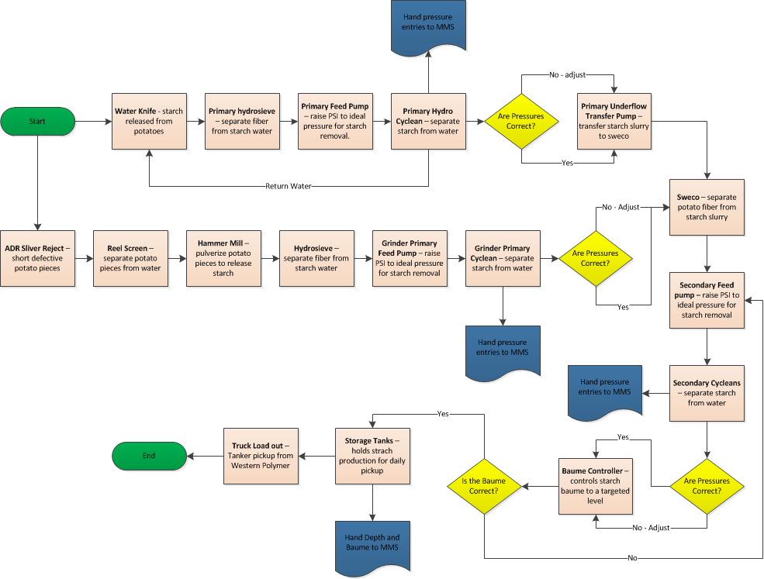
Detailed Process Map

Slide 15
Plan for Data Collection
Data Collection Plan (Measure Phase)
 | What to Measure |  | Operational Definition |  | Data Collection
Ref # | Question to Answer | Measure Name | Words | Formulas | Data Type | Sample Size | Collection Method | Who collects | Tools to use | Stratification Variables
1 | What is our starch recovery baseline | Starch Recovery | Starch produced divided by pounds of raw potatoes used in plant | Dry starch lbs / Raw Potatoe Lbs. | Continuous | 3 years of data | Accounting | Starch Team | Excel | Month
2 | What is our baseline efficiency of the transition primary cycleans? | Percent Baume recovered | Baume recovered divided by inlet Baume | Baume A / Baume B | Continuous | 100mL | Hand | Process Water Attendant | Excel / boxplot | Shift
3 | What is our baseline efficiency of the starch room primary cycleans? | Percent Baume recovered | Baume recovered divided by inlet Baume | Baume A / Baume B | Continuous | 100mL | Hand | Process Water Attendant | Excel / boxplot | Shift
4 | What is our baseline efficiency of the secondary cycleans? | Percent Baume recovered | Baume recovered divided by inlet Baume | Baume A / Baume B | Continuous | 100mL | Hand | Process Water Attendant | Excel / boxplot | Shift
5 | How many lbs/hr can the hammer mill process | Hammer Mill Pounds / Hour | Pounds fed to hammer mill per hour without plugging up. | Lbs X Time | Continuous | TBD | Hand | Starch Team | Excel | None
6 | Can we accurately measure the final starch Baume at the plant | Baume | Starch Density measurement | Visual from a calibrated tube | Continuous | 100mL | Hand | Process Water Attendant | MSA | Operator
7 | Can we accurately measure the volume of starch produced at the plant | Tank level | The depth of starch in the tank in inches | Visual from a tape measure | Continuous | Inches over time | Hand | Process Water Attendant | MSA | Operator

Slide 16
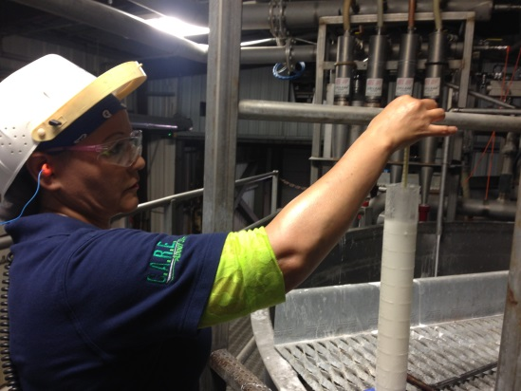
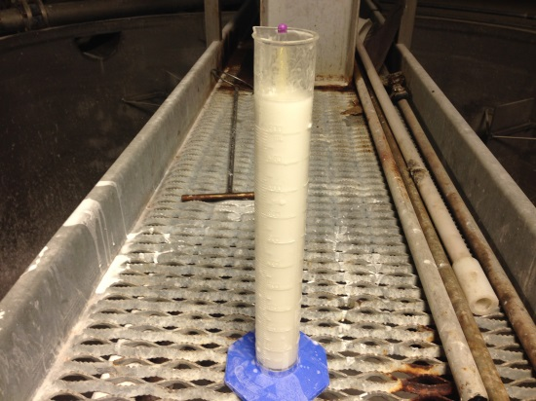
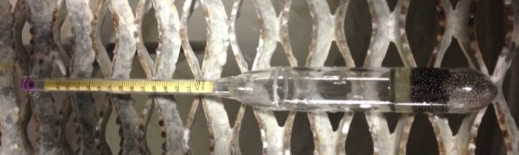
Validate Measurement System - Baumè Hydrometer
We conducted a Gauge R&R study on the Baumè hydrometer. 3 starch system operators were randomly chosen to participate in the study. We selected 10 starch samples with varying Baumè levels and did 2 replicates. Operators were asked to read the Baumè level to the nearest 1 Baumè.
Results on next page

Slide 17
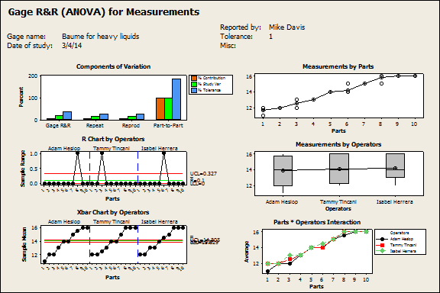
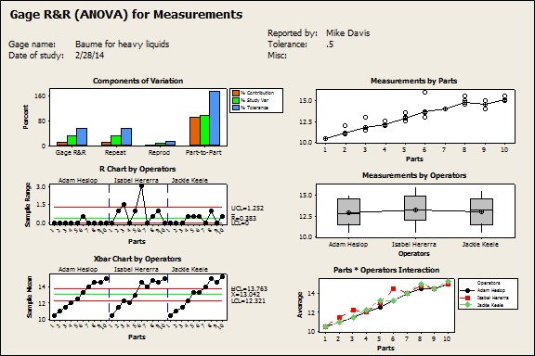
Validate Measurement System – Baumè Hydrometer
Gage R&R
%Contribution
Source VarComp (of VarComp)
Total Gage R&R 0.25373 9.13
Repeatability 0.23924 8.60
Reproducibility 0.01450 0.52
Operators 0.01450 0.52
Part-To-Part 2.52687 90.87
Total Variation 2.78060 100.00
Process tolerance = 5.5
Study Var %Study Var %Tolerance
Source StdDev (SD) (6 * SD) (%SV) (SV/Toler)
Total Gage R&R 0.50372 3.0223 30.21 54.95
Repeatability 0.48912 2.9347 29.33 53.36
Reproducibility 0.12040 0.7224 7.22 13.13
Operators 0.12040 0.7224 7.22 13.13
Part-To-Part 1.58961 9.5377 95.33 173.41
Total Variation 1.66751 10.0051 100.00 181.91
Number of Distinct Categories = 4
Gage R&R
%Contribution
Source VarComp (of VarComp)
Total Gage R&R 0.10000 3.49
Repeatability 0.05000 1.74
Reproducibility 0.05000 1.74
Operators 0.01759 0.61
Operators*Parts 0.03241 1.13
Part-To-Part 2.76759 96.51
Total Variation 2.86759 100.00
Process tolerance = 5.5
Study Var %Study Var %Tolerance
Source StdDev (SD) (6 * SD) (%SV) (SV/Toler)
Total Gage R&R 0.31623 1.8974 18.67 34.50
Repeatability 0.22361 1.3416 13.20 24.39
Reproducibility 0.22361 1.3416 13.20 24.39
Operators 0.13264 0.7958 7.83 14.47
Operators*Parts 0.18002 1.0801 10.63 19.64
Part-To-Part 1.66361 9.9816 98.24 181.48
Total Variation 1.69340 10.1604 100.00 184.73
Number of Distinct Categories = 7
* MSA failed initially due to low discernment of the gage. Changed gage to the best discernment available.
FAIL
*PASS

Slide 18
Measure Baseline Performance
*Calculated based on starch recovery benchmark at .8%
Current:
COPQ: $253,129.40
Relevant Metric: 0.6103% starch recovery
PPM (or DPMO): 1897
Sigma Level: 4.39
Goal:
COPQ: $131,004.60
Relevant Metric: 0.7018% starch recovery
PPM (or DPMO): 982
Sigma Level: 4.60
 | enter | enter
n= | 667059398 | 667059398
o= | 1 | 1
c= | 1265647 | 655023
 | 0.001897353 | 0.000981956
 | 1,897 | 982
Sigma = | 4.39 | 4.60

Slide 19
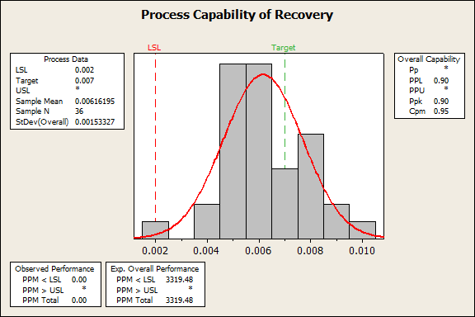
Process Capability
Current process is not considered capable
Target was established at 15% above historical mean and is the goal of the project
No LSL existed from the customer, so we established it at 3s from the mean
We did not establish an USL since more is better…

Slide 20
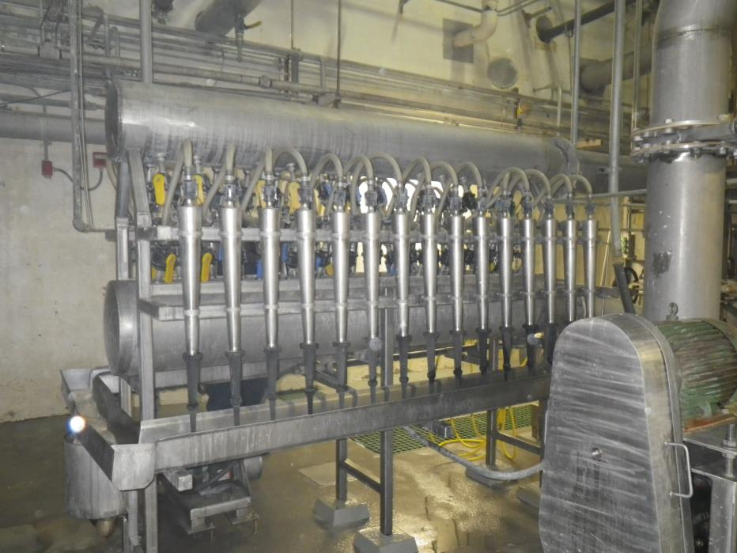
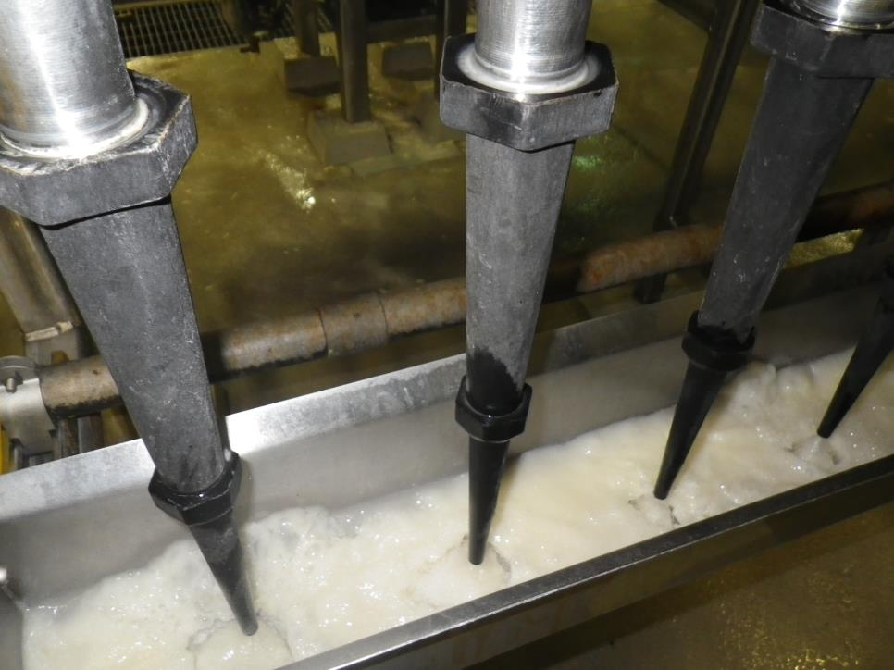
Pictures
3” RB80X Hydro-Cyclean (Beloit) - Vortex effect causes heavy solids separation and discharge downward while the effluent and light solids eject from the top.

Slide 21
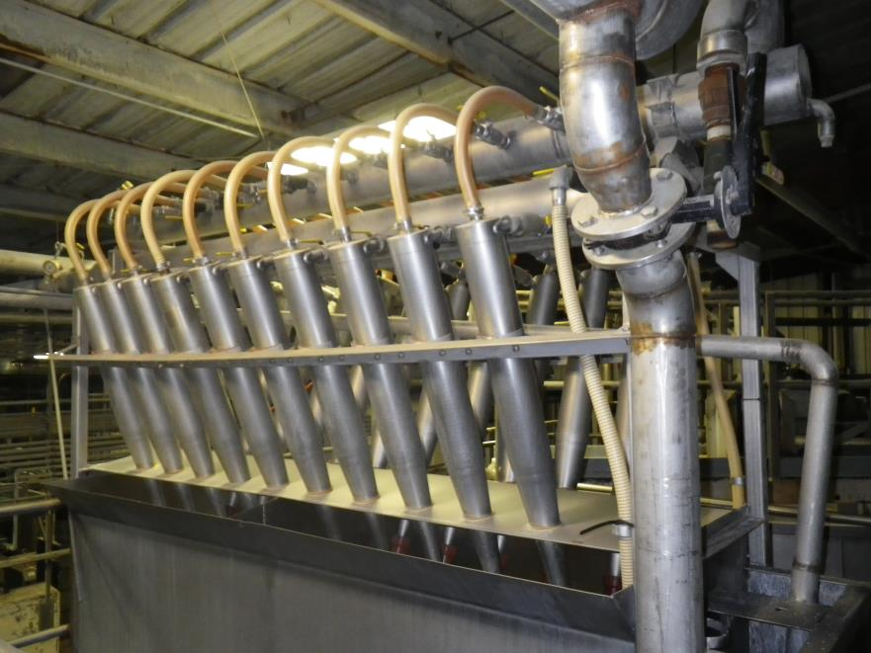
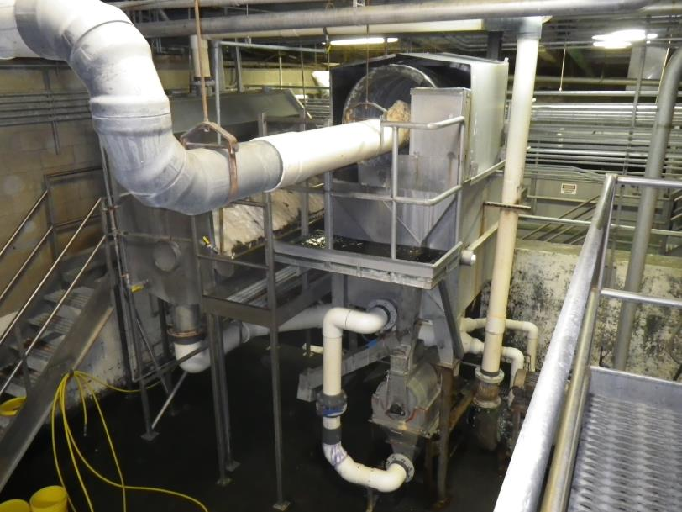
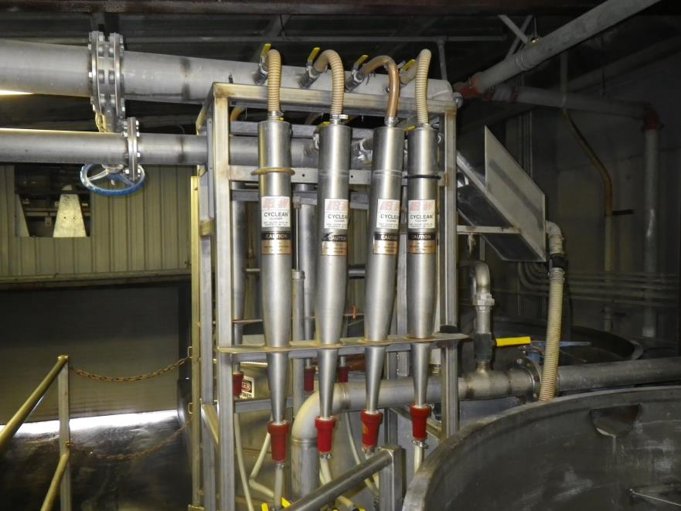
Pictures
4” Bird Hydro-Cyclean - Vortex effect causes heavy solids separation and discharge downward while the effluent and light solids eject from the top.

Slide 22
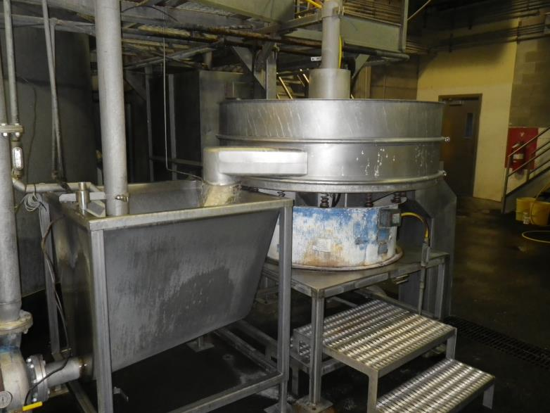
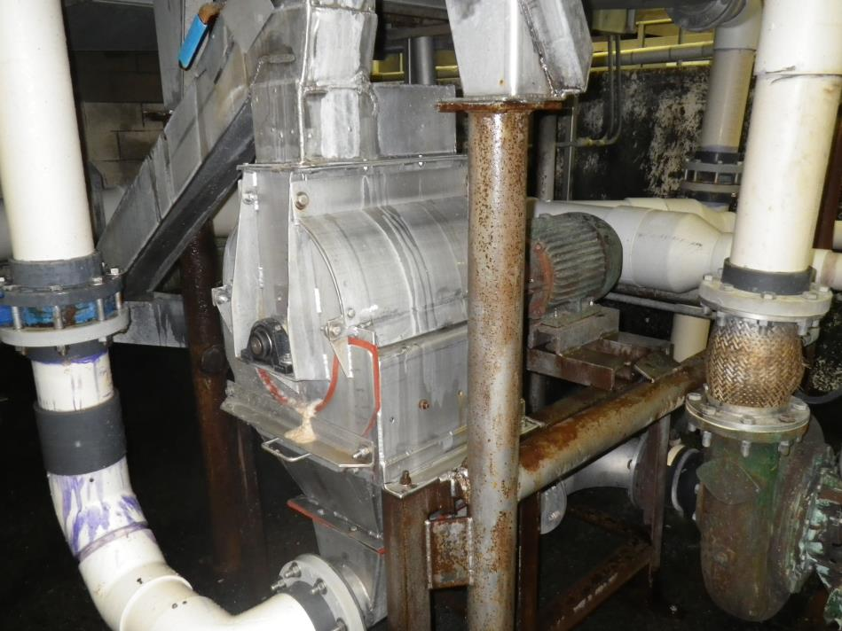
Pictures
Sweco: Fine mesh vibratory screen (74 – 84 mesh).
Hammer Mill: Equipment used to reduce the raw feed to release starch granules.

Slide 23
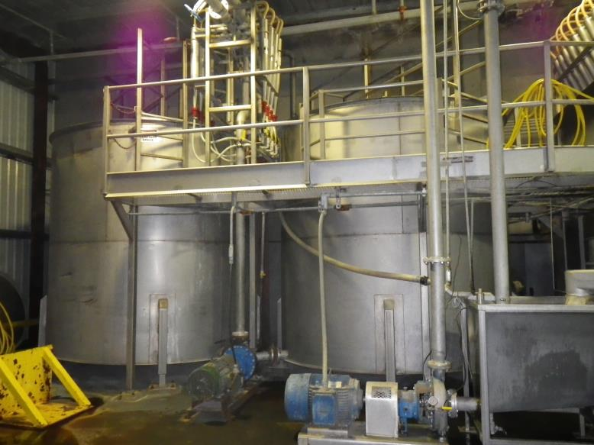
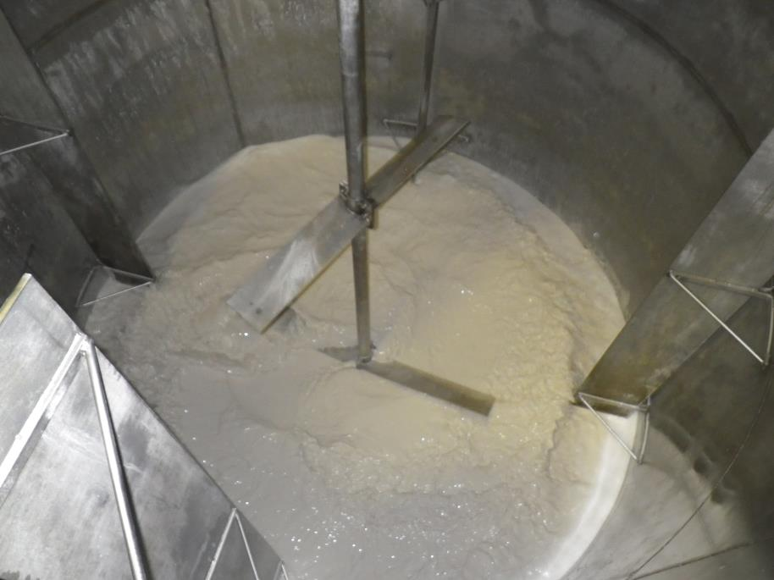
Pictures
Storage Tanks – Tanks to store finished starch prior to truck unloading.
Paddles: Stirs the finished starch in the storage tanks to prevent it from solidifying.

Slide 24
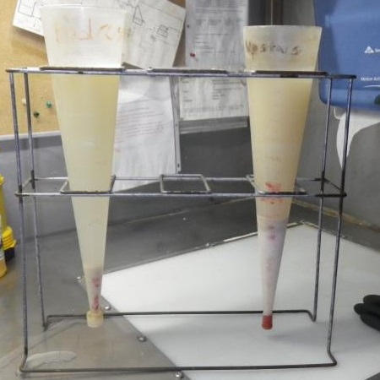
Pictures
Imhoff Cones – A graduated vessel for measuring settled solids composition.

Slide 25
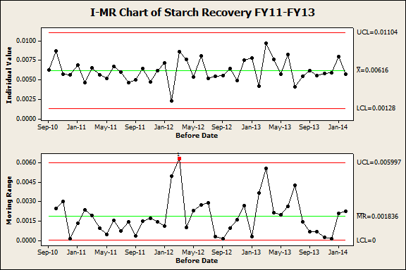
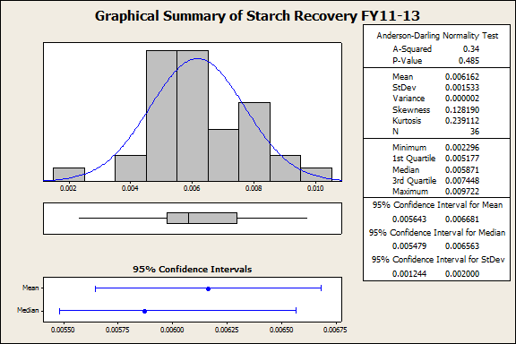
Graphical Analyses

Slide 26
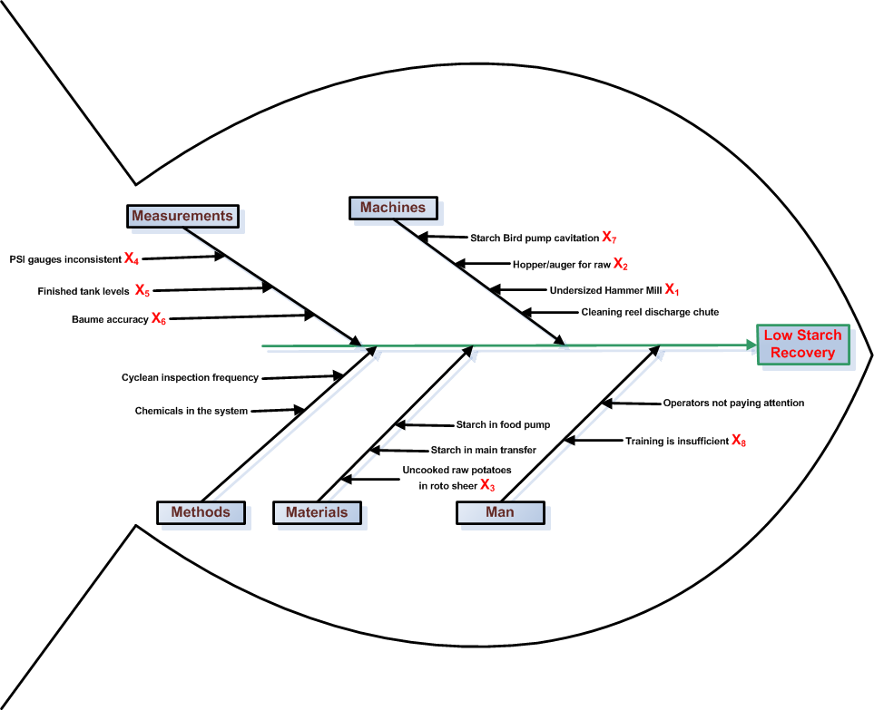
Cause-Effect Diagram(s)

Slide 27
Process FMEA
Process Step or Variable or Key Input | Potential Failure Mode | Potential Effect on Customer Because of Defect | SEV | Potential Causes | OCC | Current Process Controls | DET | RPN
What is the process step? | In what ways can the Process Step, Variable, or Key Input go wrong? (chance of not meeting requirements) | What is the impact on the Key Output Variables (customer requirements) or internal requirements? | How Severe is effect to the customer? | What causes the Key Input to go wrong? (How could the failure mode occur?) | How frequent is cause likely to Occur? | What are the existing controls that either prevent the failure mode from occurring or detect it should it occur? | How probable is Detection of cause? | Risk Priority # to rank order concerns
Roto Sheer | Not currently tied into starch system | Raw potato waste that could be used for starch is not used. | 7 | Does not exist | 6 | None | 7 | 294
WPS rejects | Not currently tied into starch system | Raw potato waste that could be used for starch is not used. | 7 | Does not exist | 6 | None | 7 | 294
Finished Tank Level | Mis-read production volume | Over or understate production | 6 | Misread gage | 7 | None | 6 | 252
Cyclean pressure | Difficult to accurately read pressure gauges | Starch recovery is not optimized | 5 | Misread gage | 7 | None | 7 | 245
Hopper / Auger for raw | We do not currently have this system | Raw potato waste that could be used for starch is not used. | 5 | Does not exist | 7 | None | 7 | 245
Starch bird pump | Pump may cavitate | Interupts starch production and wastes starch on the floor | 7 | Pump sucks tank dry and then cavitates | 5 | Operator observation | 6 | 210
Hammer Mill | Plug - up / Not handle flow | Starch production is interupted | 7 | Hammer mill is too small | 4 | Operator observation | 7 | 196
Baume | Innacurate Baume readings | Finished Baume is less than desirable | 5 | Misread gage | 6 | None | 6 | 180
Training | Improper setup | System may not be as efficient as it could be | 5 | Lack of training | 5 | WP audit | 7 | 175
Operators | Not paying attention | Many components of the system can fail or not be optimized. | 7 | Lack of training | 5 | Existing traininig | 5 | 175
Cleaning Reel | Discharge chute plugs up | Raw going to reel is wasted and not made into starch | 6 | Chute is too small | 4 | Operator observation | 7 | 168
Food pump | Not currently tied into starch system | System may have starch in it that we are not recovering | 5 | Does not exist | 6 | None | 4 | 120
Main transfer | Not currently tied into starch system | System may have starch in it that we are not recovering | 5 | Does not exist | 6 | None | 4 | 120

Slide 28
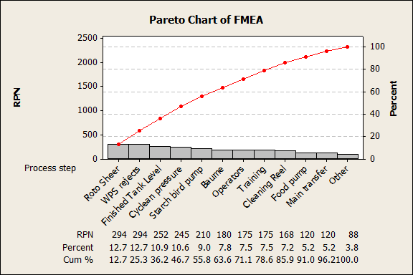
Process FMEA Pareto Chart

Slide 29
Potential Xs—Theories To Be Tested
X₁: Undersized hammer mill causes low starch recovery
X₂: Uncaptured raw waste causes low starch recovery
X₃: Not capturing raw uncooked potatoes from Rotoshear causes low starch recovery
X₄: Lack of discernment on PSI gauges causes low starch recovery
X₅: Measuring finished tank levels with a tape measure causes low starch recovery
X₆: Not controlling Baume causes low starch recovery
X₇: Starch bird pump cavitation causes low starch recovery
X₈: Poor training causes low starch recovery

Slide 30
Six Sigma Roadmap
Define
Measure
Analyze
Improve
Control

Slide 31
Potential Xs—Theories To Be Tested
X₁: Undersized hammer mill causes low starch recovery
X₂: Uncaptured raw waste causes low starch recovery
X₃: Not capturing raw uncooked potatoes from Rotoshear causes low starch recovery
X₄: Lack of discernment on PSI gauges causes low starch recovery
X₅: Measuring finished tank levels with a tape measure causes low starch recovery
X₆: Not controlling Baume causes low starch recovery
X₇: Starch bird pump cavitation causes low starch recovery
X₈: Poor training causes low starch recovery

Slide 32
Data Collection Plan for Analyze Phase
Ref. | Theories To Be Tested (Selected From The C-E Diagram, FMECA, and/or FDM) | List Of Questions That Must Be Answered To Test Each Selected Theory | Where Applicable, State The Null and Alternative Hypotheses |  | Tools To Be Used | Data To Be Collected
 |  |  | H₀ | H_{A} |  | Description/ Data Type | Sample Size, Number of Samples | Where To Collect Data | Who Will Collect Data | How Will Data Be Recorded | Remarks
1 | Undersized hammer mill causes low starch recovery | At what feed rate does the hammer mill plug? | h_{test} = h_{target} | h_{test} ≠ h_{target} | 1-sample Wilcoxon | Continuous (lbs/hour) | 1 basket, min 40 | Form line optisort | Process Operator | MMS | None
2 | Uncaptured raw waste causes low starch recovery | JDI - no data analysis needed
3 | Not capturing raw uncooked potatoes from Rotoshear causes low starch recovery | JDI - no data analysis needed
4 | Lack of discernment on PSI gauges causes low starch recovery | Does the poor discernment impact the ability to recover starch |  |  | MSA - Gage R&R | Continuous / PSI | 10 | At equipment | Mike & Lance | Minitab | None
5 | Measuring finished tank levels with a tape measure causes low starch recovery | JDI - no data analysis needed
6 | Not controlling Baume causes low starch recovery | JDI - no data analysis needed
7 | Starch bird pump cavitation causes low starch recovery | JDI - no data analysis needed
8 | Poor training causes low starch recovery | JDI - no data analysis needed
9 | PSI settings on the primary starch cyclones affect starch recovery | Are the primary starch system cyclones maximized | Coefficient Xm=0 | Coefficient Xm≠1 | DOE | Continuous / PSI | 10 | At equipment | Mike & Lance | Minitab | None

Slide 33
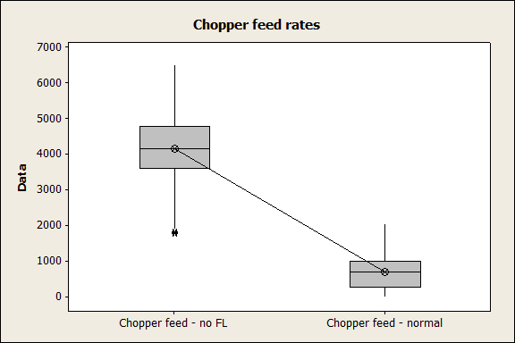
Test of Theories X₁
Theory: Undersized hammer mill causes low starch recovery
H_{o}: h_{test} = h_{target}
H_{a}: h_{test} ≠ h_{target}
Analysis:
Wilcoxon Signed Rank Test: Chopper feed - no FL
Test of median = 750.0 versus median not = 750.0
N for Wilcoxon Estimated
N N* Test Statistic P Median
Chopper feed - no FL 1354 3 1354 917250.0 0.000 4176
Statistical Conclusion: Reject H_{o}
Practical Conclusion: Hammer is not undersized.
*The test was designed to determine the feed rate that would exceed the capacity of the hammer mill by plugging it up. At 5 times the targeted rate the test was stopped.
Notes:
Normal (target) feed to FL is 750 lbs. Used a 1-Sample Wilcoxon to compare date to the target. *test results for a 1-Sample Wilcoxon as noted above is “Wilcoxon Signed Rank Test”

Slide 34
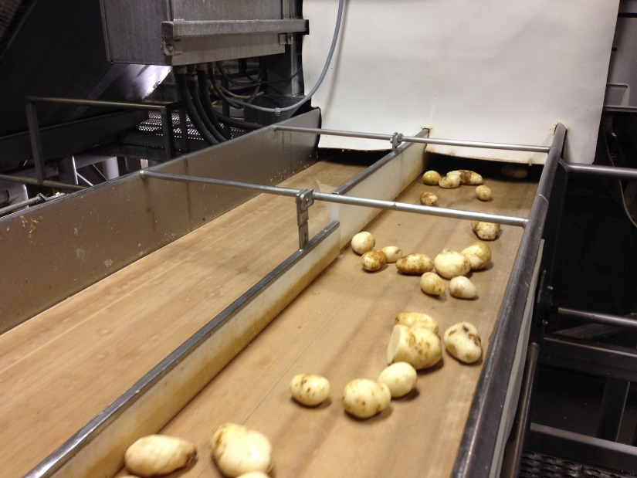
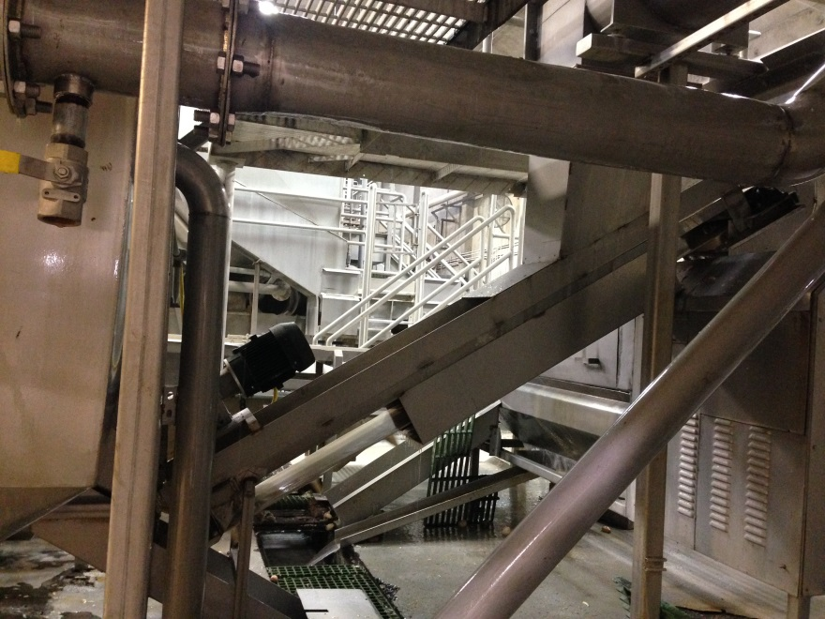
Test of Theories X₂
Old situation: Whole potato sorter rejected potatoes with excessive blemishes were rejected to waste.
New situation: Installed a conveyor and aggressive scrubber rollers to get product to formed line. Additional rejects from formed line go to starch.
Theory: Uncaptured raw waste causes low starch recovery.
JDI: Just do It!!
Scrubber with new
aggressive rollers
New conveyor
Whole Potato
Sorter rejects

Slide 35
Test of Theories X₃
Theory: Not capturing raw uncooked potatoes from Rotoshear causes low starch recovery.
JDI: Just do It!!
Any additional uncooked potato waste that can be fed to the hammer mill, such as the Rotoshear waste, will improve starch recovery.

Slide 36
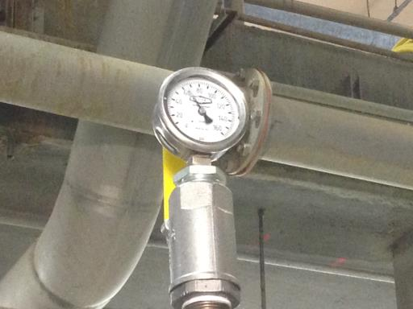
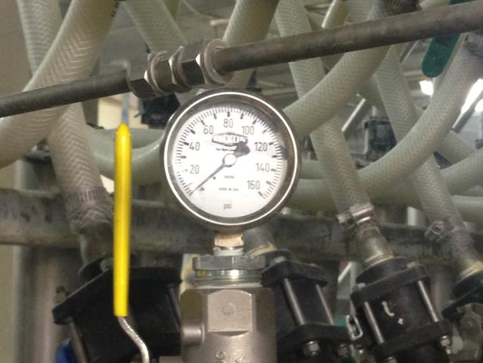
Test of Theories X₄
Theory: Lack of discernment on PSI gauges causes low starch recovery
Normally an MSA would be done in measure phase, however, as we approached the testing of X₄, we decided an MSA would be the best approach to move on.
We conducted a Gauge R&R study on the inlet and outlet pressure gauges. 3 starch system operators were randomly chose to participate in the study. We selected 10 gauge (part) settings across the operating range of the system and did 2 replicates. Operators were asked to read the gauge to the nearest 1 PSI.
Results on next page
Inlet Pressure
Outlet Pressure

Slide 37
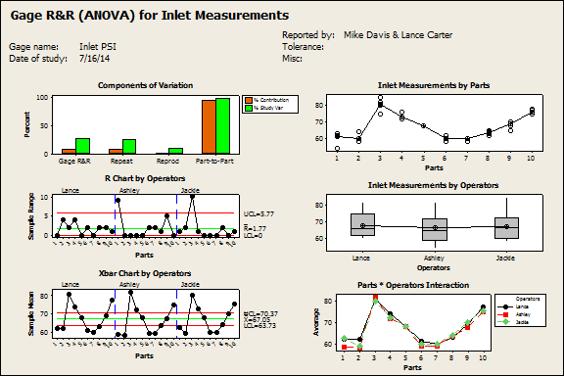
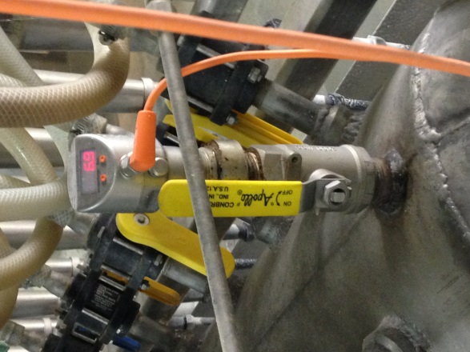
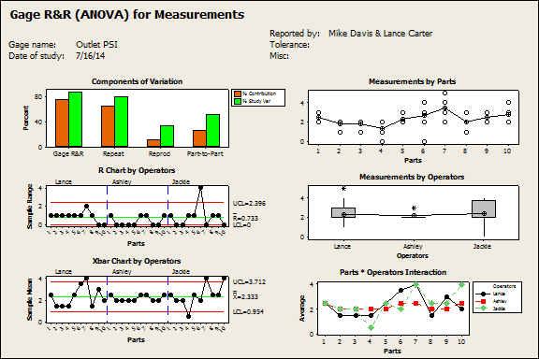
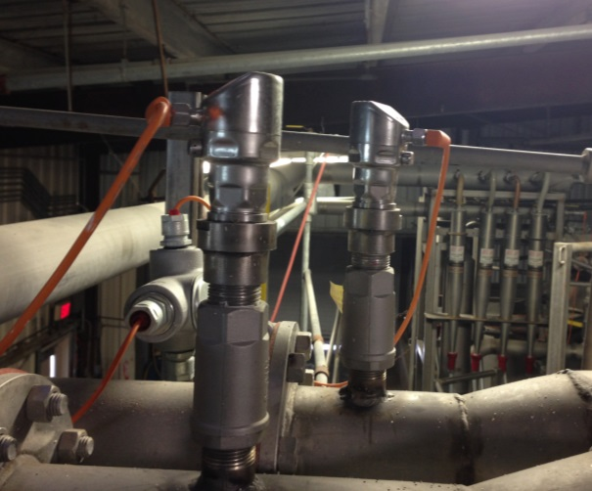
Test of Theories X₄
Theory: Lack of discernment on PSI gauges causes low starch recovery
Gage R&R
%Contribution
Source VarComp (of VarComp)
Total Gage R&R 4.1134 6.71
Repeatability 3.7299 6.09
Reproducibility 0.3835 0.63
Operators 0.3835 0.63
Part-To-Part 57.1750 93.29
Total Variation 61.2883 100.00
Study Var %Study Var
Source StdDev (SD) (6 * SD) (%SV)
Total Gage R&R 2.02814 12.1689 25.91
Repeatability 1.93128 11.5877 24.67
Reproducibility 0.61928 3.7157 7.91
Operators 0.61928 3.7157 7.91
Part-To-Part 7.56141 45.3685 96.59
Total Variation 7.82869 46.9721 100.00
Number of Distinct Categories = 5
FAIL
Gage R&R
%Contribution
Source VarComp (of VarComp)
Total Gage R&R 0.699074 74.17
Repeatability 0.600000 63.65
Reproducibility 0.099074 10.51
Operators 0.000000 0.00
Operators*Parts 0.099074 10.51
Part-To-Part 0.243519 25.83
Total Variation 0.942593 100.00
Study Var %Study Var
Source StdDev (SD) (6 * SD) (%SV)
Total Gage R&R 0.836106 5.01664 86.12
Repeatability 0.774597 4.64758 79.78
Reproducibility 0.314760 1.88856 32.42
Operators 0.000000 0.00000 0.00
Operators*Parts 0.314760 1.88856 32.42
Part-To-Part 0.493476 2.96086 50.83
Total Variation 0.970872 5.82523 100.00
Number of Distinct Categories = 1
EPIC FAIL
Replace gauges and move on to DOE. Did not repeat MSA since there are no mistakes on a digital gauge and data is recorded directly to SQL server.

Slide 38
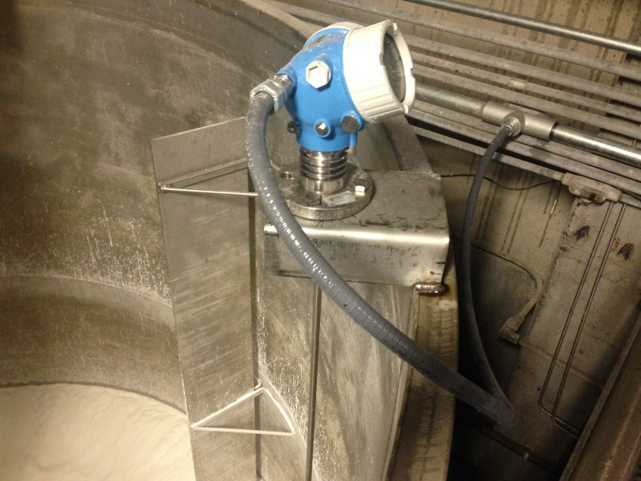
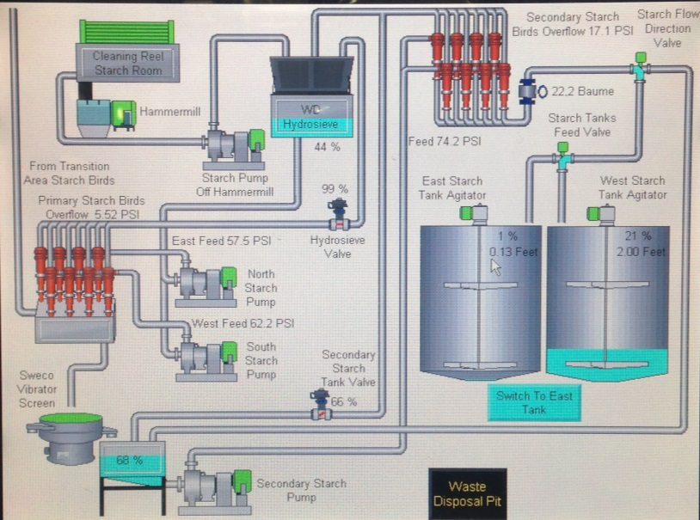
Test of Theories X₅
Old situation: The plant did not have a meaningful way to measure daily starch production.
New situation: Installed radar level indicators, HMI screen, and data feed to iFix and MMS for real time starch production volumes.
Theory: Measuring finished tank levels with a tape measure causes low starch recovery
JDI: Just do It!!

Slide 39
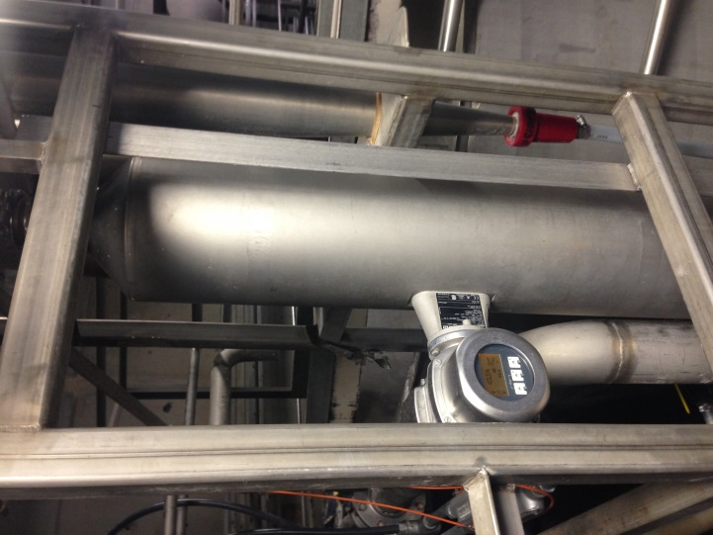
Test of Theories X₆
Old situation: The plant was using an old mass scale to control Baume in conjunction with a baume hydrometer and graduated cylinder. An MSA was conducted using the hydrometer method which passed in the “consider criticality” zone.
New situation: Installed Baume controller, 3 way control valve, HMI screen, and data feed to iFix and MMS for real time baume readings and control.
Theory: Not controlling Baume causes low starch recovery
JDI: Just do It!!

Slide 40
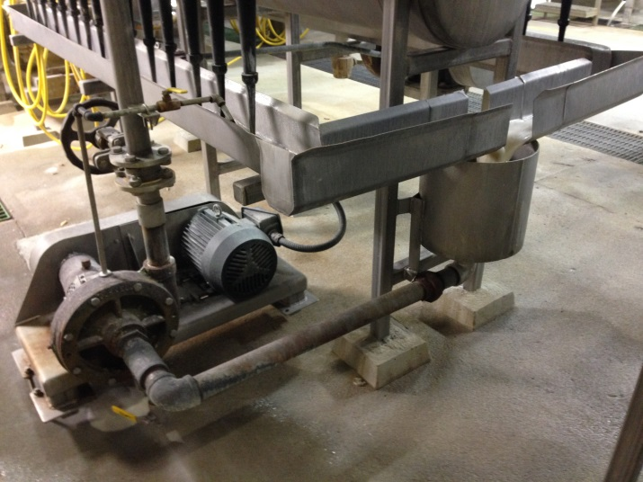
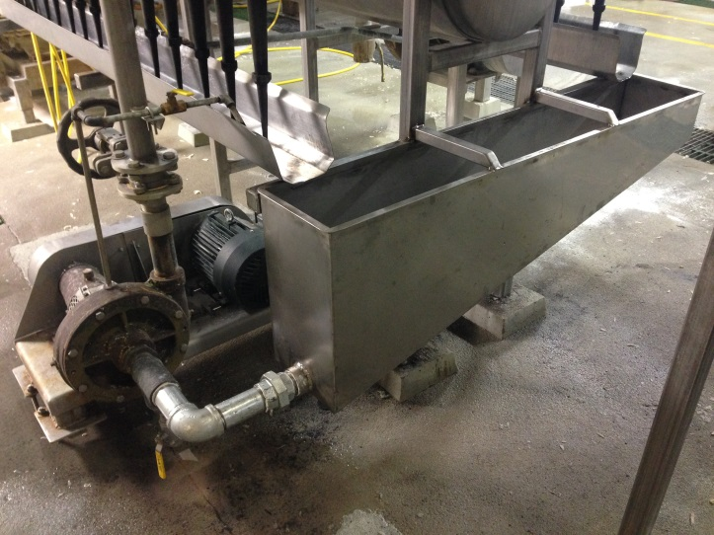
Test of Theories X₇
Theory: Starch bird pump cavitation causes low starch recovery.
JDI: Just do It!!
Replace centrifugal pump feed tank with larger sloped tank to prevent cavitation
Before
After

Slide 41
Test of Theories X₈
Theory: Poor training causes low starch recovery.
JDI: Just do It!!
Will be addressed in the communication plan

Slide 42
Summary of Testing Results
X₁: Undersized hammer mill causes low starch recovery - FALSE
X₂: Uncaptured raw waste causes low starch recovery. - JDI: Just do It!!
X₃: Not capturing raw uncooked potatoes from Rotoshear causes low starch recovery. - JDI: Just do It!!
X₄: Lack of discernment on PSI gauges causes inaccurate readings.
X₅: Measuring finished tank levels with a tape measure causes low starch recovery - JDI: Just do It!!
X₆: Not controlling Baume causes low starch recovery. - JDI: Just do It!!
X₇: Starch bird pump cavitation causes low starch recovery. - JDI: Just do It!!
X₈: Poor training causes low starch recovery. - JDI: Just do It!!

Slide 43
Vital Few Xs
Y=f(X₁,……X_{n})
Vital Few Xs are:
X₁ Uncaptured raw waste causes low starch recovery.
X₂ Not capturing raw uncooked potatoes from Rotoshear causes low starch recovery.
X₃ Lack of discernment on PSI gauges causes inaccurate readings.
X₄ Measuring finished tank levels with a tape measure causes low starch recovery
X₅ Not controlling Baume causes low starch recovery.
X₆ Starch bird pump cavitation causes low starch recovery.
X₇ Poor training causes low starch recovery.

Slide 44
Six Sigma Roadmap
Define
Measure
Analyze
Improve
Control

Slide 45
Improvement Strategies for Proven Xs
Proven Xs (Causes): | Strategies:
X₁: Uncaptured raw waste causes low starch recovery. | S₁ Install a conveyor to capture whole potato sorter rejects to starch.
X₂: Uncaptured Rotoshear waste causes low starch recovery. | S₂ Install a conveyor to capture Rotoshear waste in starch room.
X₃: Lack of discernment on PSI gauges causes inaccurate readings. | S₃ Replace the gauges with digital gauges with data output.
X₄: Measuring finished tank levels with a tape measure causes low starch recovery | S₄ Install tank level sensors with data output
X₅: Not controlling Baume causes low starch recovery. | S₅ Install automatic baume controller with data output.
X₆: Starch bird pump cavitation causes low starch recovery. | S₆ Replace centrifugal pump tank with larger sloped tank.
X₇: Poor training causes low starch recovery. | S₇ Conduct operator training

Slide 46
Pay-off Matrix of Selected Solutions

Slide 47
Selected Solutions
S₁ Install a conveyor to capture whole potato sorter rejects to starch.
S₂ Replace the gauges with digital gauges with data output.
S₃ Install tank level sensors with data output.
S₄ Install automatic baume controller with data output.
S₅ Replace centrifugal pump tank with larger sloped tank.
S₆ Conduct operator training

Slide 48
DOE
We selected the factors that have potential influence on starch recovery and selected the settings outside the normal operating range. Due to system limitations we were not able to go lower than 4 psi on the lowest back pressure setting
Theory:
H_{o}: Coefficient of X_{n} = 0 (Factors are not significant)
H_{a}: Coefficient of X_{n} ≠ 0 (Factors are significant)
Factor | High Setting | Normal | Low Setting
Feed Pressure | 100 | 80 | 60
Back Pressure | 10 | 5 | 4
Full Factorial Design
Factors: 2 Base Design: 2, 4
Runs: 10 Replicates: 2
Blocks: 1 Center pts (total): 2

Slide 49
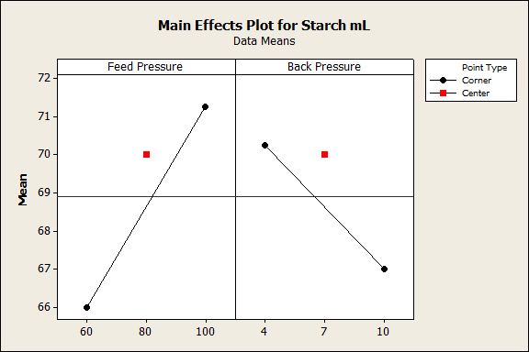
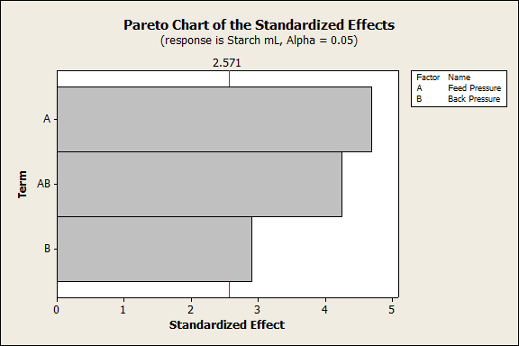
DOE
Main effects and interaction is significant. Center points indicate curvature. Modified DOE for Response Surface Design using the Central Composite Design.
Theory:
H_{o}: Coefficient of X_{n} = 0
H_{a}: Coefficient of X_{n} ≠ 0
Factorial Fit: Starch mL versus Feed Pressure, Back Pressure
Estimated Effects and Coefficients for Starch mL (coded units)
Term Effect Coef SE Coef T P
Constant 68.625 0.5590 122.76 0.000
Feed Pressure 5.250 2.625 0.5590 4.70 0.005
Back Pressure -3.250 -1.625 0.5590 -2.91 0.034
Feed Pressure*Back Pressure 4.750 2.375 0.5590 4.25 0.008
Ct Pt 1.375 1.2500 1.10 0.321
S = 1.58114 PRESS = 50
R-Sq = 90.87% R-Sq(pred) = 63.48% R-Sq(adj) = 83.56%

Slide 50
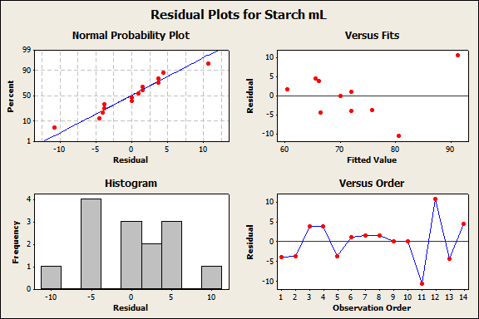
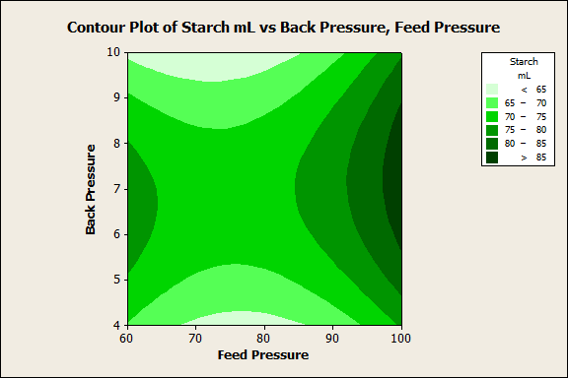
DOE
Theory:
H_{o}: Coefficient of X_{n} = 0
H_{a}: Coefficient of X_{n} ≠ 0
Response Surface Regression: Starch mL versus Block, Feed Pressure, Back Pressure
The analysis was done using uncoded units.
Estimated Regression Coefficients for Starch mL
Term Coef SE Coef T P
Constant 166.290 72.1762 2.304 0.055
Block -3.344 2.2514 -1.485 0.181
Feed Pressure -3.737 1.8279 -2.044 0.080
Back Pressure 13.292 7.7913 1.706 0.132
Feed Pressure*Feed Pressure 0.023 0.0113 2.068 0.077
Back Pressure*Back Pressure -1.187 0.5003 -2.374 0.049
Feed Pressure*Back Pressure 0.040 0.0416 0.951 0.373
S = 7.06450 PRESS = 1948.28
R-Sq = 71.48% R-Sq(pred) = 0.00% R-Sq(adj) = 47.03%
Statistical Conclusion: Reject H_{o}
Practical Conclusion: Feed pressure, back pressure and the interaction all affect starch output.
Optimal settings are 100psi feed pressure and 7psi back pressure.

Slide 51
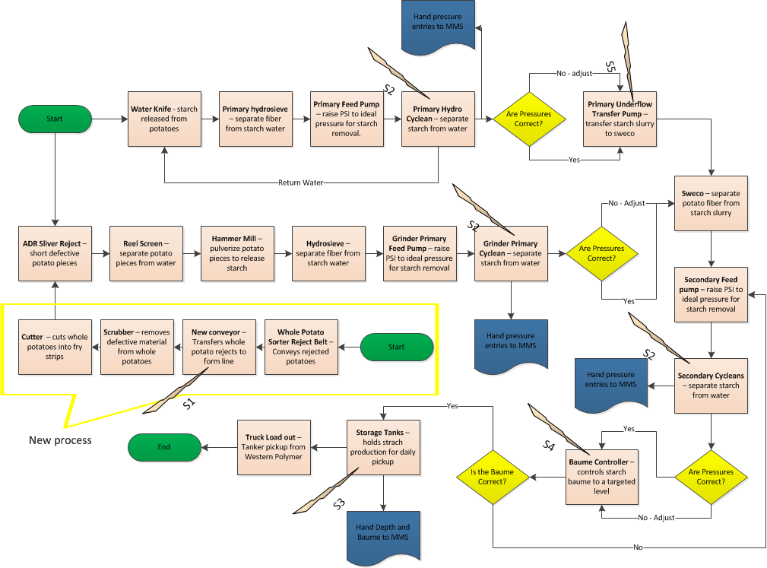
Updated Process Map
Notes:
S₁ Install a conveyor to capture whole potato sorter rejects to starch.
S₂ Replace the gauges with digital gauges with data output.
S₃ Install tank level sensors with data output.
S₄ Install automatic baume controller with data output.
S₅ Replace centrifugal pump tank with larger sloped tank.
S₆ Conduct operator training

Slide 52
Updated Process FMEA
Process Step or Variable or Key Input | Potential Failure Mode | SEV | OCC | DET | RPN | Resp.& Target Date | Actions Taken | SEV | OCC | DET | Future RPN
What is the process step? | In what ways can the Process Step, Variable, or Key Input go wrong? (chance of not meeting requirements) | How Severe is effect to the customer? | How frequent is cause likely to Occur? | How probable is Detection of cause? | Risk Priority # to rank order concerns | Who's Responsible for the recommended action? What date? | What were the actions implemented? Include completion month/year. (Then recalculate resulting RPN.) | Future Severity | Future Occurance | Future Detection
Starch bird pump | Pump may cavitate | 7 | 5 | 6 | 210 | XXXX - Sep 14 | Replaced pump tank - Sep 14 | 7 | 1 | 6 | 42
Training | Improper setup | 5 | 5 | 7 | 175 | XXXX - Sep 14 | Conducted Operator training - Sep 14 | 5 | 2 | 3 | 30
Finished Tank Level | Mis-read production volume | 6 | 7 | 6 | 252 | XXXX - July 14 | Installed level indicators - July 14 | 1 | 3 | 3 | 9
Baume | Innacurate Baume readings | 5 | 6 | 6 | 180 | XXXX - July 14 | Installed Baume controller - July 14 | 1 | 3 | 2 | 6
WPS rejects | Not currently tied into starch system | 7 | 6 | 7 | 294 | XXXX - Mar 14 | Installed Conveyor - Mar 14 | 1 | 1 | 2 | 2
Cyclean pressure | Difficult to accurately read pressure gauges | 5 | 7 | 7 | 245 | XXXX - July 14 | Installed pressure gauges - July 14 | 1 | 1 | 1 | 1

Slide 53
Implementation Plan
S₁ Install a conveyor to capture whole potato sorter rejects to starch. – XXXX, March 2014
S₂ Replace the gauges with digital gauges with data output. – XXXX, July 2014
S₃ Install tank level sensors with data output. – XXXX, July 2014
S₄ Install automatic baume controller with data output. – XXXX, July 2014
S₅ Replace centrifugal pump tank with larger sloped tank. – XXXX, Sept 2014
S₆ Conduct operator training. – XXXX, Sept 2014

Slide 54
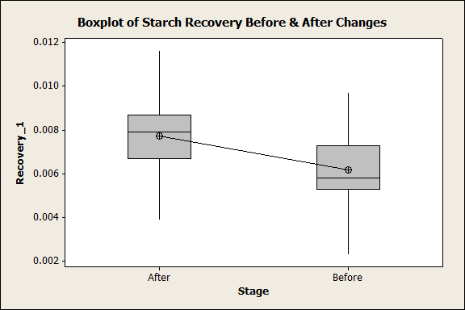
Statistical Proof of Improvements
Theory: This Six Sigma project affects starch recovery.
H_{o}: μ_{Before =} μ_{After}
H_{a}: μ_{Before} ≠ μ_{After}
Statistical Analysis:
Two-Sample T-Test and CI: Recovery_1, Stage
Two-sample T for Recovery_1
Stage N Mean StDev SE Mean
After 23 0.00772 0.00155 0.00032
Before 42 0.00616 0.00145 0.00022
Difference = mu (After) - mu (Before)
Estimate for difference: 0.001555
95% CI for difference: (0.000784, 0.002327)
T-Test of difference = 0 (vs not =): T-Value = 4.03 P-Value = 0.000 DF = 63
Both use Pooled StDev = 0.0015
Statistical Conclusion: Reject H_{o}
Practical Conclusion: Changes
from this project improved starch recovery.

Slide 55
Six Sigma Roadmap
Define
Measure
Analyze
Improve
Control

Slide 57
Training & Communication Plan
Round table meetings to train & communicate new/updated procedures to Shift Managers, Process Team Leaders and Process Water Operators at round tables on 9/16/14 & 9/17/14. Training conducted by, XXXX & XXXX.
Updated/Uploaded procedures to SharePoint for all plant access.
Add procedures to structured job training (SJT) manuals and added to qualifications checklist

Slide 58
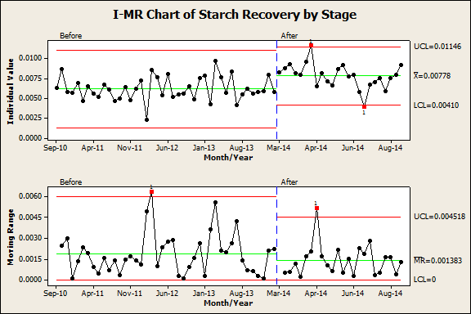
Control Charts

Slide 59
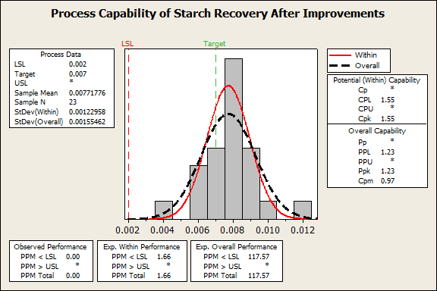
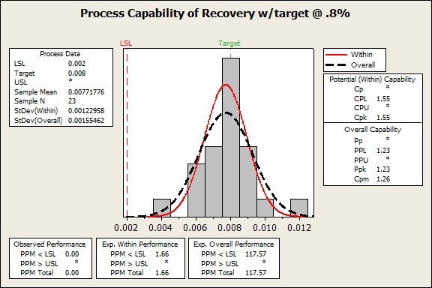
Updated Process Capability
New process is capable
Target was established at 15% above historical mean and is the goal of the project
No LSL existed from the customer, so we established it at 3s from the mean
We did not establish an USL since more is better…
Ran Process capability using a target of .8%

Slide 60
Project Results
Additional Annual Revenues of $223,781
Project Baseline: |  | Project Target: |  | Project Actual:
COPQ= | $253,129 | COPQ= | $131,004 | COPQ= | $29,348
Metric= | 0.6103% Starch Recovery | Metric= | 0.7018% Starch Recovery | Metric= | 0.7780% Starch Recovery
DPMO= | 1897 | DPMO= | 982 | DPMO= | 220
Sigma Level= | 4.39 | Sigma Level= | 4.60 | Sigma Level= | 5.01
*Calculated based on starch recovery benchmark at .8%

Slide 61
Lessons Learned
Anyone that ever says “we’ve always done it that way” is really asking you to scrutinize the process.
All processes must have target. Cyclone pressure did not have hard targets.
“Some people are just happier being angry.”
Don’t be afraid to test equipment to its limits to see what it can do. i.e. Chopper and pressures.
People have different interpretations; electronic and mechanical devices do not.

