Slide 1

Six Sigma Black Belt
Project Report Presentation: Food Industry
Project Number: PLP-BB-14-019
Project Name: Used Salad Oil Reduction – Oil Management
Project Team Leader: XXXX
Project Champion :XXXX

Slide 2
Six Sigma Roadmap
Define
Measure
Analyze
Improve
Control

Slide 3
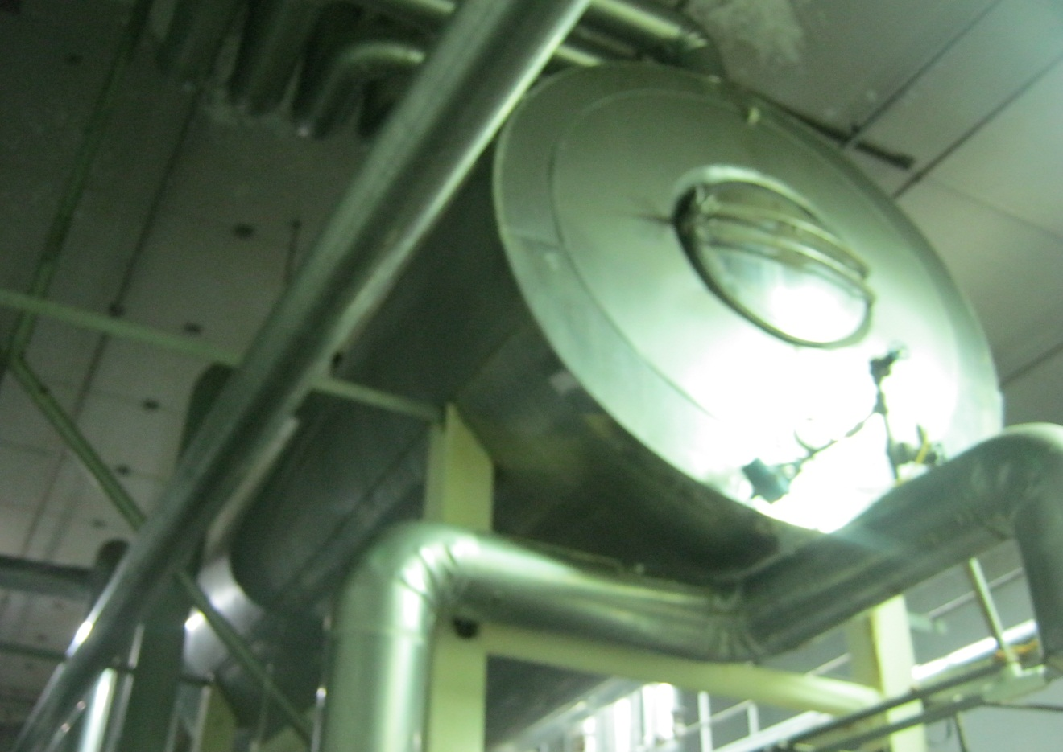
Operational Definitions of Key Terms
Air Purge – A blast of air, to empty pipes, used to transfer oil
Day Tanks – Tanks in the fryer rooms used to pre-stage oil, before the fryers

Slide 4
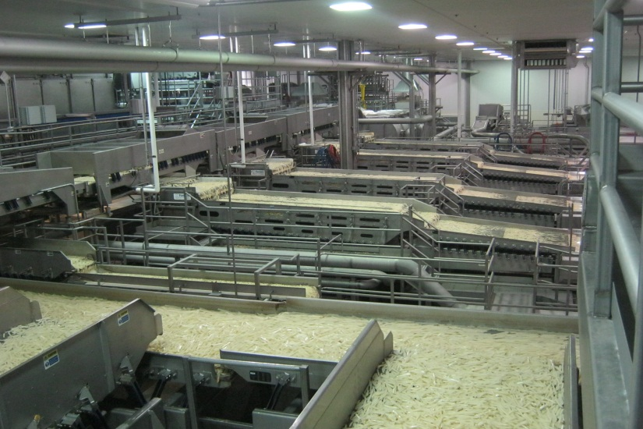
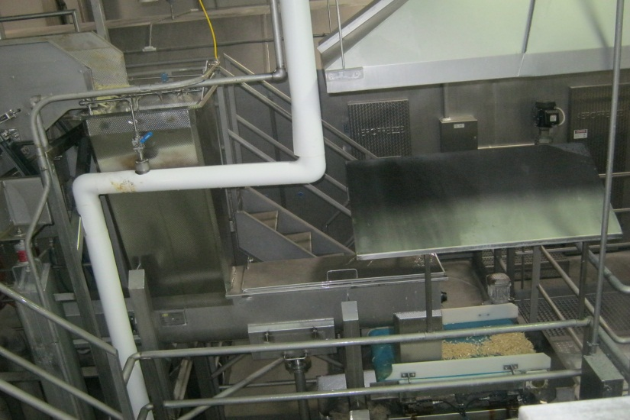
Operational Definitions of Key Terms
Line 1 – Plant Fry processing line.
Line 2 – Plant, formed product processing line

Slide 5
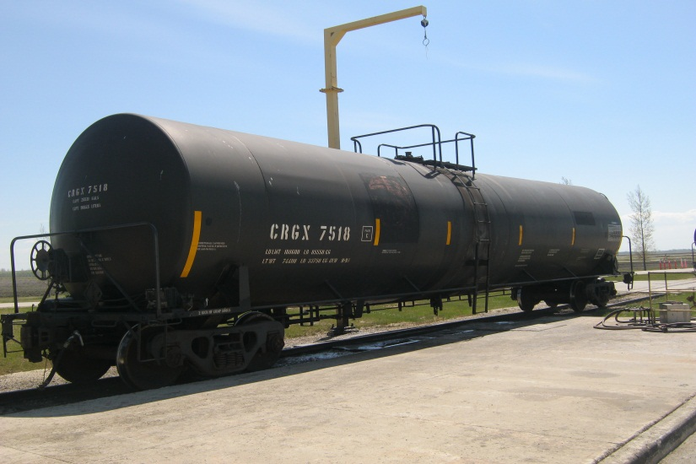
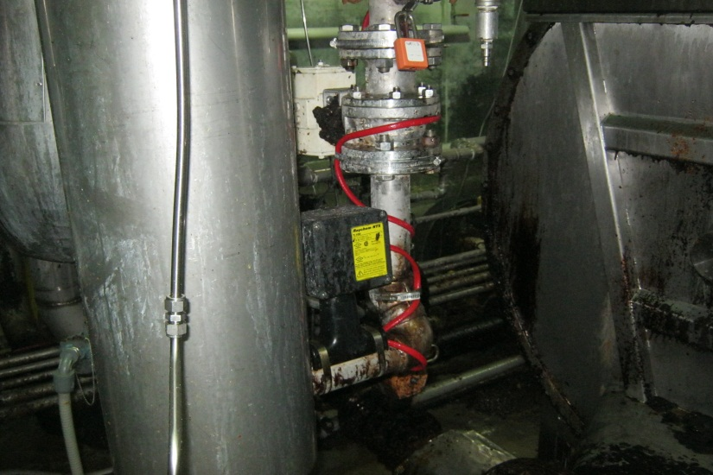
Operational Definitions of Key Terms
Rail Car – Railroad car used to bring fresh oil to the factory, and store used oil
Slip Line – A pipe which oil flows from Line 2 fryer to Line 1 Day tank

Slide 6
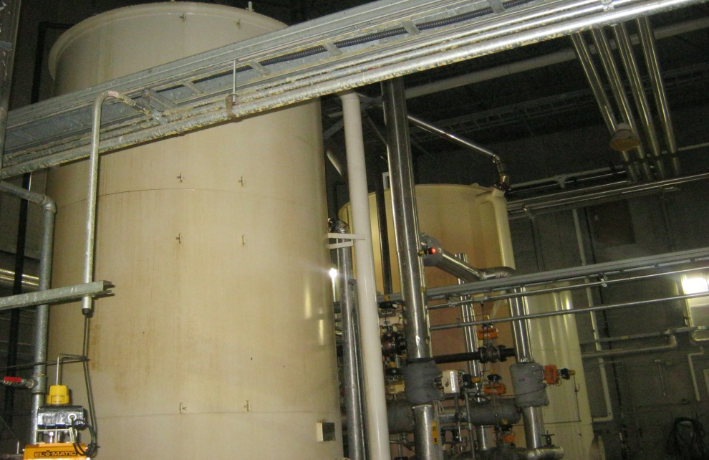
Operational Definitions of Key Terms
Used Oil – Salad oil which has been used to fry product
Used Oil tank – A storage tank used to store, used oil
Tank Farm – Storage room where all oil storage tanks are located

Slide 7
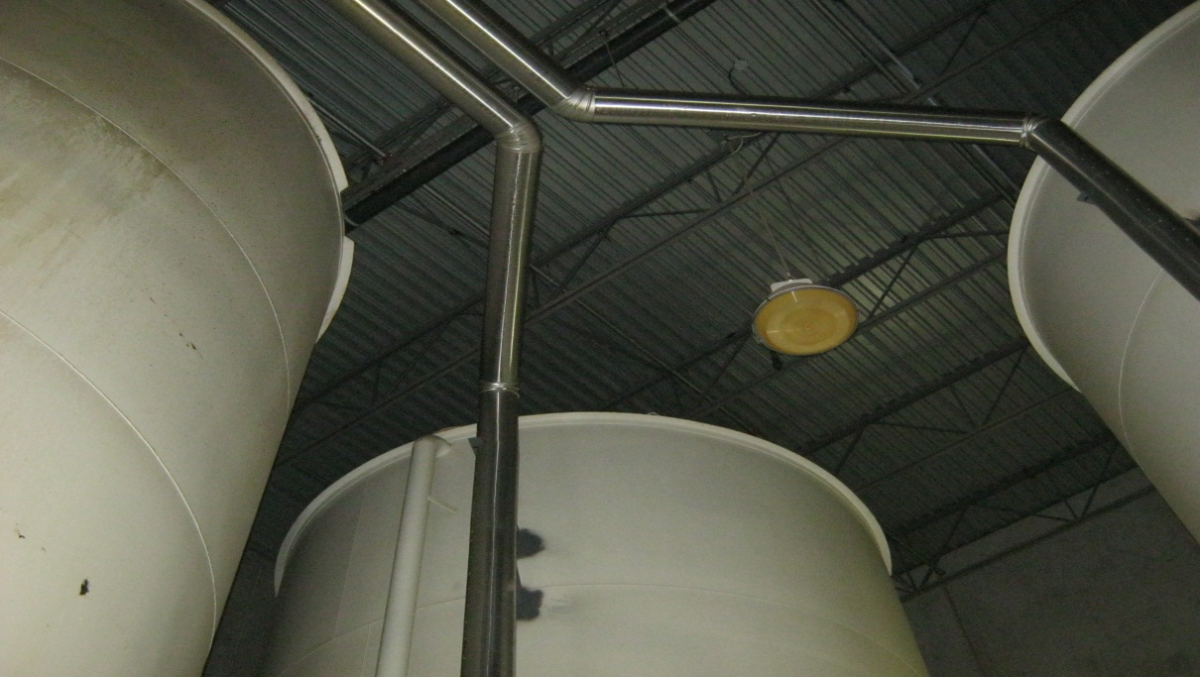
Operational Definitions of Key Terms
Fresh Tank – Storage tank used to store fresh oil
Salad Oil – Frying oil made from soy beans
Mac Oil – Special oil blend

Slide 8
Problem and Goal
Problem Statement: From 01/01/13 to 01/01/14 we have accumulated an average of 30,869lb of used salad oil at the Plant factory per week. In the next 12 months we are forecasted to produce using salad oil for 14.74 weeks. At 30,869lbs of accumulation/week we would be looking at 455,009lbs of used salad oil accumulated over the next 12 months. This accumulation would cost our factory, $186,371.71
Goals/Objective(s): Reduce the accumulation of used salad oil by 75% by June 2015.

Slide 9
Project Scope
In Scope: Salad oil, L1 and L2 oil storage, Oil shipping for rendering, L1 and L2 oil transfer, L1 and L2 frying, L1 and L2 FFA sampling, L1 and L2 oil miser operation and fat content on finished product. L1 and L2 finished solids. L1 and L2 drying.
Items Out of Scope: Mac oil, all L1 processing up to the dryer, L1 Freeze Tunnel, all L1 packaging and freezer storage. All L2 processing up to the dryer, the spiral freezer, packaging and freezer storage.

Slide 10
Project Justification and Expected Results
Relevant Metrics: Lbs of oil/1000lbs of product, lbs of product produced/hr, % fat content on the finished product, % finished Solids, FFA%.
Improvement targets: Reduce the accumulation of used salad oil, by 75%.
Operational/Strategic Impact: This project aligns with ABC Company’s Strategic plan to “Demand Operational Excellence”. It also aligns with the Plant Strategic plan to ensure “Optimal Use Of Our Resources”.

Slide 11
Financial Impact: Business Case or COPQ Calculation

Slide 12
Financial Impact: Business Case or COPQ Calculation
Savings From Less Accumulation
Forcasted Weeks of Running Salad Oil in FY15/FY16 | 14.74
Forecasted Used Salad Oil Accumulated in Lbs | 455,009.06
Forcasted Cost of Accumulated Used Salad Oil at $0.5346/lb | $243,247.84
Forecasted Cost of Shipping Used Salad Oil to be Rendered at $0.055/lb | $25,025.50
Profit from rendering Used Salad oil at $0.18/lb | $81,901.63
Forecasted Rendering Total Cost | $186,371.71
Improvement Target | 75%
Forecasted Project Savings |  | $139,778.78

Slide 13
Project Team Membership
Project Champion: XXXX
Project Team Leader: XXXX (BB)(GB)(LE)(Day Shift Manager)
Project Core Team Members: XXXX (GB)(Safety Specialist), XXXX (Packaging Supervisor), XXXX (GB)(HR Manager), Cam Calvert(IT)
Ad Hoc Members or SMEs: XXXX (Electrical), XXXX (Plant engineer), XXXX (Shift Manager), XXXX (Manager), XXXX (Process Quality Supervisor), XXXX (Process Quality Supervisor), XXXX (Shift Manger), XXXX (Shift Manager)

Slide 14
Project Plan- Milestones and Timing
Milestones |  | Timelines
Start |  | 1/6/2014
Define |  | 1/6/2014
Measure |  | 2/6/2014
Analyze |  | 3/6/2014
Improve |  | 4/6/2014
Control |  | 5/6/2014

Slide 15
Voice of the Customer - VOC
Voice of the Customer (VOC) Matrix
Rank | Customer | Voice of Customer | Key Issue | CTQ (the Y)
1 | ABC Company | Get the maximum value for our money, on salad oil | We are losing money on oil when we render it, instead of using it. | Accumulation of salad oil until we have to make the decision to render it.
2 | Plant Unit Director | Stop rendering used salad oil | We are rendering used salad oil instead of blending it. | Reaching 0lbs of used salad oil, rendered.
3 | Plant Production Manager | Stop making used salad oil, and blend as much used as we can if it has accumulated. | The blending does not have a solid control plan. | An excellent guide line for blending used salad oil will ensure maximum usage if there is, accumulation.
4 | Plant Shift Managers | I need to be able to blend used salad oil, and produce a high quality product at the same time. | Ensuring we produce high quality while blending used salad oil | Blend the maximum amount of used salad oil as possible and keep the FFA % lower than the upper spec.

Slide 16
High Level Process Map
SIPOC Template
SUPPLIER | INPUT (use nouns) | PROCESS (use verbs) | OUTPUT (use nouns) | CUSTOMER | CTQ's
XXXX | New salad oil | Ship new salad oil to ABC Company | Rail car full of new salad oil | XXXX | New salad oil with an FFA of .04% or lower
XXXX | Rail car full of new salad oil | Transfer salad oil into the salad oil storage tank | Storage tank full of new salad oil | Utilities | New salad oil in the storage tanks with an FFA of .04% or lower
Production | Storage tank full of new salad oil | Transfer new salad oil to day tanks | New salad oil stored inside day tanks | Day Tanks | New salad oil in the prep tanks with an FFA of .04% or lower
Day tanks | New salad oil stored inside day tanks | Transfer new salad oil to the fryers | Fryers full of salad oil | Fryers | New salad oil in the fryers with an FFA of .04% or lower
Fryers | Fryers full of salad oil | Fry strips | Product with excess used salad oil | Oil miser systems | Save and reuse salad oil
Oil miser systems | Excess used salad oil | Filter the used salad oil | Used salad oil which has had solids filtered out | Drum filters/Paper filter | Keep the FFA down
Drum filters/Paper filter | Used salad oil which has had solids filtered out | Reuse salad oil which has been recaptured and filtered | Used salad oil suitable to blend in the fryer | L1 Fryer | Use as much reclaimed and filtered salad oil as possible

Slide 17
Six Sigma Roadmap
Define
Measure
Analyze
Improve
Control

Slide 18
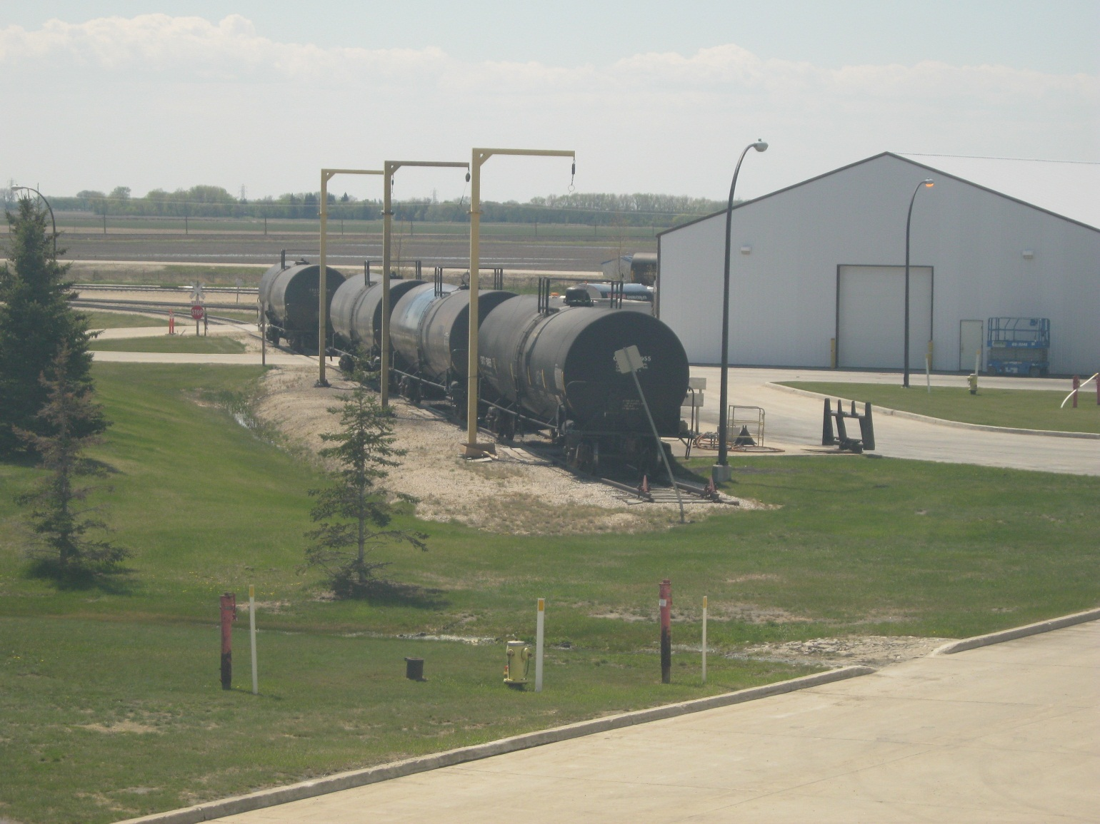
Project Y (or Ys) in Y=f(x)

Slide 19
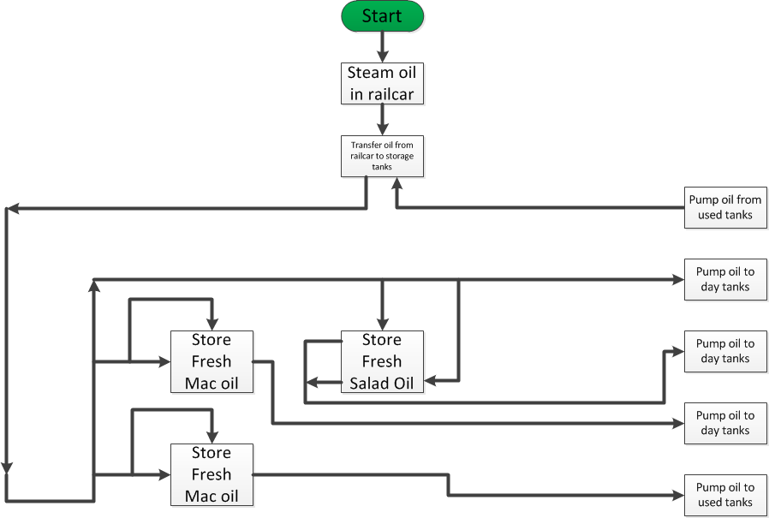
Detailed Process Map – Fresh Oil Tank Farm

Slide 20
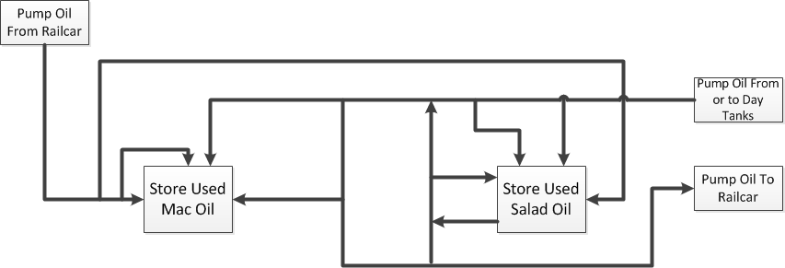
Detailed Process Map – Used Oil Tank Farm

Slide 21
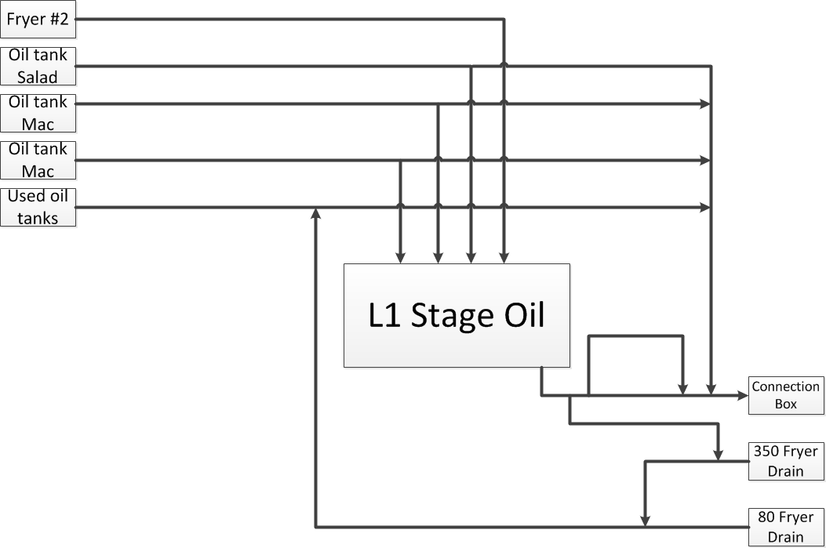
Detailed Process Map – L1 Day Tank

Slide 22
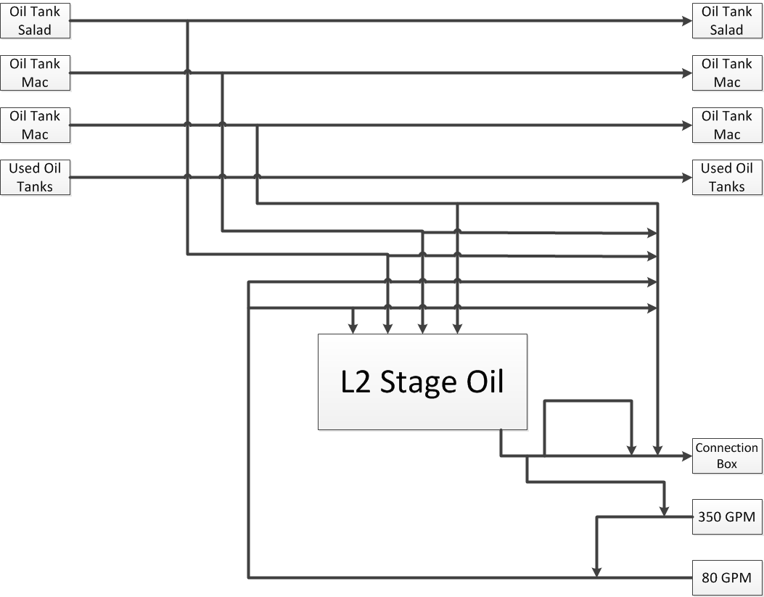
Detailed Process Map – L2 Day Tank

Slide 23
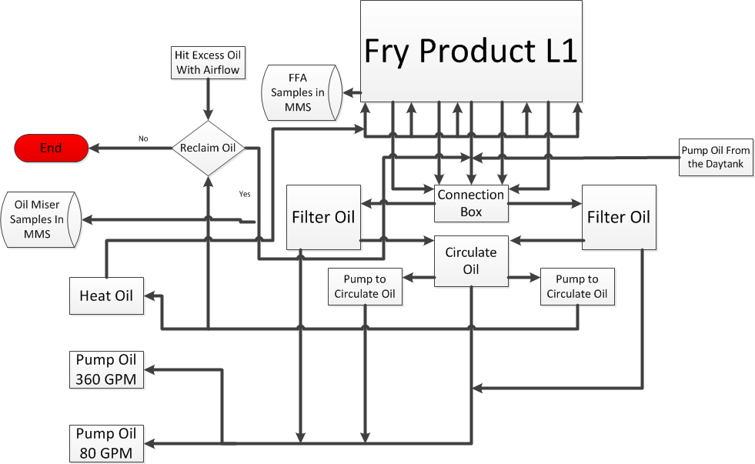
Detailed Process Map – L1 Fryer

Slide 24
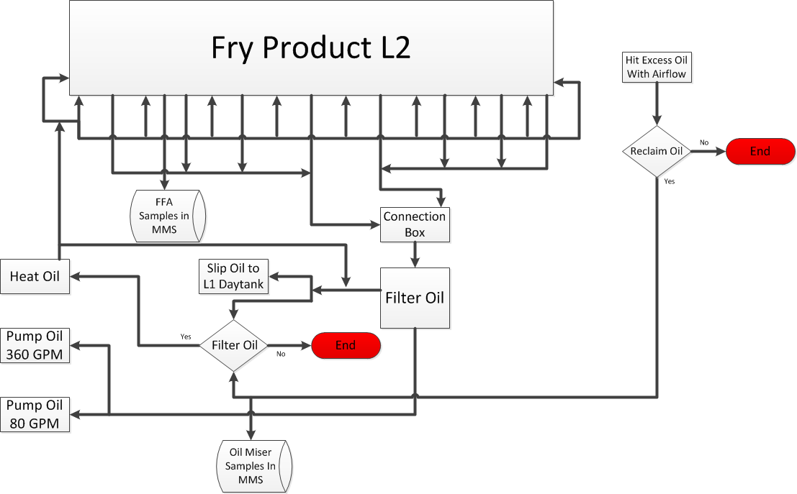
Detailed Process Map – L2 Fryer

Slide 25
Plan for Data Collection
Data Collection Plan
 | What to Measure |  | Operational Definition |  |  | Data Collection
Ref # | Question to Answer | Measure Name | Words | Formulas |  | Data Type | Sample Size | Collection Method | Who collects | Tools to use | Stratification Variables
1 | Can everyone distinguish what shade of pink is correct? | Shade of pink | Percent of people who can distinguish the correct shade of pink. | Number of people who can distinguish the correct color of pink/the total number doing the test |  | Categorical | 63 | Visual picture choices | Process operators | Attribute MSA | 3 different shades of pink
2 | Is the Titration for % FFA repeatible and reproducible | FFA | Will the results of the tirations completed pass a Gage RandR? | Will 90% of the samples completed be similar enough to pass a gage RandR |  | Continuous | 3 operators, measuring, 10 different samples, 3 different times | Titration on fryer oil | Process operators | Gage RandR | % FFA of oil

Slide 26
Validate Measurement System
An attribute agreement analysis was completed so 6 operators would have the opportunity to look at 3 different colors of pink to determine which color was the correct choice during an FFA sample. The procedure states that the sample needs to be faint pink but there is no reference guideline.
A Gage R and R was completed on the FFA sample as a whole. 3 operators were able to complete 5 different samples, and repeat the 5 samples 3 times each. All samples were done in a random order.
Attribute Agreement Analysis Worksheet
Samples: 3 Appraisers: 6
Replicates: 5 Total runs: 90
Gage R&R Study Worksheet
Parts: 5 Operators: 3
Replicates: 3 Total runs: 45

Slide 27
Validate Measurement System(Attribute Agreement Analysis)
Within Appraisers
Assessment Agreement
Appraiser # Inspected # Matched Percent 95% CI
Everett 3 2 66.67 ( 9.43, 99.16)
JJ 3 3 100.00 (36.84, 100.00)
Marj 3 2 66.67 ( 9.43, 99.16)
Pam 3 0 0.00 ( 0.00, 63.16)
Scott L. 3 1 33.33 ( 0.84, 90.57)
Wilmot 3 3 100.00 (36.84, 100.00)
Between Appraisers
Assessment Agreement
# Inspected # Matched Percent 95% CI
3 0 0.00 (0.00, 63.16)
Fail
All Appraisers vs Standard
Assessment Agreement
# Inspected # Matched Percent 95% CI
3 0 0.00 (0.00, 63.16)

Slide 28
Validate Measurement System(Gage R and R)
Gage R&R Study - ANOVA Method
Two-Way ANOVA Table With Interaction
Source DF SS MS F P
Parts 4 7.56868 1.89217 1038.39 0.000
Operators 2 0.02533 0.01267 6.95 0.018
Parts * Operators 8 0.01458 0.00182 2.56 0.029
Repeatability 30 0.02133 0.00071
Total 44 7.62992
Alpha to remove interaction term = 0.25
Gage R&R
%Contribution
Source VarComp (of VarComp)
Total Gage R&R 0.001804 0.85
Repeatability 0.000711 0.34
Reproducibility 0.001093 0.52
Operators 0.000723 0.34
Operators*Parts 0.000370 0.17
Part-To-Part 0.210039 99.15
Total Variation 0.211843 100.00
Study Var %Study Var
Source StdDev (SD) (6 * SD) (%SV)
Total Gage R&R 0.042479 0.25487 9.23
Repeatability 0.026667 0.16000 5.79
Reproducibility 0.033066 0.19839 7.18
Operators 0.026888 0.16133 5.84
Operators*Parts 0.019245 0.11547 4.18
Part-To-Part 0.458300 2.74980 99.57
Total Variation 0.460264 2.76158 100.00
Number of Distinct Categories = 15
Pass
<1% is acceptable
<10% is acceptable
>10 is acceptable

Slide 29
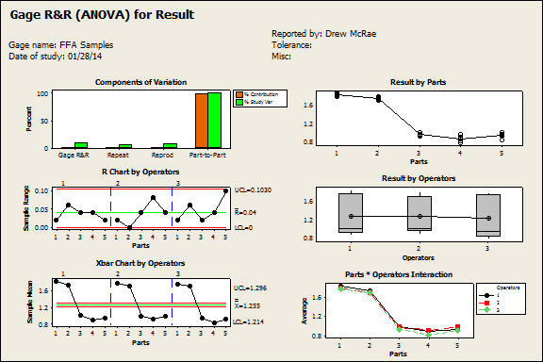
Validate Measurement System(Gage R and R)

Slide 30

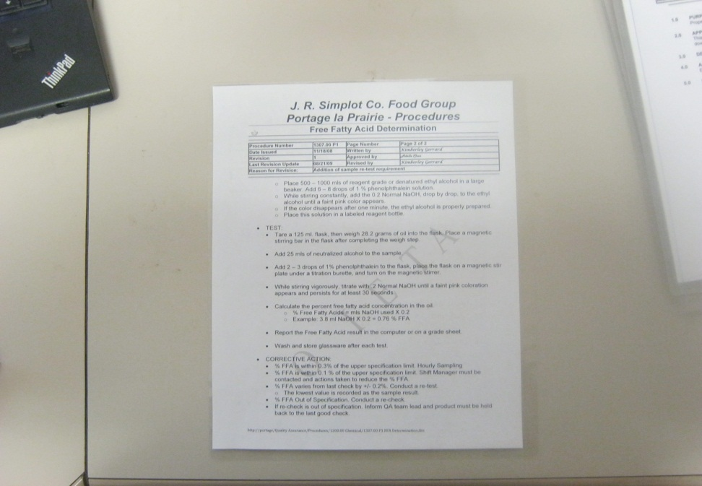
Validate Measurement System(Attribute Agreement Analysis)
A second Attribute Analysis was completed. 3 operators were asked to identify whether or not 20 shades of pink were either “acceptable” or “not acceptable”. This time the 3 operators were given a refresher on Procedure 1307.00 P2 Free Fatty Acid Determination. They were also given the target shade so they could reference it during the testing.
Attribute Agreement Analysis Worksheet
Samples: 20 Appraisers: 3
Replicates: 2 Total runs: 120

Slide 31
Validate Measurement System(Attribute Agreement Analysis)
Within Appraisers
Assessment Agreement
Appraiser # Inspected # Matched Percent 95% CI
1 20 20 100.00 (86.09, 100.00)
2 20 20 100.00 (86.09, 100.00)
3 20 20 100.00 (86.09, 100.00)
Between Appraisers
Assessment Agreement
# Inspected # Matched Percent 95% CI
20 19 95.00 (75.13, 99.87)
Pass
All Appraisers vs Standard
Assessment Agreement
# Inspected # Matched Percent 95% CI
20 19 95.00 (75.13, 99.87)

Slide 32
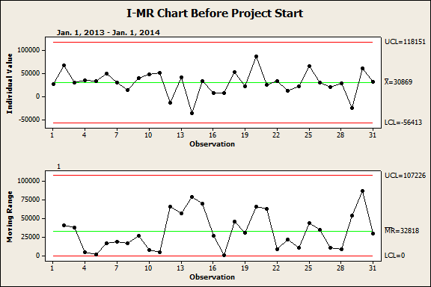
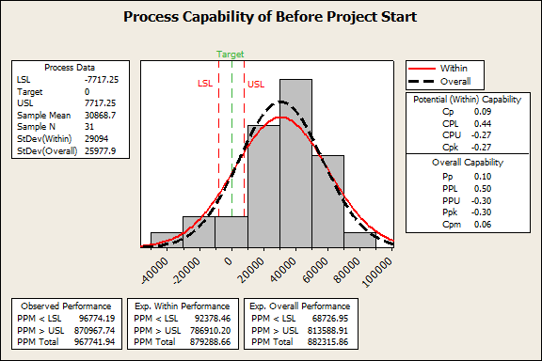
Measure Process Capability
Sigma Level

Slide 33
Measure Baseline Performance
Current:
COPQ: $186,371.71
Relevant Metric: Y = lbs of used Soy/Salad oil accumulated.
PPM (or DPMO): 882,315.86
Sigma Level: 0.31
Goal:
COPQ: $46,592.93
Relevant Metric: Y = lbs of used Soy/Salad oil accumulated.
PPM (or DPMO): 220,578.97
Sigma Level: 2.2

Slide 34
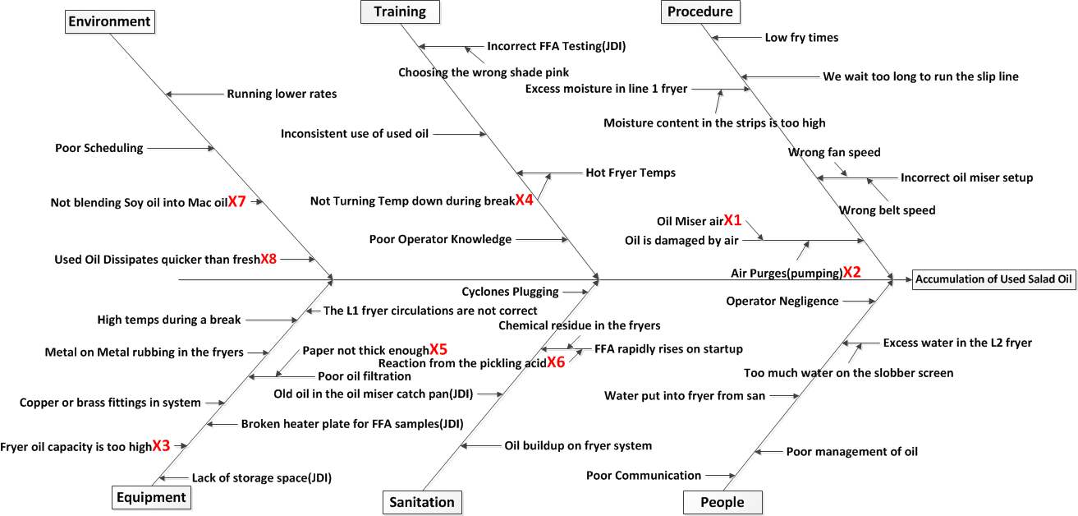
Cause-Effect Diagram

Slide 35
Process FMEA
Item Function | Potential Failure Mode | Potential Effect on Customer Because of Defect | SEV | Potential Causes | OCC | Current Process Controls | DET | RPN
Procedure | Oil miser air - Air penetration from oil miser fan | Oil is degraded quicker | 7 | Oil is damaged from air | 10 | Oil miser procedure for operation | 7 | 490
Procedure | Air purges(pumping) Air purges after a transfer could be causing damage to the oil | Oil is degraded quicker | 7 | Oil is damaged from air | 8 | Nothing for air purges | 7 | 392
Equipment | Fryer oil capacity - The required amount of oil is not being carried out of the fryer | Oil remains in the fryer and is subject to the higher heat for longer periods of time causing more degredation | 7 | Fryer Oil Capacity is too high, we don’t turn over the oil quick enough | 10 | No procedure | 4 | 280
Procedure | Not turning temp down during break - A break in the line comes along and the fryer temp does not get turned down. The higher temp causes the oil to degrade quicker | Oil degrading quicker results in more used oil which results in more costs. | 8 | High oil temp during a break damages oil | 4 | No procedure | 7 | 224

Slide 36
Process FMEA
Item Function | Potential Failure Mode | Potential Effect on Customer Because of Defect | SEV | Potential Causes | OCC | Current Process Controls | DET | RPN
Equipment | Paper is not thick enough - If crumb and burnt pieces are left in the oil it will degrade the oil quicker | If the oil is degraded faster more used oil will be created | 7 | Poor oil filtration | 5 | No procedure | 6 | 210
Sanitation | Reaction from the pickling acid - The acid we are currently using is causing a reaction in the oil causing FFA to rise | Higher FFA can cause difficulty blending and will result in more used oil | 10 | The pickling acid we are currently using to season the fryer chain is reacting and causing the FFA to increase rapidly | 5 | Procedure outlining how and what to use to pickle the chain | 4 | 200
Procedure | Not blending soy oil into Mac oil - 70% of our volume on L1 is Macfries | Not being able to blend used oil will result in us having to render it at a loss | 7 | Customer requirements, views, opinions | 5 | None | 5 | 175
Environment | Used oil dissipates or burns up quicker than fresh oil | If used oil burns up quicker then we will use more oil per lb of potatoes | 7 | The higher the temperature of the oil the quicker the viscosity breaks down | 5 | Unwritten rule to fry between 360 and 370. | 5 | 175

Slide 37
Potential Xs—Theories To Be Tested
X₁: Is our oil being damaged from oil miser airflow?
X₂: Is our oil being damaged from air purges during pumping?
X₃: Is our L1 fryer Oil Capacity too high?
X₄: Do high oil temps during a break damage oil?
X₅: Would using thicker paper, on the paper filter for L2 fryer, lessen the degradation of oil by removing more solids (burnt crumb)?
X₆: Is our pickling acid causing degradation?
X₇: Would blending Salad oil into Mac oil allow us to use more used oil?
X₈: Is our oil consumption higher when blending used salad oil?

Slide 38
Six Sigma Roadmap
Define
Measure
Analyze
Improve
Control

Slide 39
Potential Xs—Theories To Be Tested
X₁: Is our oil being damaged from oil miser airflow?
X₂: Is our oil being damaged from air purges during pumping?
X₃: Is our L1 fryer Oil Capacity too high? Do we turn over the oil quick enough to allow degraded oil to be refreshed?
X₄: Do high oil temps during a break damage oil?
X₅: Would using thicker paper, on the paper filter for L2 fryer, lessen the degradation of oil by removing more solids (burnt crumb)?
X₆: Is our pickling acid causing degradation on our oil?
X₇: Would blending Salad oil into Mac oil allow us to use more used oil?
X₈: Is our oil consumption higher when blending used salad oil?

Slide 40
Just Do Its
Lack of storage space for used oil – JDI(Decided not to change tanks around due to cost for exhaust, on the storage tank).
Broken heater plate for FFA samples – JDI(A new hot plate was purchased and is checked for replacement on a monthly basis)
Incorrect FFA sampling – JDI(Was corrected after the failure of an MSA. A new target picture was introduced for reference while doing a sample)

Slide 41
Data Collection Plan for Analyze Phase
Data Collection Plan for the Analyze Phase (Template)
Ref. | Theories To Be Tested (Selected From The C-E Diagram, FMECA, and/or FDM) | List Of Questions That Must Be Answered To Test Each Selected Theory | Where Applicable, State The Null and Alternative Hypotheses |  | Tools To Be Used | Data To Be Collected
 |  |  | H₀ | H_{A} |  | Description/ Data Type | Sample Size, Number of Samples | Where To Collect Data | Who Will Collect Data | How Will Data Be Recorded
1 | Is our salad oil getting damaged from air flow in the oil miser? | Does repeated airflow cause an increase in FFA and degradation? | The difference between µ1 and µ2 = 0 | The difference between µ1 and µ2 ≠ 0 | Graphical summary, Paired T | Paired FFA samples, Continuous data | 28 samples before the oil miser, 28 samples after the oil miser | Before samples collected from the fryer, After samples collected at the bottom of the cyclones | XX | On paper, transferred to Minitab
2 | Is our salad oil getting damaged from air flow during an air purge after pumping? | Is it better to use/not use an air purge to clean the lines? | ETA1 before the air purge = ETA2 after the air purge | ETA1 before the air purge ≠ ETA2 after the air purge | Graphical summary, Mann-Whitney | Paired FFA samples, Continuous data | 19 samples before an air purge, 19 samples after an air purge | Before samples collected from the fresh tank, after samples collected after the day tank at the entrance of L1 fryer | XX | On paper, transferred to Minitab
3 | Is the oil capacity in our fryer low enough to refresh the oil efficiently? | Does the oil in our fryer sit there too long causing the FFA to get too high before it is refreshed? | ETA1 at a 7.8inch fryer level = ETA2 at a 6.5inch fryer level | ETA1 at a 7.8inch fryer level ≠ ETA2 at a 6.5inch fryer level | Graphical summary, Mann-Whitney | 16 FFA samples at an oil level of 7.8 and 25 FFA samples at an oil level of 6.5 Continuous data | 16 oil samples at 7.8 inches and 25 samples at 6.5 inches | All samples collected from L1 fryer | XX | On paper, transferred to Minitab
4 | Does our salad oil get damaged from a higher temperature? | Do we need to turn the temp down on the fryer when there is a break? | ETA1 low temp = ETA2 high temp | ETA1 low temp ≠ ETA2 high temp | Graphical summary, Mann-Whitney | FFA samples, Continuous data | 25 samples at low temp and 25 samples at high temp | Low temp samples collected at 300 F, High samples collected at 370 F | XX | On paper, transferred to Minitab

Slide 42
Data Collection Plan for Analyze Phase

Slide 43
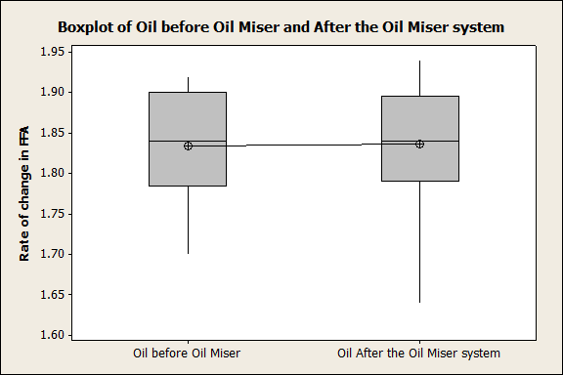
Test of Theories for X₁
Theory: The air from the oil miser systems is damaging our oil
H_{o}: Oil FFA before exposed to oil miser airflow = Oil FFA after exposure to oil miser airflow
H_{a}: Oil FFA before exposed to oil miser airflow ≠ Oil FFA after exposure to oil miser airflow
Analysis: Graphical analysis was done on both sets of samples which showed the data was normal. Next a paired T test was done to compare the rate of change difference on the results.
Paired T for Oil before Oil Miser - Oil After the Oil Miser system
N Mean StDev SE Mean
Oil before Oil Miser 28 1.8343 0.0644 0.0122
Oil After the Oil Miser 28 1.8364 0.0728 0.0138
Difference 28 -0.00214 0.02685 0.00508
95% CI for mean difference: (-0.01256, 0.00827)
T-Test of mean difference = 0 (vs not = 0): T-Value = -0.42
P-Value = 0.676
Statistical Conclusion: The high P-Value tells us to “Fail to Reject the Null Hypothesis”
Practical Conclusion: The FFA is no different after the oil is exposed to the airflow from the oil miser.
Statistical Conclusion:
Practical Conclusion:
High P-value

Slide 44
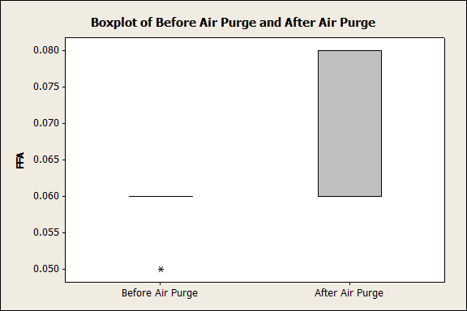
Test of Theories X₂
Theory: The air purges after an oil transfer are damaging our oil
H_{o}: Oil FFA before exposed to air purge = Oil FFA after exposure to air purge
H_{a}: Oil FFA before exposed to air purge ≠ Oil FFA after exposure to air purge
Analysis: Graphical Summary was conducted on both sets of data and it was concluded that both sets were not normal. A Mann-Whitney test was performed to compare the medians.
Mann-Whitney Test and CI: Before Air Purge, After Air Purge
N Median
Before Air Purge 19 0.06000
After Air Purge 19 0.06000
Point estimate for ETA1-ETA2 is -0.00000
95.3 Percent CI for ETA1-ETA2 is (-0.02000,0.00000)
W = 289.0
Test of ETA1 = ETA2 vs ETA1 not = ETA2 is significant at 0.0180
The test is significant at 0.0014 (adjusted for ties)
Statistical Conclusion: We will “reject the null hypothesis”.
Practical Conclusion: Statistical analysis proves that there is a significant difference between the two sets of data. However the difference only being 0.02 of a percent tells us that the air purge is not damaging the oil enough to cause a significant accumulation issue.
Low P-value

Slide 45
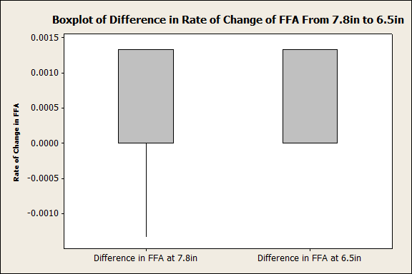
Test of Theories X₃
Theory: The rate of change in FFA is less when the oil level is lower
H_{o}: Rate of change, of FFA at an oil level of 7.8 = Rate of change, of FFA at an oil level of 6.5
H_{a}: Rate of change, of FFA at an oil level of 7.8 ≠ Rate of change, of FFA at an oil level of 6.5
Analysis: Graphical Summary was conducted on both sets of data and it was concluded that both sets were not normal. A Mann-Whitney test was performed to compare the medians.
Mann-Whitney Test and CI: Difference in FFA, Difference in FFA
N Median
Difference in FFA at 7.8 15 0.00000
Difference in FFA at 6.5 divide 18 0.00000
Point estimate for ETA1-ETA2 is -0.00000
95.1 Percent CI for ETA1-ETA2 is (-0.00000,-0.00000)
W = 260.0
Test of ETA1 = ETA2 vs ETA1 not = ETA2 is significant at 0.8708
The test is significant at 0.8521 (adjusted for ties)
Statistical Conclusion: We will “fail to reject the null hypothesis”.
Practical Conclusion: There is no difference in the rate of change, of FFA, from a 7.8in oil level to a 6.5in oil level.
High P-value

Slide 46
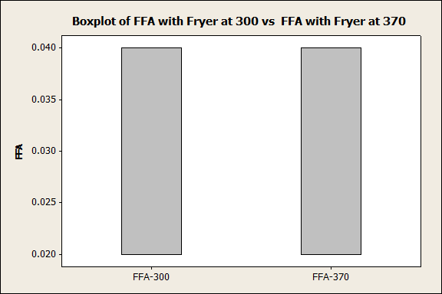
Test of Theories X₄
Theory: The hotter the temperature of our oil, the higher the degradation rate
H_{o}: Rate of change, of FFA at 300 degrees F = Rate of change, of FFA at 370 degrees F
H_{a}: Rate of change, of FFA at 300 degrees F ≠ Rate of change, of FFA at 370 degrees F
Analysis: Graphical Summary was conducted on both sets of data and it was concluded that both sets were not normal. A Mann-Whitney test was performed to compare the medians.
Mann-Whitney Test and CI: FFA-300, FFA-370
N Median
FFA-300 25 0.02000
FFA-370 25 0.04000
Point estimate for ETA1-ETA2 is 0.00000
95.2 Percent CI for ETA1-ETA2 is (0.00000,0.00000)
W = 612.5
Test of ETA1 = ETA2 vs ETA1 not = ETA2 is significant at 0.6345
The test is significant at 0.5828 (adjusted for ties)
Statistical Conclusion: We will fail to reject the null hypothesis.
Practical Conclusion: Temperature alone does not make a difference in degradation of oil.
High P-value

Slide 47
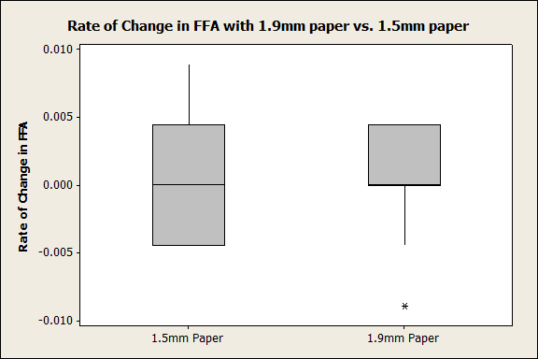
Test of Theories X₅
Theory: Using a thicker filter paper on L2 will lessen the degradation time
H_{o}: Rate of change, of FFA with a 1.9mm paper = Rate of change, of FFA with a 1.5mm paper
H_{a}: Rate of change, of FFA with a 1.9mm paper ≠ Rate of change, of FFA with a 1.5mm paper
Analysis: Graphical Summary was conducted on both sets of data and it was concluded that both sets were not normal. A Mann-Whitney test was performed to compare the medians.
Mann-Whitney Test and CI: 1.5mm Paper, 1.9mm Paper
N Median
1.5mm Paper 39 0.00000
1.9mm Paper 39 0.00000
Point estimate for ETA1-ETA2 is 0.00000
95.1 Percent CI for ETA1-ETA2 is (-0.00444,-0.00000)
W = 1468.5
Test of ETA1 = ETA2 vs ETA1 not = ETA2 is significant at 0.4749
The test is significant at 0.4425 (adjusted for ties)
Statistical Conclusion: We will fail to reject the null hypothesis.
Practical Conclusion: Thickness of paper does not lessen the degradation of the oil.
High P-value

Slide 48
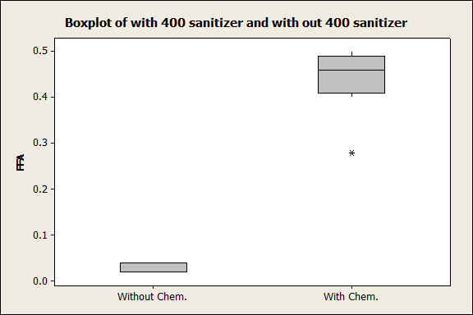
Test of Theories X₆
Theory: The use of our pickling acid, 400 sanitizer, is causing rapid degradation of our oil
H_{o}: FFA on oil mixed with 400 sanitizer = FFA on oil without 400 sanitizer
H_{a}: FFA on oil mixed with 400 sanitizer ≠ FFA on oil without 400 sanitizer
Analysis: A Graphical Summary was conducted on both sets of data and it was concluded that both sets were not normal. A Mann-Whitney test was performed to compare the medians.
Mann-Whitney Test and CI: Without Chem., With Chem.
N Median
Without Chem. 17 0.04000
With Chem. 17 0.46000
Point estimate for ETA1-ETA2 is -0.44000
95.0 Percent CI for ETA1-ETA2 is (-0.46001,-0.40001)
W = 153.0
Test of ETA1 = ETA2 vs ETA1 not = ETA2 is significant at 0.0000
The test is significant at 0.0000 (adjusted for ties)
Statistical Conclusion: We will reject the null hypothesis.
Practical Conclusion: 400 sanitizer used to pickle L2 fryer chain, causes FFA to rise by 0.42%.
Low P-value

Slide 49
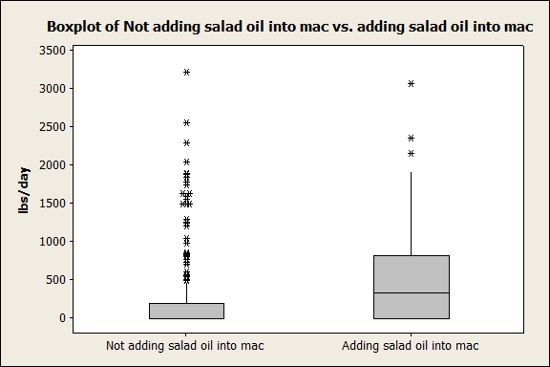
Test of Theories X₇
Theory: Blending used salad with fresh salad and fresh Mac will allow us to blend more used salad oil
H_{o}: lbs/day of used salad blended into fresh salad = lbs/day of used salad blended into fresh salad and fresh Mac
H_{a}: lbs/day of used salad blended into fresh salad ≠ lbs/day of used salad blended into fresh salad and fresh Mac
Analysis: A Graphical Summary was conducted on both sets of data, and it was concluded that both sets were not normal, because there are a lot of outliers the Mood’s Median test was conducted.
Mood Median Test: Salad oil added versus Were we adding?
Mood median test for Salad oil added
Chi-Square = 74.67 DF = 1 P = 0.000
Were we Individual 95.0% CIs
adding? N<= N> Median Q3-Q1 +---------+---------+---------+------
NO 185 62 0 193 *
YES 29 81 334 817 (------*------------)
+---------+---------+---------+------
0 150 300 450
Overall median = 0
A 95.0% CI for median(NO) - median(YES): (-472,-225)
Statistical Conclusion: The P is low so we will reject the null
Practical Conclusion: We are able to blend more used salad when using it in both, salad and Mac.
Low P-value

Slide 50
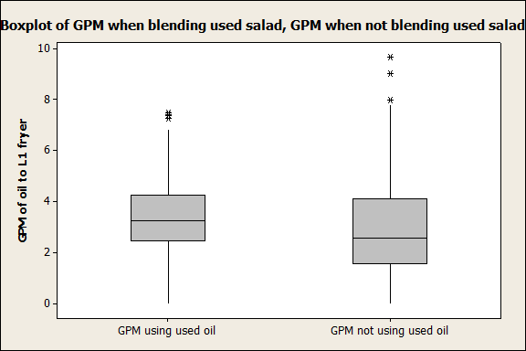
Test of Theories X₈
Theory: Used oil dissipates/burns up quicker than fresh oil, therefore we use more oil when blending used oil
H_{o}: Oil usage in GPM, at the same fry time, and running the same lbs, while blending used oil = Oil usage in GPM, at the same fry time, and running the same lbs while not blending used oil
H_{a}: Oil usage in GPM, at the same fry time, and running the same lbs, while blending used oil = Oil usage in GPM, at the same fry time, and running the same lbs while not blending used oil
Analysis: Once we were sure that the fry time and pounds we were producing were equal, we then were able to compare the data points taken from the oil flow meter into L1 fryer. A graphical analysis was conducted on the oil flow data and the Anderson-Darling test showed us that the data from both set of flow meter data were not equal. We then compared the Mann-Whitney Test and CI: GPM using used oil, GPM not using used oil
N Median
GPM using used oil 97 3.2500
GPM not using used oil 76 2.5650
Point estimate for ETA1-ETA2 is 0.7400
95.0 Percent CI for ETA1-ETA2 is (0.2302,1.2503)
W = 9334.0
Test of ETA1 = ETA2 vs ETA1 not = ETA2 is significant at 0.0062
The test is significant at 0.0062 (adjusted for ties)
Statistical Conclusion: The P is low so we will reject the null
Practical Conclusion: Used oil disipates or burns up quicker than fresh oil
Low P-value

Slide 51
Summary of Testing Results
X₁: Our salad oil IS NOT being damaged from oil miser airflow.
X₂: Our salad oil IS being damaged from air purges during pumping but it is not of practical significance.
X₃: Our L1 fryer oil capacity IS NOT too high for our operating range, we turn over the oil quick enough to allow degraded oil to be removed from the fryer.
X₄: High oil temps during a break DOES NOT damage our salad oil.
X₅: Using thicker paper on the paper filter for L2 fryer DOES NOT lessen the degradation of salad oil by removing more solids (burnt crumb).
X₆: Our pickling acid IS CAUSING degradation.
X₇: Blending used salad oil into Mac DOES ALLOW us to blend more used salad oil.
X₈: We DO USE more oil when blending used oil with fresh oil as opposed to only using fresh oil.

Slide 52
Vital Few Xs
Y=f(X_{6,} X₇, X₈)
Vital Few Xs are:
JDI: A new target picture was introduced for reference while doing an FFA sample
X₆: Our pickling acid IS CAUSING degradation.
X₇: Blending used salad oil into Mac DOES ALLOW us to blend more used salad oil as a whole.
X₈: We DO USE more oil when blending used oil with fresh oil as opposed to only using fresh oil.

Slide 53
Six Sigma Roadmap
Define
Measure
Analyze
Improve
Control

Slide 54
Improvement Strategies for Proven Xs
Proven Xs (Causes): | Strategies:
X₆ Our pickling acid causes degradation on our oil. | 1.Do not use 400 sanitizer which is the pickling acid we were using to season our chain before putting it in the oil. 2.Season the chain with an alternative acid.
X₇ Blending Salad oil into Mac oil allows us to use more used oil. | 1.Blend our used Salad oil into our fresh Mac oil. 2.Create a procedure to guide operators through the blending process. 3. Idaho can buy all our used Mac oil from us at the same price we purchase it for. So this allows more opportunity to blend more used salad oil into Mac oil.
X₈ We do use more oil when blending used oil with fresh oil as opposed to only using fresh oil. | 1. Account for used oil at a price less than fresh to allow a higher blend rate without a negative impact on the daily cost reports.

Slide 55
Descriptions of Possible Solutions (Pros and Cons)
Description of Possible Solutions
Possible Solution: | Strengths (Pros): | Weaknesses (Cons):
1. A picture of the correct shade of pink has been added to the FFA testing to ensure the correct color is chosen. | 1. Operators are given a guide to help them choose the correct color. | 1. Some operators are color blind
1.Find a different acid or method to pickle the L2 fryer chain. | 1. A new acid may not cause a rise in the FFA on fryer oil | 1. New solution could be more expensive
 | 2. A new acid could be cheaper. | 2. A new method could cause more down time
 | 3. A new acid or method could give better results, less sticking etc.
1. Blend Salad oil into Mac oil. | 1. Our blending opportunity increases. | 1. May cause different flavor.
 | 2. Higher volumes on Mac will allow a better chance for blending. | 2. Could cause an increase in color on finished product.
1. Account for used oil at a price less than fresh to allow a higher blend rate without a negative impact on the daily cost reports. | 1. With this understanding we can cost our used oil differently. | 1. When we use up a large amount of used oil it usually shows up as a loss on the cost reports.
 | 2. We can make a plan to use all used oil and explain the loss. | 2. Our oil/lbs of production rate goes up when blending.
1. Sell as much used oil to Idaho as we can. | 1. We can blend more salad into the Mac if we don't have used Mac. | 1. Takes time and money to organize the shipping to Idaho

Slide 56
Pay-off Matrix of Selected Solutions
Use picture of target color for FFA samples Do not use 400 sanitizer to season the L2 fryer chain Blend used salad oil into Mac oil Control with a blending plan so we don’t show such a large loss when we do use a lot of used oil.
Benefit
Effort

Slide 57
Selected Solutions
S₁ – Use the target reference when doing an FFA sample.
S₂ – Discontinue the use of 400 sanitizer to season L2 fryer chain. Create a new procedure with direction to use PL-10 for seasoning.
S₃ – Blend used Salad oil into fresh Mac oil when running Fries. Sell used Mac oil to Idaho.
S₄ – Blend used oil at a ratio of 10% used, 90% fresh.

Slide 58
Updated Process FMEA

Slide 59
Implementation Plan
Improvement | Implementation Plan | Who is Responsible
Use the Target color when doing an FFA sample | 1-Jun-14 | XXXX, Shift Managers, L2 Operators
Use PL-10 to pickle the L2 fryer chain | 10-Jan-15 | XXXX, Shift Managers, L2 Operators
Control Plan for blending used salad oil into Mac oil | 17-Oct-14 | XXXX, Shift Managers, Process Operators, Control Room Operators
Plan to blend used salad oil at a rate that won't hit our cost reports as a hard loss | 17-Oct-14 | XXXX, Shift Managers, Process Operators, Control Room Operators

Slide 60
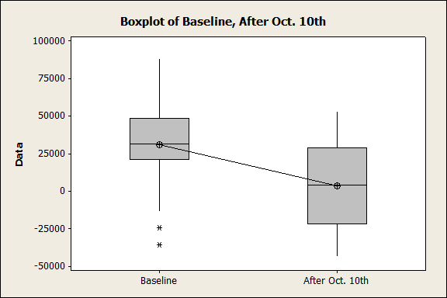
Statistical Proof of Improvements
Theory: The rate of accumulation of used salad oil was higher before the start of this project.
H_{o}: The accumulation of used salad oil before the project start = The accumulation of salad oil after improvements were put into place
H_{a}: The accumulation of used salad oil before the project start ≠ The accumulation of salad oil after improvements were put into place
Analysis: Graphical Summary was conducted on before and after data and it was concluded that both sets were normal. A Mann-Whitney test was then conducted to compare both set of data statistically.
Variance Tests
Method DF1 DF2 Statistic P-Value
F Test (normal) 30 17 0.85 0.686
Assume Variance is the same.
Two-sample T for Baseline vs After Oct. 10th
N Mean St Dev SE
Baseline 31 30869 25978 4666
After Oct. 10th 18 3577 28102 6624
Difference = mu (Baseline) - mu (After Oct. 10th)
Estimate for difference: 27292
95% CI for difference: (11336, 43248)
T-Test of difference = 0 (vs not =): T-Value = 3.44 P-Value = 0.001 DF = 47 Both use Pooled St Dev = 26765.481
P is low, the null must go!
Statistical Conclusion: With the low P-value we reject the null hypothesis which means the two set of data are not equal
Practical Conclusion: The weekly accumulation of salad oil before the project started was statistically higher than after the project started.

Slide 61
Six Sigma Roadmap
Define
Measure
Analyze
Improve
Control

Slide 62
Control Plan
Juran's Process Control Plan Matrix
 | Process Control Plan for: Used Salad oil Accumulation |  | Improvements on used salad oil |  |  |  | Date: April 10, 2015 |  | Revision Level: | New | Approved By:
Ref. | Control Subject | Subject Goal (Standard) | Unit of Measure | Sensor | Frequency of Measurement | Sample Size | Where Measurement Recorded | Measured by Whom | Criteria for Taking Action | What Actions to Take | Who Decides | Who Acts | Where Action Recorded
1 | Blend used salad oil into fresh Mac oil on L1 at 10% | To maintain 10% used salad oil and 90% Fresh Mac oil blend | Gallons | MMS oil usage log | Every oil Transfer | 1000 - 2000 gallons | MMS | Control room operator | If no used salad oil is being blended into fresh Mac | Correct behavior | Production manager | Shift manager | MMS
2 | Ship used Mac oil to Idaho at the same cost as fresh | Send all used Mac oil to Idaho until they cannot take anymore | Gallons | Used Mac oil inventory | Daily | Transfers between 0 and 100,000 gallons | MMS | Utility Employees | If Idaho stops taking used Mac oil. If the utility workers stop recording oil transfers | Find a different means of blending or using our used Mac oil. Correct the behavior of the utility workers | Production manager | Purchasing coordinator | Purchasing, MMS
3 | Use PL-10 to pickle the L2 fryer chain | To not have issues on startup which would cause FFA to rise out of control and refresh the fryer | Litres | Ruler on the GP Sprayer | Every 20 days on a major cleanup | 6 litres of PL-10/6 liters of water | Sanitation forms | Process Operator | If PL-10 is not used to pickle L2 fryer chain | Correct behavior of process operator | Production manager | Shift manager | Sanitation forms

Slide 63
Communication Plan
Improvement | Completion Date | Who Is Responsible
Using the picture of a target color for FFA samples | 1-Jun-14 | All production L2 process operators
Blending used salad oil into Mac oil | 17-Oct-14 | All production control room operators and all process operators
Using PL10 to condition L2 fryer chain instead of 400 sanitizer | 10-Jan-14 | All production L2 process operators

Slide 64
Training Plans

Slide 65
Control Charts

Slide 66
Updated Process Capability
Improved Sigma Level

Slide 67
Project Results
Project Baseline: |  | Project Target: |  | Project Actual:
COPQ= | $186,371.71 | COPQ= | $46,592.93 | COPQ= | $27,568.79
Metric= | Y = lbs of used Soy/Salad oil accumulated | Metric= | Y = lbs of used Soy/Salad oil accumulated | Metric= | Y = lbs of used Soy/Salad oil accumulated
DPMO= | 882315.86 | DPMO= | 220578.97 | DPMO= | 785310.85
Sigma Level= | 0.31 | Sigma Level= | 2.2 | Sigma Level= | 0.71
87% improvement
0.40 point improvement on the sigma level

Slide 68
Project Results
Now that we are able to blend used salad oil into Mac oil there will be a savings. The savings will come because Mac is a higher cost to purchase. We purchase Salad oil at $0.5346/lb and we purchase Mac oil at $0.8311/lb. If we use less Mac and more salad we will save the difference in cost.
Savings From blending salad oil instead of Mac oil
Median for used salad blended/week in lbs | 7,762
Forecast of Used salad blended instead of using Mac oil over the next 52 weeks in lbs | 403,624
The cost of using Mac oil instead of salad over the next 52 weeks | $335,451.91
The cost of using Salad oil instead of Mac over the next 52 weeks | $215,777.39
The cost to ship used Mac to Caldwell at $0.05/lb | $20,181.20
Savings from blending used salad instead of Mac | $99,493.32

Slide 69
Lessons Learned
Keep on working away, just because it is taking longer to complete doesn’t mean there won’t be a savings.
Always test, don’t go off of what others think.
Better time management in order to find the time to work on your project.

