Slide 1

Lean Six Sigma Green Belt
Project Report Presentation: Healthcare Industry
Project Number: XX
Project Name: Increase Financial Clearance
Project Team Leader: XXXX
Project Champion: XXXX
Green Belt Candidates: XXXX

Slide 2
LSS Roadmap
Define
Measure
Analyze
Improve
Control

Slide 3
Operational Definitions of Key Terms
Key Terms | Operational Definitions
Financial arrangement | Payment process for self-pay, charity, high deductible, underinsured, patients w/o authorization, worker’s comp, grants.
Financially cleared visit | All Financial Clearance elements are completed (see list in Measure phase)
Late “Add On” | All patients except with verified straight Medicare/Medicaid added < 3 business days
Managed Care Organization (MCO) | A managed care organization is a group of health industry companies that work together to provide healthcare and control the costs of providing the services.
Precertification requirements | Referral / authorization / benefits verified.

Slide 4
Operational Definitions of Key Terms
Key Terms | Operational Definitions
Scheduled appointment R/Y/G status | Status of a scheduled appoint as assigned by Pre-cert; R = Not Approved; Y = Caution (issue(s); possible reschedule); G = Go.
Walk-in | Patients presenting to C1200 with orders for labs or basic X-rays and/or stat diagnostic exams.

Slide 5
Problem and Goal
Problem Statement:
During calendar year 2014, there were 88,821 outpatient visits for ABC Hospital diagnostic services that were scheduled by Central Scheduling, or cleared through the ABC Hospital pre-cert process. Of these, 57% were financially cleared up to point of service. This contributed to $344,461 in lost revenue, and generated patient and physician dissatisfaction.
Goal Statement:
Increase the percentage of ABC Hospital diagnostic service outpatient visits that are financially cleared up to the point of service from 57% to 90% by the end of Q1, 2015.

Slide 6
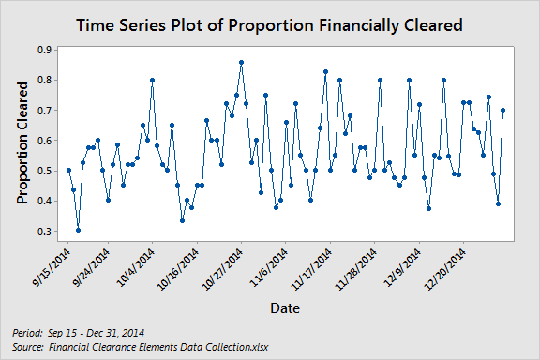
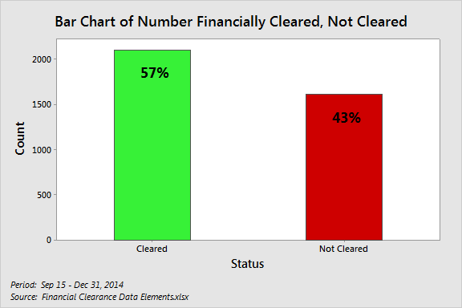
Graphical Verification of Problem
A time series plot and bar chart were created to visually demonstrate that the problem is both chronic and significant.
Conclusion: Approximately 43% of visits had one or more financial clearance elements missing on a regular, ongoing basis.

Slide 7
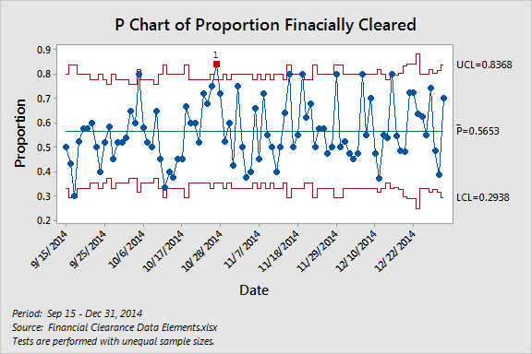
Baseline Control Chart
Baseline data were collected September 15 – December 31, 2014 based on a sample on ~25 visits each day in C1200.
Conclusion: The process shows variation in financially cleared data presenting to C1200.
Average of
57% cleared

Slide 8
Project Scope
In Scope:
All outpatient diagnostic service visits at ABC Hospital made via Central Scheduling appointments, and those made by departments but financially cleared by pre-cert. Walk-ins. Component revenue cycle operations include: pre-cert, medical necessity, eligibility, financial counseling & POS collections, denials. Process start/stop: Central Scheduling or Department makes appointment / Patient goes to ancillary department for service.
Items Out of Scope:
XYZ Hospital, clinic visits, ED, observations/inpatients, outpatient surgery, Hemo/Oncology.

Slide 9
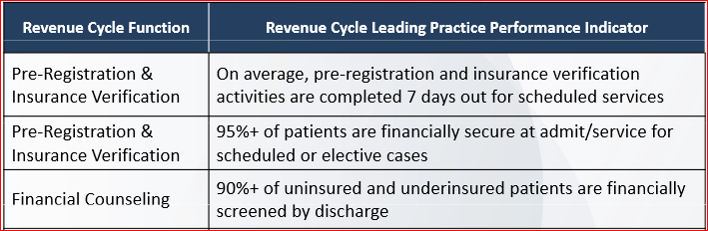
Project Justification and Expected Results
Relevant Metrics and Improvement Targets:
Financial clearance (target 90%)
Benchmark metrics (source in Notes View):
Operational/Strategic Impact:
Strategic: Supports initiatives to improve yield, and patient, physician and employee satisfaction; decrease denials.
Operational: Improve bottlenecks and patient flow across services; enhance patient and physician satisfaction; increase service capacity utilization. Leverage to XYZ Hospital, XXX Hospital for additional benefit.
Notes:
Source: Berkeley Research Group; www.brg-expert.com
http://www.mdaaham.com/storage/10.%20N%20Lowman%20-%20MD%20AAHAM%20AI%20in%20OC%20Berkeley%20Presentation.pdf

Slide 10
Financial Impact: Business Case or COPQ Calculation
Financial Impact: $264,354 additional net revenues annually.
COPQ is estimated as 100% of in-scope ABC Hospital outpatient diagnostic service charges for patients with zero receipts for Jan-Jun 2014 service (as of 1/14/15) x average collection rate by service, x 2 (to annualize), which was $344,461 during CY2014. Improvement of the % financially cleared from 57% to 90% will reduce COPQ from $344,461 to $80,107 for a benefit (COPQ reduction) of $264,354.
Baseline data from Mike Morgenstern (Finance) on 1/14/15 - "COPQ Financial Clearance (Jan 14 2015).xlsx"
Financial Clearance - COPQ Calculations
 | Value
Baseline COPQ* | $ 344,461
Goal % financially cleared | 90
Current % Cleared | 57
Current % Not Cleared | 43
COPQ Reduction | $ 264,354
COPQ Goal | $ 80,107
Assumptions
Change in Financial Clearance as measured by project Y will correspond to identical change in COPQ as measured by Finance.
Charges with zero receipts by 1/14/15 for Jan-Jun 2014 service will remain zero.

Slide 11
Project Team Membership
Role | Name & Title
Project Champion | XXXX
Project Team Leader | XXXX
LSS Green Belt Candidates | XXXX XXXX
Core Team Members | XXXX XXXX XXXX
Ad hoc or SMEs | XXXX XXXX XXXX

Slide 12
Project Plan - Milestones and Timing
Phase | Sept 2014 | Sept 2014 | Oct 2014 | Nov 2014 | Dec 2014 | Jan 2014 | Feb 2014 | Mar 2014
Define
Measure
Analyze
Improve
Control

Slide 13
High Level Process Map (SIPOC)
Process starts at Central Scheduling or department makes appointment and the process ends when the patient goes to the ancillary department. Major players are central scheduling, precert, Financial counseling, registration and ancillary departments.
SIPOC: Financial Clearance
SUPPLIER | INPUT (use nouns) | PROCESS (use verbs) | OUTPUT (use nouns) | CUSTOMER
Patient, Physician / Clinic | Patient demographics; Order | Central Scheduling or Department makes appointment | Scheduled service | Patient; Pre-cert Dept; Ancillary Dept
Central Scheduling or Department | Scheduled service | Precert verifies eligibility, benefits, and starts precertification process | R/Y/G status of scheduled service | Patient; Pre-cert Dept; Ancillary Dept
Pre-cert Dept | R/Y/G status of scheduled service | Patient checks in at C1200* | Schedule confirmation, Verified proper documentation, Financial Counselor need | Patient; Registrar; Financial Counselor
Patient; Registrar | Verified proper documentation, Financial Counselor need | Patients requiring financial arrangements go to financial counselor | Financial arrangements | Patient; Registrar
Patient, Registrar; Financial Counselor | Verified proper documentation; Financial arrangements | Registration processes patient | Registered patient | Ancillary Dept
Patient; Registrar | Registered patient | Patient goes to Ancillary Department for service | Checked-in patient at Ancillary Dept | Patient; Ancillary Dept
* Walkins start at check-in C1200

Slide 14
Voice of Customer to CTQ Analysis – Priority Ranking
Not all customers are of equal importance. The team ranked customer groups based on importance to the process and the business.
Rank | Customer
1 | Patient/Family
2 | Ancillary Departments
3 | Pre-Cert Department
4 | Financial Counselor
5 | Registrar

Slide 15
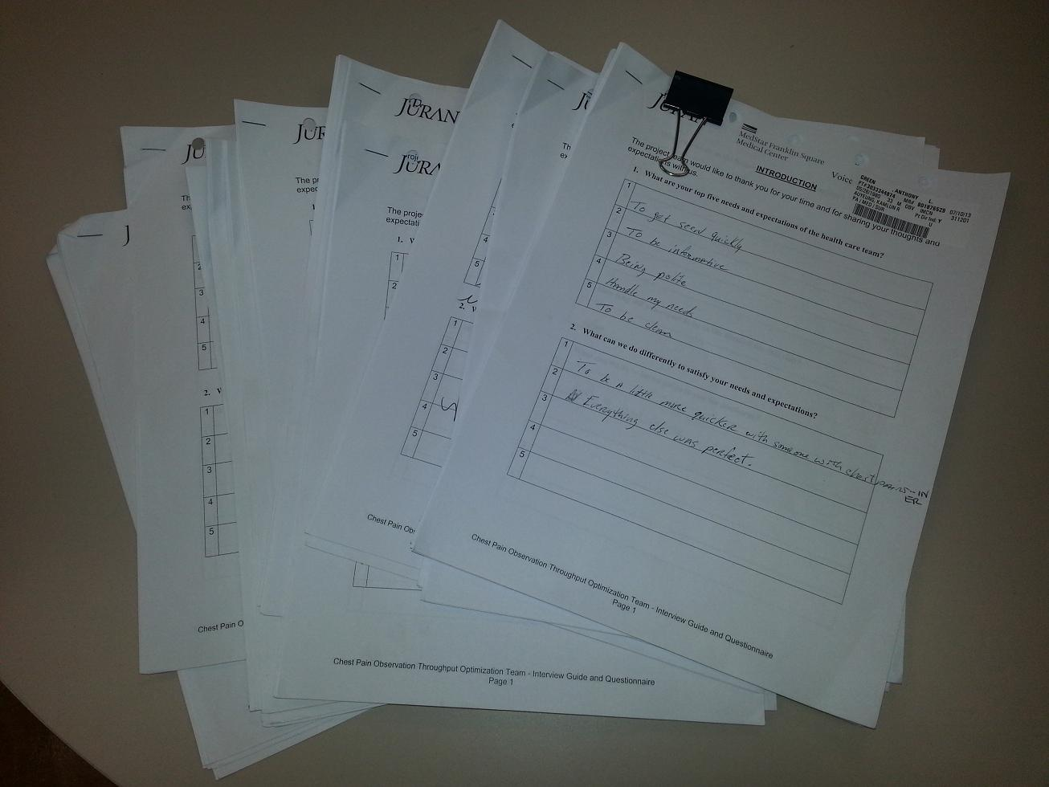
Voice of Customer - Eliciting Feedback
Internal Customers
Internal customers were asked for input via 1:1, face-to-face interviews
Patients
Patients / Families were asked for feedback via 1:1, face-to-face and phone interviews across the ancillary departments.

Slide 16
Voice of Customer - Internal Staff Interview Questions
Demographics: Job Title
Q1: What is your role in the process of ensuring outpatients with appointments for diagnostic services are financially cleared by the day of service?
Q2: What things do you believe contribute to performance issues in financially clearing patients? (e.g., delays, errors, incomplete or missing information)?
Q3: What do you need that you do not get now from the process to financially clear patients?
Q4: What in the current financial clearance process is aggravating or burdensome and provides little/no perceived value, and should be either redesigned or eliminated (if possible)?
Q5: What would you do differently to improve the process of obtaining financially cleared patients?
Q6: What currently works well and should be kept in the financial clearance process?
Q7: Please provide any other comments that may be useful to the project team.

Slide 17
Voice of Customer - Patient Interview Questions
Q1: Were your financial responsibilities for this visit clearly explained to you before you arrived? [For example, told of co-pay, needed order]. If "no," please describe.
Q2: What could ABC Hospital have done to make the process smoother for your day of service?

Slide 18
Voice of Customer to CTQ Analysis
Voice of the Customer (VOC) Matrix
Rank | Customer | Voice of the Customer | Key Issue | CTQ (the Y)
1 | Patient | I have county care how come the clinic didn’t tell me that I no longer had coverage. I cant afford to pay anything I don’t care how cheap it is. | No clear communication process with patient in regards to their expectation | Timely Communication to patient of financial estimate, responsibility and expectations
2 | Precertification | Error in insurances and patient date of birth, incorrect policy numbers, not enough clinical data, notes, wrong PCP listed | Insufficient/incorrect data delays the authorization process | Correct insurance information
3 | Registrar Financial Counselor | We need for the patients to be prepared with all the necessary paperwork when they arrive for their appt. | Patients arrive with out referrals or orders which then delays whole process | Patients arrive with all required paperwork
4 | Ancillary Departments | Patient comes in with an order without a referral, registration says it is not their hob to get the referral and then the technologist call for the referral, Patients here since 11a and don't come to department until 5-5:30 which causes overtime for technologist. | Registration not clear on what documents they are required to obtain which can cause delays | Registration (C1200) and Department staff are competent in obtaining financially cleared visits
5 | Patient | I arrived 30 min early for my exam, was registered and sent to the department and there the tech told me that I could not have my exam because insurance wasn't cleared | Inconsistent communication process between departments: Precertification, Registration, and Ancillary Departments. | Correct determination of financial clearance by Registration
6 | Registration | Financial Counseling services not available to clear patients early in the morning. | Limited hours of operation result in longer patent wait times | Financial Counseling services available during all diagnostic service operating hours
7 | Financial Counseling | Need hard guidelines for such services as infertility. | Patients who are not financially cleared are still able to obtain services, there is no clear direction on how to handle grey areas of financial clearance | Support for staff in the event a patient is not prepared

Slide 19
Final List of CTQ’s
The CTQs are Critical to Quality requirements or characteristics of the process that are important in meeting customer needs.
CTQs
A minimum of 24 hour notification of financial clearance to patient, responsibility and expectations.
100% correct insurance information a minimum of 24 hours prior to service.
≥90% of patients arrive with all required paperwork.
100% of C1200 staff have 90% or greater competency score in recognizing correct paperwork for financially cleared visits.
100% of registrars can determine 90% or better of financially cleared visits.
Financial Counseling services available during all diagnostic service operating hours. (deferred until new vendor determines staffing, etc…)
Support for 100% of staff directly involved in the event a patient is not prepared.
Notes:
All CTQ’s must be measurable and have a target established.
For example: Turnaround time of <30 minutes from receipt in lab to results

Slide 20
Stakeholder Analysis Worksheet
Identified that the parties directly involved in the day to day process
are supportive. A plan was created to address the needs of other parties.
Name or Group | Strongly Against | Moderately Against | Neutral | Moderately Supportive | Strongly Supportive
Patient |  |  |  | X
Ancillary Dept |  |  |  |  | X
Pre-Cert Dept |  |  |  | X
Financial Counselor |  |  |  |  | X
Registrar |  |  |  |  | X
Administration |  |  |  |  | X
Physicians/clinics |  | X

Slide 21
Define Phase Deliverables
Define | Complete
Operational definitions of key terms | X
Problem statement | X
Graphical Verification of Problem | X
Goal statement | X
Business case and expected benefits | X
Project scope | X
Project team members | X
Project plan | X
High level process map (SIPOC) | X
Voice of Customer (VOC) and Critical-to-Quality (CTQs) | X
Stakeholder analysis | X
Gate Review and Sign-off by Champion | X

Slide 22
Lean Six Sigma Roadmap
Define
Measure
Analyze
Improve
Control

Slide 23
Project Y (or Ys) in Y=f(x)
Project Y = % of ABC Hospital diagnostic service visits that are financially cleared up through the point of service.
= (number of visits with all needed elements / total number of visits) x 100%
A list of financial clearance elements was defined…

Slide 24
Project Y (or Ys) in Y=f(x)
* Not measurable until technology solution is in place.
A visit is financially cleared if all needed elements are present.
Element | YES | NO
Order Available
Patient Name Correctly spelled
DOB Correct
Insurance Plan Correct
Policy Number Correct
Group Number Correct (if applicable)
DOS Correct
MRN Correct
Ordering MD correct (cross reference order)
Correct Test Scheduled
Diagnosis Correct (cross reference order)
Was Medical Necessity check performed (Medicare only)*
Other Demo (address, telephone, emergency contact, employer)
Authorization number available (if applicable)
If self pay, referred to Financial Counseling prior to visit
Required documentation available electronically (e.g., scanned) (Referral, Physician’s Order, ID, Insurance Card (if applicable))
Out of Pocket, Deductible reflected in insurance screen
Conversation/reminder call done with patient prior to DOS

Slide 25
Current State Value Stream Map
This was a defect reduction and not a flow or efficiency project.
A VSM was not appropriate.
Notes:
A VSM is a particular style of a process map that shows all of the process steps required to complete a service or product an output.. It is a powerful tool for analyzing information and flow throughout or between organizations to identify and plan improvements.
The goal is to optimize the patient journey or processes that support the patient journey
The focus of mapping is to improve processes that support caregivers and employees by distinguishing process steps which create value from those that don’t (rework, wait times) and build in quality by eliminating waste

Slide 26
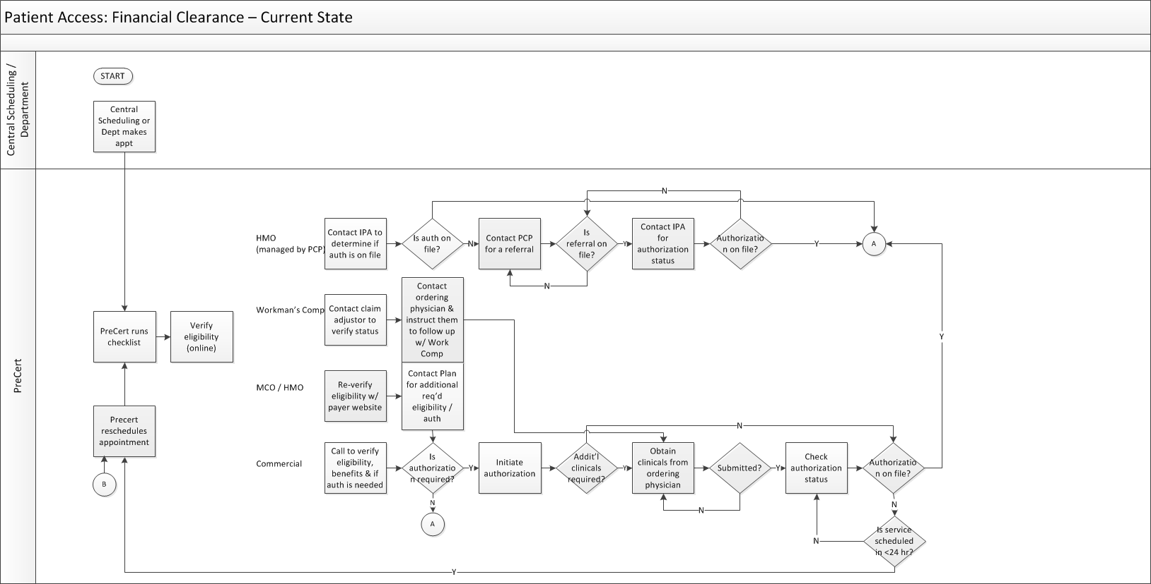
Current State Detailed Process Map
The process begins with an appointment being made; PreCert then verifies eligibility. On the day of the appointment, the patient arrives and registers in C1200. If not insured, the patient meets with a Financial Counselor before obtaining service.
Add findings, conclusions…

Slide 27
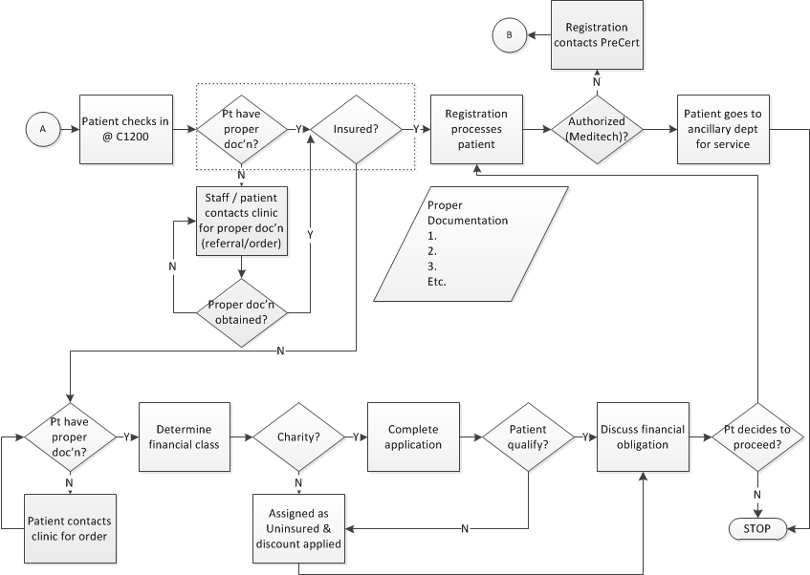
Current State Detailed Process Map, cont.

Slide 28

Plan for Baseline Data Collection
The measure phase data collection plan is helping to validate our potential Y and characterize process performance.
Data Collection Plan (Measure Phase)
 | What to Measure |  | Operational Definition |  | Data Collection
Ref # | Question to Answer | Measure Name | Words | Formulas | Data Type | Sample Size | Collection Method | Who collects | Tools to use | Stratification Variables
1 | What percentage of patients are financially cleared by day of service? | Financial Clearance (Y) | Percentage of patients with all necessary and sufficient financial clearance elements completed by day of service | (# Cleared / Total) x 100% | Categorical | 25 patients arriving for diagnostic service appointments (ongoing; prospective) | Point of service checklist | C1200 Staff | Run chart | N/A
2 | What are the vital few reasons for not being financially cleared? | Reasons patient not financially cleared | Reasons patient not financially cleared (defective elements required for financial clearance) | N/A | Categorical |  |  |  | Pareto, Run chart | Reasons (Elements)
3 | What is the appointment demand by payer? | Appointment demand by payer | Number of appointments handled by PreCert | N/A | Categorical | Total number of appointments made Jan 1 - June 30, 2014 | Meditech Report | Stephanie / Richard | Run chart | Payer
3 | What is the dollar value of denials? | Denials | Projected collection of 10% of charges (claims adjusted off w/o payment) | Hospital visit charges (current, adjusted) x 10% | Categorical | All claims adjusted off w/o payment Jan 1 - June 30, 2014 | Meditech Report | Stephanie / Jorge | Descriptive Statistic | Department
5 | What is the incidence of patients arriving with no orders? | Patients w/o orders | Percentage of patients presenting to C1200 with no order readily available. | (# patients w/o order) / (total # registrations) x 100% | Categorical | Total number of registrations made Jan 1 - ongoing | Meditech Flash Report/manual tracking | C1200 Staff | Run chart | N/A

Slide 29
Validate Measurement System
Measurement system analysis (MSA) is not part of the Green Belt training.
Financial clearance was not measured prior to the start of the project.
The Financial Clearance checklist was developed and used to assess a sample of up to 25 patients each day.
A single, experienced data collector obtained all baseline and subsequent data, eliminating Gage Reproducibility as a concern.

Slide 30
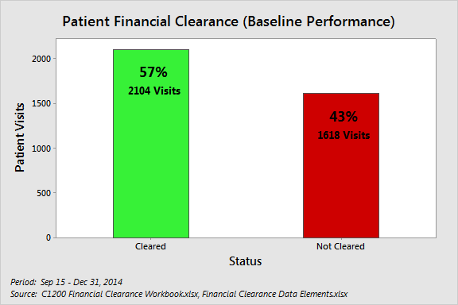
Measure Questions to be Answered
Question/Reference #1: What percentage of patients are financially cleared by day of service?
Conclusion: Only 57% of patients were cleared upon arrival at C1200.

Slide 31
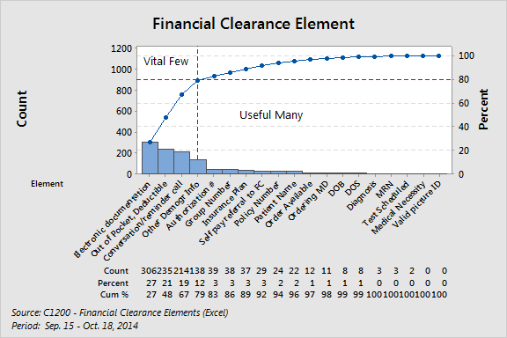
Measure Questions to be Answered
Question/Reference #2: What are the vital few reasons for not being financially cleared?
Conclusion: Defects in four categories contribute ~80% of the problem.

Slide 32
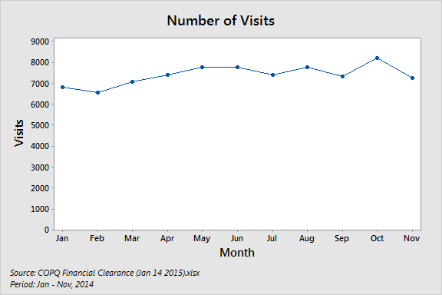
Measure Questions to be Answered (Customer Demand)
Question/Reference #3: What is the appointment demand by payer?
Conclusion: Visits for ABC Hospital diagnostic services gradually increased over 2014, ranging from 6,500 to 8,250 per month.

Slide 33
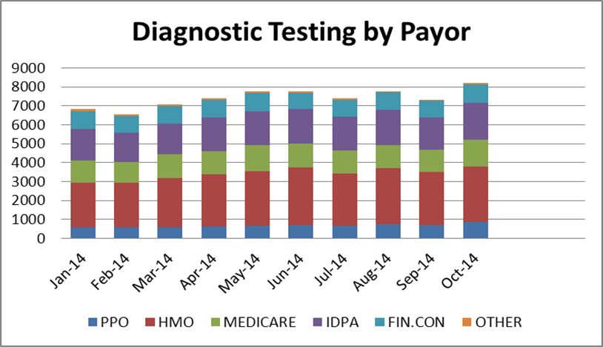
Measure Questions to be Answered (Customer Demand)
Question/Reference #3: What is the appointment demand by payer?
Since the ACA, we have seen a growing number of patients converting to HMOs with stricter requirements.
Conclusion: The number of HMOs are increasing which means that more services have authorization requirements.

Slide 34
Measure Questions to be Answered
Question/Reference #4: What are denials by dollar amount?
Several unsuccessful attempts were made to obtain denial data. Ultimately, COPQ was estimated based on charges for service Jan 1 – June 30, 2014 for which no payments were made, applying department-specific collection rates.
Conclusion: Approximately $344,500 was uncollected, representing the baseline COPQ.

Slide 35
Measure Questions to be Answered
Question/Reference #5: What is the incidence of Patients arriving with no orders?
% of patients arriving to C1200 with no order on the date of service.
Conclusion: <10% or more of patients presenting to C1200 on daily basis do not have their order.

Slide 36
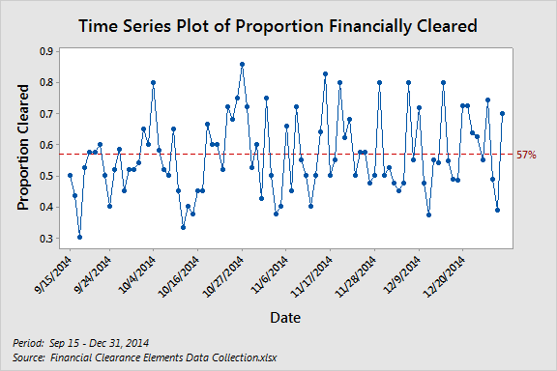
Baseline Performance (Y or Ys)
Baseline measurement concluded that 43% of visits had one or more financial clearance elements missing, so that only 57% were cleared.
Conclusion: The problem is both chronic and significant.

Slide 37
Measure Baseline Performance
 | Current | Goal
COPQ | $344,461 | $80,107
Percentage Cleared | 57% | 90%
PPM (of DPMO) | 858,661 | 100,000
Sigma Level | 1.66 | 2.78

Slide 38
Sigma Calculation
Of 3,722 patient visits sampled from Sep. 15 – Dec. 31, 2014, 1,618 were defective (43%), yielding a baseline of 1.66 sigma. Reducing this to 10% defective will yield an improvement to 2.78 sigma.
General Worksheet For Calculating Process Sigma
 |  |  |  |  | Baseline | Goal
1 | Number Of Units Processed |  |  | n= | 3722 | 3722
2 | Number Of Defect Opportunities | Per Unit |  | o= | 1 | 1
3 | Total Count Of Defects Made | (Include Defects Made And Later Fixed) |  | c= | 1618 | 373
4 | Solve for Defects Per Opportunity DPO = c / (n*o) |  |  |  | 0.434713 | 0.100215
5 | Solve For Defects Per Million Opportunities (DPO * 1,000,000) |  |  |  | 434,713 | 100,215
6 | Look Up Process Sigma In Abridged Sigma Conversion Table |  |  | Sigma = | 1.66 | 2.78
 | Calculated by NORMSINV(1-DPMO/Million)+1.5

Slide 39
Other Relevant Metrics
None identified for this project

Slide 40
Spaghetti Diagram
Not applicable due to the nature of the project.
Graphical representations are not needed due to the fact that we are not analyzing process paths.

Slide 41
Load Charts
Not applicable due to the nature of the project.
Project is not measuring demand and does not require Takt time.

Slide 42
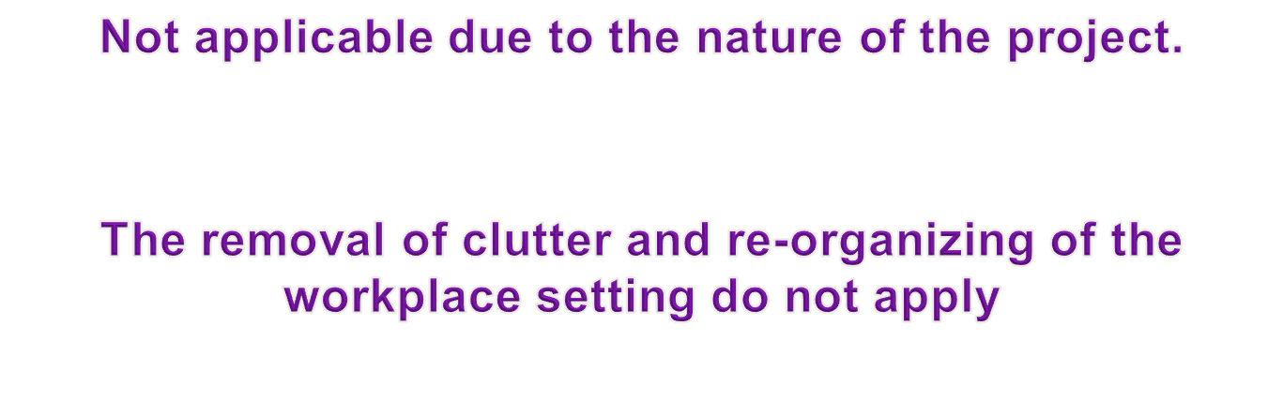
S1 – S3

Slide 43
Measure Phase Deliverables
Measure | Complete
Measureable definition of Y (or Ys) in Y = f(x) | X
At least one of the following for current state (as is) process: detailed process map(s) or value stream map with process attributes | X
Data collection plan for measure phase | X
Customer demand analysis | X
Baseline performance (Y or Y’s) | X
Process capability – Sigma level | X
Pareto charts | X
Value stream map attribute data (as appropriate) | N/A
Spaghetti diagrams (as appropriate) | N/A
Current load charts (as appropriate) | N/A
Assess for 6S and implement S1 – S3 | N/A
Gate review and Sign-off by Champion | X

Slide 44
Lean Six Sigma Roadmap
Define
Measure
Analyze
Improve
Control

Slide 45
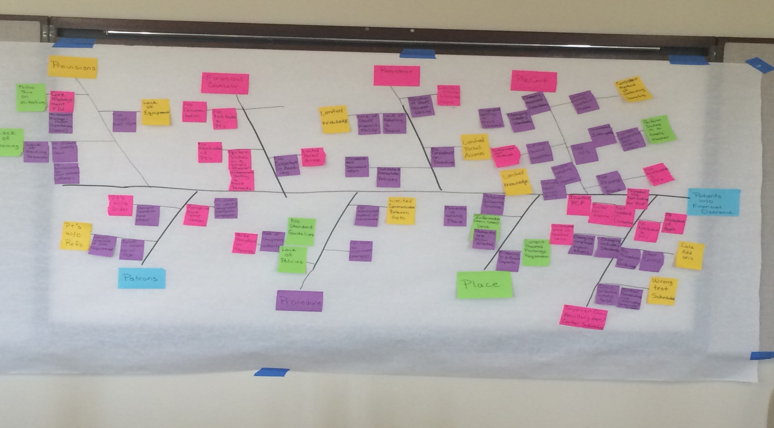
Cause-Effect Diagram(s)
Completed, manual cause effect diagram.

Slide 46
Cause-Effect Diagram(s)
Possible causes selected for testing are highlighted in blue (X7, X9 shown in process map).
X11,
X12
X2
X4
X8
X6
X3
X5
X1
X5
X10

Slide 47
Cause-Effect Diagram(s)
Below is the spreadsheet version. Possible causes selected for testing are highlighted in blue.
Major Cause Category | Level | Possible Cause
PreCert | Main Branch (Why 1) | Inappropriate staffing to meet demand
PreCert | Sub-branch (Why 2) | Changing employee expectations
PreCert | Sub-branch (Why 2) | Changing industry standards
PreCert | Main Branch (Why 1) | Inconsistent method of obtaining benefits (X2)
PreCert | Sub-branch (Why 2) | Limited training and consistent process (see Provisions)
PreCert | Main Branch (Why 1) | Not perform duties in a timely manner (X4)
PreCert | Sub-branch (Why 2) | Late add-ons (X5)
PreCert | Sub-branch (Why 2) | Unneeded interruptions
PreCert | Sub-branch (Why 2) | Limited cooperation from ordering MDs
PreCert | Main Branch (Why 1) | Authorization not obtained
PreCert | Sub-branch (Why 2) | Limited clinical cooperation
PreCert | Main Branch (Why 1) | Limited knowledge (X3)
PreCert | Sub-branch (Why 2) | Variation in staff accountability
PreCert | Sub-branch (Why 2) | Variation in adapting to new process
PreCert | Main Branch (Why 1) | No / late notification to patients of rescheduling (X1)
PreCert | Sub-branch (Why 2) | No process in place to notify patients

Slide 48
Cause-Effect Diagram(s)
Major Cause Category | Level | Possible Cause
Registrar | Main Branch (Why 1) | Limited Portal access (e.g., NextGen)
Registrar | Sub-branch (Why 2) | No consistent on-boarding
Registrar | Main Branch (Why 1) | Limited knowledge (correct paperwork, clearance) (X11, X12)
Registrar | Sub-branch (Why 2) | Lack of staff accountability
Registrar | Sub-branch (Why 2) | Lack of adapting to new process
Registrar | Main Branch (Why 1) | Inconsistent documentation when patient arrives (X6)
Registrar | Sub-branch (Why 2) | Outdated / obsolete policies
Registrar | Main Branch (Why 1) | Limited training and consistent process (see Provisions)
Registrar | Sub-branch (Why 2) | Variation in staff accountability
Financial Counselor | Main Branch (Why 1) | No documentation
Financial Counselor | Sub-branch (Why 2) | No notification to patients of needed documentation
Financial Counselor | Main Branch (Why 1) | No notification of patients (X8)
Financial Counselor | Sub-branch (Why 2) | Do not perform duties in timely manner (X8)
Financial Counselor | Twig (Why 3) | Inappropriate staffing to meet demand
Financial Counselor | Main Branch (Why 1) | Limited portal access (e.g., NextGen)
Financial Counselor | Main Branch (Why 1) | No consistent onboarding

Slide 49
Cause-Effect Diagram(s)
Major Cause Category | Level | Possible Cause
Provisions | Main Branch (Why 1) | No follow-through on initiatives to ensure compliance
Provisions | Sub-branch (Why 2) | Limited core management follow-up (control)
Provisions | Sub-branch (Why 2) | Unreasonable management expectations
Provisions | Main Branch (Why 1) | Lack of equipment
Provisions | Sub-branch (Why 2) | Too much red tape
Provisions | Main Branch (Why 1) | Lack of training
Provisions | Sub-branch (Why 2) | Lack of training resources
Provisions | Sub-branch (Why 2) | No process to identify needs
Provisions | Twig (Why 3) | No consideration of downstream customers
Patrons | Main Branch (Why 1) | Patients w/o order
Patrons | Sub-branch (Why 2) | Patient does not have order
Patrons | Twig (Why 3) | Patient received but forgot to bring order
Patrons | Twig (Why 3) | Patient received but did not know to bring order
Patrons | Twig (Why 3) | Patient did not receive order
Patrons | Main Branch (Why 1) | Patients w/o referrals
Patrons | Sub-branch (Why 2) | Failure to follow up w/ PCP
Patrons | Sub-branch (Why 2) | Patient unaware of insurance requirement
Patrons | Sub-branch (Why 2) | Patient received but forgot to bring referral
Patrons | Sub-branch (Why 2) | Patient received but did not know to bring referral
Patrons | Sub-branch (Why 2) | Patient did not receive referral
Patrons | Sub-branch (Why 2) | Patient given wrong referral
Patrons | Main Branch (Why 1) | Patient unable to identify designated, appropriate employee
Patrons | Sub-branch (Why 2) | Inappropriate / poor visual workspace

Slide 50
Cause-Effect Diagram(s)
Major Cause Category | Level | Possible Cause
Procedures | Main Branch (Why 1) | Limited communication between departments
Procedures | Sub-branch (Why 2) | No established method of communication
Procedures | Main Branch (Why 1) | Wide variation in process
Procedures | Sub-branch (Why 2) | Lack of disciplinary authority
Procedures | Twig (Why 3) | Lack of policies
Procedures | Twig (Why 3) | No standard guidelines
Procedures | Main Branch (Why 1) | No time to effectively implement changes
Place | Main Branch (Why 1) | Patients in wrong place
Place | Sub-branch (Why 2) | Patients misdirected (e.g., Mani Lobby Information Desk)
Place | Sub-branch (Why 2) | Patients following routine
Place | Main Branch (Why 1) | Current set-up prolongs registration process
Place | Sub-branch (Why 2) | Convergence of 3 separate departments in same space

Slide 51
Cause-Effect Diagram(s)
Major Cause Category | Level | Possible Cause
Supplier: Ancillary / CS | Main Branch (Why 1) | Incorrect PCP
Supplier: Ancillary / CS | Sub-branch (Why 2) | Not loaded into dictionary
Supplier: Ancillary / CS | Sub-branch (Why 2) | Scheduling not asking for PCP
Supplier: Ancillary / CS | Sub-branch (Why 2) | Caller unaware of PCP (unassigned)
Supplier: Ancillary / CS | Main Branch (Why 1) | Patient unaware of appointment
Supplier: Ancillary / CS | Sub-branch (Why 2) | No notification to patients of appointment
Supplier: Ancillary / CS | Main Branch (Why 1) | No designated staff w/ needed skills
Supplier: Ancillary / CS | Sub-branch (Why 2) | Changing industry standards
Supplier: Ancillary / CS | Sub-branch (Why 2) | Changing employee expectations
Supplier: Ancillary / CS | Main Branch (Why 1) | Late add-ons (X5)
Supplier: Ancillary / CS | Sub-branch (Why 2) | No procedure or guidelines
Supplier: Ancillary / CS | Sub-branch (Why 2) | Stat exams
Supplier: Ancillary / CS | Main Branch (Why 1) | Limited training and consistent process (see Provisions)
Supplier: Ancillary / CS | Main Branch (Why 1) | Wrong test scheduled (X10)
Supplier: Ancillary / CS | Sub-branch (Why 2) | Wrong test ordered
Supplier: Ancillary / CS | Sub-branch (Why 2) | Central Scheduling not interpreting verbal order correctly

Slide 52
5 Why Analysis
Improvement Opportunities | Why ? | Why ? | Why ? | Why ? | Why ?
Patients without orders | Patient forgets orders | Patient received but did not bring order | Patient received but did not know to bring order
Inappropriate staffing to meet demands | Changing employee expectations | Changing industry standards
Inconsistent method of obtaining benefits | Limited training and consistent process
Sample of 5 why analysis

Slide 53
Current State FMEA
Process Step or Variable or Key Input | Potential Failure Mode | Potential Effect on Customer Because of Defect | SEV | Potential Causes | OCC | Current Process Controls | DET | RPN | Actions Recommended | Resp.& Target Date | Actions Taken | SEV | OCC | DET | Future RPN
What is the process step? | In what ways can the Process Step, Variable, or Key Input go wrong? (chance of not meeting requirements) | What is the impact on the Key Output Variables (customer requirements) or internal requirements? | How Severe is effect to the customer? | What causes the Key Input to go wrong? (How could the failure mode occur?) | How frequent is cause likely to Occur? | What are the existing controls that either prevent the failure mode from occurring or detect it should it occur? | How probable is Detection of cause? | Risk Priority # to rank order concerns | What are the actions for reducing the Occurrence of the cause, or improving Detection? Should have actions on high RPN's or Severity of 9 or 10. | Who's Responsible for the recommended action? What date? | What were the actions implemented? Include completion month/year. (Then recalculate resulting RPN.) | Future Severity | Future Occurance | Future Detection
Central Scheduling / Department makes appointment | Incorrect demographic information | Rework to correct | 5 | Receive / input wrong | 4 | Loxogon | 3 | 60 |  |  |  | 8 | 2 | 4 | 64
Central Scheduling / Department makes appointment | Incorrect demographic information | Delay in financial clearance | 8 | Receive / input wrong | 4 | Loxogon, PreCert, Front Desk, Registrar, Finacial Counselor | 2 | 64
Central Scheduling / Department makes appointment | Add-ons lengthy / improperly processed | Patient canceled or rescheduled | 9 | Poor workflow for add-ons | 5 | PreCert Worklist | 8 | 360 | Pursue (X5)
PreCert | Failure to follow appropriate insurance process | Services provided w/o financial clearance | 7 | Multiple procedures and requirements for each insurance carrier | 3 | None | 9 | 189
Financial Counseling | Counselors not notified prior to day of service for self-pay | Delay in financial clearance and ancillary service | 8 | Poor workflow for volume | 7 | Self-Pay Worklist | 8 | 448 | Pursue (X8)

Slide 54
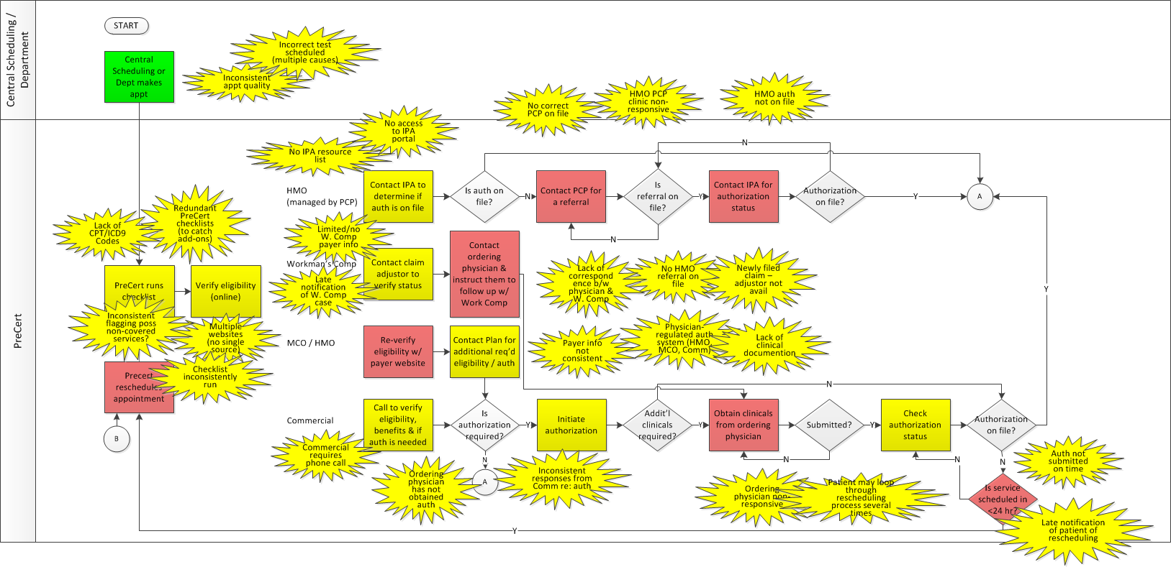
VA/NVA Analysis Process Map(s)
## Steps
## VA Steps
## NVA/BNVA Steps
## Decision Points

Slide 55
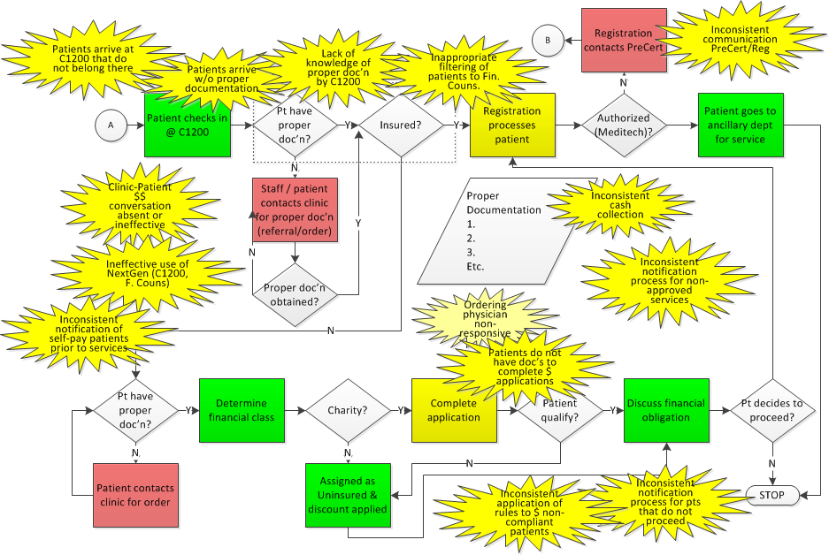
VA/NVA Analysis Process Map(s)
X7
X9

Slide 56
VA/NVA Analysis of VSM
Not applicable due to the nature of the project

Slide 57
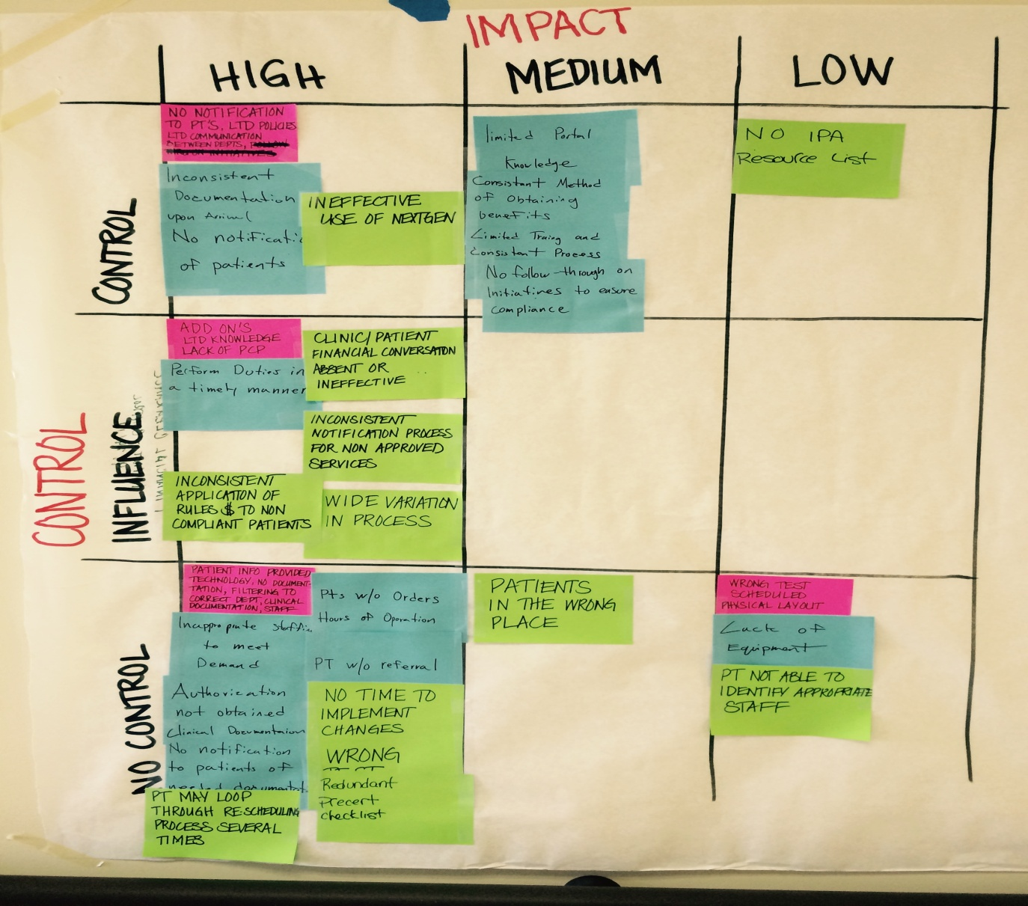
Impact Control Matrix

Slide 58
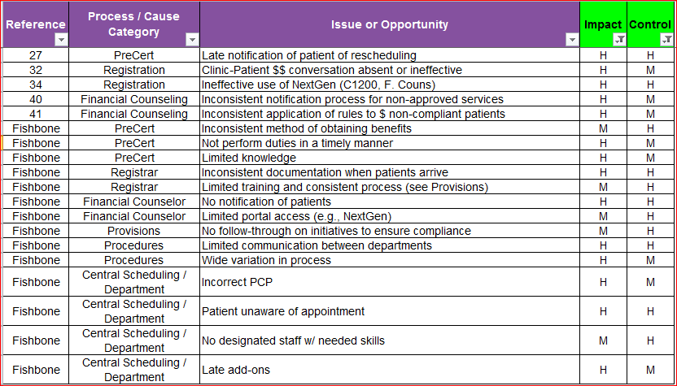
Impact Control Matrix Summary
Summary showing possible causes with H/M impact and control. A subset were selected for testing…

Slide 59
Potential Xs—Theories To Be Tested
X₁: Late notification of patient rescheduling (PreCert)
X₂: Inconsistent method of obtaining benefits (PreCert)
X₃: Limited knowledge (PreCert)
X₄: Not perform duties in a timely manner (PreCert)
X₅: Late add-ons (all patients except w/verified straight Medicare/Medicaid added < 3 business days) (PreCert, Central Sched, Depts)
X₆: Inconsistent documentation when patient arrives (Registrar)
X₇: Inconsistent notification process for non-approved services (Fin Counseling)
X₈: No notification of patients/not performing duties in a timely manner (Fin Counseling)
X₉: Inconsistent application of rules to $ non-compliant patients (Fin Counseling)
X₁₀: Wrong test scheduled (Cent Scheduling/Depts)
X₁₁: Limited knowledge of correct paperwork for financially cleared visits (C1200)
X₁₂: C1200 incorrectly determines financial clearance

Slide 60
Data Collection Plan Sample for Analyze Phase
Data Collection Plan for the Analyze Phase
Ref. | Theories To Be Tested (Selected From The C-E Diagram, FMEA, etc.) | List Of Questions That Must Be Answered To Test Each Selected Theory | Results that will support theory | Results that will rule out theory | Tools To Be Used | Data To Be Collected
 |  |  |  |  |  | Description/ Data Type | Sample Size, Number of Samples | Where/How To Collect Data | Who Will Collect Data | How Will Data Be Recorded |  | Remarks
X1 | Late notification of patient of rescheduling (PreCert) | How far in advance are attempts to contact patient made? | ≤24 hr. | >24 hr. | Descriptive Statistics | Continuous | 2 weeks | No Auth form | Stephanie | Tally sheet |  | TRUE
X2 | Inconsistent method of obtaining benefits (PreCert) | Are PreCert staff documenting detailed benefit information? | ≥2 staff not documenting | <2 staff not documenting | Bar chart | Categorical (count); across commercial payers | Total # staff (7) | Audit of account | Kim | Tally sheet |  | TRUE
X3 | Limited knowledge (PreCert) | Is PreCert staff up to date on industry standards with obtaining benefits according to best practice? | Quiz score ≤90% | Quiz score >90% | Bar chart | Categorical (Test score %) | Total # staff (7) | Quiz | Kim | Score sheet; by Question |  | TRUE
X4 | Not perform duties in a timely manner (PreCert) | How far ahead is PreCert working? | Working ≤1 week out | Working >1 week out | Bar chart (by staff) | Continuous (days); cross-reference vs. worklist | Total # staff (7) | Survey | Kim | Tally sheet |  | TRUE
X5 | Late add-ons (all patients except w/ verified straight Medicare/Medicaid added <3 business days) (PreCert / Central Sched / Depts) | How many late add-ons are scheduled, by payer, w/ authorization required? | ≥7 in one week requiring authorization | <7 in one week requiring authorization | Descriptive Statistics | Categorical (count) | All add-ons over 1 week | Print screen of add-on accounts | Stephanie | Tally sheet |  | TRUE
X6 | Inconsistent documentation when patients arrive (Registrar) | What percentage of patients arrive w/o required ID, Order, or Referral? | ≥10% missing 1 or more document | <10% missing 1 or more document | Descriptive Statistic, Bar chart | Categorical (count) | All in-scope visits (ongoing) | C1200 | Carmen | Excel spread-sheet |  | FALSE

Slide 61
Data Collection Plan Sample for Analyze Phase, continued
X7 | Inconsistent notification process for non-approved services (Financial Counseling) | What is your process for non-approved services for patients? | ≥1 response (of 4) different from another | All responses identical | Bar chart | Categorical (count) | Total # FCs (4) | Interview w/ written response | Lisa, Jorge | Interview form | TRUE
X8 | No notification of patients / not perform duties in timely manner (Financial Counseling) | What is the percentage of patients arriving for self-pay scheduled service are scheduled for a FC that see a FC? (# scheduled w/ FC / # saw FC) x 100% | ≤90% are scheduled w/ FC | >90 % are scheduled w/ FC | Descriptive Statistic, Bar chart | Categorical (count) | All in-scope scheduled visits over 1 week | Manual | Jorge | Tally sheet | TRUE
X9 | Inconsistent application of rules to $ non-compliant patients (Financial Counseling) | What do you do with patients that are non-compliant with payment? | ≥1 response (of 4) different from another | All responses identical | Bar chart | Categorical (count) | Total # FCs (4) | Interview w/ written response | Lisa, Jorge | Interview form | TRUE
X10 | Wrong test scheduled (Central Sched / Depts) | How many patients with the wrong test scheduled continue to have service provided? | >5 in a week | <5 in a week | Descriptive Statistic | Categorical (count) | 1 week | Manual; Vasc Lab, CT Mammo | Dept. Res. Coord's / Lead Techs (Cindy) | Tally sheet | FALSE
X11 | Limited knowledge of correct paperwork for financially cleared visits (C1200) | What is the capability of C1200 staff to recognize correct paperwork? | <100% have a 90% or better | 100% have a 90% or better | Knowledge-Based Quiz | Categorical (Test score (%)) | All registrars & front desk staff (17) | Survey Monkey | Carmen | Score sheet; by Question | TRUE
X12 | C1200 incorrectly determines financial clearance | What is the capability of C1200 staff to determine financial clearance? | <100% have a 90% or better | 100% have a 90% or better | Bar Chart | Categorical (Test score (%)) | Sample Size (5 registrars) | Face to face interview with 5 examples | Stephanie | Score sheet; by Question | TRUE

Slide 62

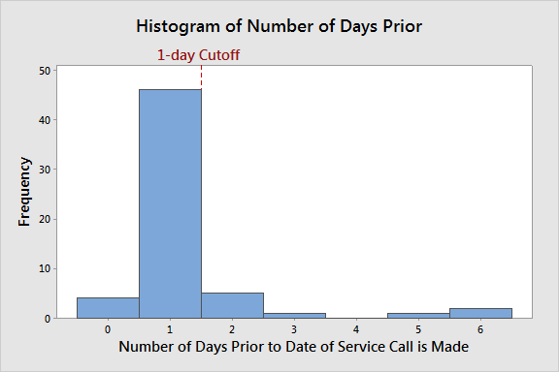
Test of Theories X₁
Theory: Late notification of patient rescheduling (PreCert)
Question: How far in advance are attempts to contact patient made?
Analysis: Attempts made to reschedule are less than 24 hours.
Practical Conclusion: PreCert staff are contacting patients less than 24 hours prior to the service date which leads to unhappy patients and schedule capacity issues for diagnostic areas.
See Notes View for hypothesis test.
Notes:
Wilcoxon Signed Rank Test: Difference
Test of median = 2.000 versus median < 2.000
N for Wilcoxon Estimated
N Test Statistic P Median
Difference 59 54 183.0 0.000 1.000
Hypothesis test shows that the median number of days prior to scheduled
service that a call is made is 1, This is less than the minimum time that is
appropriate

Slide 63
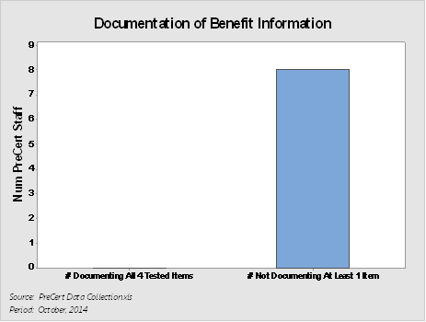
Test of Theories X2
Theory: Inconsistent method of obtaining benefits
Question: Are PreCert staff documenting detailed benefit information?
Analysis: All 8 of 8 individuals did not properly document at least on of four elements

Slide 64
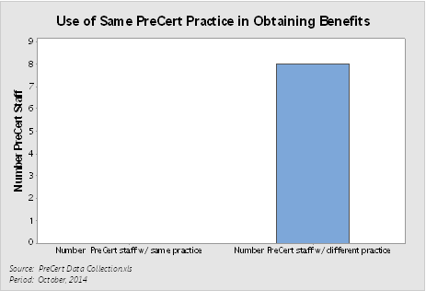
Test of Theories X3
Theory: Limited Knowledge
Question: Is PreCert staff up to date on industry standards with obtaining benefits according to best practice?
Analysis: All 8 of 8 individuals have a different process (no pattern of completion “yes/no” across process steps is repeated across staff)

Slide 65

Test of Theories X₄
Theory: Not perform duties in a timely manner (PreCert)
Question: How far ahead is PreCert working?
Analysis: On average, PreCert staff is working 5 days out.
Practical Conclusion: While the average reflects 5 days, we need to address the staff working <5 days to bring them up to the desired expectation.

Slide 66
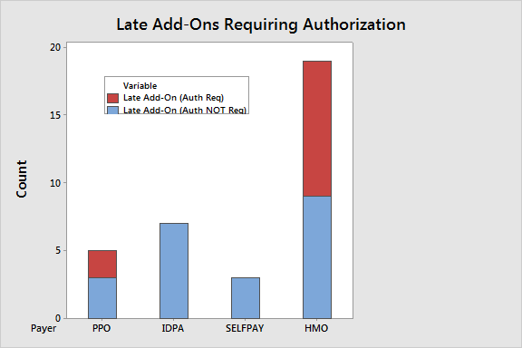
Test of Theories X₅
See Notes View for hypothesis test.
Theory: Late add-ons (all patients except w/ verified straight Medicare/Medicaid added < 3 business days) (PreCert, Central Sched, Depts) contribute to poor financial clearance.
Question: How many late add-ons are scheduled, by payer, w/ authorization required?
Analysis: There is an increase oh HMOs with the ACA therefore late add ons are more difficult to get authorized with insurance company requirements.
Practical Conclusion: The number of late add ons requiring authorization over a weeklong period was 12, which is greater than the limit of 7. Additionally, 35% of late add ons required authorization which is higher that the hypothesized proportion. of 20%.
Notes:
Test and CI for One Proportion
Test of p = 0.2 vs p > 0.2
Sample X N Sample p 95% Lower Bound P-Value
1 12 34 0.352941 0.217880 0.027
Hypothesis test shows that the proportion of late add-ons requiring authorization is greater than appropriate (7 max in one week).

Slide 67
Test of Theories X6
Source: No ids referral orders for October.xlsx
FALSE
Theory: Inconsistent documentation when patients arrive at Registration contributes to poor financial clearance.
Question: What percentage of patients arrive w/o required ID, Order, or Referral?
Analysis: A total of 8% of patient visits had no identification, no order, or no referral.
Practical Conclusion: 8% missing 1 or more document, which is less than the established 10% limit. Conclude theory is FALSE.
Number of ok registrations for the month of October | Total number of patient with no ID | Total number of patients with no orders and/or referrals | % for the month with no ids and no orders/referrals
4309 | 30 | 306 | 8%

Slide 68
Test of Theories X7
Theory: Inconsistent notification process for non-approved services for patients.
Question: What is your process for non-approved services for patients?
Analysis: 1 out of 4 Financial Counselors answered inconsistently.
Practical Conclusion: Financial Counselors do not consistently use the same methods of notifying patients which contributes to confusion and dissatisfaction.

Slide 69
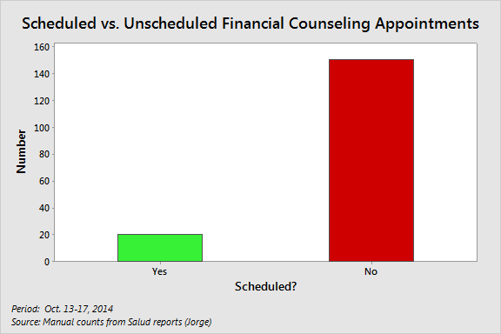
Test of Theories X₈
Theory: No notification of patients/not performing duties in a timely manner (Financial Counseling)
Question: What is the percentage of patients arriving for self-pay scheduled service are scheduled for a Financial Counseling meeting that see a Financial Counselor?
Analysis: Only 13.2% of self-pay patients (20 out of 151) are scheduled with Financial Counseling. This is less than the target of at least 90%.
Practical Conclusion: Patients that are not scheduled with a Financial Counselor prior to the date of service causes backlogs in registration and angry patients.

Slide 70
Test of Theories X₉
Theory: Inconsistent application of rules to $ non-compliant patients..
Question: What do you do with patients that are non-compliant with payment?
Analysis: 1 out of 4 Financial Counselors answered inconsistently.
Practical Conclusion: Financial Counselors are not consistently practicing the same rules amongst non-compliant patients which attributes to miscommunication and dissatisfaction amongst patients and staff.

Slide 71
Test of Theories X₁₀
FALSE
Theory: Wrong test scheduled (Central Scheduling / Departments).
Question: How many patients with the wrong test scheduled continue to have service provided?
Analysis:
Ancillary departments were unable to produce documentation showing wrong tests were being scheduled.
Practical Conclusion: With no evidence supporting this theory, conclude it is false, and team will not pursue.

Slide 72
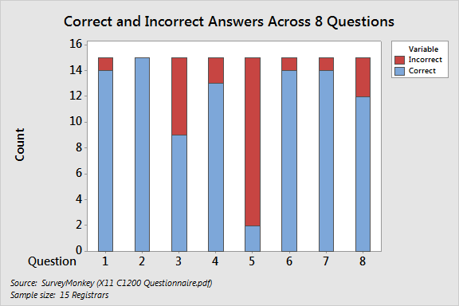
Test of Theories X₁₁
Theory: Limited knowledge of correct paperwork for financially cleared visits (C1200)
Question: What is the capability of C1200 staff to recognize correct paperwork?
Analysis:
Question Correct Incorrect Total % Correct
1 14 1 15 93%
2 15 0 15 100%
3 9 6 15 60%
4 13 2 15 87%
5 2 13 15 13%
6 14 1 15 93%
7 14 1 15 93%
8 12 3 15 80%
Only 2 Registrars answered Question #5 correctly. At best, only 2 of 15 (13%) of the Registrars obtained a score of at least 87.5% (answering 7 of 8 questions correctly), below the cutoff of 100% obtaining a score of 90% or better.
Practical Conclusion: C1200 staff have inadequate understanding of the
correct paperwork to obtain financially cleared visits.
Practical Conclusion:

Slide 73
Test of Theories X₁₂
TRUE
Theory: C1200 incorrectly determines financial clearance
Question: What is the capability of C1200 staff to determine financial clearance?
Analysis: C1200 staff were presented with 5 examples of different insurances to determine if they can decipher the difference in the plans.
Practical Conclusion: Although 88% of the time staff was able to identify the correct insurance plan from the examples presented, the team was looking
for an accuracy rating of 90% or better.

Slide 74
Summary of Testing Results
TRUE
X₁: Late notification of patient rescheduling (PreCert) TRUE
X₂: Inconsistent method of obtaining benefits TRUE
X₃: Limited Knowledge TRUE
X₄: Not perform duties in a timely manner (PreCert) TRUE
X₅: Late add-ons (all patients except w/verified straight Medicare/Medicaid added < 3 business days) (PreCert, Central Sched, Depts) contribute to poor financial clearance. TRUE
X6: Inconsistent documentation when patients arrive (Registrar) FALSE
X7: Inconsistent notification process for non-approved services for patients. TRUE
X8: No notification of patients/not performing duties in a timely manner (Financial Counseling) TRUE
X9: Inconsistent applications of rules to $ non-compliant patients (Financial Counseling) TRUE
X10: Wrong test scheduled (Cent Scheduling/Department) FALSE
X11: Limited knowledge of correct paperwork for financially cleared visits (C1200)
X₁₂: C1200 incorrectly determines financial clearance TRUE

Slide 75
List of Vital Few Root Causes (Proven Xs)
Y=f(X₁,……X_{n})
Vital Few Xs are:
X1: Late notification of patient rescheduling (PreCert)
X2: Inconsistent method of obtaining benefits
X3: Limited Knowledge
X4: Not perform duties in a timely manner (PreCert)
X5: Late add-ons (< 3 business days) (PreCert, Central Sched, Depts) contribute to poor financial clearance.
X7: Inconsistent notification process for non-approved services for patients.
X8: No notification of patients/not performing duties in a timely manner (Financial Counseling)
X9: Inconsistent applications of rules to $ non-compliant patients (Financial Counseling)
X11: Limited knowledge of correct paperwork for financially cleared visits (C1200)
X12: C1200 incorrectly determines financial clearance

Slide 76
List of Vital Few Wastes
Vital Few Wastes are:
PreCert searching for PCP (Cause-Effect)
Address via Quick Hit
C1200 check in desk sending a non-financially cleared patient to Registrar (related to X11, X12)
Address as part of Meditech Daily Scheduled Appointment List
Patients go to Financial Counselor for billing issue (interrupts new workflow)
Address via Quick Hit

Slide 77
Analyze Phase Deliverables
Analyze | Complete
Cause-effect diagram(s) | X
5 Why analysis (as appropriate) | X
FMEA on current state process | X
Analysis of value stream map and process map(s) | X
VA/NVA decomposition analysis | X
Inventory analysis (as appropriate) | N/A
Impact control matrix to prioritize potential root causes and wastes | X
List of theories to be tested (list of selected potential Xs) | X
Data collection plan for analyze phase | X
Each theory tested (proven or disproven) using graphical or statistical analysis | X
Summary listing of proven or disproven theories | X
List of vital few root causes (proven Xs), i.e., Y=f(X₁, X₂, ….X_{n}) | X
List of vital few wastes (as appropriate) | X
Gate review and Sign-off by Champion | X

Slide 78
Lean Six Sigma Roadmap
Define
Measure
Analyze
Improve
Control

Slide 79
Improvement Strategies for Xs
Proven Xs (Causes) | Strategies
X1: Late notification of patient of rescheduling (PreCert) | Implement 48 hr. non-approval guideline to minimize late notifications.
X2: Inconsistent method of obtaining benefits (PreCert) | Create standard workflow, including guidelines, procedure manuals, training to ensure consistent methods, and effective communication of changes to PreCert staff.
X3: Limited knowledge (PreCert) | Create standard workflow, including guidelines, procedure manuals, training to ensure consistent methods, and effective communication of changes to PreCert staff.
X4: Not perform duties in a timely manner (PreCert) | Redistribute work load across staff (e.g., alphabetic assignment (balance work load, reduce duplication of effort, identify internal best practices). Physician Offices responsible for obtaining authorization for add-ons.
X5: Late add-ons (all patients except w/ verified straight Medicare/Medicaid added < 3 business days) (PreCert / Central Sched / Depts) | Implement scheduling guidelines in reference to late add-ons to ensure appointments follow insurance industry standard of processing pre-auth approvals a minimum 3 days out.

Slide 80
Improvement Strategies for Xs
Proven Xs (Causes) | Strategies
X7: Inconsistent notification process for non-approved services (Financial Counseling) | Create standard workflow, including guidelines, procedure manuals, training to ensure consistent methods, and effective communication of changes to Financial Counseling staff.
X8: No notification of patients / not perform duties in timely manner (Financial Counseling) | Use existing Meditech report to identify future scheduled appointments, and workflow to integrate into Financial Counseling process (who schedules future appointments, how to manage workflow of scheduled vs. walk-ins).
X9: Inconsistent application of rules to $ non-compliant patients (Financial Counseling) | Establish guideline for non-compliant patients based on existing 3-strike rule or similar.

Slide 81
Improvement Strategies for Xs
Within these strategies, more specific, possible solutions were identified and evaluated via pros/cons, and a criteria-based selection matrix…
Proven Xs (Causes) | Strategies
X11: Limited knowledge of correct paperwork for financially cleared visits (C1200) | Management by exception to pull out problem visits and handle separate from normal flow. Cross-train all registrars and front desk staff in how to interpret more standardized PreCert notes using existing PreCert report. Process for patients arriving w/o financial clearance.
X12: C1200 incorrectly determines financial clearance | Consistent documentation and location by PreCert. Patient does not pass Front Desk if not cleared.

Slide 82
Descriptions of Possible Solutions (Pros and Cons)
X1: Late notification of patient of rescheduling (PreCert) | Strategy: Implement 48 hr. non-approval guideline to minimize late notifications.
Possible Solution | Strengths (Pros) | Weaknesses (Cons)
A. 48 hr. phone call to all in-scope patients re: appointment & financial clearance status. | - Force an appropriate time line for patient notifications. - All patients will be contacted and informed of financial responsibilities prior to their visit, which in turn should increase TOS collections. - May also serve as a reminder call. | - Increase workload for insurance verifiers. - Difficult to obtain correct phone numbers.
B. 48 hr. notification if authorization not obtained, and reschedule appointment. | - Reduces chances of us not being able to contact patient. - Reduces the chances of the last minute scramble. | - Less time to work on authorization.
C. Paper guidelines for PreCert | - PreCert will be able to refer to their guidelines for direction. - Will assist in training new employees. | - Impossible to include all situations (cannot be all inclusive). - Maintenance will be time consuming.
D. Electronic guidelines for PreCert. | *see above. - Easily accessible. | See above (paper guidelines).
E. Assign patient calls based on language (bilingual staff). | - Better customer service. | - Difficult to determine in advance which patients are non-English speaking.
Design: A, B, C, D
Evaluate further: E

Slide 83
Descriptions of Possible Solutions (Pros and Cons)
X2: Inconsistent method of obtaining benefits (PreCert) X3: Limited knowledge (PreCert) | Strategy: Create standard workflow, including guidelines, procedure manuals, training to ensure consistent methods and effective communication of changes to PreCert staff.
Possible Solution | Strengths (Pros) | Weaknesses (Cons)
A. Create Standard Operating Procedure for insurance verification. | - Similar work flow process for staff. - Easy to train new staff. | - Determining which methods are most effective. - Breaking previous work habits.
B. Update personal policy manuals with electronic communications from management. | - Can be visually audited. - May give employee the opportunity to address issues/questions. | - Time consuming. - Still does not ensure effective communication/understanding.
C. Comprehensive training on all elements at one time. | - Quicker implementation. | - Higher chance of error due to information overload.
D. Step-by-step training on elements over time. | - Allow for evaluation of process as implemented which allows for periodic re-evaluation. | - Can be time consuming. - Requires a lot of follow up/thru.
E. Periodic communication & group discussion of changes. | - Allow employees to discuss challenges and changes. | - Time consuming, - May require a lot of follow thru.
Design: A, D, E
Evaluate further: B

Slide 84
Descriptions of Possible Solutions (Pros and Cons)
X4: Not performing duties in a timely manner (PreCert) | Strategy: Redistribute work across staff. Physician Offices responsible obtain add-on auths or is rescheduled
Possible Solution | Strengths (Pros) | Weaknesses (Cons)
A. Change work assignments to alpha. | - Even distribution of work load. - Reduce duplicate work efforts. | - Staff will have to be knowledgeable in all areas.
B. Assign work via insurance payer. | - May allow rapid financial clearance of payers who have quick turn around time. | - Will overload employees who are assigned to work HMO’s. - Uneven distribution of work load.
C. Designate a person to work on special cases (add-on’s). | Will allow other staff to work farther out. Minimize impact of exceptions on flow of other work. | Hard to predict volume of special cases. Do not have staff to easily accommodate.
D. Weekly audits conducted by management to determine how far ahead staff is working. | Reinforces employee self-control. Allows management to see and react to trends. | Time-consuming for management. Resistance from employees.
E. Establish employee quotas. | Sets guideline for productivity. Allows measurement of workload staffing needs. | Risk of poor quality. Resistance from employees.
F. Physician Offices responsible obtain add-on auths or is rescheduled. | - Puts responsibility and accountability back on clinic - Forces clinic to be involved and understand processes | Clinic will not do, patient stuck in the middle
Design: A, D, E; Evaluate further: C, F

Slide 85
Descriptions of Possible Solutions (Pros and Cons)
X5: Late add-ons (all patients except w/ verified straight Medicare/Medicaid added < 3 business days) (PreCert / Central Sched / Depts) | Strategy: Implement scheduling guidelines in reference to late add-ons to ensure appointments follow insurance industry standard of processing pre-auth approvals a minimum 3 days out.
Possible Solution | Strengths (Pros) | Weaknesses (Cons)
A. Scheduling staff notify PreCert of any late add-ons <3 business days. | - Allow PreCert to promptly start authorization process if necessary. | - Precert will have to stop task to attend to add-ons. - Insurance may required additional time to process request.
B. PreCert overrides late scheduling (<3 business days). | - None identified. | Creates follow-up work for Scheduler. Schedulers have no insurance knowledge.
C. Scheduling asks “caller” re: urgency & if urgent talk to PreCert, else schedule >3. | - May prompt office to obtain authorization due to PreCert feed back. | - Precert will have to stop task to attend this issue. - Information may not be available until call is made to ins company.
D. Provider rep from insurance to expedite late add-ons. | - Immediate access to rep’s. | - High turn over at insurance companies. - Insurance company must be willing to work with us.
E. Epic access to clinicals. | - Immediate access to clinicals, - Reduce call time with clinics. | - Insurance may required additional processing time. - Not all clinics use Epic.
F. Clinic provides clinicals at time of urgent appointment request. | - Reduce back and forth calling to clinic. | - Hard to enforce, what if clinic does not fax the info? - Insurance company may still require additional time to process.
G. Clinic must provide authorization for late add-on’s. | - Will not consume precert’s resources as authorization should already be on file. - Clinic may refrain from adding patients on if they have to obtain auth | - Clinic refuse to cooperate. - Precert still must take steps to verify authorizations.
Design: A, C, F
Evaluate further: G

Slide 86
Descriptions of Possible Solutions (Pros and Cons)
X7: Inconsistent notification process for non-approved services (Financial Counseling) | Strategy: Create standard workflow, including guidelines, procedure manuals, training to ensure consistent methods, and effective communication of changes to Financial Counseling staff.
Possible Solution | Strengths (Pros) | Weaknesses (Cons)
A. When PreCert identifies non-covered or non-approved services, email distribution list to notify Financial Counselors to contact patient and document in Meditech (B/AR). | - Financial Counselors are able to expedite financial clearance process. | Due to inconsistent volume of patients to be seen in C1200, it gives a current staff minimum time to work with patients over the phone. Redundant work for PreCert. Creating new workflow outside of Meditech.
B. Form on P Drive consolidates and tracks email to Financial Counselors (PreCert adds). | - Financial clearance team able to track progress on obtaining financial clearance. | - Same as above.
C. Develop work flow using Meditech reporting capabilities (worklist). | Majority of work already done in Meditech. Staff have clear picture of workload and real-time access. Reduces redundancy in info. | May need to create new reports, additional fields in Meditech.
D. Physician notification if test is canceled. | - Provides opportunity for physician to follow up and intervene with patient. | - Physician will not cancel patient in a timely manner / insist on treatment. - Patients still arrive to be seen. - No administrative support.
E. Create a policy implementing guidelines for non approved patients. | - All involved know processes; reduce inconsistencies. | - Challenge to approve and train in policies.
Design: C, D, E
Evaluate further: N/A

Slide 87
Descriptions of Possible Solutions (Pros and Cons)
X8: No notification of patients / not perform duties in timely manner (Financial Counseling) | Strategy: Use existing Meditech report to identify future scheduled appointments, and workflow to integrate into Financial Counseling process (who schedules future appointments, how to manage workflow of scheduled vs. walk-ins).
Possible Solution | Strengths (Pros) | Weaknesses (Cons)
A. Alphabetic assignment of self-pay patients to Financial Counselors to schedule appointment in advance. | Patients arrive cleared prior to test; arrive w/ proper documentation. Establishes personal relationship between FC and patient. | Limited staff currently does not allow for split. Does not account for walk-ins. Does not fit current model allocating FCs by function.
B. Assignment by days out / exceptions (rotate among Financial Counselors). | - Patients arrive prepared on or before date of service w. co-pay, FAP (charity) documents, etc. | - Unable to accommodate self-pay and walk-in patients simultaneously.
C. Prioritization of arrived, scheduled before walk-ins (e.g., front desk enters FC appointment reason) | - Patients that are scheduled for services seen on time. | - No process in place to let Financial Counselors know who is scheduled vs. walk-in. - Penalizes patients that were unable to schedule appointment.
D. Cashier handles basic billing questions. | - Financial Counselors can better focus on more complex issues patient may have. | May disrupt and prolong cashier workflow; requires full attention (varied responsibilities). Require additional training; layout problems.
E. Clinics refer self-pays to Patient Navigators. | - Patients have a better understanding of all options available for their health care needs. | After Navigators speak to self-pay patients, they still have to be seen by Financial Counselors. Potentially low patient volume.
F. Designated staff to handle billing and overflow / walk-ins. | Allows for patients to be scheduled in advance. Allows faster turnaround time. | - Requires designated staff (TBD w/ contracting changes).
Design: B, C; Evaluate: N/A

Slide 88
Descriptions of Possible Solutions (Pros and Cons)
X9: Inconsistent application of rules to $ non-compliant patients (Financial Counseling) | Strategy: Establish guideline for non-compliant patients based on existing 3-strike rule or similar.
Possible Solution | Strengths (Pros) | Weaknesses (Cons)
A. Establish guideline for non-compliant patients that is supported by Administration. Create a policy that is supported by the health system to reinforce decisions made for non-compliant patients.. | Staff and health system have a clear direction on the financial clearance process. Staff feel confident in that decisions are supported by management. | Administration not supporting decisions made by staff; this creates low morale w/in staff.
B. Formalize and enforce 3-strike guideline / dollar limit. | Staff and health system have a clear understanding of consequences of non-compliant patients. | Physicians disputing decisions made by Financial Clearance team.
C. Proactively communicate to patient consequences of non-compliance via Promissory Note. | Patients are aware of consequences of non-compliance. | Difficult to enforce.
D. Patient deposit required by day of service. | Fewer accounts go into bad debt. | No established process if patient does not pay. Does not guarantee full payment.
E. Patient receives prompt payment discount. | Fewer accounts go into bad debt. AR goes down. | No established process if patient does not pay. Is no process to notify FC that account has been finalized.
Design: A, B, C, D, E
Evaluate: N/A

Slide 89
Descriptions of Possible Solutions (Pros and Cons)
X11: Limited knowledge of correct paperwork for financially cleared patients (C1200) | Strategy: Management by exception to pull out problem visits and handle separate from normal flow. Cross-train all registrars and front desk staff in how to interpret more standardized PreCert notes using modified PreCert report. Consistent process for patients arriving w/o financial clearance.
Possible Solution | Strengths (Pros) | Weaknesses (Cons)
A. C1200 Front Desk runs PreCert report 2x/day to flag add-ons, modified to show a) Financial clearance?, b) Does patient need to see FC?, c) Has FC cleared patient? | Faster flow for self-pay routed to Financial Counselor. Prevents patients bottlenecking Registrar. Real-time information. | - Front Desk not private.
B. Non-add-ons (scheduled but not financially cleared) referred back to PreCert (clear criteria, standardized communications to patient & clinic). | PreCert can clearly explain & resolve w/ patient. | PreCert only operates standard business hours.
C. Insurance training for Front Desk staff. | - Front Desk can immediately resolve minor issues; eliminate inappropriate flow. | - Time-consuming; slow implementation w/ need for reinforcement.
D. Scripting for non-approved, scheduled tests (Front Desk, Registrars) referred to PreCert. | - Consistent communication to patient and PreCert, including off-hours. | - None identified.
Design: A, B, C, D
Evaluate: N/A

Slide 90
Descriptions of Possible Solutions (Pros and Cons)
For most strategies and solutions, pros and cons were sufficient to make decisions. For others, a criteria-based selection matrix was applied that evaluated options with explicit criteria, including the Critical to Quality requirements (CTQs)…
X12: C1200 incorrectly determine financial clearance | Strategy: Consistent documentation and location by PreCert. Patient does not pass Front Desk if not cleared.
Possible Solution | Strengths (Pros) | Weaknesses (Cons)
A. Refer to scheduled list to determine if patient financially cleared (vs. Meditech lookup). | Quicker to facilitate. Decreases registration time. | - Paper-based; not real-time information.
B. Clearly designated Yes/No indicating if cleared by PreCert or Financial Counseling. | Quicker to facilitate. Removes decision-making by C1200. | - Possible over-reliance on single field (C1200 no longer look at other information).
Design: A, B
Evaluate: N/A

Slide 91
Criteria-Based Selection Matrix
* It later was decided, after consultation with Champion, to pursue the X4C solution.
Criteria-based Selection Matrix
 |  | Option
Criteria | Weight | X4 Strategy: Redistribute work load across staff | X4 Strategy: Separate out exceptions | X4 Strategy: Physician Offices responsible obtain add-on auths |  | X1E: Assign patient calls based on language | X2/X3B: Personal policy manuals w/ mgmt electronic communications | X4C: Designated person works on special cases (add-on’s) | X5G: Clinic must provide authorization for late add-on’s
 |  | Score | Score | Score |  | Score | Score | Score | Score
Affordable cost | 5 | 3 | 0 | 0 |  | 5 | 5 | 0 | 0
Impact on the problem | 9 | 3 | 3 | 9 |  | 1 | 5 | 3 | 9
Benefit and cost relationship | 5 | 3 | 3 | 5 |  | 5 | 5 | 3 | 5
Cultural impact and resistance to change | 1 | 9 | 0 | -9 |  | -1 | -3 | 0 | -9
Implementation time | 3 | 5 | 3 | 0 |  | 9 | -1 | 3 | 0
Uncertainty about effectiveness | 5 | 9 | 3 | 1 |  | 5 | 1 | 3 | 1
Health and safety* | 1 | 0 | 0 | 0 |  | 0 | 0 | 0 | 0
Environment* | 1 | 0 | 0 | 0 |  | 0 | 0 | 0 | 0
CTQ: A minimum of 24 hour notification of financial clearance to patient, responsibility and expectations. | 9 | 3 | 5 | 9 |  | 3 | 0 | 5 | 9
CTQ: 100% correct insurance information a minimum of 24 hours prior to service. | 9 | 0 | 0 | 3 |  | 0 | 0 | 0 | 3
CTQ: ≥90% of patients arrive with all required paperwork. | 5 | 0 | 0 | 0 |  | 5 | 0 | 0 | 0
CTQ: Precert staff are competent in obtaining financially cleared visits | 9 | 5 | 3 | 0 |  | 0 | 9 | 3 | 0
CTQ: 100% of C1200 staff have 90% or greater competency score in recognizing correct paperwork for financially cleared visits. | 5 | 0 | 0 | 0 |  | 0 | 0 | 0 | 0
CTQ: 100% of registrars can determine 90% or better of financially cleared visits. | 5 | 0 | 0 | 0 |  | 0 | 0 | 0 | 0
CTQ: Support for 100% of staff directly involved in the event a patient is not prepared. | 3 | 0 | 0 | 0 |  | 0 | 0 | 0 | 0
Total | 75 | 264 | 184 | 280 | # | 216 | 233 | 184 | 280
 |  | PURSUE | DROP | PURSUE |  | JDI | PURSUE | DROP* | PURSUE
*Note: Health and safety, Environment were evaluated and found not to be relevant criteria for the selection process.

Slide 92
List of Selected Remedies (Solutions)
Implement 48 hr. non-approval guideline to minimize late notifications.
Create standard workflow, including guidelines, procedure manuals, training to ensure consistent methods and effective communication of changes to PreCert staff.
Redistribute work across staff.
Implement scheduling guidelines in reference to late add-ons to ensure appointments follow insurance industry standard of processing pre-auth approvals a minimum 3 days out.
Create standard workflow, including guidelines, procedure manuals, training to ensure consistent methods, and effective communication of changes to Financial Counseling staff.
Use existing Meditech report to identify future scheduled appointments, and workflow to integrate into Financial Counseling process (who schedules future appointments, how to manage workflow of scheduled vs. walk-ins).
Establish guideline for non-compliant patients based on existing 3-strike rule or similar.
Management by exception to pull out problem visits and handle separate from normal flow. Cross-train all registrars and front desk staff in how to interpret more standardized PreCert notes using modified PreCert report. Consistent process for patients arriving w/o financial clearance.
Consistent documentation and location by PreCert. Patient does not pass Front Desk if not cleared.

Slide 93
Solution Descriptions (X1: Late notification of rescheduling)
Stephanie
Strategy: Implement 48 hr. non-approval guideline to minimize late notifications.
Solutions: 48 hr. phone call to all in-scope patients re: appointment & financial clearance status.
48 hr. notification if authorization not obtained, and reschedule appointment. Paper & electronic guidelines for PreCert. Pursue as JDI: Assign patient calls based on language (bilingual staff).
New process flows | Require insurance process to take place prior to 48 hours in advance; will require insurance verifier to contact patients
Standard work, policies / guidelines, manuals, etc. | Update existing insurance verification policy requiring provision for contacting patient and physician.
HR-related items (e.g., job descriptions, training) | Light training required specifically on Meditech documentation.
Facilities needed to support solution | Adequate privacy for phone calls. (via Ryerson move)
IT integration (hardware, software) | Standard work station phone/fax/pc, scanner.
Materials and supplies | n/a
Other | May need plan for non bilingual precert members.

Slide 94
Solution Descriptions (X2, X3: Obtain benefits, Knowledge)
Stephanie
Strategy: Create standard workflow, including guidelines, procedure manuals, training to ensure consistent methods and effective communication of changes to PreCert staff.
Solutions: Create Standard Operating Procedure for insurance verification. Update personal policy manuals with electronic communications from management. Step-by-step training on elements over time. Periodic communication & group discussion of changes.
New process flows | Must establish most efficient work flow process.
Standard work, policies / guidelines, manuals, etc. | Guidelines including FAQ’s, direction for common situations/scenarios. Identify specific questions and fields with standardized responses to promote rapid and accurate understanding/interpretation of notes (including by C1200).
HR-related items (e.g., job descriptions, training) | May require employees to be overall knowledgeable about the precert process for all departments. 1-2 additional PreCert FTEs to accommodate increased HMO volume and responsibilities.
Facilities needed to support solution | n/a
IT integration (hardware, software) | Employee access and training on how to utilize Meditech reports. Standard office set up including scanners. Cisco-compatible headsets. Upgrade from XP operating system.
Materials and supplies | File Cabinet.
Other | n/a

Slide 95
Solution Descriptions (X4: Duties in timely manner)
Stephanie
Strategy: Redistribute work across staff.
Solutions: Change work assignments to alpha. Weekly audits conducted by management to determine how far ahead staff is working. Establish employee quotas. Physician Offices responsible obtain add-on auths or is rescheduled
New process flows | Establish work flow process.
Standard work, policies / guidelines, manuals, etc. | Update policies on employee assignment responsibilities.
HR-related items (e.g., job descriptions, training) | May require training as this change may require employees to be familiar with various departments.
Facilities needed to support solution | Privacy for phone call, open area for consultation amongst staff members for guidance and advice.
IT integration (hardware, software) | Creation/modification of Meditech reports. Standard workstation with phone, fax and scanners.
Materials and supplies | n/a
Other | n/a

Slide 96
Solution Descriptions (X5: Late add-ons)
Stephanie
Strategy: Implement scheduling guidelines in reference to late add-ons to ensure appointments follow insurance industry standard of processing pre-auth approvals a minimum 3 days out.
Solutions: Scheduling staff notify PreCert of any late add-ons < 3 business days. Scheduling asks “caller” re: urgency & if urgent talk to PreCert, else schedule >3. Clinic provides clinicals at time of urgent appointment request. Clinic must provide authorization for late add-on’s.
New process flows | Need approval from administration, update Central Scheduling guidelines, precert team must be available to assist Central Scheduling with late add on request.
Standard work, policies / guidelines, manuals, etc. | Update central scheduling polices. Define clear process for late add on’s.
HR-related items (e.g., job descriptions, training) | May require additional training for Central Schedulers and require reinforcement from management.
Facilities needed to support solution | Adequate space for phone privacy, also requires easy access to co-workers.
IT integration (hardware, software) | Requires real time accurate eligibility verification.
Materials and supplies | Standard workstation with phone, fax and scanners.
Other | May need to inform referring physicians (Access & SMG) of new guidelines.

Slide 97
Solution Descriptions (X7: Notification non-approved services)
Jorge
Strategy: Create standard workflow, including guidelines, procedure manuals, training to ensure consistent methods, and effective communication of changes to Financial Counseling staff.
Solutions: Develop work flow using Meditech reporting capabilities (worklist). Physician and patient notification if test is canceled. Create a policy implementing guidelines for non approved patients.
New process flows | Create a new workflow that will facilitate any changes that financial counselors need to be aware of. Clear assignment of responsibilities.
Standard work, policies / guidelines, manuals, etc. | Guidelines having a clear direction of workflow. Have the ability to contact parties responsible for cancellation/reschedule of procedures. Have a policy in place for non-compliant patients (combine with x9 policy).
HR-related items (e.g., job descriptions, training) | Training of financial counselors of new workflow.
Facilities needed to support solution | Sufficient privacy for phone calls.
IT integration (hardware, software) | Meditech provides information for Financial counselors. Work list of patients with non-approved services. Phone, Workstation.
Materials and supplies | n/a
Other | Bilingual.

Slide 98
Solution Descriptions (X8: No notification of patients)
Jorge
Strategy: Use existing Meditech report to identify future scheduled appointments, and workflow to integrate into Financial Counseling process (who schedules future appointments, how to manage workflow of scheduled vs. walk-ins).
Solutions: Assignment by days out / exceptions (rotate among Financial Counselors). Prioritization of arrived, scheduled before walk-ins (e.g., front desk enters FC appointment reason).
New process flows | Need new process flow for scheduling patients in advance (from Step A to Step B) that designates an employee to pull info from Meditech, contact patients and schedule appt.
Standard work, policies / guidelines, manuals, etc. | Guideline including FAQs; scripting for reinforcement of need to meet Financial Counselor prior to visit.
HR-related items (e.g., job descriptions, training) | Reassignment of work. Training of FCs and employees making appointments in how to schedule appts, documentation pts need, overview of Financial Counseling process (what to expect).
Facilities needed to support solution | Sufficient privacy for phone calls.
IT integration (hardware, software) | Modify Meditech report to include information deemed necessary for workflow (TBD). Phone, workstation.
Materials and supplies | n/a
Other | Bilingual.

Slide 99
Solution Descriptions (X9: Non-compliant patients)
Jorge
Strategy: Establish guideline for non-compliant patients based on existing 3-strike rule or similar.
Solutions: Establish guideline for non-compliant patients that is supported by Administration. Create a policy that is supported by the health system to reinforce decisions made for non-compliant patients. Formalize and enforce 3-strike guideline / dollar limit. Proactively communicate to patient consequences of non-compliance via Promissory Note. Patient deposit required by day of service. Patient receives prompt payment discount.
New process flows | Create a new policy to provide guidelines for non-compliant patients (combine with x7 policy). Based on occurrence and/or cash amount.
Standard work, policies / guidelines, manuals, etc. | Policy and Guidelines need to provide clear instructions and reinforce consequences of non-compliant patients. Payments paid before or on day of service.
HR-related items (e.g., job descriptions, training) | Training of financial counselors of new workflow.
Facilities needed to support solution | Sufficient privacy for phone calls and cash collections
IT integration (hardware, software) | Ability to take payments by phone, including credit cards, debits and checks. Phone, workstation
Materials and supplies | n/a
Other | Bilingual

Slide 100
Solution Descriptions (X11: C1200 paperwork knowledge)
Carmen
Strategy: Management by exception to pull out problem visits and handle separate from normal flow. Cross-train all registrars and front desk staff in how to interpret more standardized PreCert notes using modified PreCert report. Consistent process for patients arriving w/o financial clearance.
Solution: C1200 Front Desk runs PreCert report 2x/day to flag add-ons, modified to show a) Financial clearance?, b) Does patient need to see FC?, c) Has FC cleared patient? Non-add-ons (scheduled but not financially cleared) referred back to PreCert (clear criteria, standardized communications to patient & clinic). Insurance training for Front Desk staff. Scripting for non-approved, scheduled tests (Front Desk, Registrars) referred to PreCert.
New process flows | Front desk workflow from “assembly line” to allow 1 staff member to “own” individual patients. Process flow to separate problem visits.
Standard work, policies / guidelines, manuals, etc. | Established standard work for front desk procedures. (to eventually be incorporated into policies)
HR-related items (e.g., job descriptions, training) | Training of front desk staff to run Meditech report, Meditech functionality, other portions of standard work/workflow.
Facilities needed to support solution | Recommend C1200 facilities & workflow changes as loner term solution.
IT integration (hardware, software) | Upgrade from XP operating system
Materials and supplies | n/a
Other | n/a

Slide 101
Solution Descriptions (X12: C1200 financial clearance)
Carmen
Strategy: Consistent documentation and location by PreCert. Patient does not pass Front Desk if not cleared.
Solution: Refer to scheduled list to determine if patient financially cleared (vs. Meditech lookup). Clearly designated Yes/No indicating if cleared by PreCert or Financial Counseling.
New process flows | Modify existing appointment schedule report from Meditech to identify financially cleared patient, continue the use of Epic and NextGen to retrieve orders when patient present without them, train staff to understand documentation from PreCert.
Standard work, policies / guidelines, manuals, etc. | Guidelines to include process for C-1200 regarding patients that present that are not financially cleared and what steps to follow when patients present without clearance.
HR-related items (e.g., job descriptions, training) | Update current job description, list of all duties and responsibilities for registration, provide additional training along with training manual and increase staff.
Facilities needed to support solution | Volume of patients has increased; need more space in waiting area.
IT integration (hardware, software) | Modify scheduling report to indicate when patients are financially cleared. Upgrade computer system with speed and electronic signature pad.
Materials and supplies | n/a
Other (e.g., Service Level Agreements, etc.) | The support of administration when patients are not financially cleared.

Slide 102
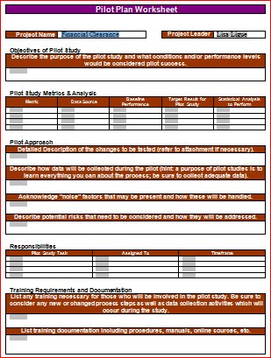
Pilot/DOE (as applicable)
The team determined that the selected solutions were straightforward and did not introduce significant risk.
Piloting therefore was unnecessary.

Slide 103
Updated Process FMEA
Re-scoring based on the solutions showed a reduction in risk, as shown by the lower RPN numbers.
Process Step or Variable or Key Input | Potential Failure Mode | Potential Effect on Customer Because of Defect | SEV | Potential Causes | OCC | Current Process Controls | DET | RPN | Actions Recommended | Resp.& Target Date | Actions Taken | SEV | OCC | DET | Future RPN
What is the process step? | In what ways can the Process Step, Variable, or Key Input go wrong? (chance of not meeting requirements) | What is the impact on the Key Output Variables (customer requirements) or internal requirements? | How Severe is effect to the customer? | What causes the Key Input to go wrong? (How could the failure mode occur?) | How frequent is cause likely to Occur? | What are the existing controls that either prevent the failure mode from occurring or detect it should it occur? | How probable is Detection of cause? | Risk Priority # to rank order concerns | What are the actions for reducing the Occurrence of the cause, or improving Detection? Should have actions on high RPN's or Severity of 9 or 10. | Who is Responsible for the recommended action? What date? | What were the actions implemented? Include completion month/year. (Then recalculate resulting RPN.) | Future Severity | Future Occurance | Future Detection
Financial Counseling | Counselors not notified prior to day of service for self-pay | Delay in financial clearance and ancillary service | 8 | Poor workflow for volume | 7 | Self-Pay Worklist | 8 | 448 | X8 Strategy: Use existing Meditech report to identify future scheduled appointments, and workflow to integrate into Financial Counseling process (who schedules future appointments, how to manage workflow of scheduled vs. walk-ins). | Jorge Jan 2015 | Assignment by days out / exceptions (rotate among Financial Counselors). Prioritization of arrived, scheduled before walk-ins (e.g., front desk enters FC appointment reason). | 3 | 5 | 5 | 75
Central Scheduling / Department makes appointment | Add-ons lengthy / improperly processed | Patient canceled or rescheduled | 9 | Poor workflow for add-ons | 5 | PreCert Worklist | 8 | 360 | X5 Strategy: Implement scheduling guidelines in reference to late add-ons to request faxed clinicals upon scheduling of urgent patients. Refer to designated PreCert staff for expedited turnaround. | Stephanie Jan 2015 | Scheduling staff (CS & Depts) notify PreCert of any late add-ons <3 business days. Clinic provides clinicals at time of urgent appointment request. Hire additional FTE to become “designated” employee assigned for add-ons. | 9 | 3 | 2 | 54
FUTURE STATE: Request clinicals to be faxed from clinic to PreCert | Clinic does not FAX | Delay in service | 6 | No vested interest in authorization process | 5 | None | 8 | 240 | None identified
FUTURE STATE: Request clinicals to be faxed from clinic to PreCert | Scheduler does not ask | Delay in service | 6 | As an exception, is a deviation from normal workflow | 6 | Feedback from PreCert staff | 9 | 324 | None identified

Slide 104
Future State Value Stream Map
Only if appropriate

Slide 105
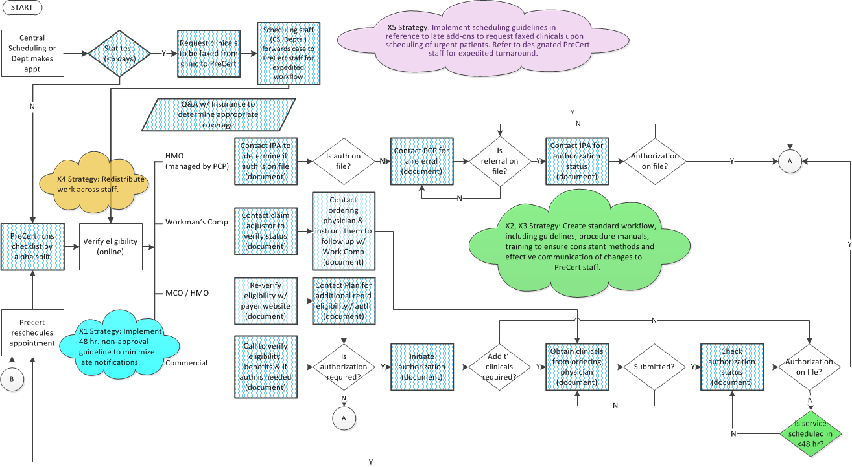
Future State Process Map (p. 1 of 2)

Slide 106
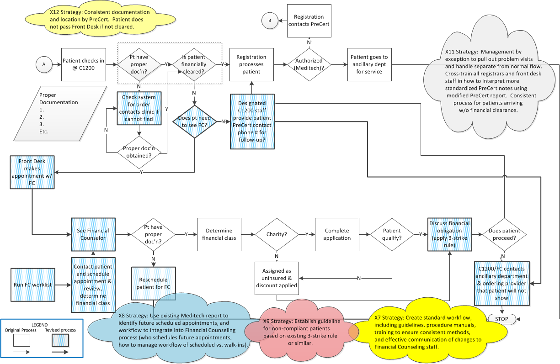
Future State Process Map (p. 2 of 2)

Slide 107
Quick Hits
Numerous changes were identified that could be made relatively quickly and easily.
Opportunity | Event | Owner | Assigned Date | Implement By…. | Deliverables | Percent Complete | Completion Date | Results
Weight =
Ineffective use of NextGen, including limited portal access (C1200, F. Couns) | Just Do It | Carmen (C1200); Jorge (Fin Couns) | 8-Oct-14 | C1200: Oct. 3, 2014; Fin Couns: Oct. 15, 2014 | Access to NextGen to retrieve orders (C1200, Financial Counseling); Post-payment, check balances, etc. capability (Financial Counseling) | 100% | 11/28/14 | NextGen access (decrease wait time for referrals)
Limited training and consistent process (see Provisions) (Registrar) | Just Do It | Per Training Plan | 7-Jan-15 | End of Improve | Incorporate into Training Plan; daily rounding. | 100% | Mid-Feb | Training per plan to support solutions.
Limited communication between departments (Procedures) | Just Do It | Stephanie | 8-Jan-15 | 12/15/14 | Diagnostic Departments will have ability to run own reports at their convenience to identify financial status of their patients / remind. Reminder to Departments of availability. | 100% | 12/15/14 | Report access (reduce calls to PreCert and potential for service w/o clearance).
Incorrect PCP (Central Scheduling / Depts) | Just Do It | Stephanie | 4-Feb-15 | 2/13/15 | Reinforce Policy / Procedure for what is required by Central Scheduling for scheduling an appointment (completion of PCP field w/ appropriate PCP name; not marked as unassigned) via flagging of individual errors. Central Scheduling will schedule the intial appointment and transfer call to Department; Department will edit time and overbook as needed. | 100% | 2/13/15 | Feedback indicates departments are booking appts incorrectly, not CS. Address as part of Ancillary Dept training.

Slide 108
Quick Hits
Opportunity | Event | Owner | Assigned Date | Implement By…. | Deliverables | Percent Complete | Completion Date | Results
Weight =
X1: Late notification of patient of rescheduling (PreCert) | Just Do It | Stephanie | 8-Jan-15 | End of Improve | Assign patient calls based on language (bilingual staff) as indicated by patient "preferred language." | 100% | 1/14/15 | Team approach to Spanish calls working acceptably.
ACD phone line | Just Do It | Stephanie | 14-Jan-15 | Mid-late March, IT build implementation; new PreCert hire training | Cisco training (completed for Brent's group). Separate surgery, financial counseling and diagnostics phone lines for access to teams w/ questions. Go Live; training of diagnostic department (once PreCert 3-4 days ahead) but no piloting needed. | 50% | Late July | In process
Patients go to Financial Counselor for billing issue (interrupts new workflow) | Just Do It | Jorge | 2/4/15 | End of Improve | Designated party to handle billing issues (direct patient to); ABC Hospital & XYZ Hospital. Consistent processes for main entrance Front Desk & C1200. Interim solution is for Financial Counselors to direct patient to call Cymetrix Customer Service Line. | 25% | 3/18/15 | Jorge mtg w/ Cymetrix Feb 25. Follow up w/ Tracy & John; cc: Lisa & Stephanie (Mar 11).

Slide 109
Standard Work
PreCert
Notification of Patients Not Financially Cleared (new)
Physician Notification of Patient Not Financially Cleared (new)
Financial Counseling
Physician Notification of Patient Not Financially Cleared (new)
Scheduling of Patients (new)
Handling of Flagged Patients (new)
C1200
Scheduling for Financial Counselors (revised work instruction)
Scripting for Patient Wait Time in C1200 (new)

Slide 110
Standard Work
Example:
Not Financially Cleared Worksheet
Example:
Services Not Approved FAX

Slide 111
Barriers and Aids Chart
Photo of original chart is in Notes View
Barriers
Contacting patient
Inconsistent process between Depts
Additional PreCert responsibilities
Limited training resources
Resistance to non-compliant pt process
Physician cooperation / assistance obtaining auth
New Financial Clearance Process
Management reinforcement
Generating guidelines
Reduction of duplicate work
Creation of policy manuals (PreCert)
Notification of COO / CFO
Modify Meditech p. 6
2 additional FTEs (PreCert)
Aids
Monthly staff mtgs
(communication / feedback)
Possible escalation to CMO
Countermeasures

Slide 112
Change Management Plan
The team developed a Change Management Plan to help smooth transitions.
Planned Change | Who is Affected? | Potential Objections | Facts (What will really happen) | Benefits to those affected (Business and Personal Benefits) | Communication Plan (Who/What/When/How)
PreCert process - various | PreCert Staff | Perceived as more work to complete larger portions of process, beginning to end (e.g., check authorizations). | Staff responsible for completion of financial clearance by patient instead of by department. | Better customer service for patient. PreCert staff will be more conscious of workflow, improving financial clearance accuracy, reducing checking, etc. | Communicate guidelines and expectations via distribution of hard copy with acknowledgement; place individuals on performance plan as needed.
PreCert process - various | Weaker PreCert Staff | Greater accountability and exposure of weaker performers. | Provisioning of needed tools. Monitoring of individual performance and upgrading of skills via new hires as needed. | Elimination of weaker links will decrease likelihood on non-financially cleared patients. Improved teamwork and morale. | Communicate guidelines and expectations via distribution of hard copy with acknowledgement signature; place individuals on perfomance plan as needed.
PreCert phone call to patient | Patients | Cancelation of appointment (require patient schedule change, rescheduling inconvenience). | Cancelations done to ensure financial clearance. | Patients avoid arriving w/o being financial clearance (wait, risk of no service). Higher level of customer service. | Script delivered when PreCert contacts patient. Script to communicate lack of authorization and process to obtain approval (prior process, next steps via specialist, contact info for original PreCert owner, how patient can assist).
Registration staff responsible for identifying financially cleared patient | Registrars | Registrars put in position to communicate to patient when not financially cleared. | Registrars are last line of defense to ensure financially cleared patients. | Patients not financially cleared will be more appropriately processed. Registrars part of consistent process to do the right thing, and supported by management. | Guidelines, scripting communicated via in-service for Registrars, new employees. Weekly rounding by management (Carmen, Vicky) to prompt Q&A.
Appointment cancelations when not financially cleared | Physicians / Clinics | Cancelation of appointment (delay in care, rescheduling of patient service). | May require occasional coordination of care according to insurance guidelines. | Clearly-identified PreCert contact for physicians/clinics. Higher overall patient satisfaction. | Letter to providers explaining issues, process improvements (e.g., late add-ons), benefits, and need for physician/clinic cooperation.

Slide 113
Implementation Plan
An Implementation Plan guided the development and operationalization of solutions.
Ref | Key Issue | Strategy Description | Solution | What (Tasks, Actions to Complete) | Owner | Planned Completion Date | Status
X1 | Late notification of rescheduling | Implement 48 hr. non-approval guideline to minimize late notifications. | 48 hr. notification if authorization not obtained, and reschedule appointment. Paper & electronic guidelines for PreCert. Pursue as JDI: Assign patient calls based on language (bilingual staff). | Process Flow | Stephanie | 12/3/2014 | Completed
 |  |  |  | P&P/Stand Work | Stephanie | 12/5/2014 | Completed
 |  |  |  | HR /Training | Stephanie | June | Completed
X2, X3 | Obtaining benefits; PreCert knowledge | Create standard workflow, including guidelines, procedure manuals, training to ensure consistent methods and effective communication of changes to PreCert staff. | Create Standard Operating Procedure for insurance verification. Update personal policy manuals with electronic communications from management. Step-by-step training on elements over time. Periodic communication & group discussion of changes. | Process Flow | Stephanie | N/A | N/A
 |  |  |  | P&P/Stand Work | Stephanie | Mid-March | Completed
 |  |  |  | HR /Training | Stephanie | Mid-March | Completed
 |  |  |  | IT | Stephanie | late January | Completed
X4 | PreCert duties in timely manner | Redistribute work across staff. | Change work assignments to alpha. ~Weekly audits conducted by management to determine how far ahead staff is working. Establish employee quotas. | Process Flow | Stephanie | 12/15/2014 | Completed
 |  |  |  | P&P/Stand Work | Stephanie | 1/15/2014 | Completed
 |  |  |  | HR /Training | Stephanie | Mid-March | Completed
 |  |  |  | IT | Stephanie | 12/5/2014 | Completed

Slide 114
Implementation Plan, cont.
Ref | Key Issue | Strategy Description | Solution | What (Tasks, Actions to Complete) | Owner | Planned Completion Date | Status
X5 | Late add-ons | Implement scheduling guidelines in reference to late add-ons to request faxed clinicals upon scheduling of urgent patients. Refer to designated PreCert staff for expedited turnaround. | Scheduling staff (CS & Depts.) notify PreCert of any late add-ons <3 business days. Clinic provides clinicals at time of urgent appointment request. Hire additional FTE to become “designated” employee assigned for add-ons. | Process Flow | Lisa | 12/10/2014 | Completed
 |  |  |  | P&P/Stand Work | Lisa | 12/10/2014 | Completed
 |  |  |  | HR /Training | Stephanie | May | Completed
X7 | Notification of non-approved services | Create standard workflow, including guidelines, procedure manuals, training to ensure consistent methods, and effective communication of changes to Financial Counseling staff. | Develop work flow using Meditech reporting capabilities (work list). Physician and patient notification if test is canceled. Create a policy implementing guidelines for non approved patients. | Process Flow | Jorge | 12/10/2014 | Completed
 |  |  |  | P&P/Stand Work | Jorge/Lisa | 12/17/2014 | Completed
 |  |  |  | HR /Training | Jorge | 12/22/2014 | Completed
X8 | No notification of patients | Use existing Meditech report to identify future scheduled appointments, and workflow to integrate into Financial Counseling process (who schedules future appointments, how to manage workflow of scheduled vs. walk-ins). | Assignment by days out / exceptions (rotate among Financial Counselors). Prioritization of arrived, scheduled before walk-ins (e.g., front desk enters FC appointment reason). | Process Flow | Jorge | 12/10/2014 | Completed
 |  |  |  | P&P/Stand Work | Jorge | 12/10/2014 | Completed
 |  |  |  | HR /Training | Jorge | 2/15/2015 | Completed

Slide 115
Implementation Plan, cont.
Ref | Key Issue | Strategy Description | Solution | What (Tasks, Actions to Complete) | Owner | Planned Completion Date | Status
X9 | Non-compliant patients | Establish guideline for non-compliant patients based on existing 3-strike rule or similar. | Establish guideline for non-compliant patients that is supported by Administration. Create a policy that is supported by the health system to reinforce decisions made for non-compliant patients. Formalize and enforce 3-strike guideline / dollar limit. Proactively communicate to patient consequences of non-compliance via Promissory Note. Patient deposit required by day of service. Patient receives prompt payment discount. | Process Flow | Jorge | 12/17/2014 | Completed
 |  |  |  | P&P/Stand Work | Jorge/Lisa | 12/17/2014 | In Process
 |  |  |  | HR /Training | Jorge | 12/22/2014 | Completed
X11 | C1200 paperwork knowledge | Management by exception to pull out problem visits and handle separate from normal flow. Cross-train all registrars and front desk staff in how to interpret more standardized PreCert notes using modified PreCert report. Consistent process for patients arriving w/o financial clearance. | C1200 Front Desk runs PreCert report 2x/day to flag add-ons, modified to show a) Financial clearance?, b) Does patient need to see FC?, c) Has FC cleared patient? Non-add-ons (scheduled but not financially cleared) referred back to PreCert (clear criteria, standardized communications to patient & clinic). Insurance training for Front Desk staff. Scripting for non-approved, scheduled tests (Front Desk, Registrars) referred to PreCert. | Process Flow | Carmen | February | Completed
 |  |  |  | P&P/Stand Work | Carmen | 3/18/2015 | Completed
 |  |  |  | HR /Training | Carmen | February | Completed
 |  |  |  | IT | Lisa | Mid-March | Completed
X12 | C1200 financial clearance | Consistent documentation and location by PreCert. Patient does not pass Front Desk if not cleared. | Refer to scheduled list to determine if patient financially cleared (vs. Meditech lookup). Clearly designated Yes/No indicating if cleared by PreCert or Financial Counseling. | Process Flow | Carmen | February | Completed
 |  |  |  | P&P/Stand Work | Carmen | Mid-March | completed
 |  |  |  | HR /Training | Carmen | February | Completed
 |  |  |  | IT | Carmen | 1/14/2015 | Completed
 |  |  |  | Other (handling of non-cleared patients) | Lisa | February | Completed

Slide 116
S4 – S6
Not applicable due to the nature of the project.
The removal of clutter and re-organizing of the workplace setting do not apply

Slide 117
Proof of Improvements
The percentage of defective patient visits declined over time.

Slide 118
Proof of Improvements
The number of individual defects (missing/incorrect elements) also declined by approximately four-fold.

Slide 119
Improve Phase Deliverables
Improve | Complete
Rapid Improvement Event (as appropriate) | N/A
Ideal and Future state value stream map(s) (as appropriate) | N/A
Pugh matrix or criteria selection matrix to evaluate solution alternatives | X
Planning and results of pilot (if applicable) | N/A
List of solutions selected | X
Process changes and revised process map(s) and photos if applicable | X
Revised processes to improve flow, balance work, and pull production (as appropriate) | N/A
Standard work (as appropriate) | X
FMEA on future state process | X
Barriers and Aids Chart (as needed) | X
Change Management Plan (as appropriate) | X
Implementation Plan for solutions (with dates and assigned responsibilities) | X
S4 – S6 implementation and 6S Audit after improvements (as appropriate) | N/A
Graphical analysis of results -- before vs. after, to prove effectiveness of solutions | X
Gate review and Sign-off by Champion | X

Slide 120
Lean Six Sigma Roadmap
Define
Measure
Analyze
Improve
Control

Slide 121
Control Plan

Slide 122
Visual Controls
Examples/Photos of visual controls
PreCert
A
B
C
Financial Counseling
Signage? Color indicator? Red chairs, Blue chairs? Cubicle color?
B
C
C1200
A
B
C
Not Applicable / None Identified

Slide 123
Mistake Proofing Techniques
PreCert
A
B
C
Financial Counseling
A
B
C
C1200
A
B
C
Not Applicable / None Identified

Slide 124
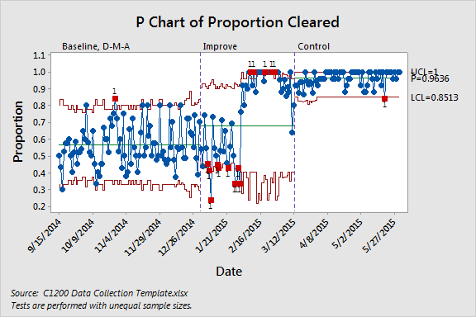
Control Chart – Subject # 1
Proportion of Financially Cleared Patients
Conclusion: The financially cleared patients have increased in control phase.

Slide 125
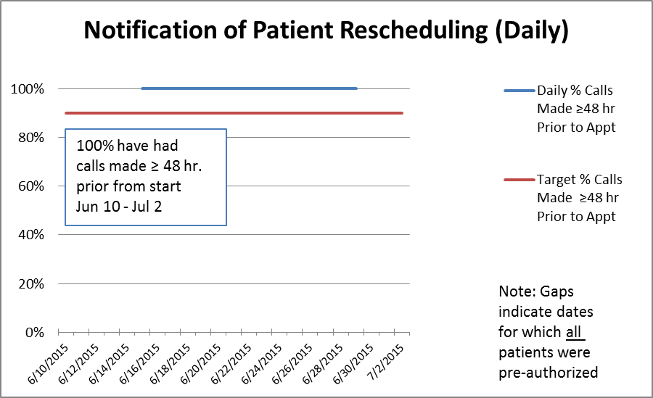
Control Chart – Subject # 2
Notification of Patient Rescheduling (X1)
Conclusion: 100% of patients have had calls made ≥ 48 hours prior from 6/10 – 7/2/15

Slide 126
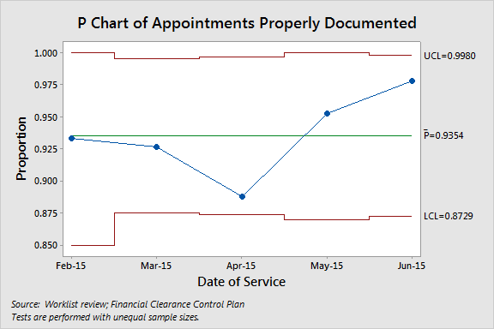
Control Chart – Subject # 3
Method of Obtaining Benefits, PreCert Knowledge (X2, X3)
Conclusion: Approximately 94% of appointments have properly documented benefits information.

Slide 127
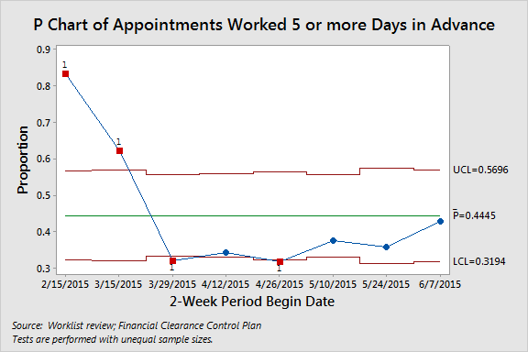
Control Chart – Subject # 4
Timeliness of Work (X4, X5)
Conclusion: Initially good performance in working appointments in advance of appointments was not sustained; however, final solutions and full staffing were not enabled until the end of May.

Slide 128
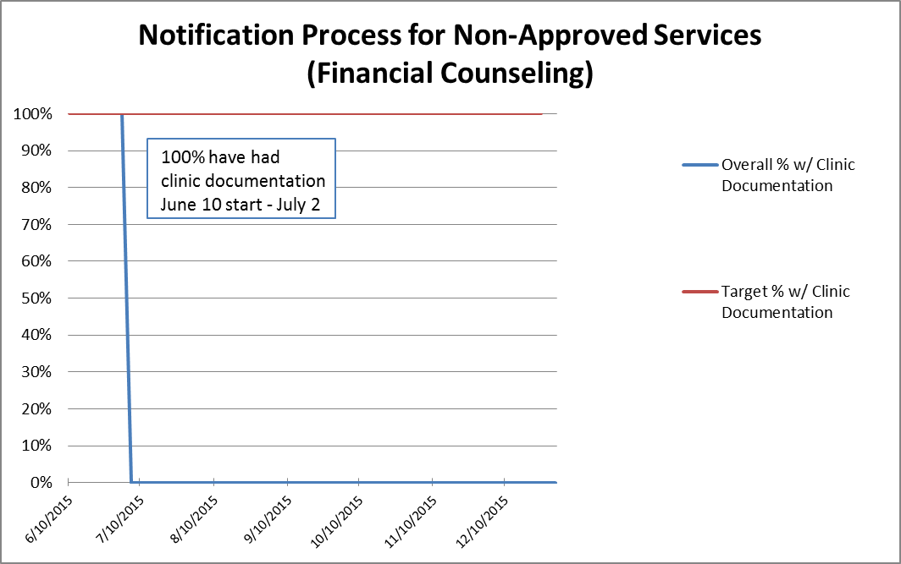
Control Chart – Subject # 5
Notification Process for Non-Approved Services

Slide 129
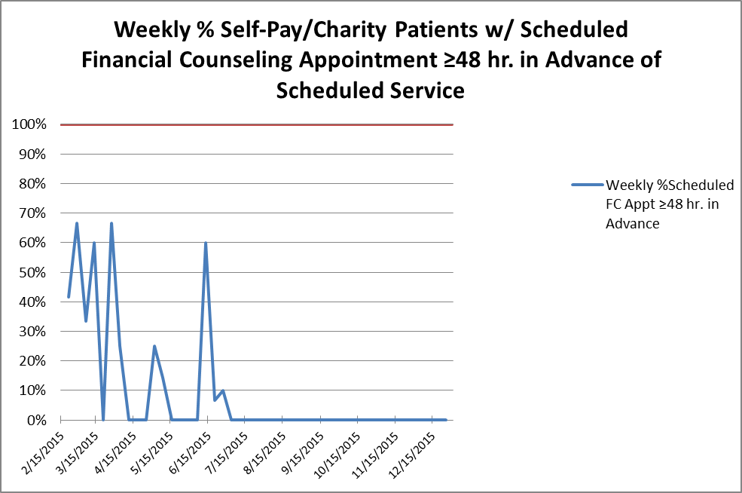
Control Chart – Subject # 6
Notification of Patients / Performing Duties in Timely Manner (X8, X9)
Conclusion: The continues to show variation and is below the 100% target.
This continues to be monitored and last employee has been hired as of 7/2015.

Slide 130
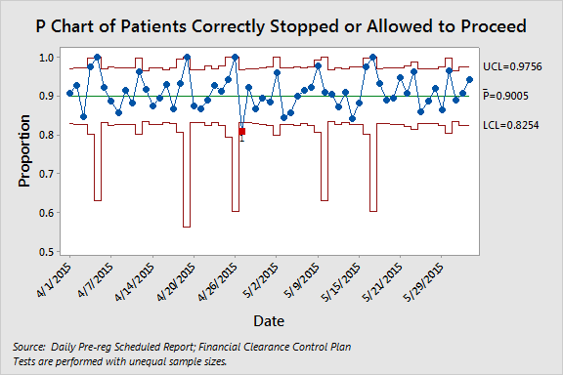
Control Chart – Subject # 7
C1200 Correct Paperwork & Determination of Financial Clearance (X11, X12)
Conclusion: Approximately 90% of patients arriving in C1200 are correctly stopped or allowed
to proceed to their appointment.

Slide 131
Standard Work Audit Plan
Not Financially Cleared Worksheets completed by two PreCert staff will be audited weekly by PreCert Manager to ensure appropriate and complete workflow.

Slide 132
Procedures/Policies
List and examples of new or revised:
PreCert (Binders)
48 Hour Patient Communication (new)
Alpha Workflow (new)
Authorization Exception Workflow (new)
Flagging of High Out of Pocket Expense (new)
Financial Counseling (Binders)
Advance Financial Appointment Scheduling (new)
Advance Patient Notification (new)
Non-Approved / Non-Compliant Patients (new)
Working of flagged patient accounts (new)
C1200
Use of Patient Financial Clearance Status Report (revised; binders)

Slide 133
Communication Plan
Conclusion:
Planned Change | Who is Affected? | Communication Plan (Who/What/When/How) | Status
PreCert process - various | PreCert Staff | Communicate guidelines and expectations via distribution of hard copy with acknowledgement; place individuals on perfomance plan as needed. | Completed (Jan 2, 2015 start)
PreCert process - various | Weaker PreCert Staff | Communicate guidelines and expectations via distribution of hard copy with acknowledgement signature; place individuals on perfomance plan as needed. | Completed (Mid-March target)
PreCert phone call to patient | Patients | Script delivered when PreCert contacts patient. Script to communicate lack of authorization and process to obtain approval (prior process, next steps via specialist, contact info for original PreCert owner, how patient can assist). | Completed
Registration staff responsible for identifying financially cleared patient | Registrars | Guidelines, scripting communicated via in-service for Registrars, new employees. Weekly rounding by management (Carmen, Vicky) to prompt Q&A. | Completed (Communicated in Feb 26-27 training (mid-Mar)
Appointment cancelations when not financially cleared | Physicians / Clinics | Letter to providers explaining issues, process improvements (e.g., late add-ons), benefits, and need for physician/clinic cooperation. | Letter completed, will go out mid July

Slide 134
Training Plan
Training and Education Planning - Financial Clearance
Topic / Area of Change | PreCert | Financial Counselors | C1200
Method of obtaining benefits (PreCert) | X
Knowledge (PreCert) | X
Notification of patients / not perform duties in timely manner (Financial Counseling) |  | X
Knowledge of correct paperwork for financially cleared visits (C1200); C1200 determination of financial clearance |  |  | X

Slide 135
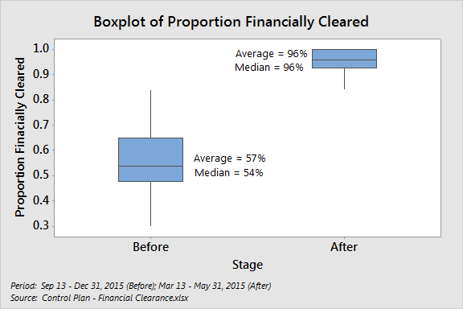
Updated Process Capability
Variable Stage N Mean StDev Minimum Q1 Median Q3 Maximum
Prop Cleared Before 89 0.5653 0.1239 0.3000 0.4794 0.5400 0.6500 0.8400
After 66 0.96136 0.04441 0.84000 0.92720 0.96000 1.00000 1.00000

Slide 136
Project Results
Note: COPQ savings are shown in Notes View.
Conclusion: Control period of 3/13-5/30/15 has significantly improved for financially cleared patients based on the Sigma level above.
General Worksheet For Calculating Process Sigma
 |  |  |  |  | Baseline | Actual
1 | Number Of Units Processed |  |  | n= | 3722 | 1540
2 | Number Of Defect Opportunities | Per Unit |  | o= | 1 | 1
3 | Total Count Of Defects Made | (Include Defects Made And Later Fixed) |  | c= | 1618 | 56
4 | Solve for Defects Per Opportunity DPO = c / (n*o) |  |  |  | 0.4347125 | 0.03636364
5 | Solve For Defects Per Million Opportunities (DPO * 1,000,000) |  |  |  | 434,713 | 36,364
6 | Look Up Process Sigma In Abridged Sigma Conversion Table |  |  | Sigma = | 1.66 | 3.29
 | Calculated by NORMSINV(1-DPMO/Million)+1.5

Slide 137
Project Plan - Milestones and Timing
Conclusion: Early phases moved approximately per plan, with Improve taking additional time.
Phase | Sept 2014 | Oct 2014 | Nov 2015 | Dec 2014 | Jan 2015 | Feb 2015 | Mar 2015 | Apr 2015
Define
Measure
Analyze
Improve
Control
Notes:
Early on, your team should establish target dates for completing key tasks in the Lean Six Sigma process.
Milestones provide a sense of urgency, a feeling of accomplishment during the project, and help ensure the achievement of timely results.
Project timeline provide sense of urgency, feeling of accomplishment and ensures timely results.

Slide 138
Lessons Learned
Consistent team member commitment is difficult to obtain, especially w/o supervisor acknowledgement and support.
Organizational understanding of PIE initiative is lacking, requiring constant reinforcement.
Access to team documents and email is helpful during team meetings.
Have a better understanding of the processes and issues of other departments.
Difficult having long meetings in uncomfortable rooms.
Long team meetings make it hard to cover regular work.
Even simple changes can take longer than anticipated because of unexpected barriers, limited resources, and insufficient planning for these.

Slide 139
Control Phase Deliverables
Control | Complete
Control Plan (including employee self-control where appropriate) | X
Visual controls (as appropriate) | X
Mistake-proofing techniques (as appropriate) | X
Control Charts (as appropriate) | X
Standard Work Audit Plans (as appropriate) | X
List and examples of Procedures (created and/or updated documents, etc.) | X
Communication and Training Plans (and status) | X
Control chart(s) showing results and comparison of process performance (before vs. after implementation -- similar to Juran Trilogy chart) to indicate that the gains are held | X
Graphical (e.g. box plots) analysis to prove significance of improvement | X
Sustained results (metrics and COPQ) of Actual vs. Target vs. Baseline | X
Gate Review and Signoff on results by Champion and Finance | X
Updated Project Plan (timeline/Gantt chart) | X
Replication opportunities (if applicable) | X
Lessons learned | X
Project documentation | X

